Slide 1





FDTD Satellite Applications Webinar: Use of the Modified SHERBE Parameter To Identify Tornadic HSLC Environments – An Examination of the Oct 21, 2021 Event Over OH/PA
Presented by
Douglas Kahn, Patrick Saunders, and Robert LaPlante
NWS CLE Cleveland, OH
12 October 2022

Slide 2
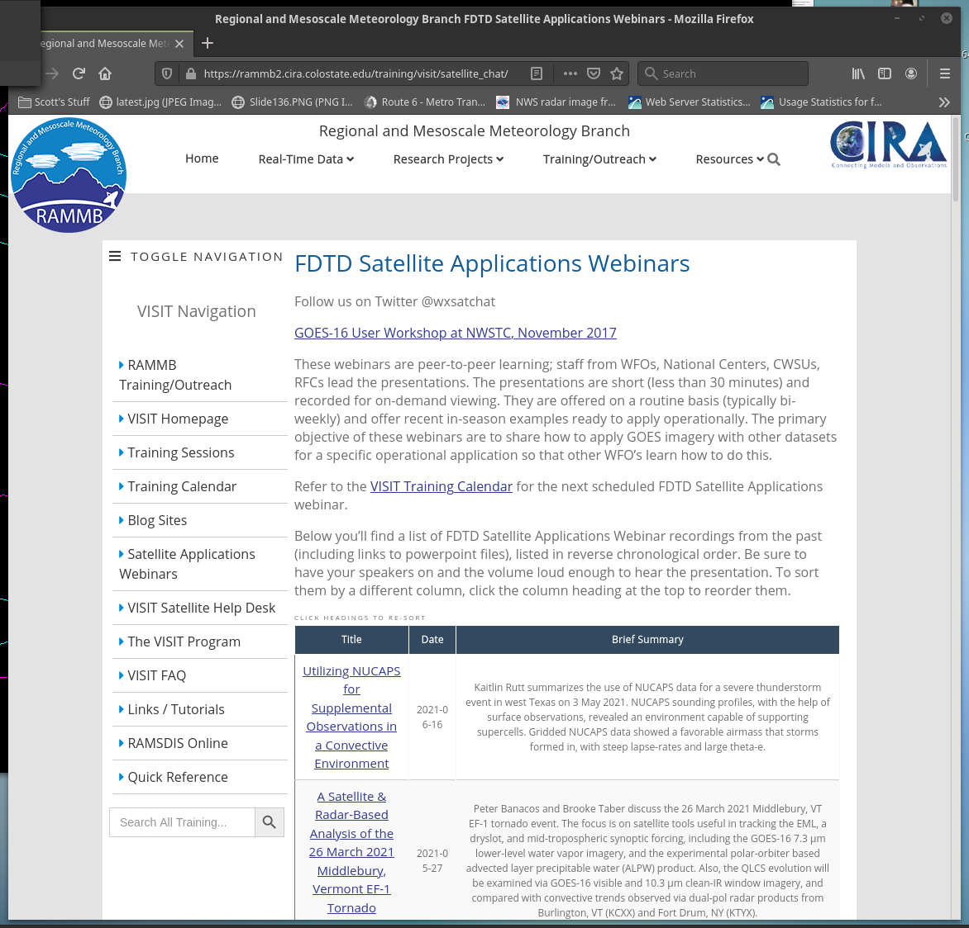
FDTD “Satellite Chat” Library
https://rammb2.cira.colostate.edu/training/visit/satellite_chat/ Recorded Content includes Q&A
Call for speakers! Let us know if you want to speak on a topic!
Contact: scott.lindstrom@noaa.gov OR dan.bikos@noaa.gov

Slide 3


FDTD Satellite Applications Webinar Protocol
~20 minutes for the speaker
Send questions via GoTo Chat
Or ask during Q&A period via phone
Followed by Q&A
Open discussion forum
Done by 1730 UTC
Do NOT press hold!!!
Mute when not speaking

Slide 4
Use of the Modified SHERBE Parameter To Identify Tornadic HSLC Environments – An Examination of the Oct 21, 2021 Event Over OH/PA
October 12, 2022 – FDTD Satellite Applications Webinar
Douglas Kahn – Meteorologist, WFO Cleveland
Patrick Saunders – Meteorologist, WFO Cleveland
Robert LaPlante – Science and Operations Officer, WFO Cleveland

Slide 5
Outline
Overview of the event.
Forecast Progression.
Satellite & radar imagery from the event.
Mesoscale Environment.
Introduction to the MOSH(E) and SHERB(E).
Utilizing MOSH in AWIPS for future HSLC events

Slide 6
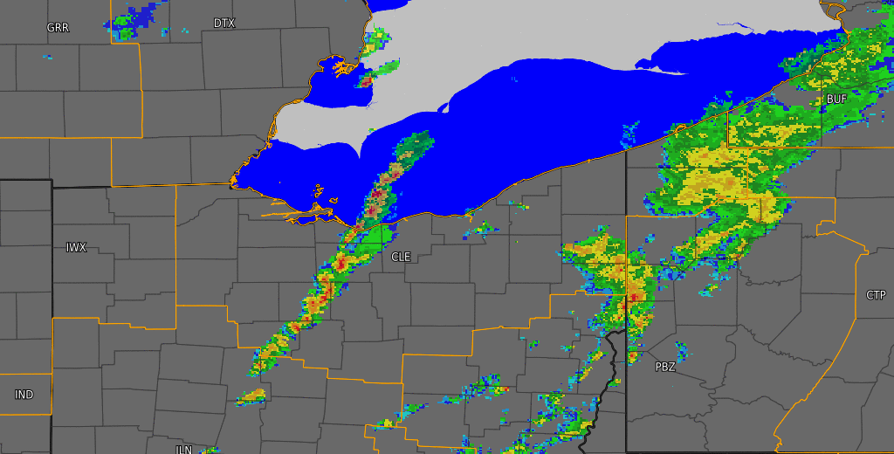
QUICK FACTS
A high shear, low CAPE tornadic event occurred across the northern Ohio Valley on October 21, 2021
The environment was favorable for embedded, low-topped supercells along a broken line of thunderstorms
8 weak tornadoes across the CLE CWA
4 EF-1, 4 EF-0
Longest path length was ~3 miles
Largest width was 50 yards
All tornadoes generally occurred between 4:30 and 6:30 PM local time
There were 0 injuries during the course of the event
Radar loop with warnings from 3:00 PM EDT to 8:00 PM EDT on October 21, 2021.

Slide 7
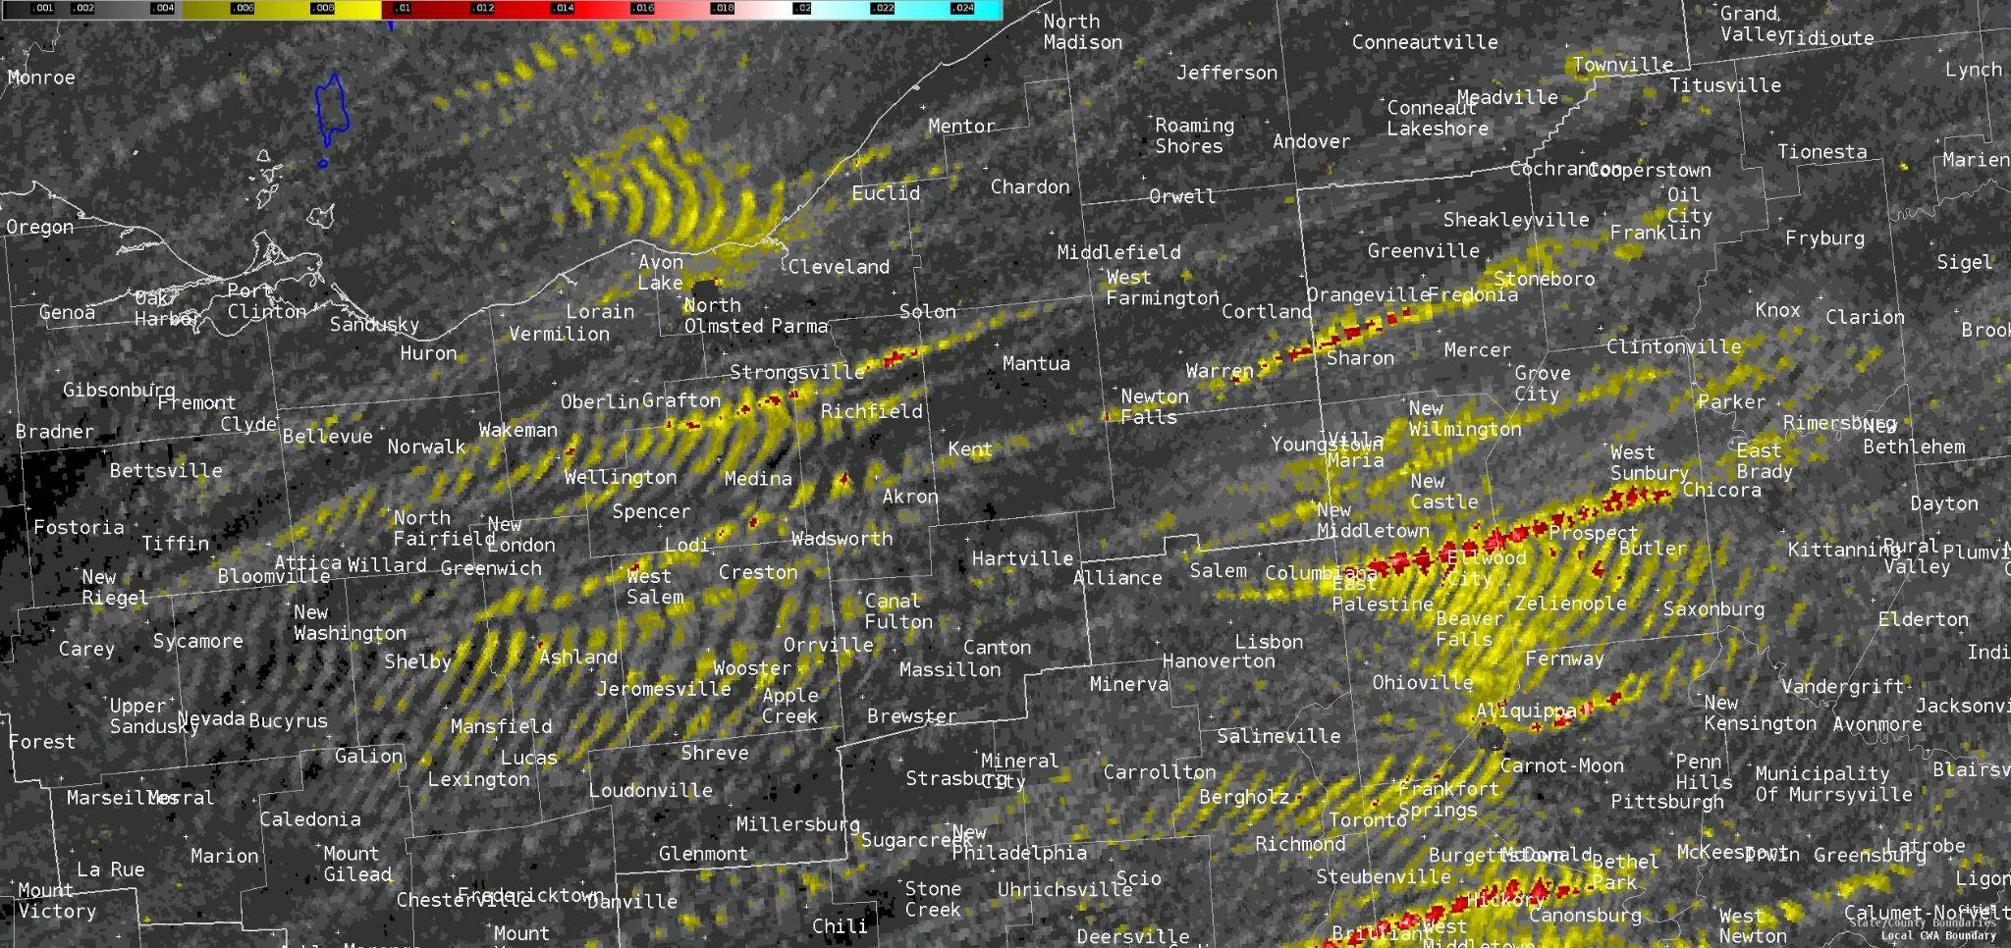
MRMS Rotational Tracks - October 21, 2021
Multi-radar-multi-sensor rotational tracks from October 21, 2021.

Slide 8
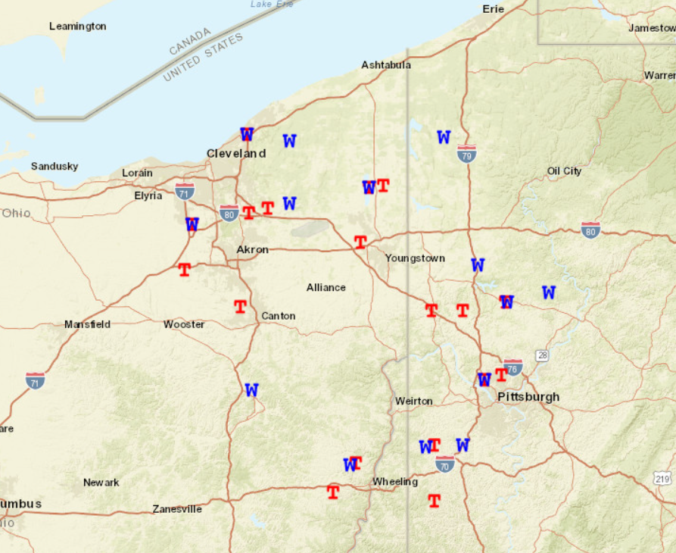

LSR Map - October 21, 2021
SPC filtered local storm reports on October 21, 2021.

Slide 9
MRMS Rotational Tracks - October 21, 2021
Multi-radar-multi-sensor rotational tracks from October 21, 2021. The white ovals highlight the three main areas along the broken line of thunderstorms where rotation was the strongest and thus where tornado potential was maximized.

Slide 10
What About The Forecast?
The potential for severe weather was apparent, with SPC outlining the region in a Day 3 marginal risk and maintaining the marginal risk up to and through the event.
However, there was never any mention of the possibility of tornadoes, mainly just the threat for damaging winds.

Slide 11
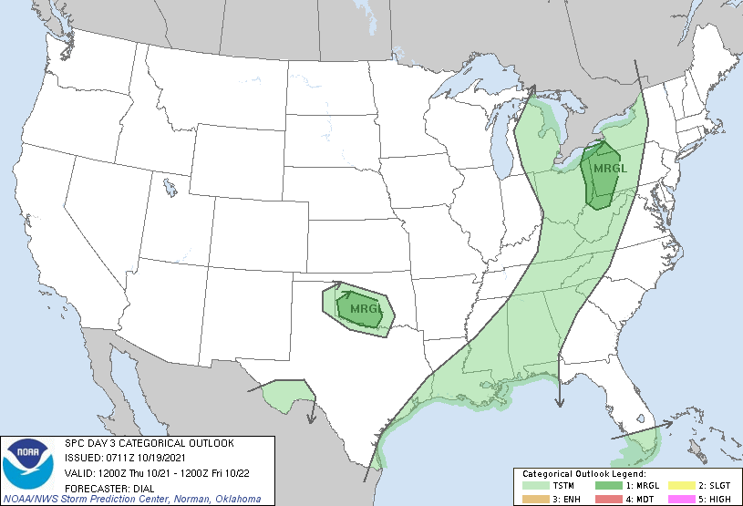
SPC Forecast Progression - Day 3

Slide 12
What About The Forecast - Day 3 Discussion
...Eastern Ohio and western Pennsylvania...
Limited low-level moisture return will occur Thursday with a narrow corridor of mid 50s dewpoints from OH into western PA. Forcing for ascent accompanying a progressive shortwave trough and its attendant cold front will move through the OH Valley during the day. Low-topped convection is expected to develop within narrow corridor of weak instability along and just ahead of the front. Activity will be embedded within strong unidirectional southwesterly winds. Potential will exist for higher momentum air to be transported to the surface within some of the rain cores during the afternoon. Overall threat should remain limited by the anticipated marginal thermodynamic environment.

Slide 13
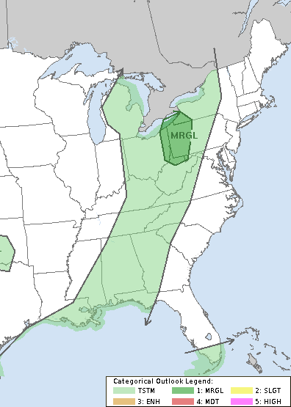
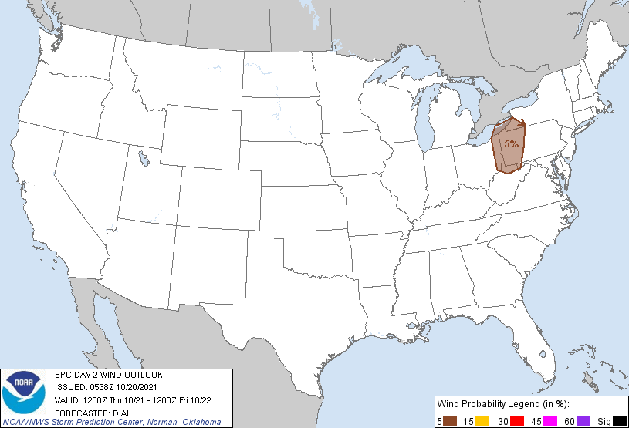
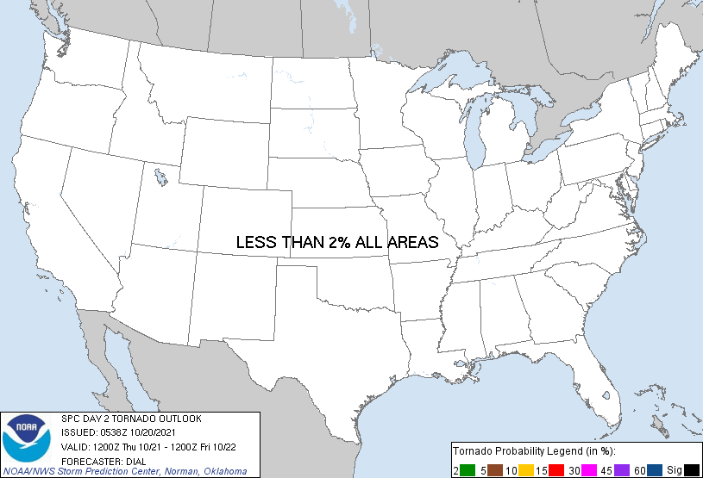
SPC Forecast Progression - Day 2
Image carousel from 6Z on October 20, 2021 showing the SPC Day 2 outlook categories (left), severe wind probabilities (middle), and tornado probabilities which shows less than 2% across all of CONUS (right).

Slide 14
What About The Forecast - Day 2 Discussion
...Eastern Ohio and western Pennsylvania...
Limited low-level moisture with a narrow corridor of mid 50s F dewpoints will return through the pre-frontal warm sector from OH into western PA. Forcing for ascent accompanying a progressive shortwave trough and its attendant cold front will move through the OH Valley during the day. Low-topped convection is expected to develop within the narrow corridor of very weak instability (less than 400 J/kg MUCAPE) along and just ahead of the front. Activity will be embedded within strong unidirectional southwesterly winds. Some potential will exist for higher momentum air to be transported to the surface within some of the rain cores. However, any severe threat should remain limited by the very marginal thermodynamic environment.

Slide 15
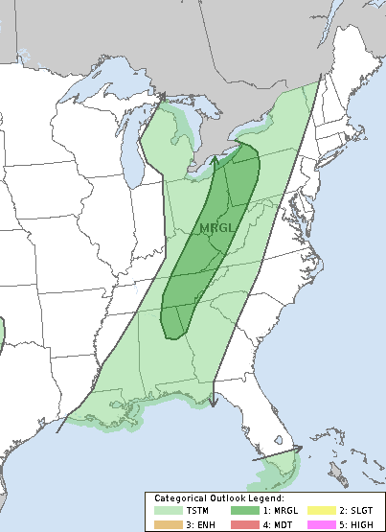
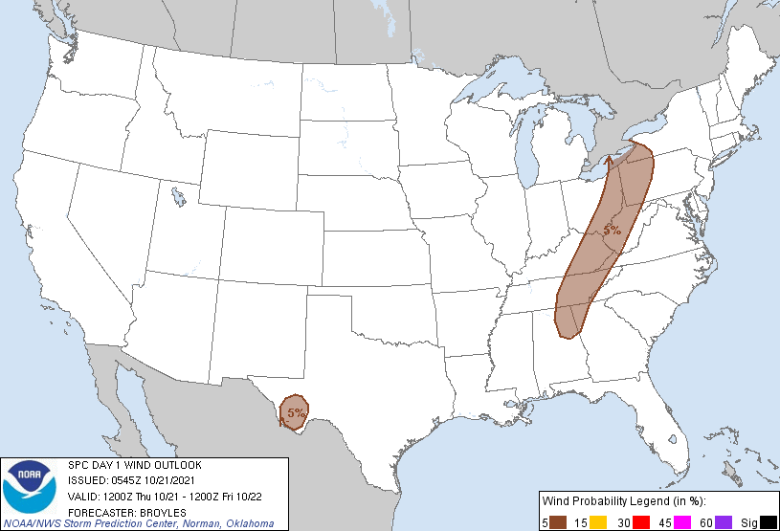

SPC Forecast Progression - Day 1 (early morning)
Image carousel from 6Z on October 21, 2021 showing the SPC Day 1 outlook categories (left), severe wind probabilities (middle), and tornado probabilities which shows less than 2% across all of CONUS (right).

Slide 16
What About The Forecast - Day 1 Discussion (1)
...Southern and Central Appalachians/Lower Great Lakes...
An upper-level low will move eastward across the southern Great Lakes region today as an associated upper-level trough moves across the mid Mississippi Valley. Ahead of the system, a narrow corridor of maximized low-level moisture will be in place across the Ohio and Tennessee Valleys. This corridor will shift eastward during the day as a cold front advances southeastward. By afternoon, weak instability will be in place from western Pennsylvania south-southwestward across eastward Ohio, eastern Kentucky and eastern Tennessee. Thunderstorms will develop along and just ahead of the much of the front by mid afternoon with this convection moving eastward into western parts of the southern and central Appalachians.
RAP forecast soundings along the axis of strongest instability by 21Z, from Pittsburgh to Knoxville, have 0-6 km shear in the 40 to 50 kt range. This combined with steep low-level lapse rates and weak instability should be enough for multicell line segments capable of strong wind gusts. The current thinking is that a line segment will develop ahead of the front during the mid to late afternoon. This line segment will move eastward into the western foothills of the Appalachians where a few marginally severe wind gusts may occur. At this time, instability appears to be the factor that will minimize severe threat coverage. Although an isolated supercell can not be ruled out, any threat should remain very localized and strongly tied to destabilization.

Slide 17
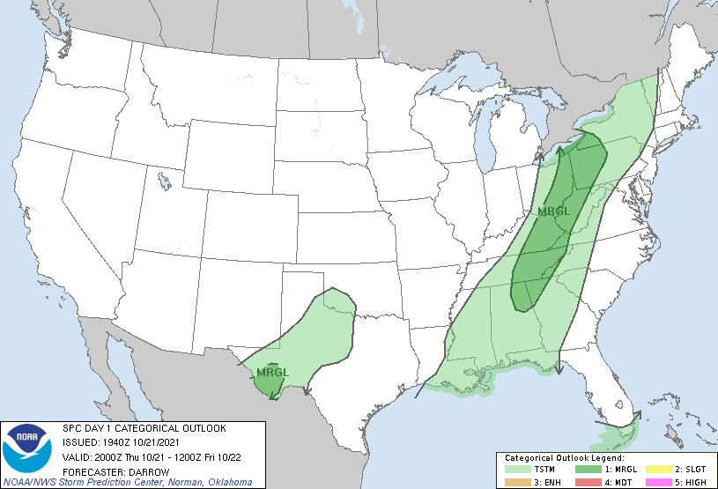
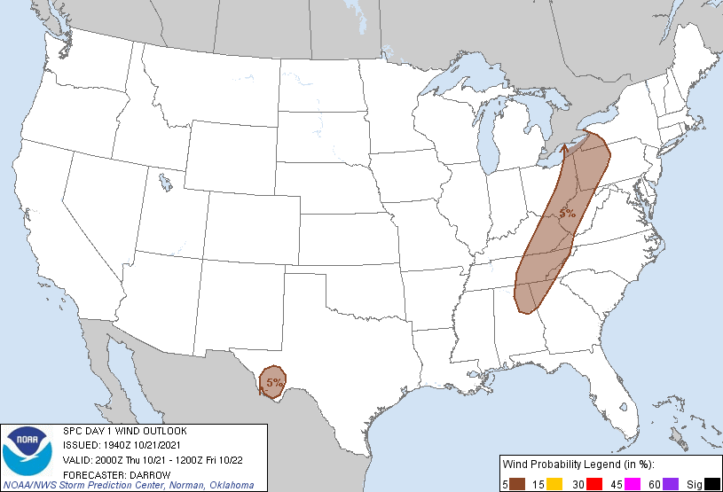
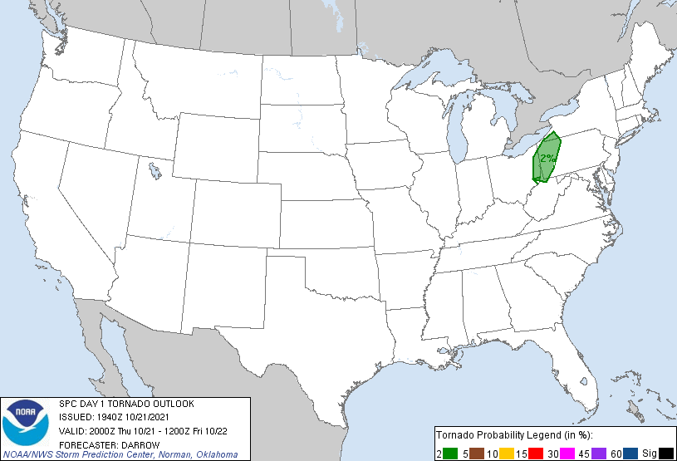
SPC Forecast Progression - Day 1 (afternoon)
Image carousel from 20Z on October 21, 2021 showing the SPC Day 1 outlook categories (left), severe wind probabilities (middle), and the addition of an area of 2% tornado probabilities across NE OH into PA (right).

Slide 18
What About The Forecast - Day 1 Discussion (2)
...20z Update...
No appreciable changes are warranted to the 1630z outlook; however, a small 2 percent tornado probability has been introduced over the upper Ohio Valley region.
Latest satellite imagery suggests large-scale forcing is spreading across OH toward western PA. Convection is gradually responding to the approaching short-wave trough with a strengthening band of convection along the surging cold front. Additionally, a narrow corridor of scattered convection extends along the OH River into western PA. Warm advection appears to be partly contributing to this activity and wind profiles do support organized rotating updrafts. While the tornado threat is low with these storms, it is non zero and have opted to introduce a 2 percent probability to reflect this potential.

Slide 19
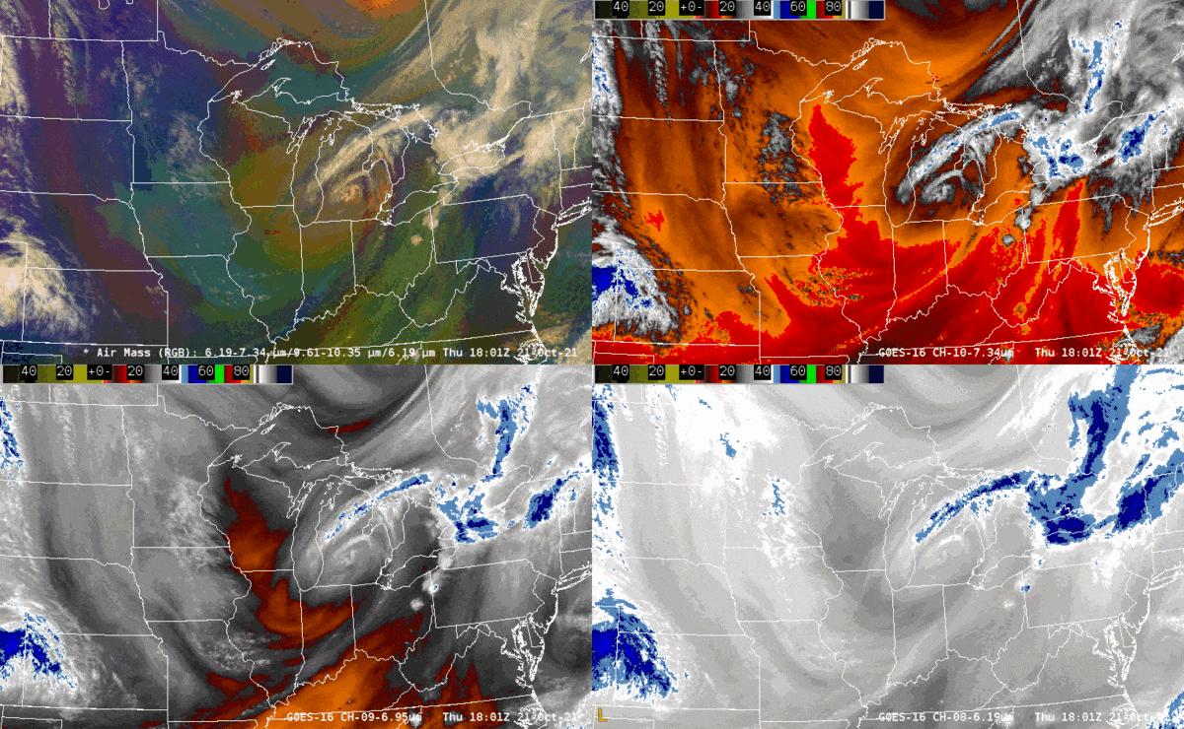
Satellite Imagery
The Air Mass RGB satellite product has contributions from several GOES bands (individual & band differences).
Red – 6.2-7.3 micrometer (upper wv-lower wv).
Green – 9.6-10.3 micrometer (ozone-clean IR).
Blue – 6.2 inverted (upper wv).
Note a narrow region of blue shading across northern OH, indicative of modest moisture depth
Perhaps “high” PV initially within the upper-level low (slight red colors in Air Mass RGB.
Air Mass RGB (top left), low-level water vapor (top right), mid-level water vapor (bottom left), upper-level water vapor (bottom right).

Slide 20
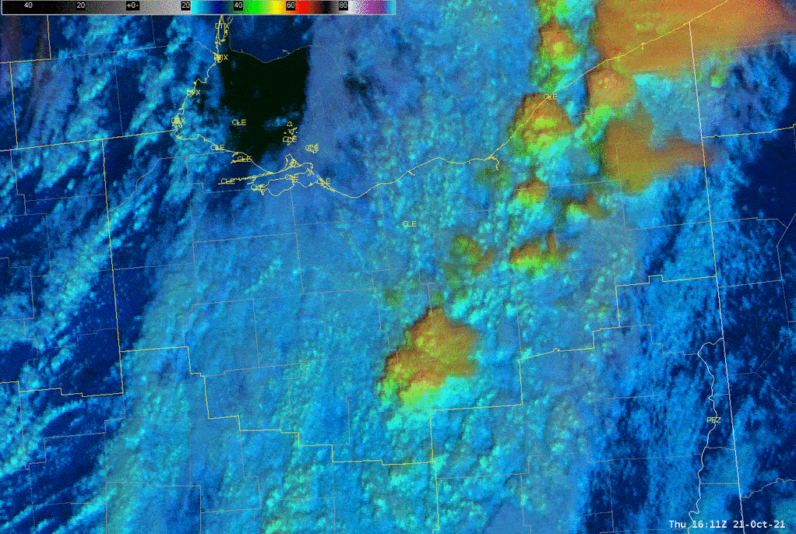
Satellite Imagery
The day cloud phase distinction (DCPD) is an RGB satellite product which has contributions from three GOES bands.
Red – 10.3 micrometer (clean infrared longwave window).
Green – 0.64 micrometer (red visible).
Blue – 1.6 micrometer (snow-ice).
The following next few slides will show the DCPD, along with its individual contribution satellite products.
Day cloud phase distinction (DCPD) satellite product loop from October 21, 2021.

Slide 21
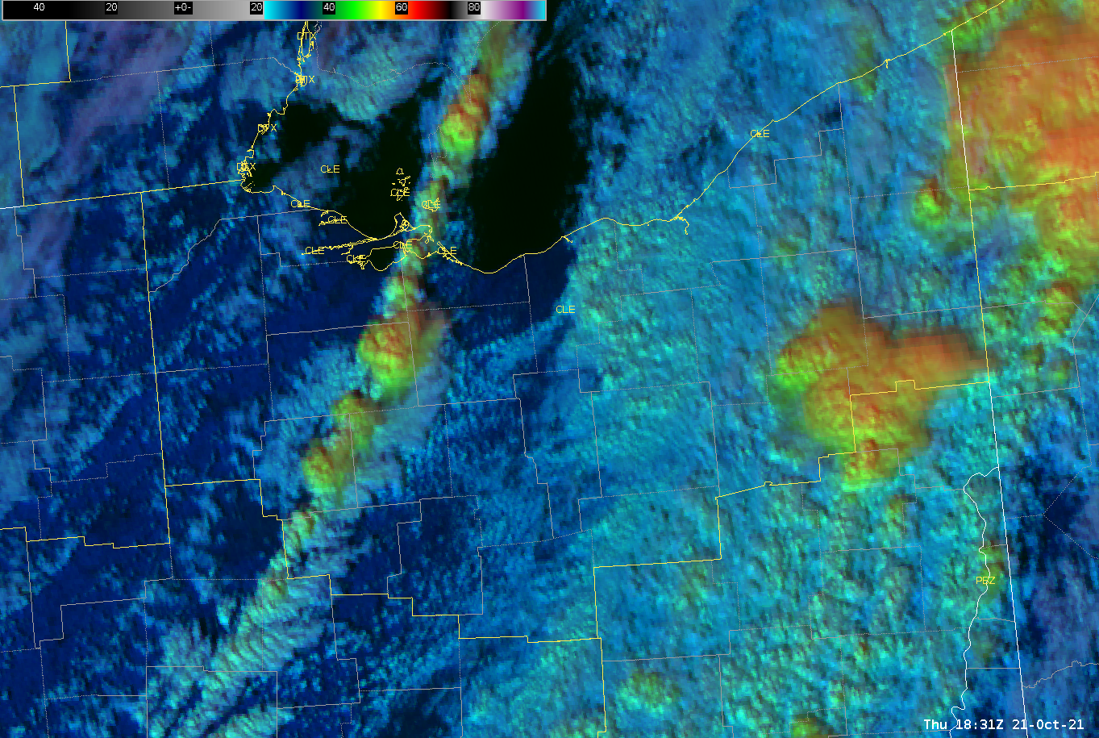
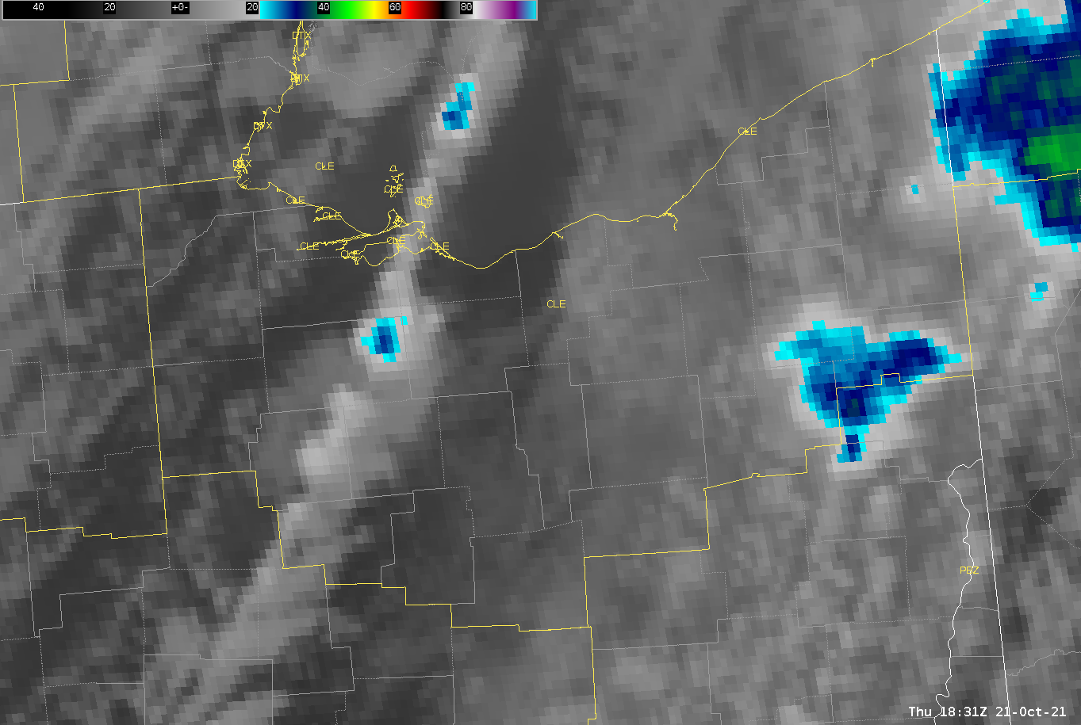
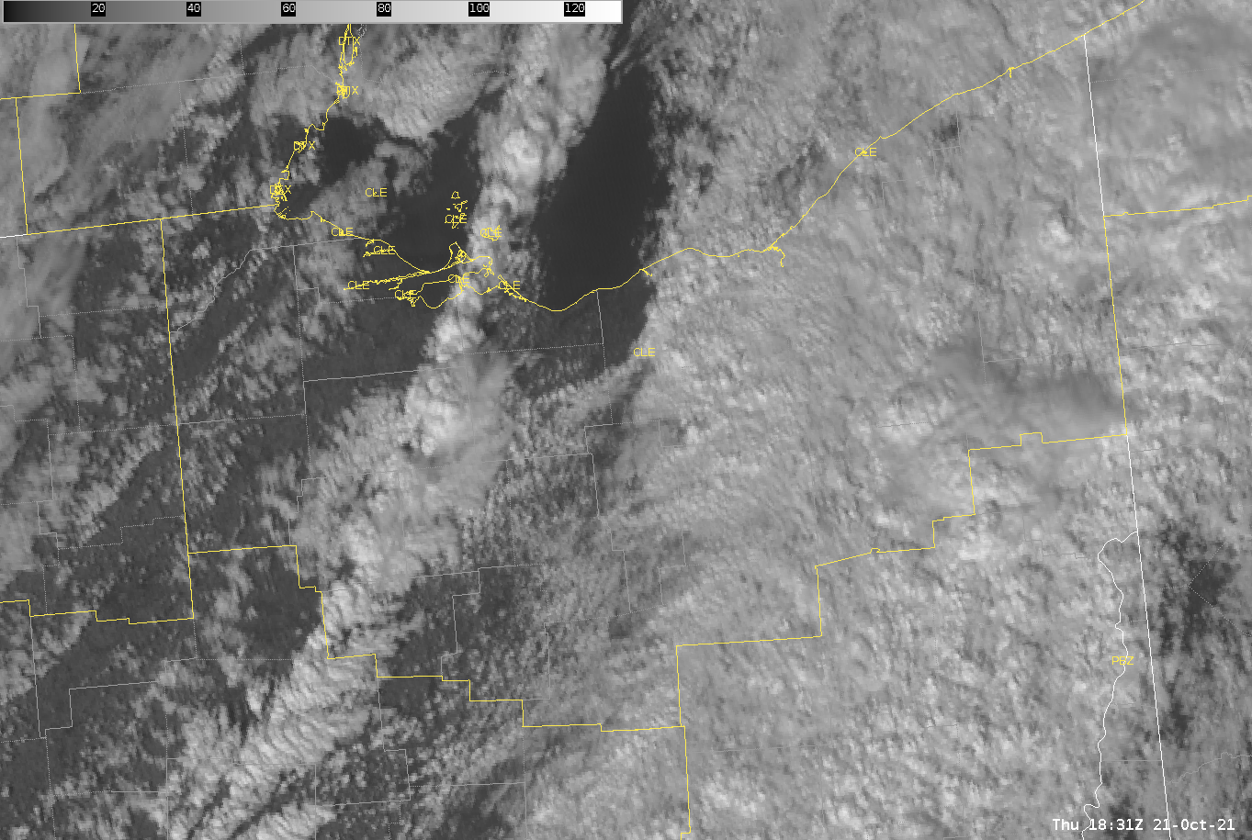
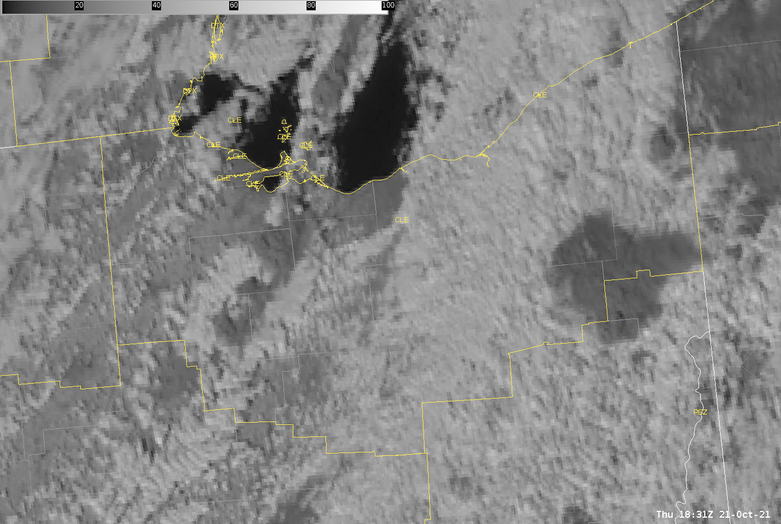
Satellite Imagery (2:30 PM)
Several things to note as the event began.
The clearing behind the initial cloudiness and morning precipitation.
Environment is potentially destabilizing faster than models suggested, evident by development of agitated cu ahead of the cold front.
Cloud glaciation beginning to occur, evident by green colors appearing on the DCPD product (top left).
DCPD (top left), clean longwave IR (top right), visible (bottom left), snow-ice (bottom right).

Slide 22
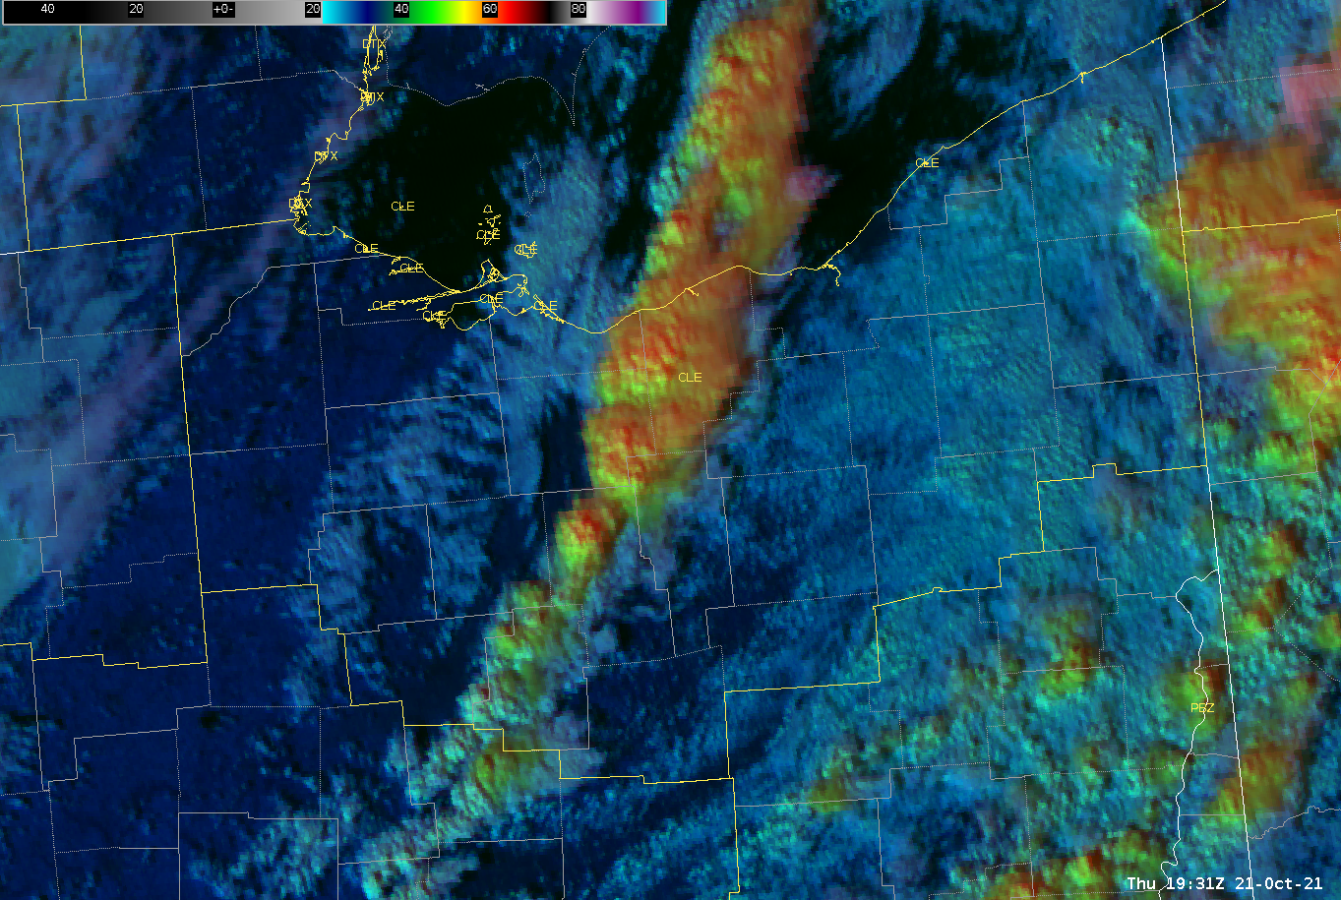
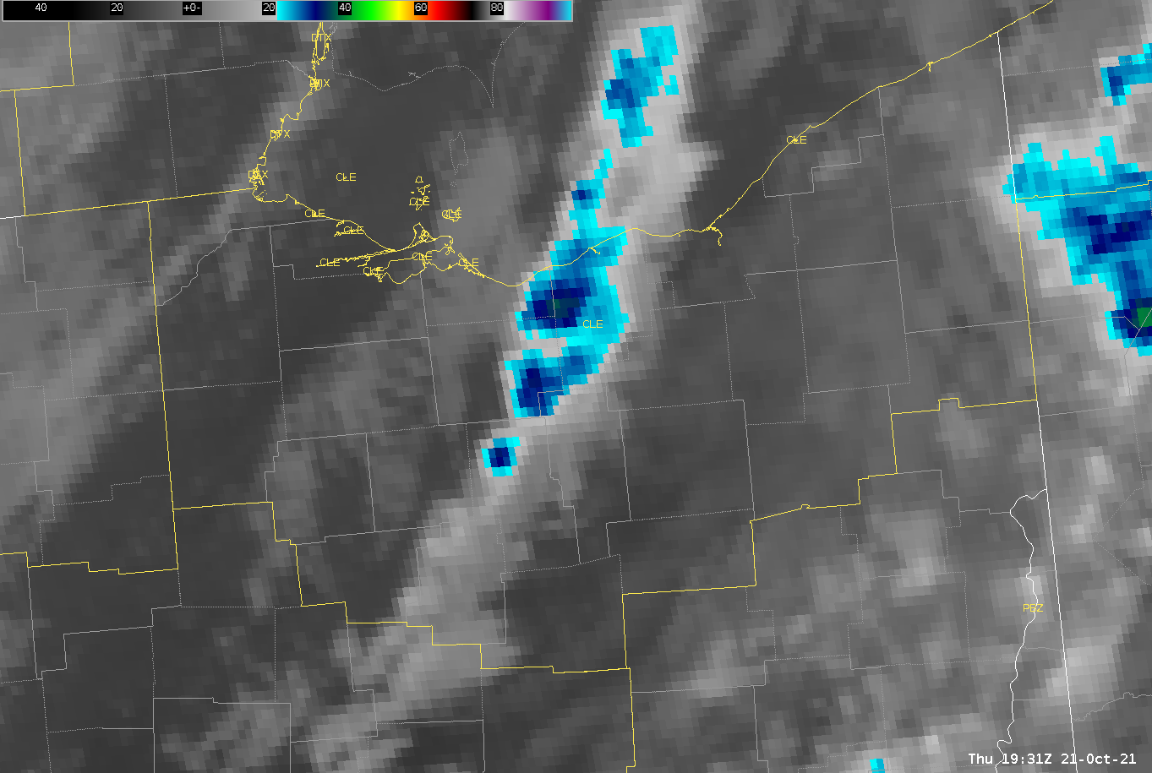
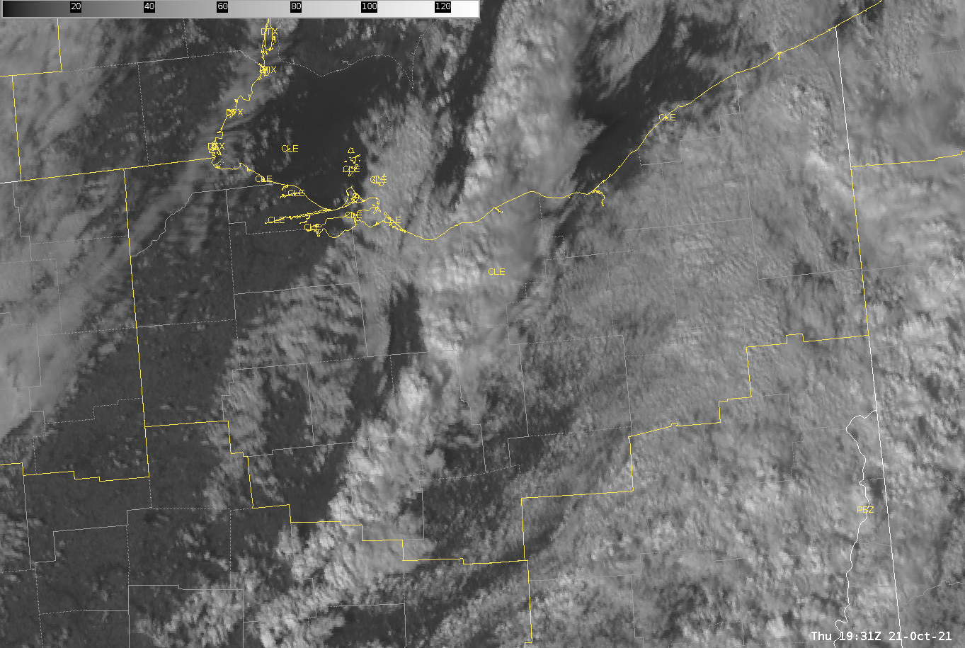
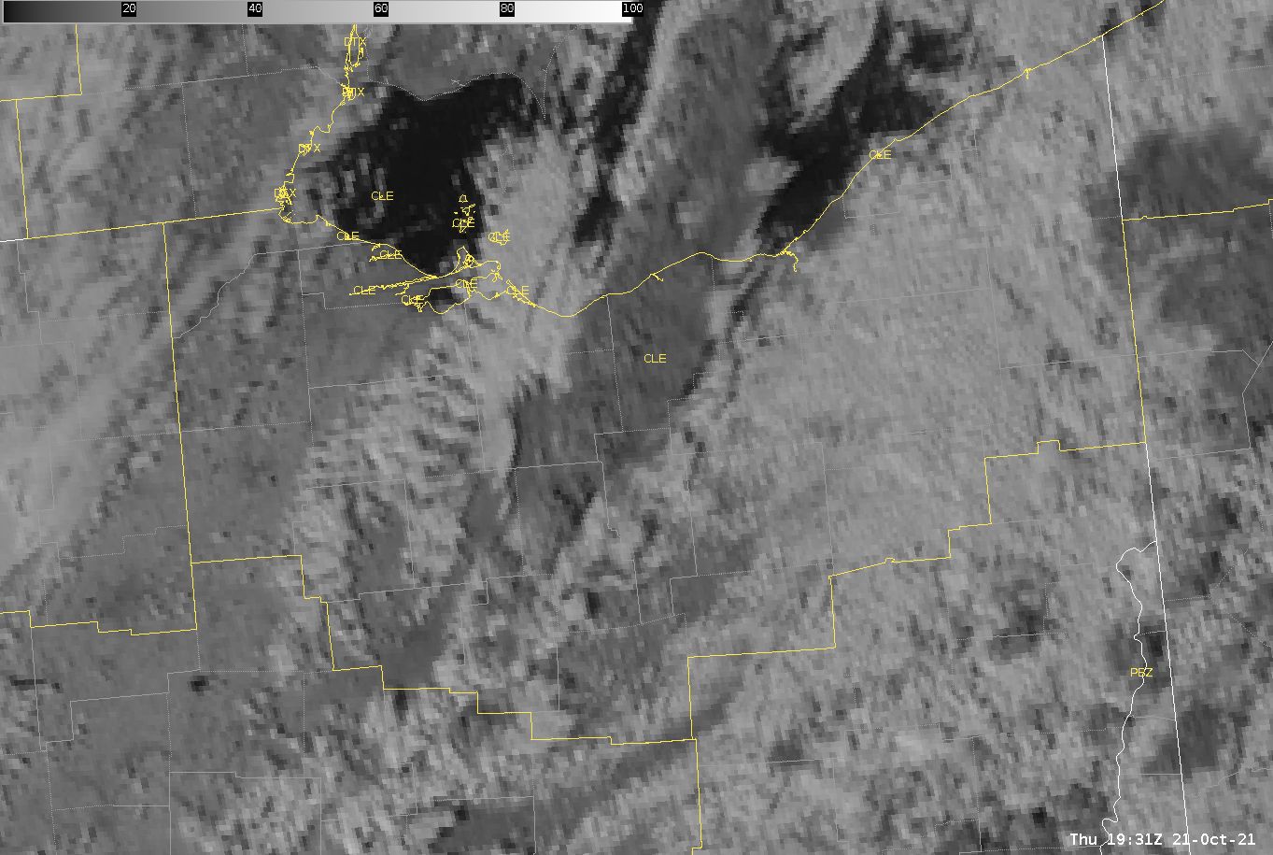
Satellite Imagery (3:30 PM)
DCPD (top left), clean longwave IR (top right), visible (bottom left), snow-ice (bottom right).

Slide 23
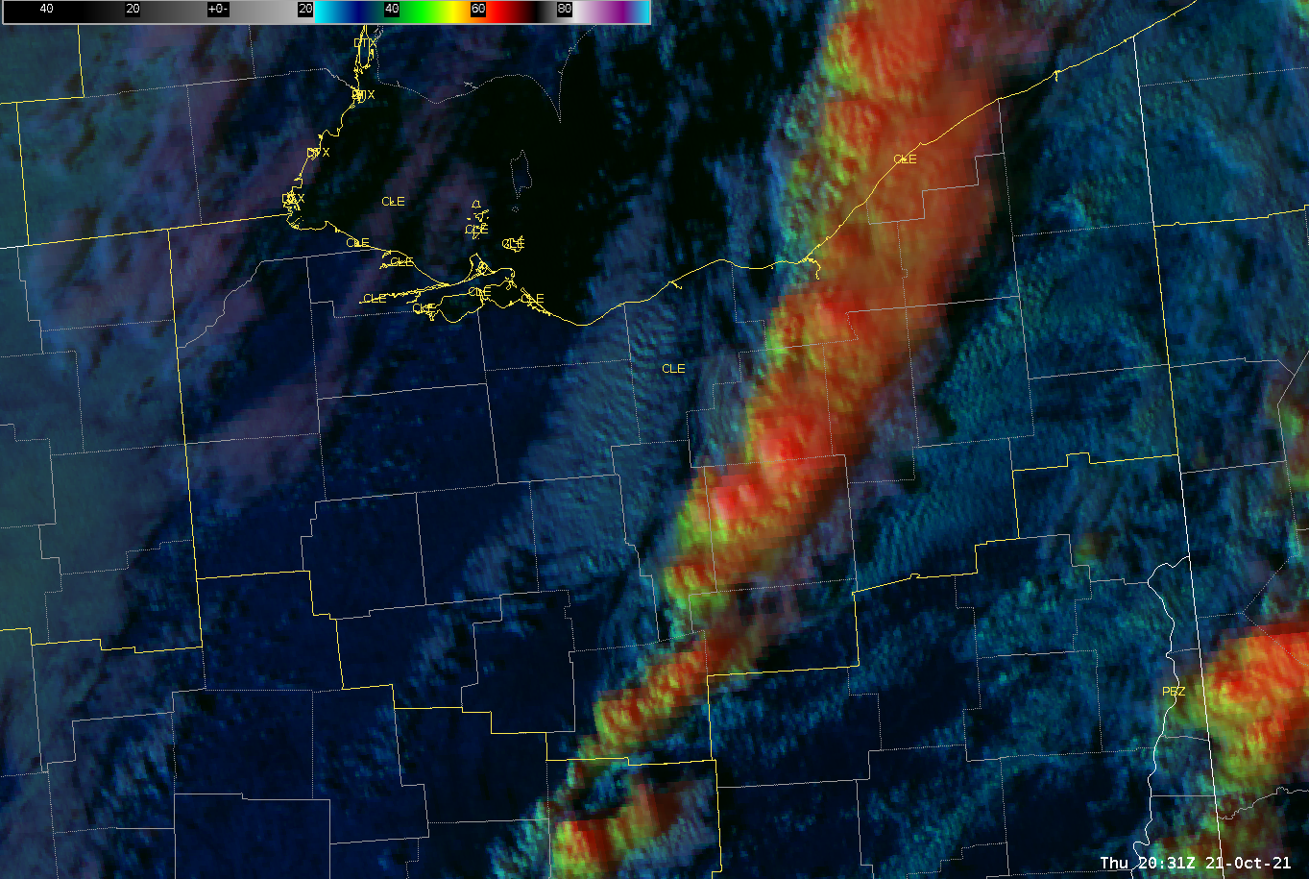
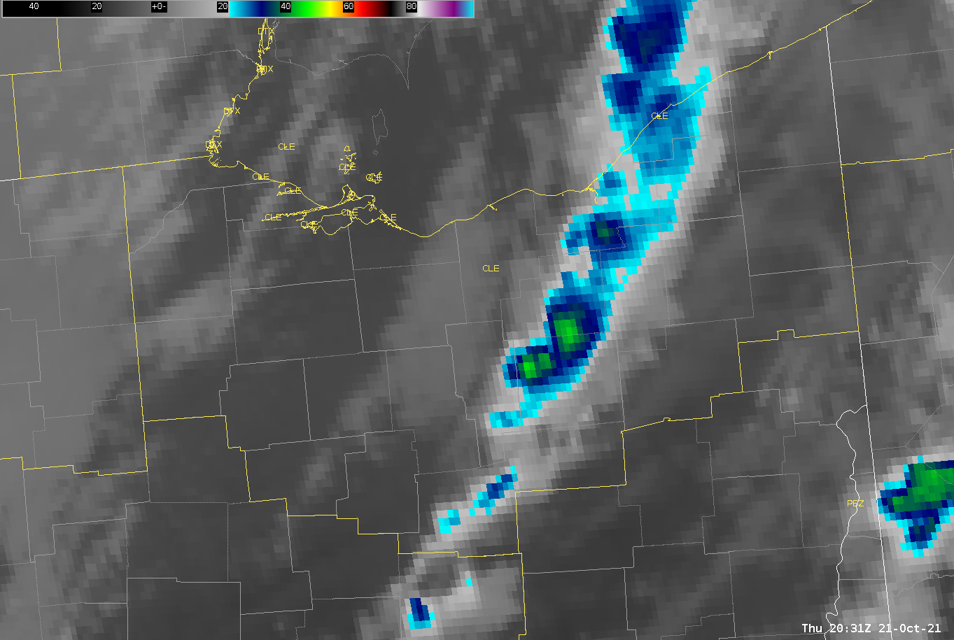
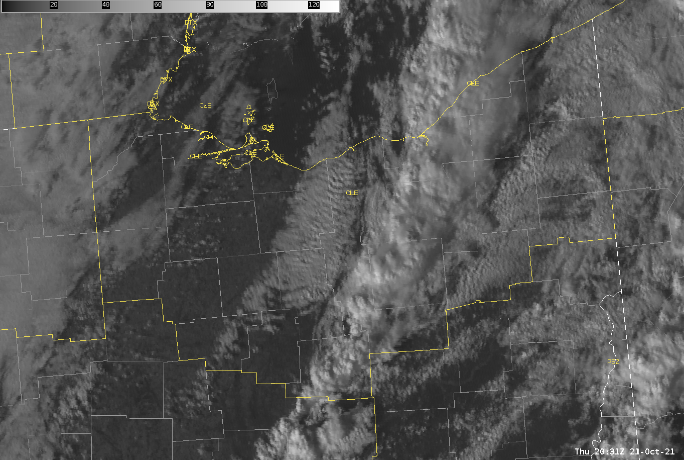
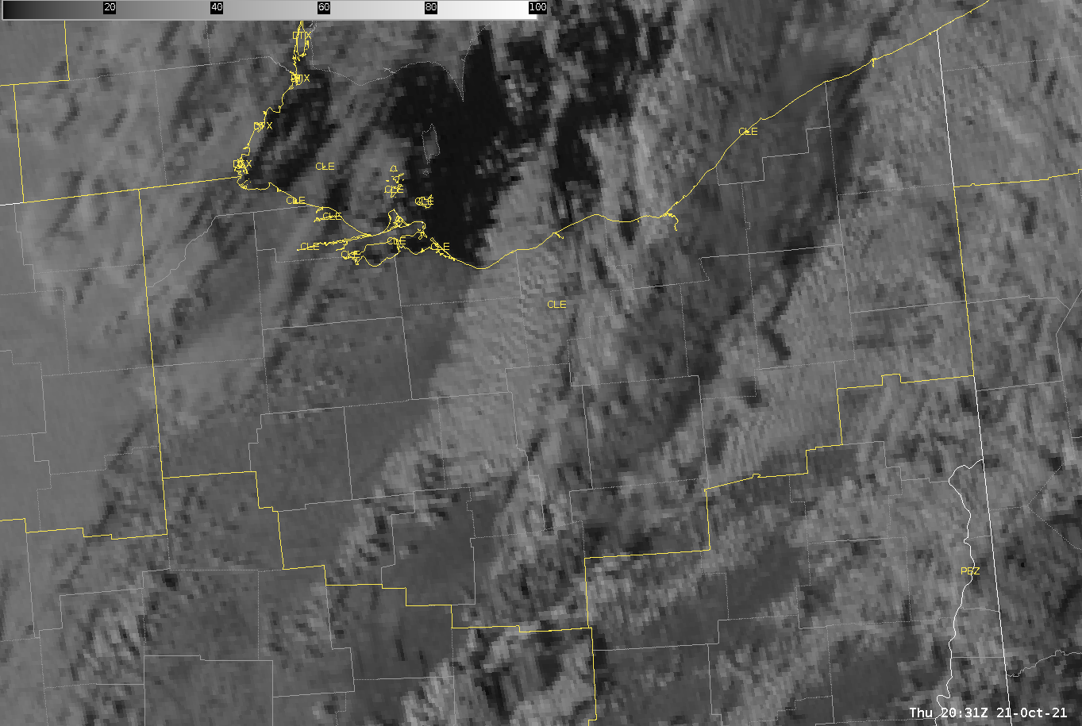
Satellite Imagery (4:30 PM)
First tornado reported at 4:36 PM in northern Medina County (EF-1).
A second tornado was reported at 4:44 PM in southern Medina County (EF-0).
Note that the cloud tops are all fully glaciated (via DCPD) with cold cloud tops less than -40C (via IR).
T
T
T
T
DCPD (top left), clean longwave IR (top right), visible (bottom left), snow-ice (bottom right).

Slide 24
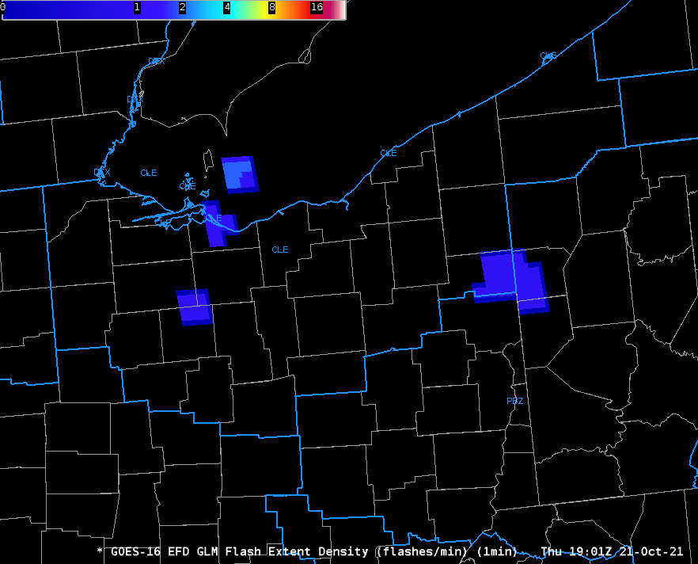
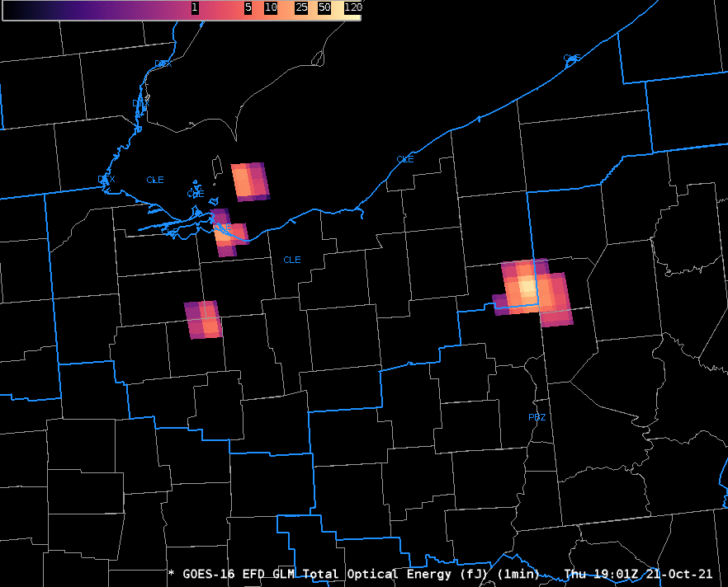
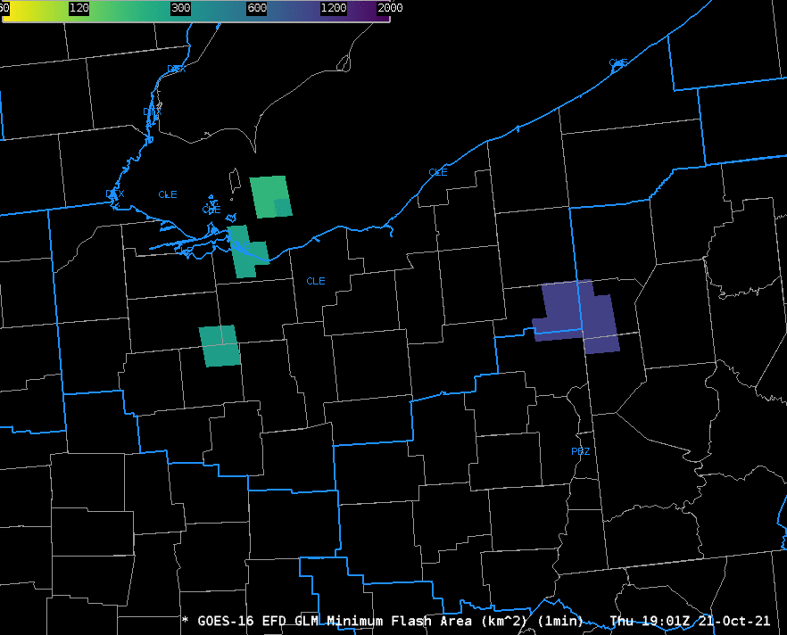
Lightning (GLM)
Sporadic and weak GLM signal across all products initially across northern OH.
MFA showed moderately-sized flashes in our area, owing to less continuity within the storms and thus, generally brief spin-ups (EF 0 & 1).
More continuity was observed as storms matured and moved into the PBZ CWA.
T
T
T
T
T
T
T
T
T
T
T
T
T
T
T
T
T
T
T
T
GLM imagery from 3 PM to 8 PM EDT Oct 21, 2021. FED (top left with modified colorbar – max of 25 flashes), MFA (top right), TOE (bottom). Red T’s represent confirmed tornadoes in the CLE CWA.
T
T
T
T

Slide 25
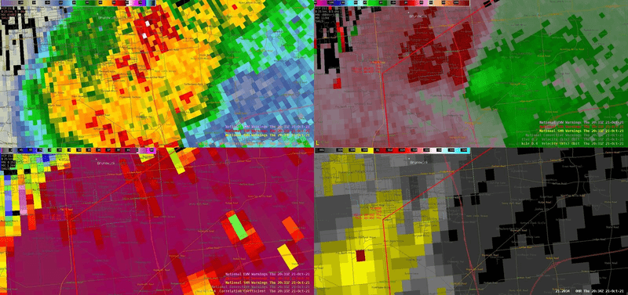
Northern Medina Tornado Radar (EF-1)
Feature-following zoom radar loop from 4:34 to 4:45 PM EDT on October 21, 2021. Radar reflectivity 0.4 elevation (top left), base velocity (top right), correlation coefficient (bottom left), and low-level MRMS track (bottom right). Note the drop in correlation coefficient near the end of the loop, indicating debris being lofted by the tornado.

Slide 26
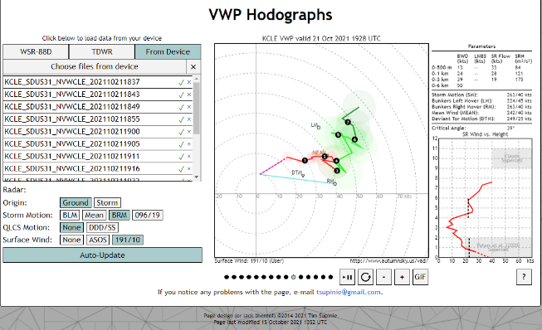
Mesoscale Environment
Initially, two things stood out during the event which differed from what was expected.
MLCAPE/SBCAPE slightly higher than forecast (closer to 500 J/kg), which allowed for any embedded rotating storms to become surface-based.
Low-level shear profiles were not entirely unidirectional with south to south-southwest winds ahead of the line.
Notice the slight clockwise curvature in the lowest 1 km of the hodograph (right), given a southerly wind of around 10 knots at KCLE.
Contributed to 0-500m effective SRH of 75 to 100 m2/s2 and 0-1km effective SRH of 100-125 m2/s2.
Image courtesy of autumnsky.us/vad/ and Tim Supinie

Slide 27
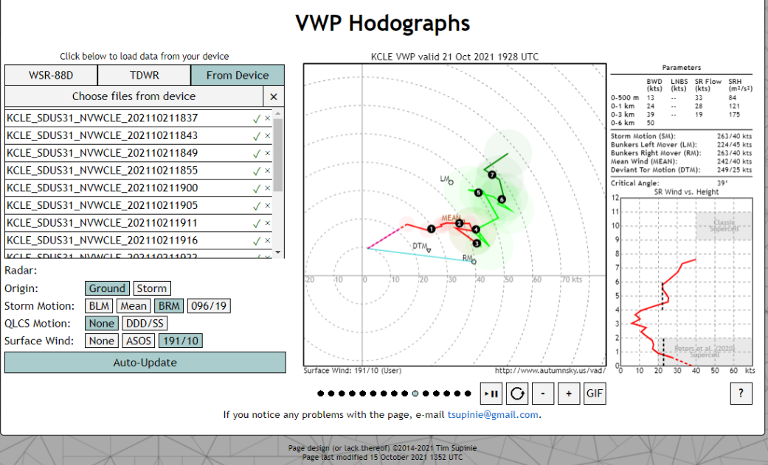
Mesoscale Environment
Image courtesy of autumnsky.us/vad/ and Tim Supinie

Slide 28
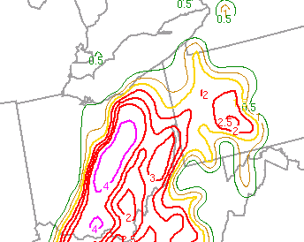
Mesoscale Environment
In the post-event review process, one composite parameter stood out among the rest; the modified SHERBE (shown bottom right at 4 PM EDT on October 21, 2021.

Slide 29
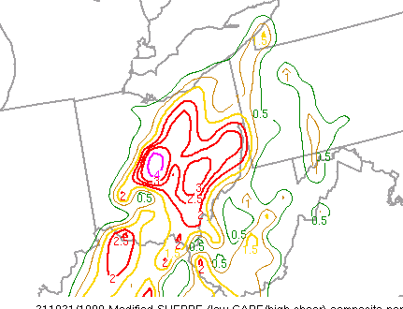
Mesoscale Environment
MOSHE loop from 3 PM to 7 PM EDT

Slide 30

Origins of the Modified SHERBE (MOSHE)
SHERB - Severe Hazards in Environments With Reduced Buoyancy
SHERBS3 (0-3km bulk shear)
Can be artificially high where there is no CAPE
SHERBE (effective bulk shear)
Can miss events where forecast CAPE is nonexistent or zero

Slide 31
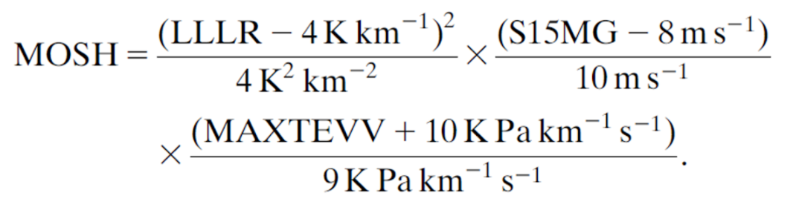
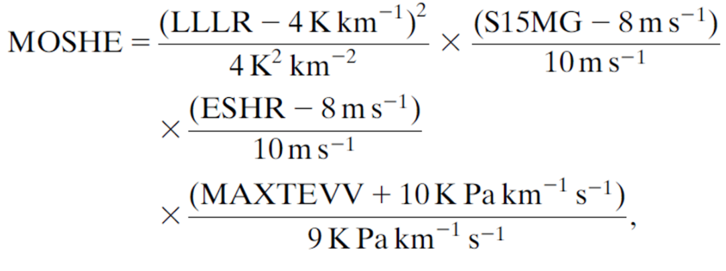
Origins of the Modified SHERBE (MOSHE)
Modified SHERB/SHERBE (MOSH/MOSHE)
MOSH
MOSHE (effective bulk shear)
Note that both equations are very similar. The only difference is the inclusion of the effective shear term in the MOSHE parameter.
The “MAXTEVV” term helps to reduce false alarm and maximize the parameter in strongly-forced situations where rapid local increases of CAPE may occur.
This term is meant to represent the release of potential instability in a location.
Any value greater than 1 for MOSHE is favorable for severe weather potential (not exclusive to tornadogenesis). Any value 3 or higher is extremely favorable for severe weather potential.
Notes:
Note the exclusion of mid-level lapse rates (700-500 mb) and the inclusion of low-level shear in the lowest 1.5km. The exclusion of the mid-level lapse rates is a result from a determination that it is less skillful. The 1.5 km low-level shear component is important as larger low-level wind shear promotes the strength of low-level mesocyclones, most often found in low-topped convection in HSLC environments.
Remember – for MOSHE, it includes effective shear, which is shear from the effective inflow base upward to 50% of the EL from the MU parcel. When CAPE is zero, so is effective shear, and thus the MOSHE is zero. This reduces false alarm area.

Slide 32
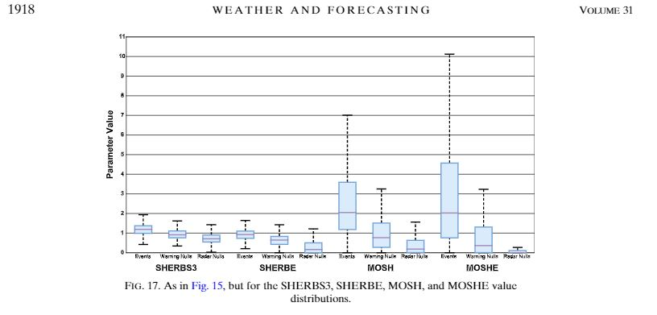
Origins of the Modified SHERBE (MOSHE)
Note that 25th and 75th percentiles for MOSHE are ~1 and ~4.5 respectively with a median value of 2.
For this event, our MOSHE values were around 4-4.5, i.e. closer to the 75th percentile.
Compare with null events, where the max is just under 3.5.
This parameter is available on the SPC mesoanalysis page under beta -> modified SHERBE.
As of early March, 2022, you can now extrapolate the MOSHE (forecast) out to 6 hours.
Figure 17 from Sherburn, K. et al. 2016.
Notes:
Note the exclusion of mid-level lapse rates (700-500 mb) and the inclusion of low-level shear in the lowest 1.5km. The exclusion of the mid-level lapse rates is a result from a determination that it is less skillful. The 1.5 km low-level shear component is important as larger low-level wind shear promotes the strength of low-level mesocyclones, most often found in low-topped convection in HSLC environments.
Remember – for MOSHE, it includes effective shear, which is shear from the effective inflow base upward to 50% of the EL from the MU parcel. When CAPE is zero, so is effective shear, and thus the MOSHE is zero. This reduces false alarm area.

Slide 33
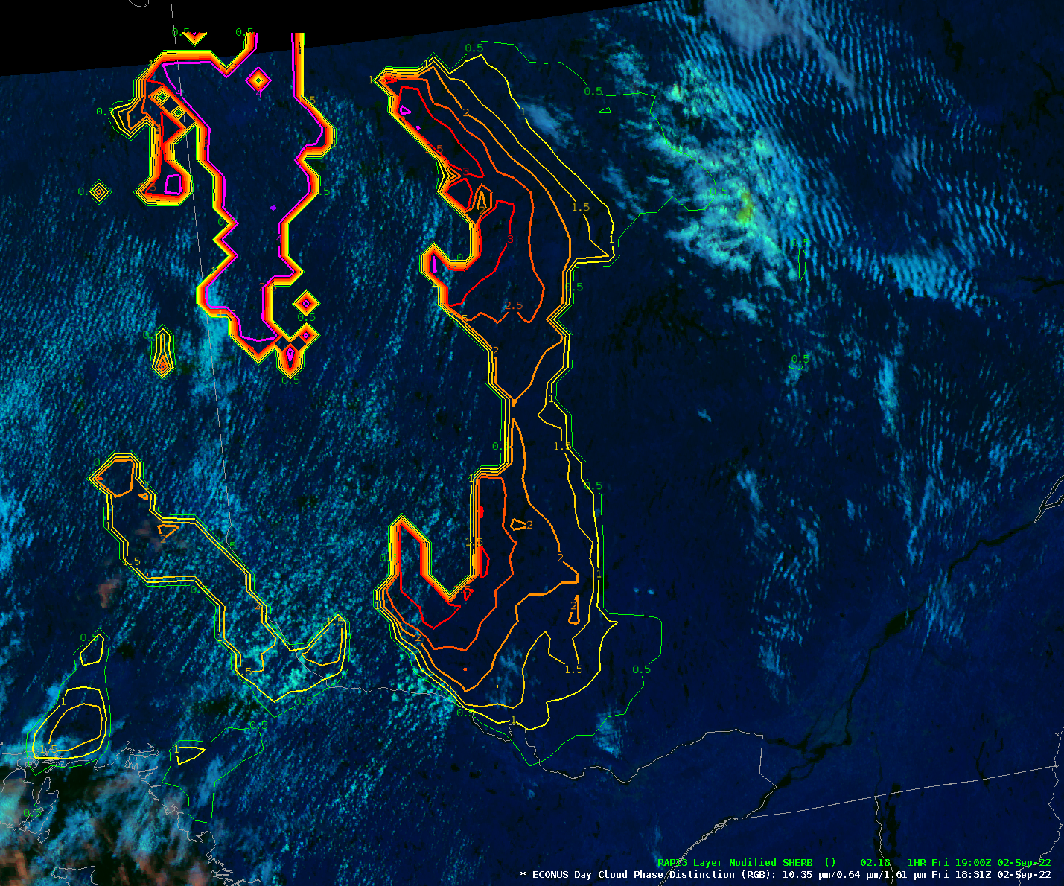
MOSH In AWIPS (Aug, 2022)
MOSH (not MOSHE) now available in the Volume Browser
Can be loaded via RAP13/NAM12/FV3/ARW/GFS20
Load as an image or contour – If loaded as a contour, can follow a technique similar to how LightningCast is being utilized as a contour style rule, overlaid on satellite imagery
MOSH will be zeroed out when model MUCAPE is < 10 J/kg or higher than 2000 J/kg.
MOSH contour overlaid on day cloud phase distinction (DCPD) satellite product. Values > 3 are shown via a pink contour.
Notes:
Note the exclusion of mid-level lapse rates (700-500 mb) and the inclusion of low-level shear in the lowest 1.5km. The exclusion of the mid-level lapse rates is a result from a determination that it is less skillful. The 1.5 km low-level shear component is important as larger low-level wind shear promotes the strength of low-level mesocyclones, most often found in low-topped convection in HSLC environments.
Remember – for MOSHE, it includes effective shear, which is shear from the effective inflow base upward to 50% of the EL from the MU parcel. When CAPE is zero, so is effective shear, and thus the MOSHE is zero. This reduces false alarm area.

Slide 34
Check Out Our Event Summary Page
For our local event archive - https://www.weather.gov/cle/localevents
For this specific event - https://www.weather.gov/cle/event_October212021TornadoOutbreak

Slide 35
References
Sherburn, K. et al. 2016: Composite Environments of Severe and Nonsevere High-Shear, Low-CAPE Convection Events. Wea Forecasting, 31, 1899-1927.

Slide 36
THANK YOU!
QUESTIONS?

Slide 37
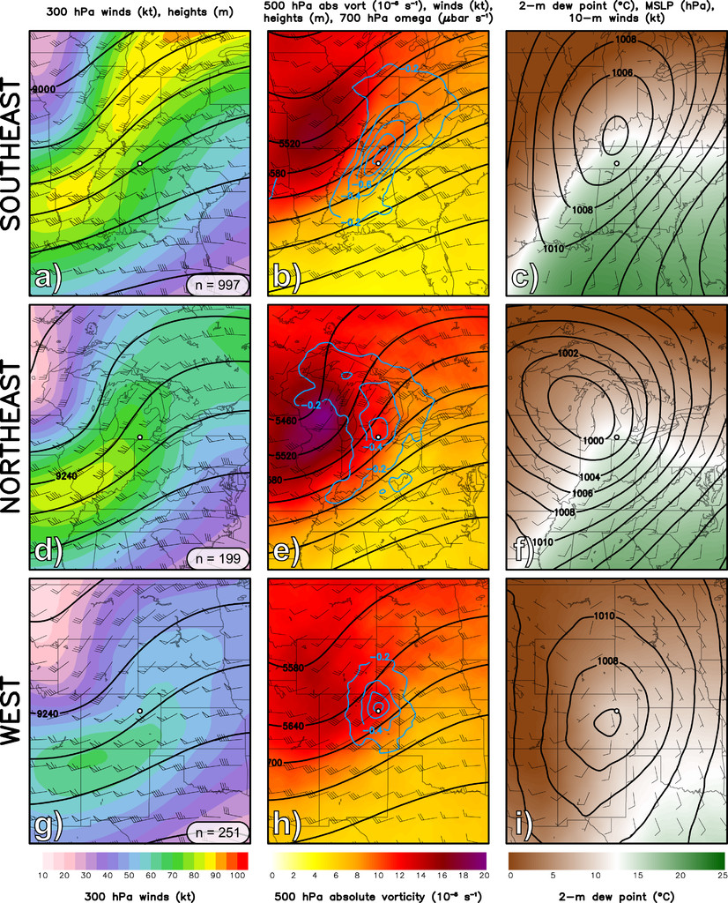
HSLC Environments for the Great Lakes Area
A “typical” high shear-low cape environment for the Great Lakes area includes:
Located under the exit region of a southwesterly upper-level jet.
A negatively tilted mid-level trough with 40-60 kts of 500mb flow.
A sub-1000mb low tracking just to the northwest.
Surface dew points in the upper 50s to near 60.
Surface southerly winds of around 10-15 kts.
Conceptual model of a typical HSLC environment for the Great Lakes area. From left to right shown are 300 mb winds, 500 mb absolute vorticity, and 2-meter dew point.

Slide 38
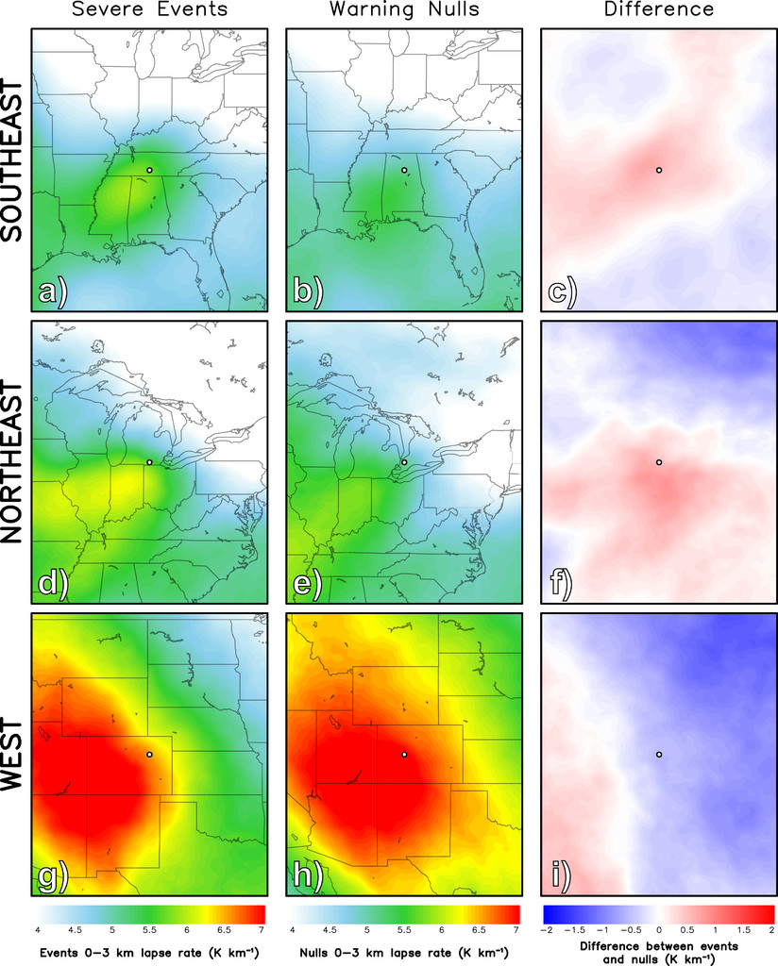
HSLC Environments for the Great Lakes Area
Low-level lapse rates is a skillful parameter in differentiating favorable and unfavorable HSLC environments.
For null events (HSLC tornado events that were forecast but didn’t occur), 0-3 km lapse rates were around 5 to 5.75 C/km whereas severe events had 5.5 to 6.25 C/km.
Diagram showing how low-level lapse rates in the lowest 3 km can be a skillful parameter in differentiating between favorable and unfavorable HSLC environments.

Slide 39


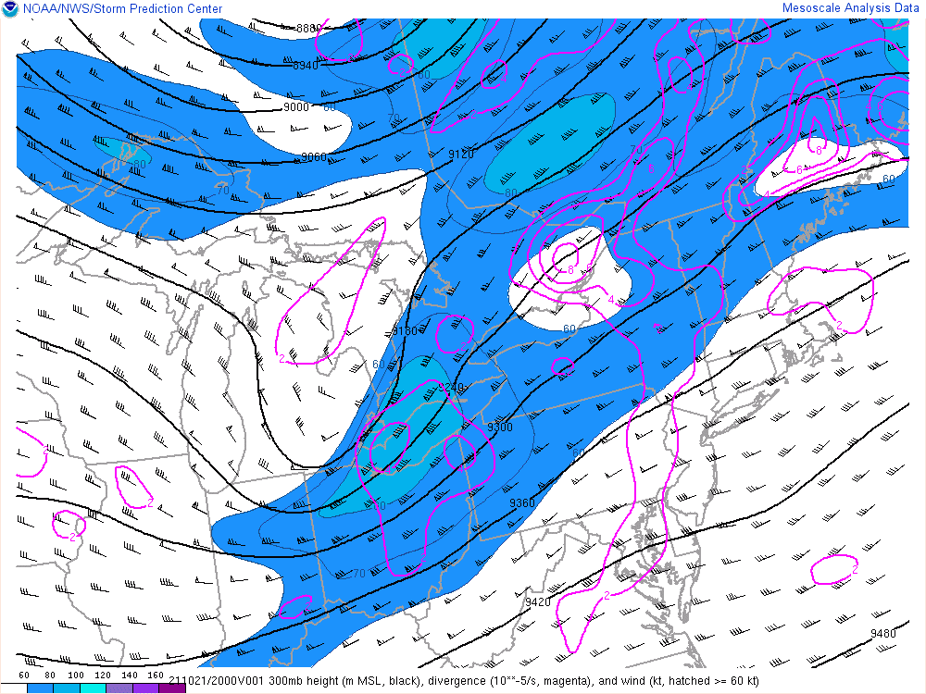
Did This Event Fit The Model?
Located under the exit region of a southwesterly upper-level jet?
Leaned more towards the right front entrance region, though still favorable for upper divergence.
300 mb mesoanalysis map at 4 PM EDT on Oct 21, 2021.

Slide 40
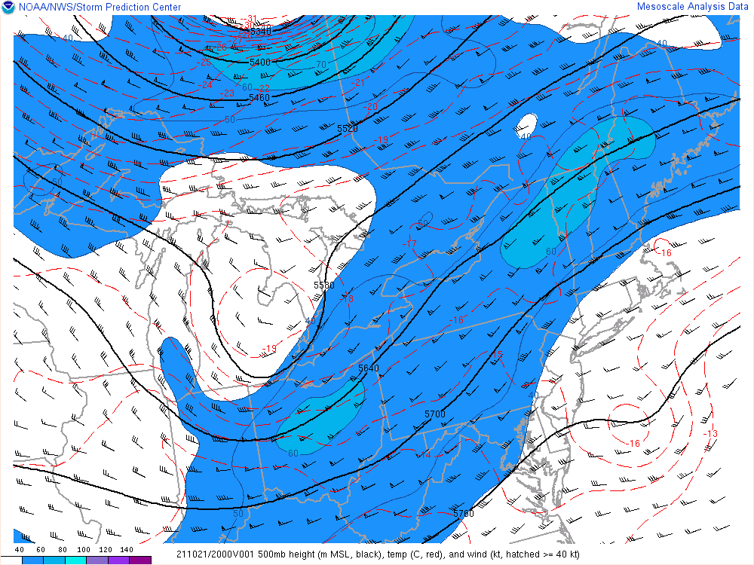
Did This Event Fit The Model?
A negatively tilted mid-level trough with 40-60 kts of 500mb flow?
Trough axis more neutral than negatively tilted
500 mb mesoanalysis map at 4 PM EDT on Oct 21, 2021.

Slide 41
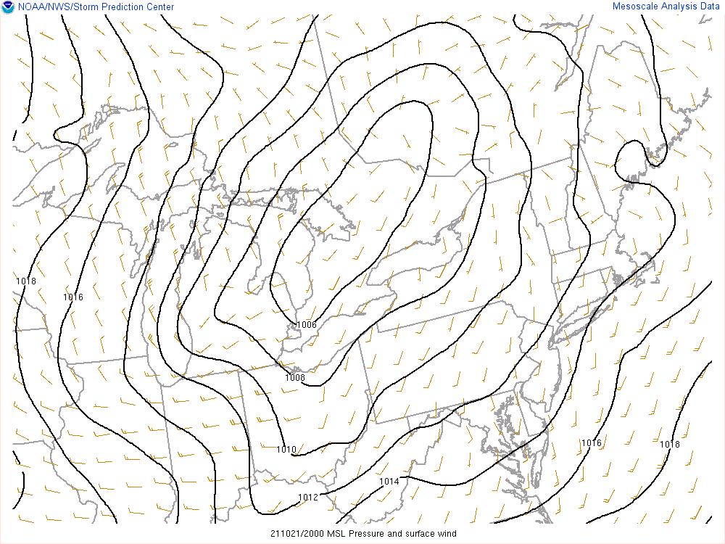
Did This Event Fit The Model?
A sub-1000 mb low tracking just to the northwest?
Despite not being sub-1000 mb, there is still a moderately strong low tracking to the north and west, allowing for our area to be placed in the warm sector.
MSLP surface map at 4 PM EDT on Oct 21, 2021.

Slide 42
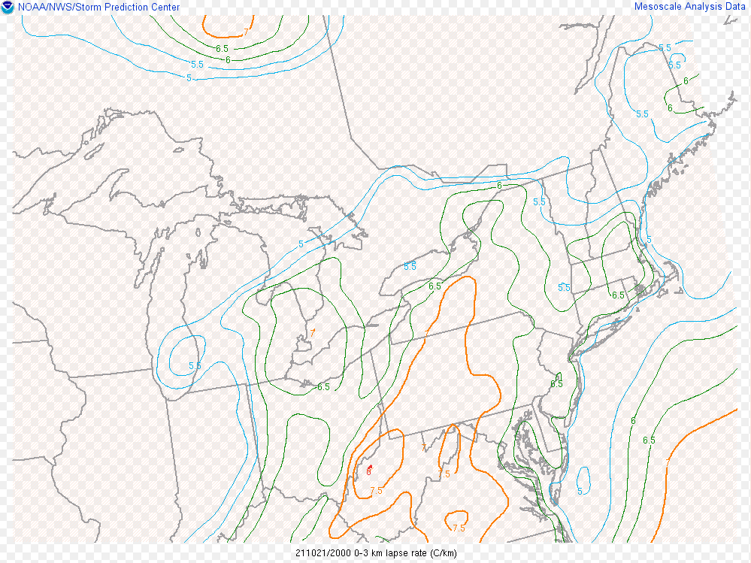
Did This Event Fit The Model?
Low-level lapse rates greater than 6 C/km?
Low-level lapse rates map at 4 PM EDT on Oct 21, 2021.

Slide 43
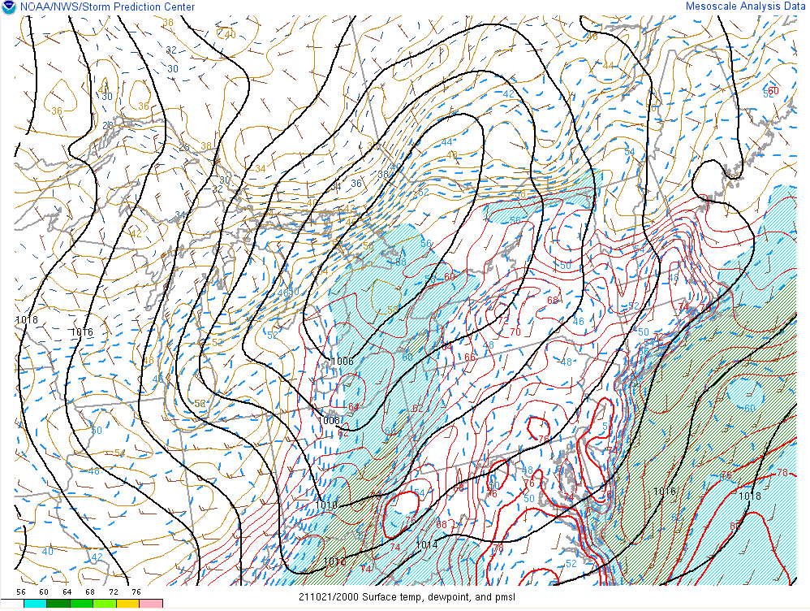
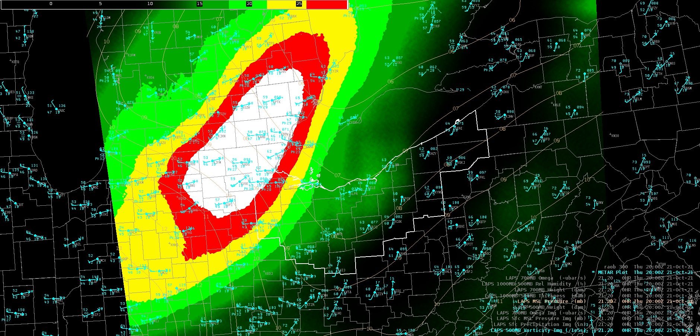
Did This Event Fit The Model?
Surface dew points in the upper 50s to near 60?
Surface southerly winds of around 10-15 kts?
Shown are 500 mb vorticity/metar plots (left) and surface temp, dewpoint, and MSLP (right) at 4 PM EDT on Oct 21, 2021. Note a narrow corridor of 55-60 F dewpoints extending north across Ohio into Canada. Also note the south to south-southwest surface flow near 10 knots ahead of the eastward-advancing cold front.

Slide 44
Did This Event Fit The Model?
Located under the exit region of a southwesterly upper-level jet?
A negatively tilted mid-level trough with 40-60 kts of 500mb flow?
A sub-1000 mb low tracking just to the northwest?
Low-level lapse rates greater than 6 C/km?
Surface dew points in the upper 50s to near 60?
Surface southerly winds of around 10-15 kts?
Not a perfect match, many favorable parameters with some variability.
This shows that not all HSLC events in the Great Lakes are “textbook” and that even a small degree of deviation from the model can still result in a favorable environment.

Slide 45
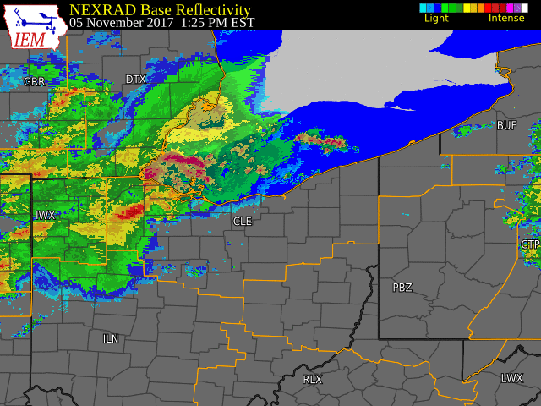
Applying the MOSHE to the Nov 5, 2017 Case
14 Confirmed Tornadoes (3 EF2, 9 EF1, 2 EF-0)
10/14 had a TDS
TDS appeared, on avg, just 1 min after touchdown
Widespread significant wind damage
Macroburst traveled ~110 miles with max width of ~13 miles and max winds of 105 mph (measured)
Average Echo Top Height of 29,000 feet

Slide 46
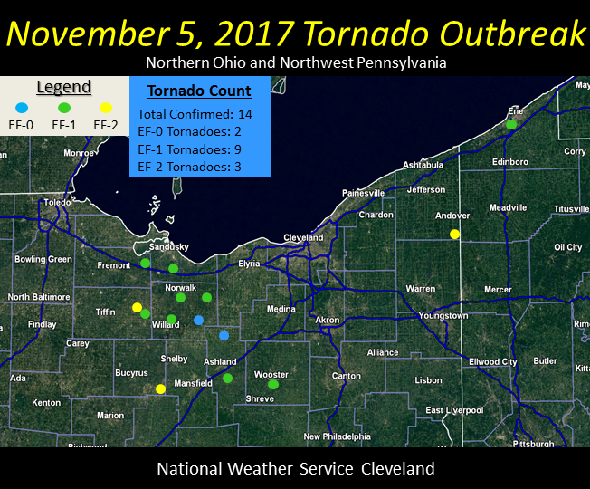
Applying the MOSHE to the Nov 5, 2017 Case
14 Confirmed Tornadoes (3 EF2, 9 EF1, 2 EF-0)
10/14 had a TDS
TDS appeared, on avg, just 1 min after touchdown
Widespread significant wind damage
Macroburst traveled ~110 miles with max width of ~13 miles and max winds of 105 mph (measured)
Average Echo Top Height of 29,000 feet

Slide 47
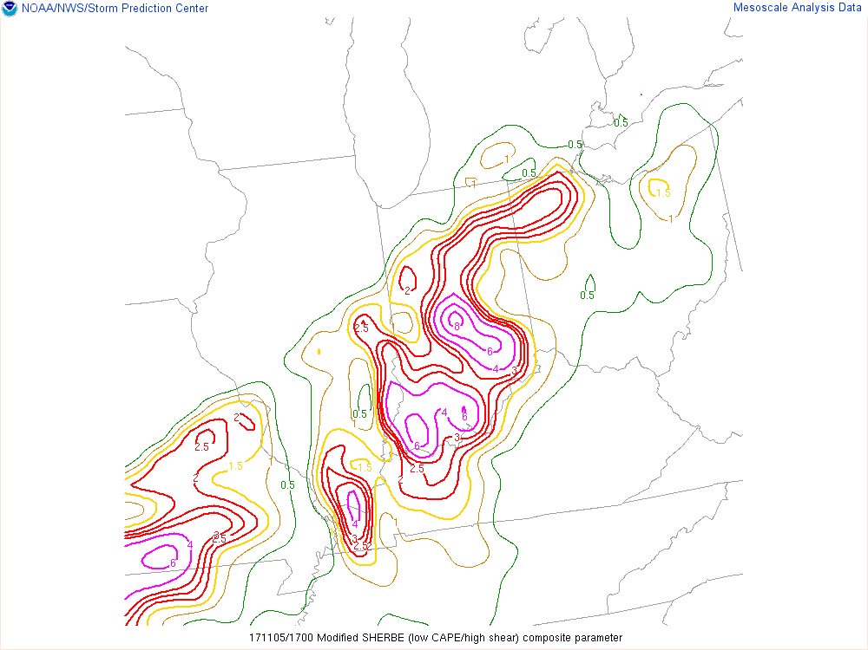
Applying the MOSHE to the Nov 5, 2017 Case
Loop of MOSHE from 1 PM EDT to 11 PM.
Note the northeast advection of higher values of the MOSHE into northern OH.

Slide 48

Compare to SHERBE for the Nov 5, 2017 Case
Loop of SHERBE from 1 PM EDT to 11 PM.
Note the “broad-brushed” values of the SHERBE, highlighting nearly all areas for severe potential, but not pinpointing any locally higher regions.

Slide 49
Compare to SHERBE for the Nov 5, 2017 Case

Slide 50

Low-Level Lapse Rate for the Nov 5, 2017 Case
Loop of low-level lapse rates from 1 PM EDT to 11 PM.
Note low-level lapse rates of 6-7 C/km entering northern OH.
Recall that low-level lapse rates can be skillful in differentiating between favorable and unfavorable HSLC environments, especially when greater than 6 C/km.

