Slide 1





FDTD Satellite Applications Webinar:
An Operational Review of the 1 May 2023 Localized Blowing Dust Event Across South-Central Illinois
Presented by
James Auten, WFO Lincoln IL
Marshall Pfahler, WFO St Louis MO
28 June 2023

Slide 2
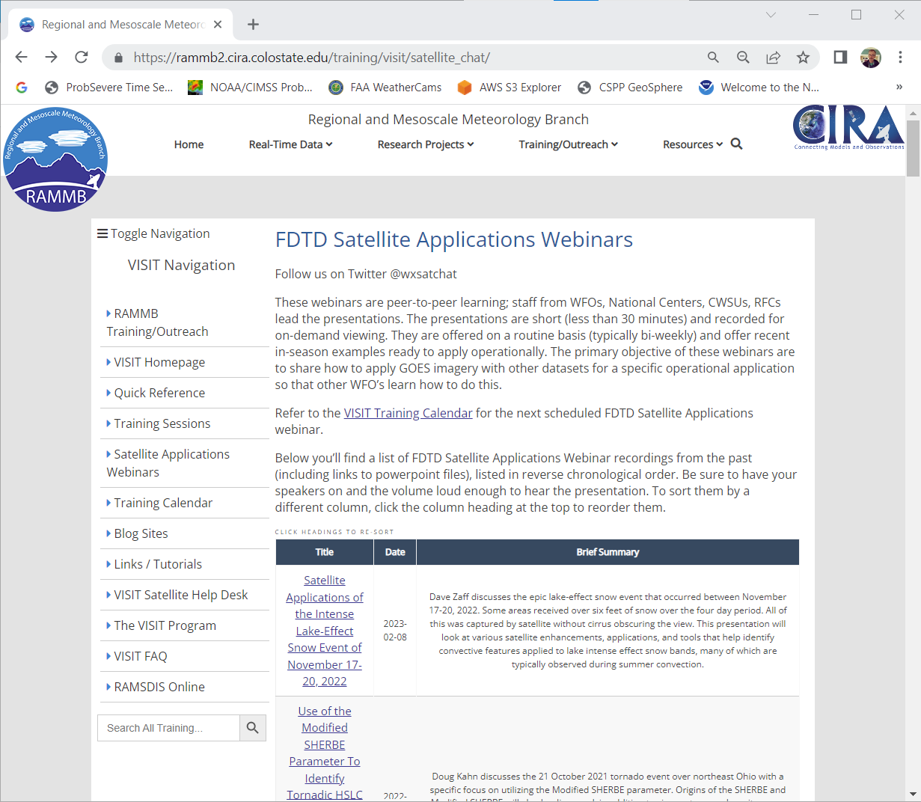
FDTD “Satellite Chat” Library
https://rammb2.cira.colostate.edu/training/visit/satellite_chat/ Recorded Content includes Q&A
Call for speakers! Let us know if you want to speak on a topic!
Contact: scott.lindstrom@noaa.gov OR dan.bikos@noaa.gov

Slide 3


FDTD Satellite Applications
Webinar Protocol
~20 minutes for the speaker
  Send questions via GoTo Chat
  Or ask during Q&A period via phone
Followed by Q&A
  Open discussion forum
  Done by 1730 UTC
Do NOT press hold!!!
Mute when not speaking

Slide 4
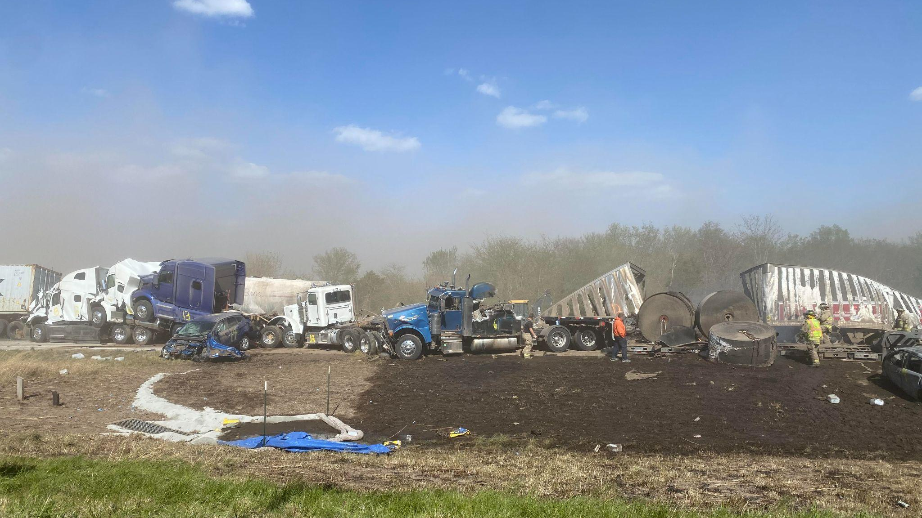


FDTD Satellite Applications Webinar:
An Operational Review of the 1 May 2023 Localized Blowing Dust Event Across South-Central Illinois
James Auten¹ & Marshall Pfahler²
¹NWS WFO Lincoln, IL; ²NWS WFO St. Louis, MO
28 June 2023

Slide 5
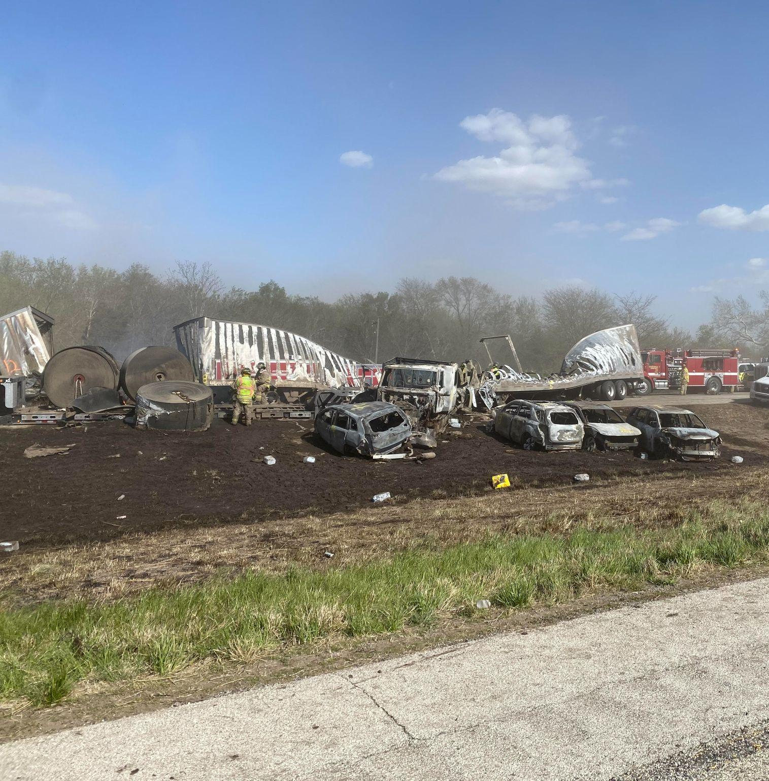
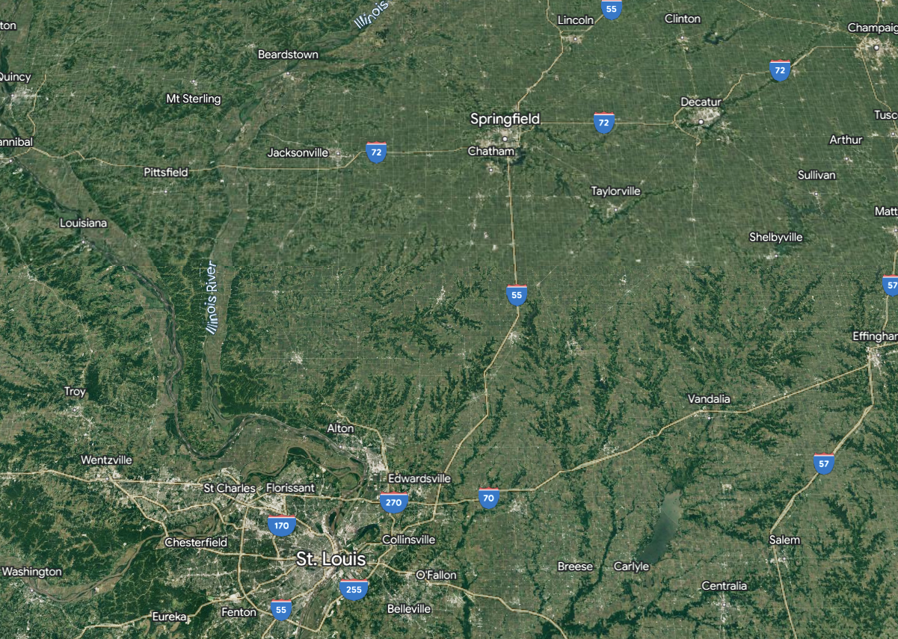
Overview
On 1 May, two narrow plumes of blowing dust in south-central Illinois resulted in localized near-zero visibilities.
The most significant impacts occurred with multiple vehicle accidents & pile ups on I-55 near the Sangamon-Montgomery County line involving 72 vehicles in total (Illinois State Police).
Seven fatalities & 37 injuries were reported.

Slide 6
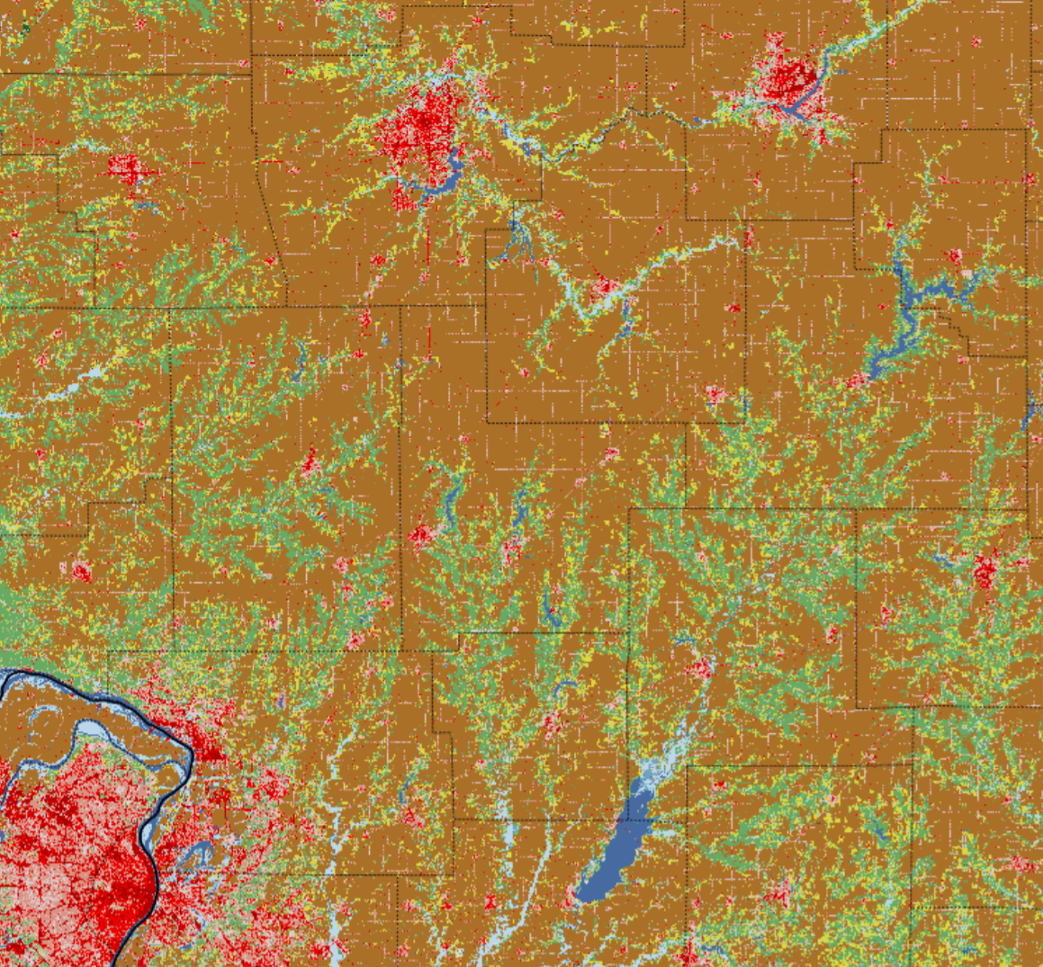
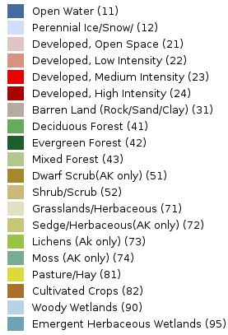
Land Cover
Much of the land cover across rural south-central Illinois is categorized as Cultivated Crops.
This categorization captures the dominance of open, farm fields across the region.
During the spring, including early May, many spring/summer crops are planted, requiring tilling of most farm fields.
Springfield
St. Louis

Slide 7
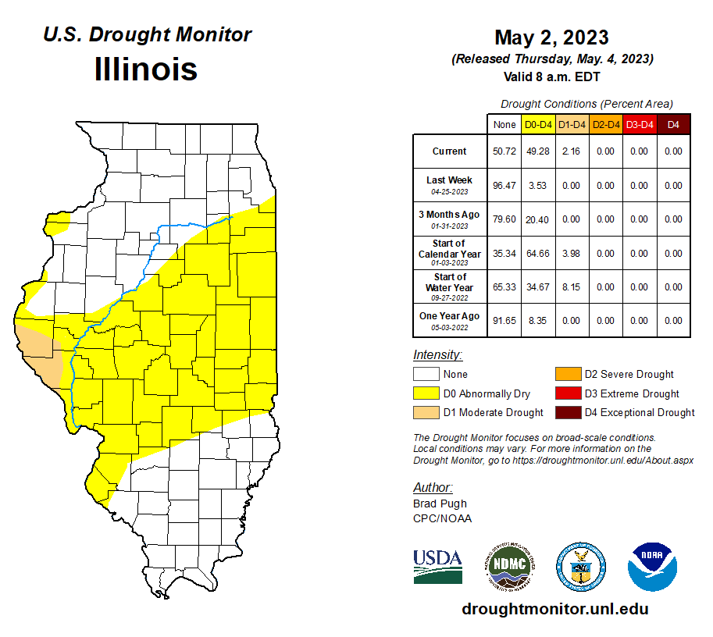
Antecedent Conditions
Through 2 May, D0 (Abnormally Dry) conditions had been expanded/ introduced across the a large corridor from west-central to east-central Illinois.
These conditions can be attributed to an abnormally dry April.

Slide 8
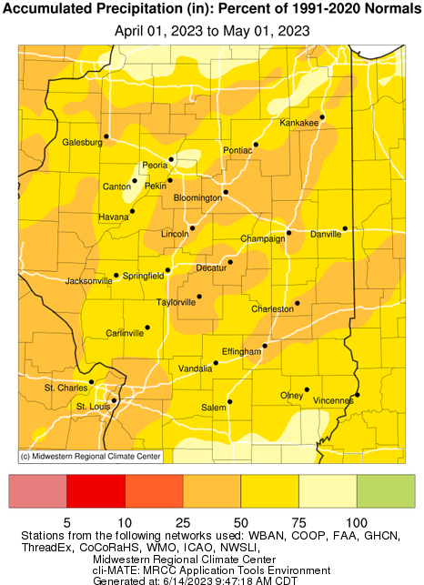
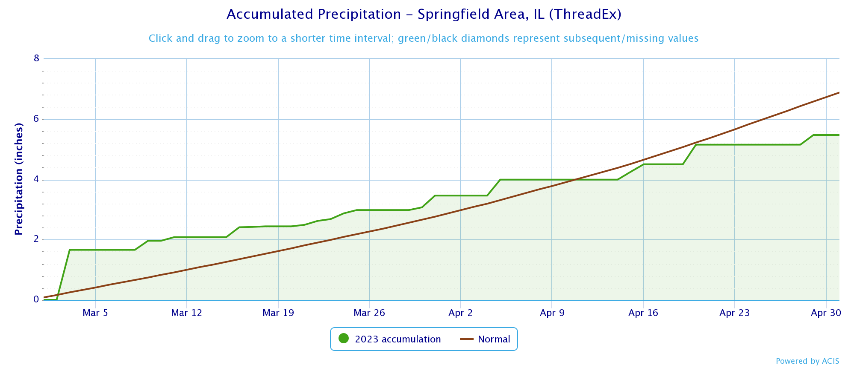
Antecedent Conditions
Over the month of April in these areas, accumulated precipitation was around 50% of average (1991–2020).
This dryness occurred after near-average precipitation in March.
Climatologically, May is around the wettest time of year.

Slide 9
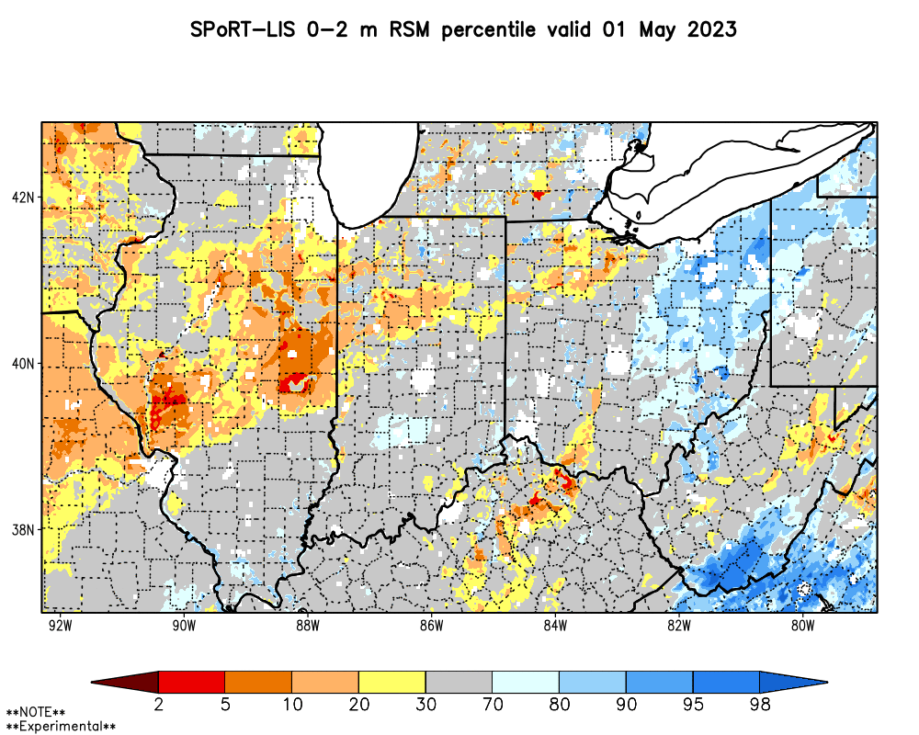
Antecedent Conditions
The dry April contributed to soil moisture decreasing to between the 5th & 20th percentiles (1981–2013) by 1 May.
Although not extremely dry, the tilling of these dry soils allowed finer soil to be exposed & carried by gusty winds.

Slide 10
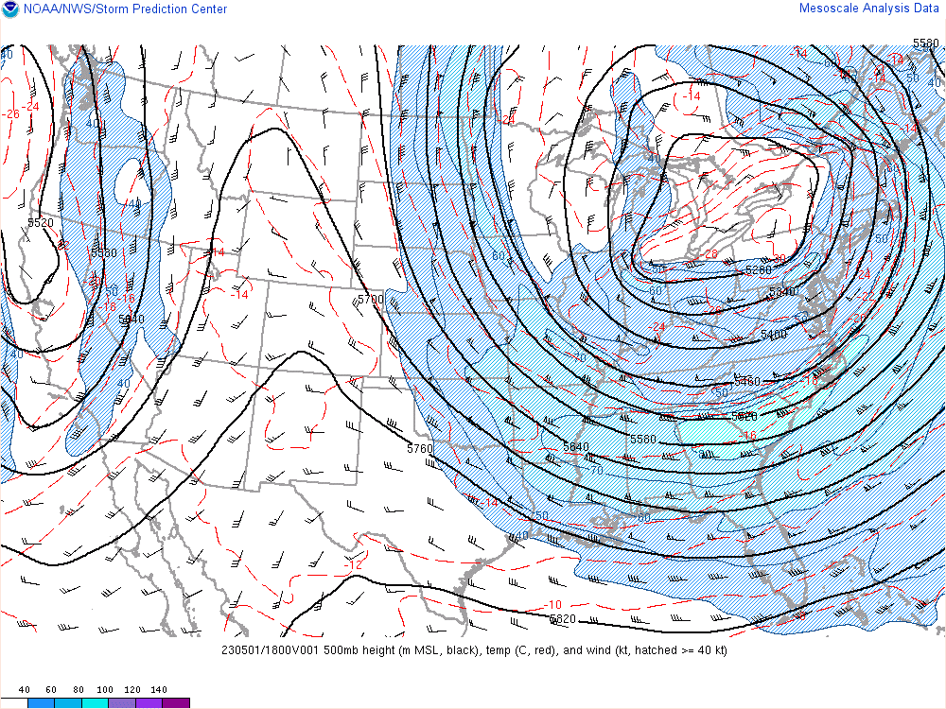
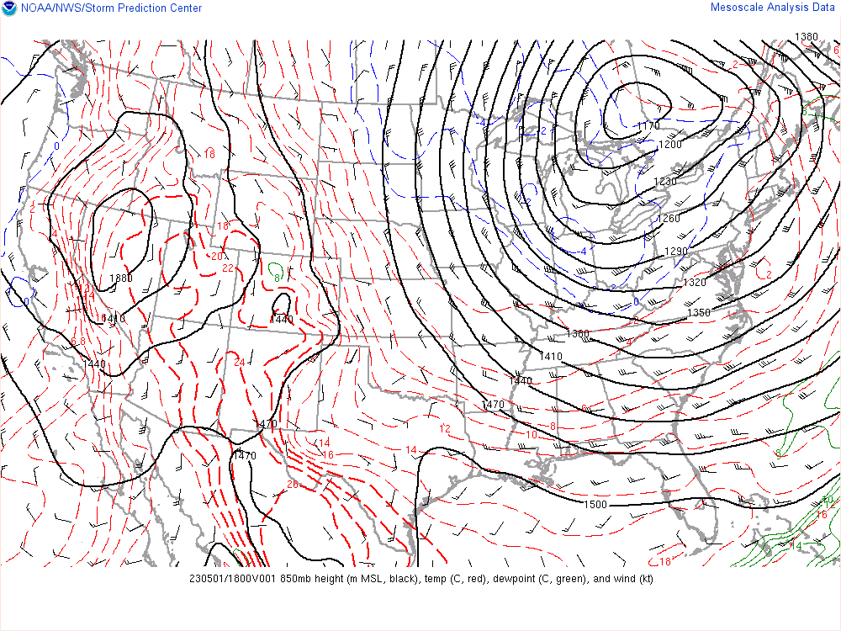
Synoptic-Scale Pattern
Through 1 May, a deepening upper-level cyclone was centered near the Great Lakes.
The cyclone established deep cyclonic, northwesterly flow across the Midwest, including Illinois.

Slide 11
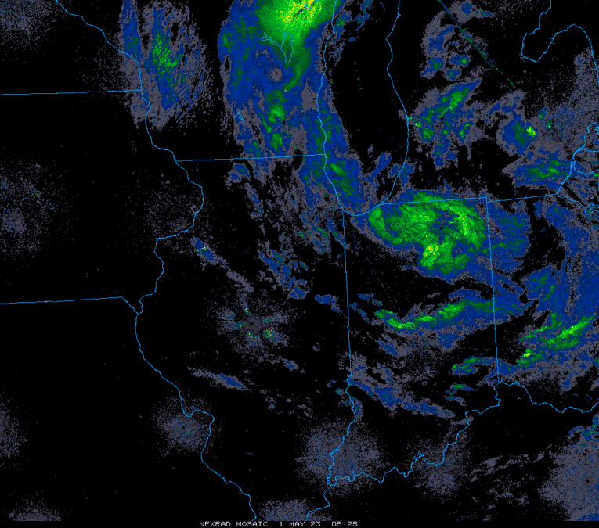
Synoptic-Scale Pattern
Synoptic-scale ascent & moisture, along with any precipitation, remained largely confined to the northeast of south-central Illinois on 1 May.

Slide 12
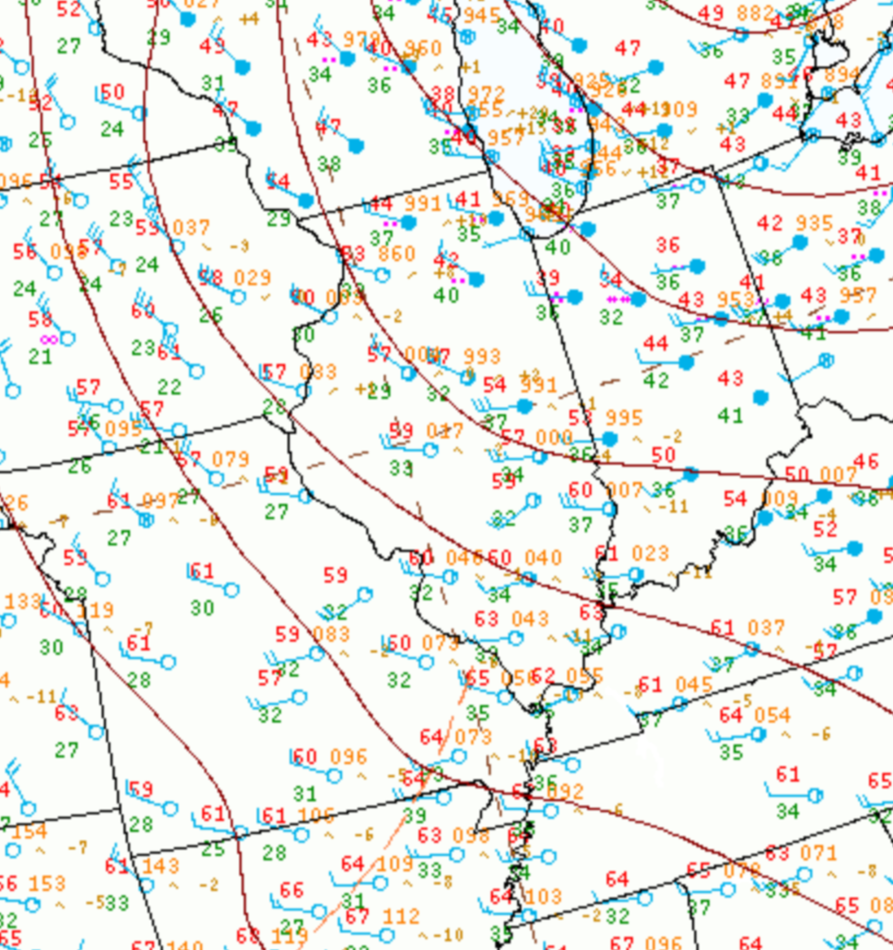
Synoptic-Scale Pattern
At the surface, northwesterly, broadly cyclonic flow was apparent & enhanced by a relatively tight pressure gradient.
Aside from a weak surface pressure trough, no notable surface features (i.e., cold front, convective outflow boundary) were present across Illinois.
18z 1 May 2023

Slide 13
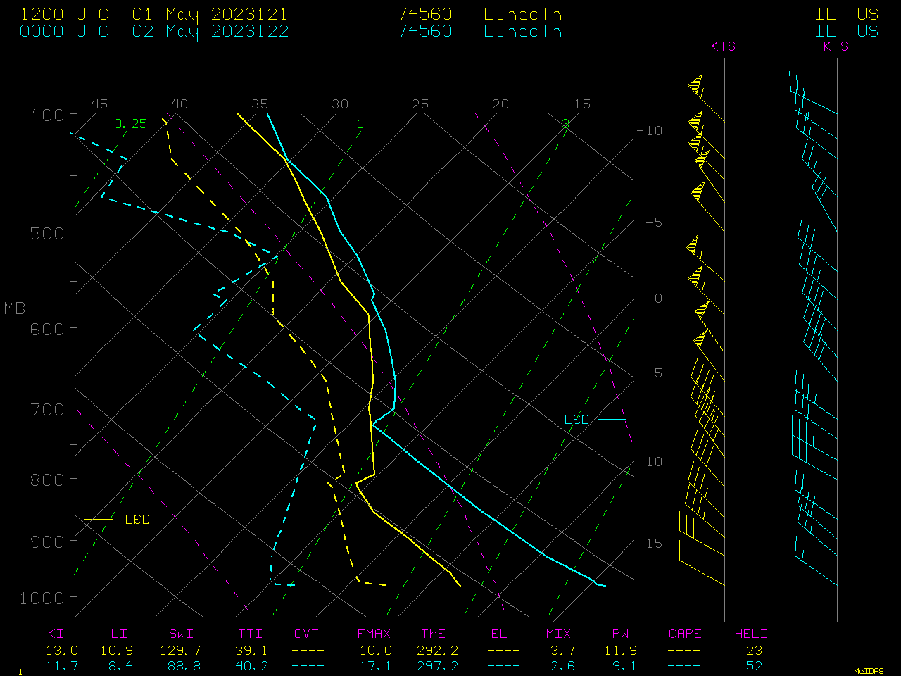
Synoptic-Scale Pattern
The KILX 12z 1 May & 00z 2 May observed soundings sampled deepening of the boundary layer to 725 hPa along with drying through significant mixing.
As the boundary layer deepened, momentum from 30 to 40 kt flow near the top of boundary layer could be transferred to the surface.
Noteworthy, is the precipitable water decreasing to 9.1 mm (0.36”) by 00z 2 May, below the 10th percentile of climatology (1949–2022).

Slide 14
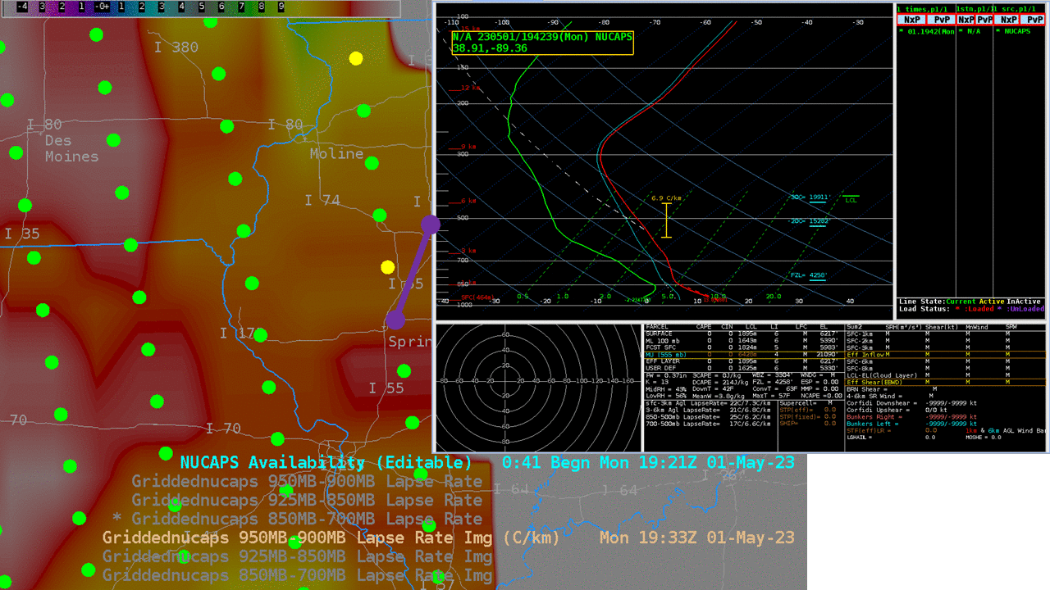
Synoptic-Scale Pattern
NUCAPS derived soundings valid ~1930z (during mid-afternoon) indicated a local maximum in low-level lapse rates (superadiabatic) across south-central IL.
This local maximum suggests that boundary layer mixing was most pronounced where the plumes of blowing dust occurred.

Slide 15
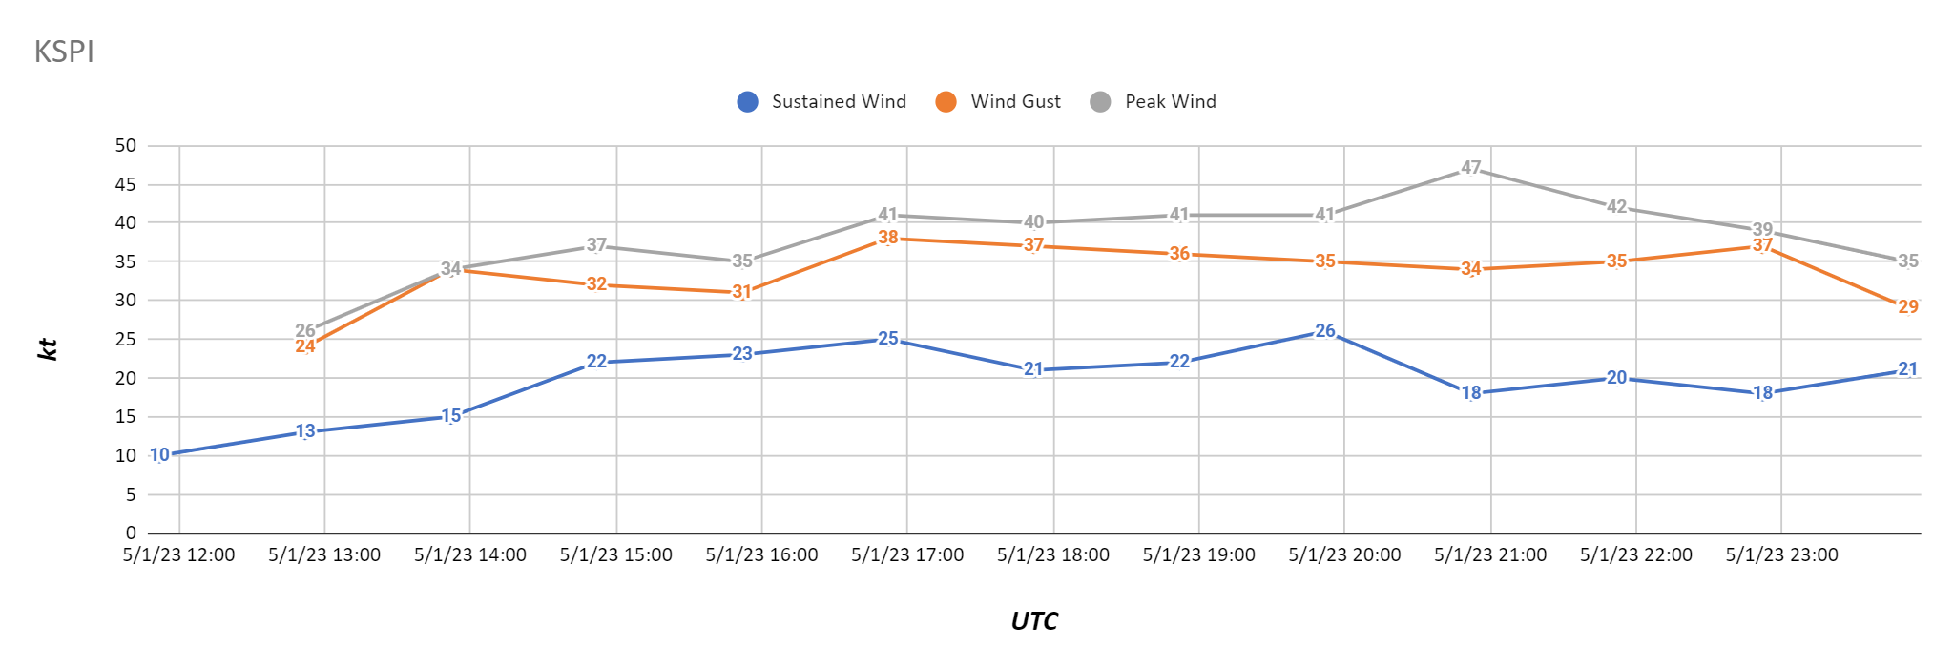
Synoptic-Scale Pattern
Northwesterly winds were sustained at 15 to 30 kt & occasionally gusted up to 30 to over 40 kt from around 14 to 23z 1 May.
A peak wind gust of 47 kt was measured at Springfield, IL (KSPI) around 21z.
But no ASOS or AWOS was properly positioned to capture diminished visibilities from blowing dust.

Slide 16
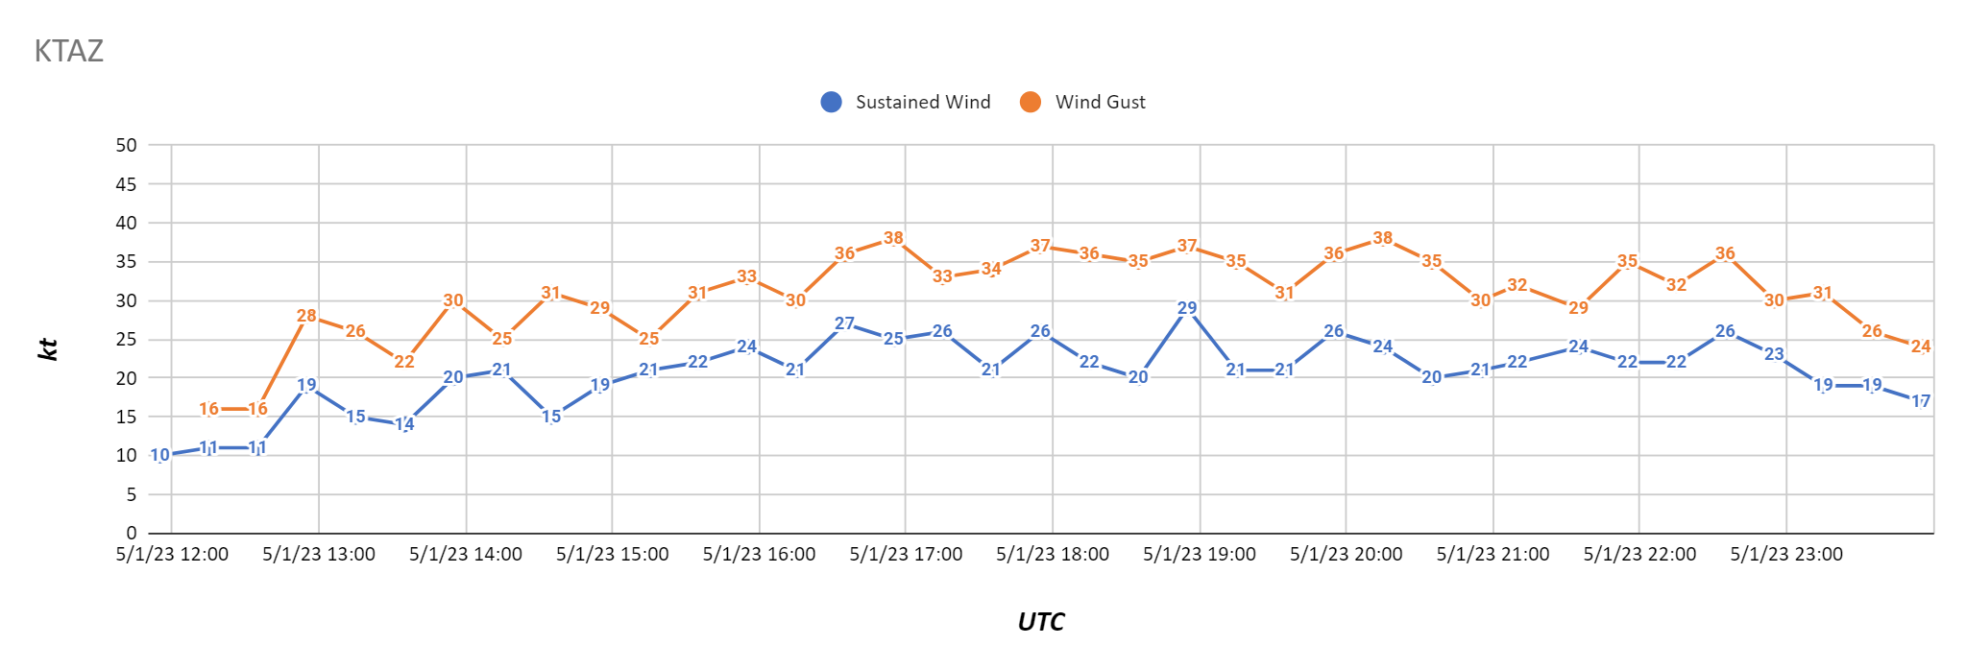
Synoptic-Scale Pattern
Northwesterly winds were sustained at 15 to 30 kt & occasionally gusted up to 30 to over 40 kt from around 14 to 23z 1 May.
A peak wind gust of 47 kt was measured at Springfield, IL (KSPI) around 21z.
But no ASOS or AWOS was properly positioned to capture diminished visibilities from blowing dust.

Slide 17
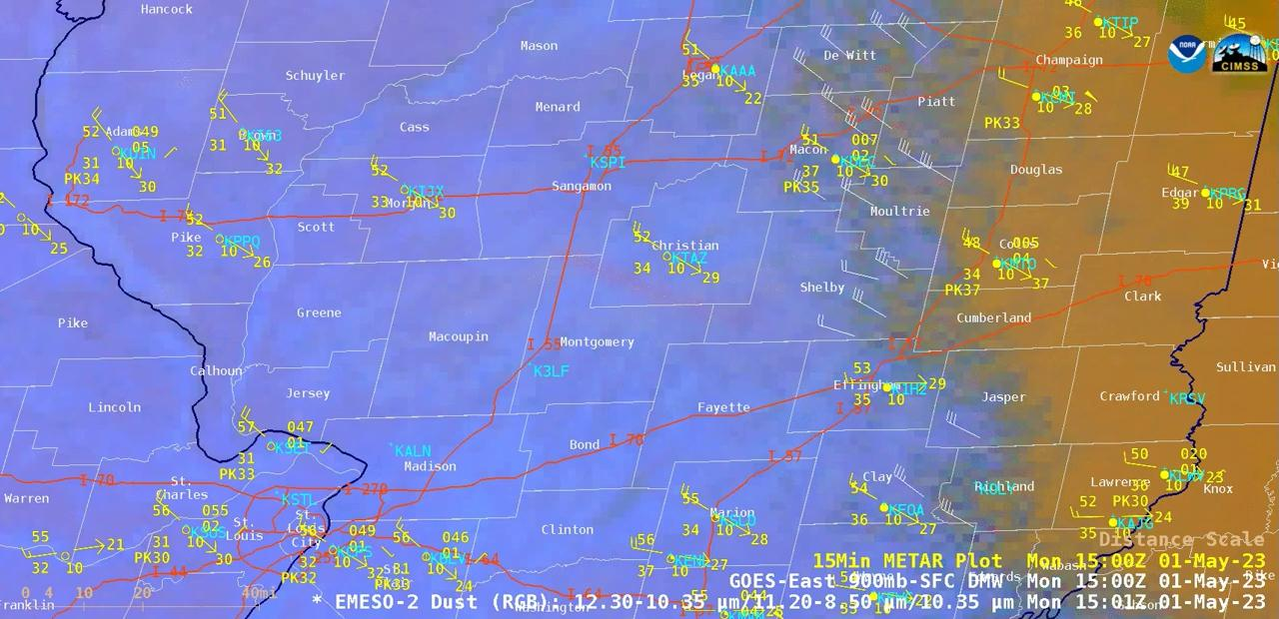
Satellite Depiction

Slide 18
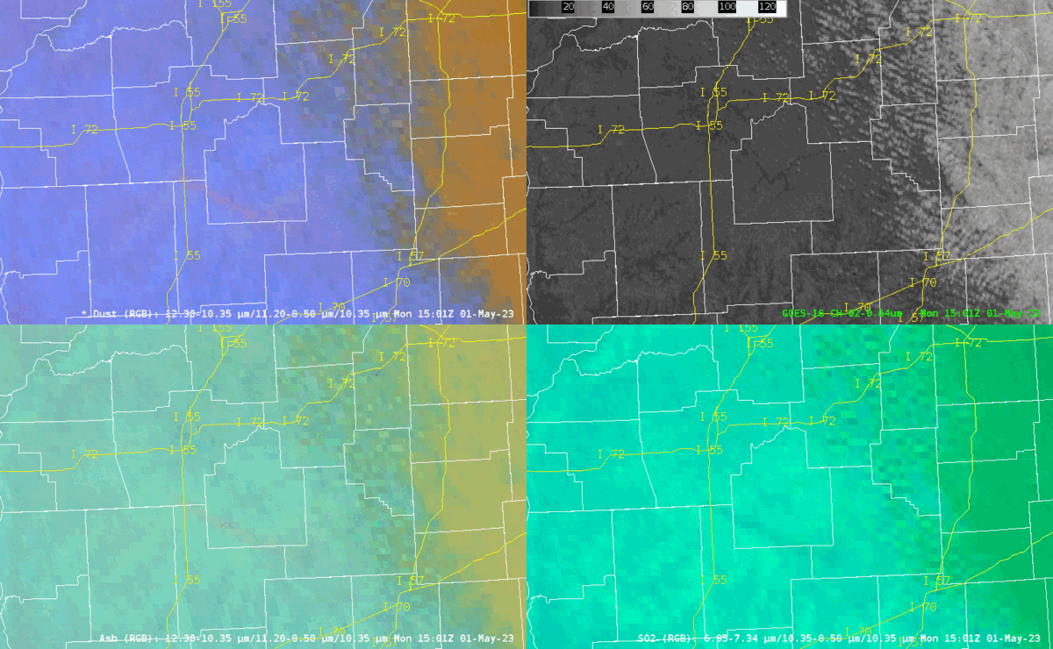
Satellite Depiction
Appropriately, the plumes of blowing dust were most apparent in the GOES-16 Dust RGB.
Additionally, the blowing dust can be detected in the ASH and SO2 RGBs but is not discernable in the visible imagery (Ch 2).
With blowing dust unexpected on 1 May, forecasters at both KILX & KLSX were not initially monitoring the Dust RGB.

Slide 19
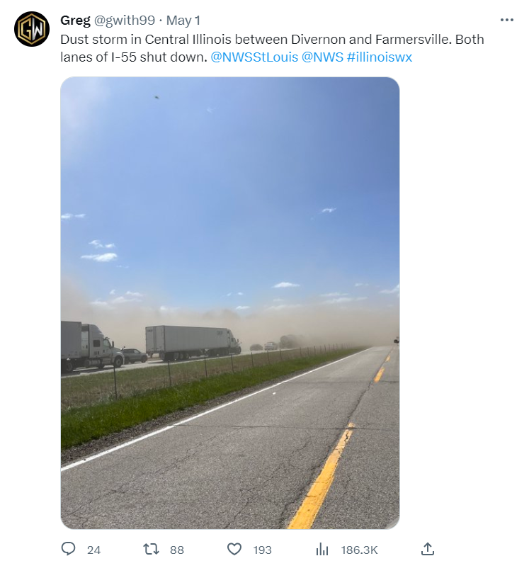
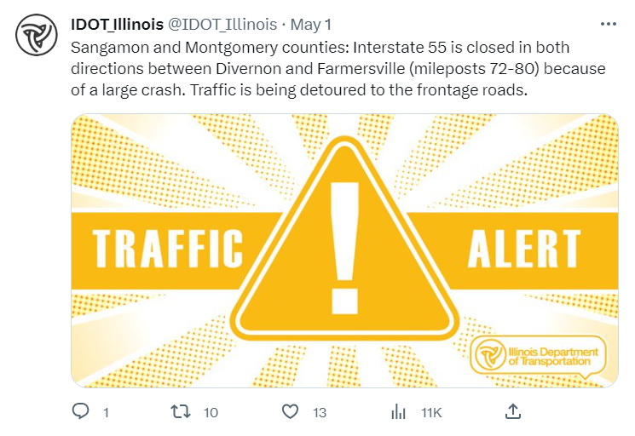
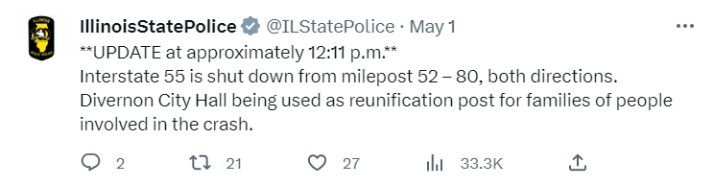
Reports From Twitter
Instead, initial reports received by KILX & KLSX between 1630 & 1730z were from Twitter, including the public, IDOT, & IL State Police.
By that time, SB & NB I-55 were already closed near the Sangamon-Montgomery County border, due to a large crash.

Slide 20
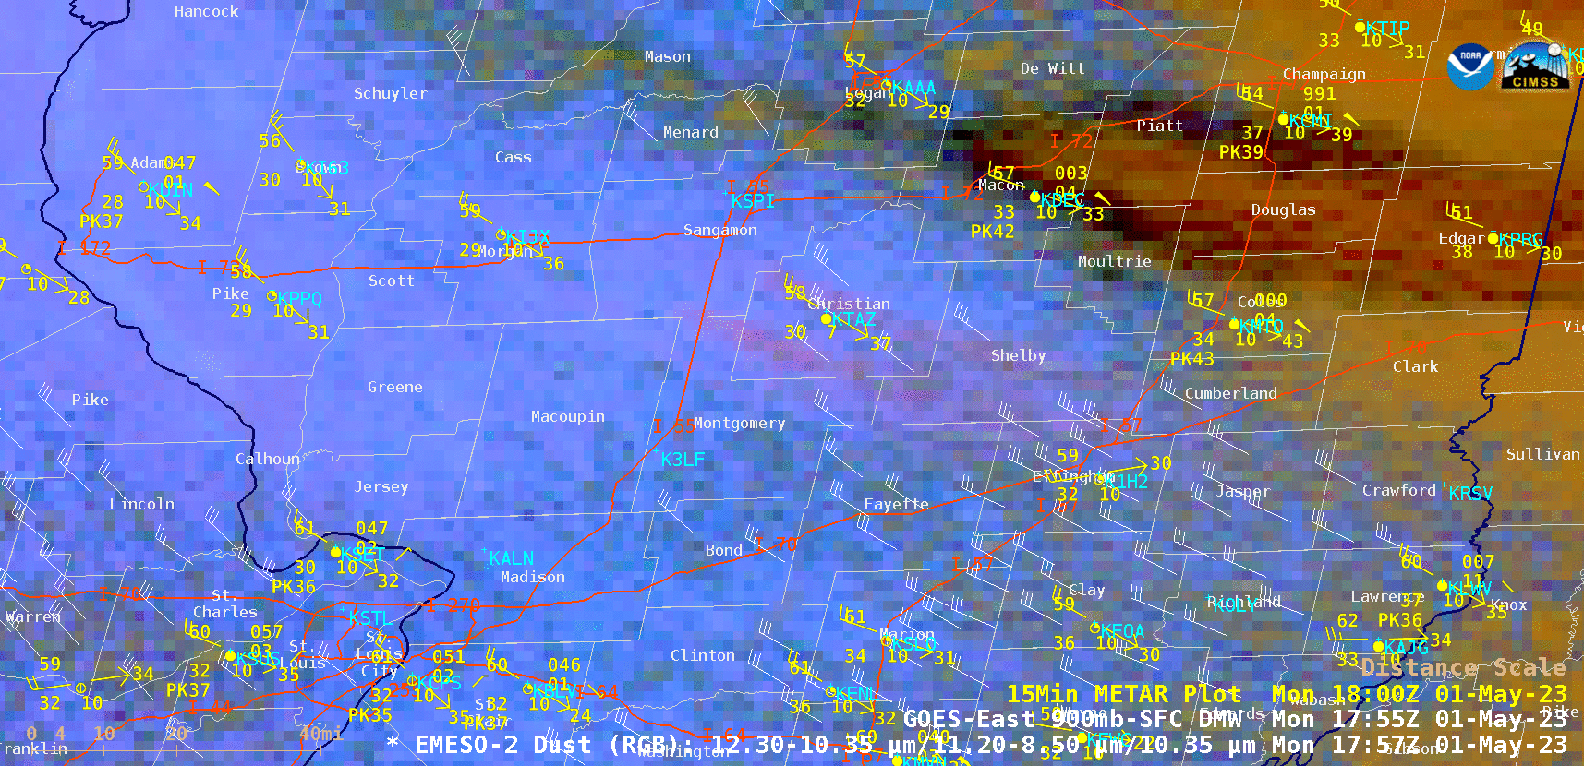
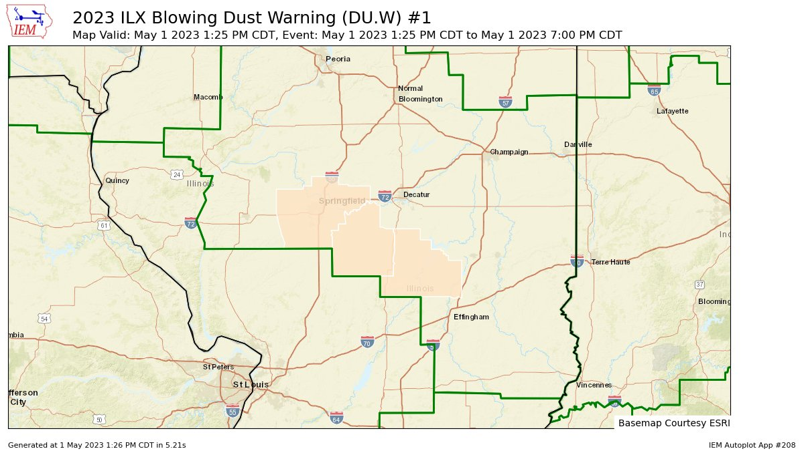
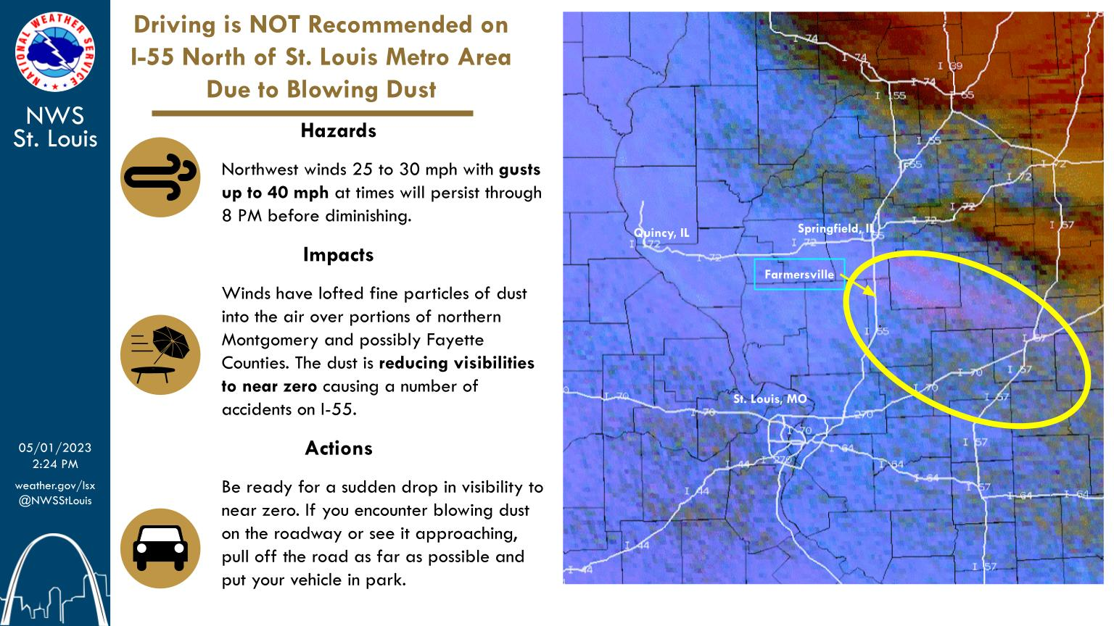
Product & Messaging Decisions
In reaction from the Twitter reports, KILX issued a Blowing Dust Warning & KLSX opted for public & partner messaging without product issuance.
Both courses of action leveraged the Dust RGB for locating & characterizing the plumes of blowing dust.

Slide 21
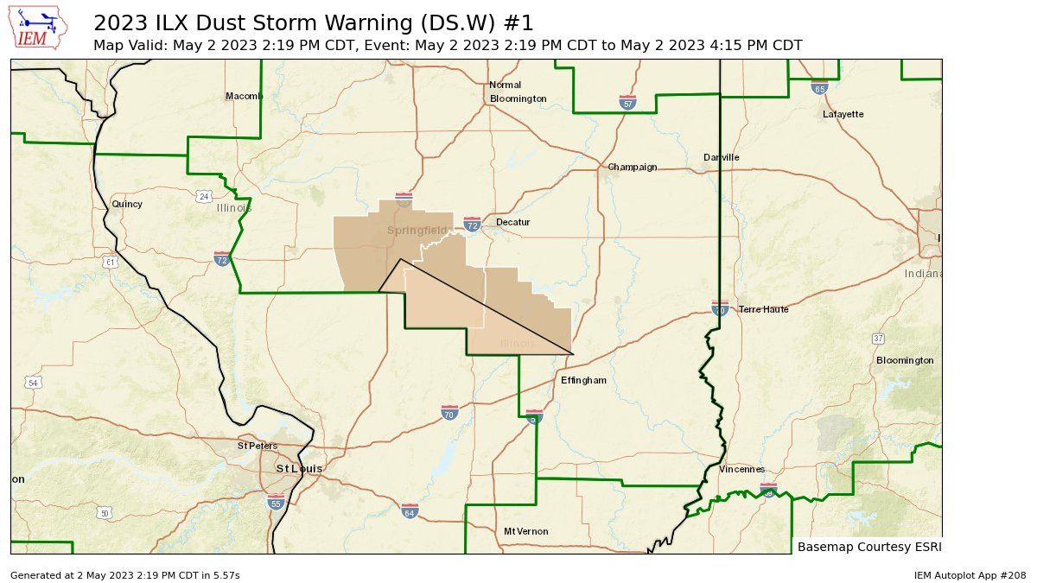
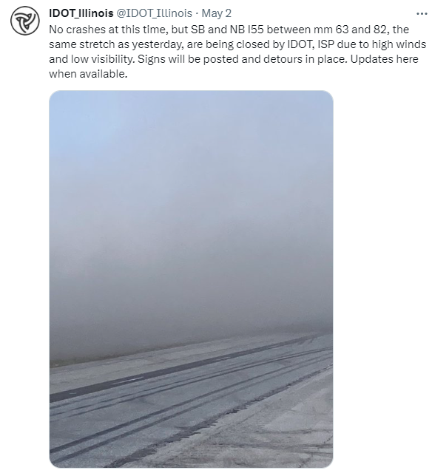
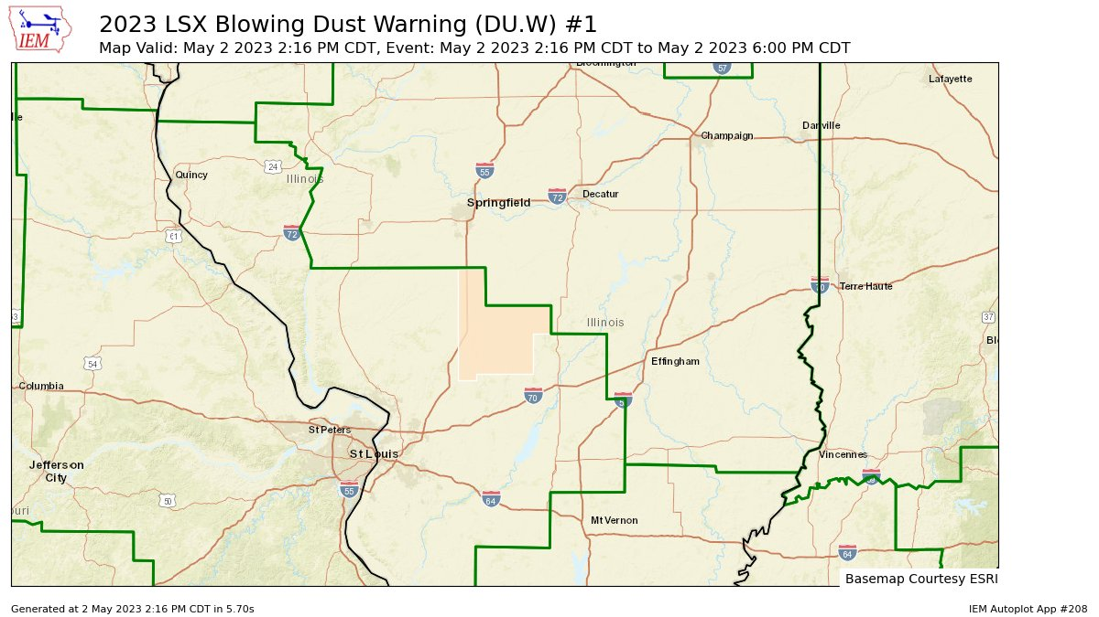
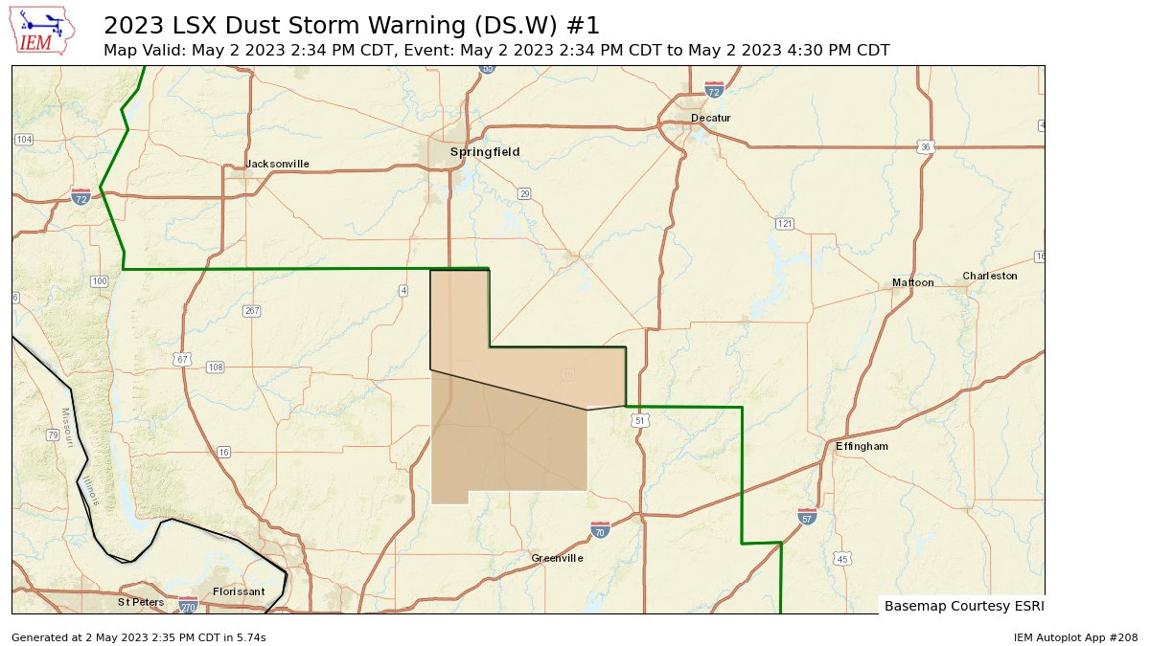
Blowing Dust Plume 2.0
May 2: Similar conditions occurred w/ high winds and low visibilities…in the same area.
To avoid another round of accidents, IDOT/IL State Police closed SB & NB I-55.
Dust RGB showed very little usefulness.
KILX & KLSX issued Dust Storm Warnings.

Slide 22
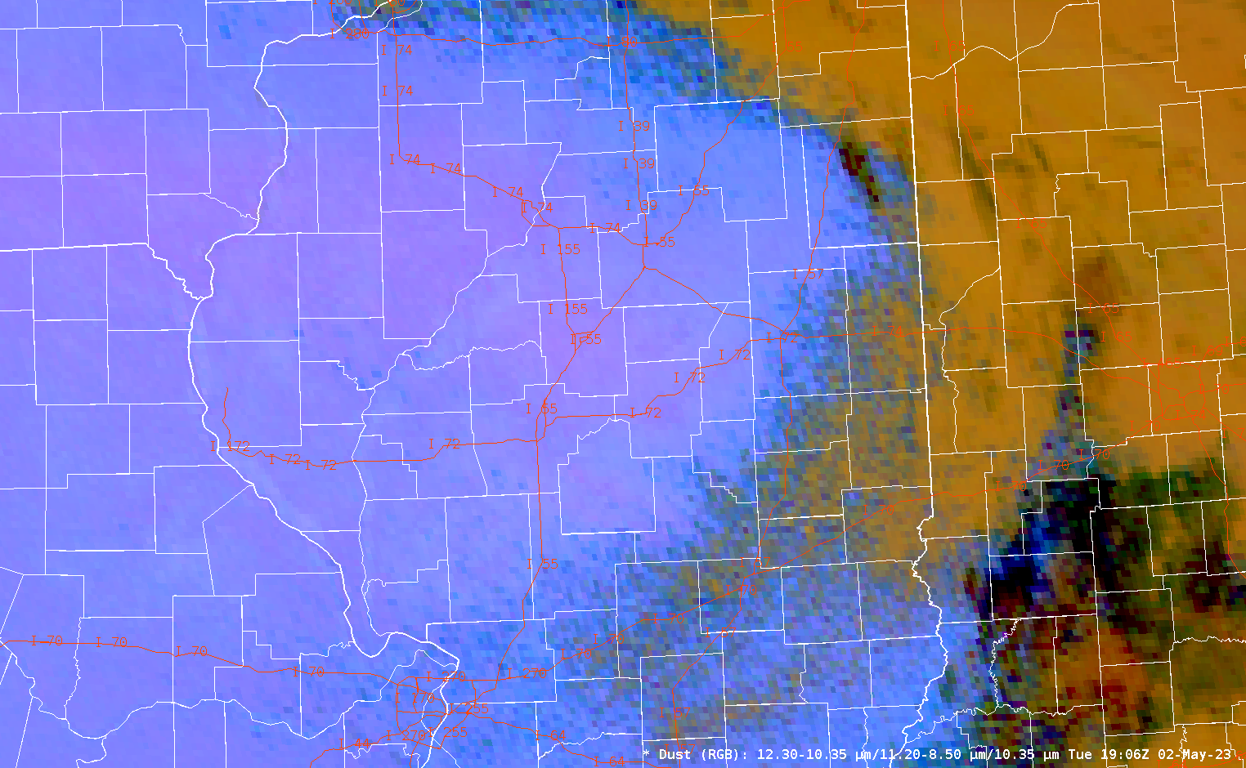
Blowing Dust Plume 2.0

Slide 23
Summary
Several factors contributed to the 1 May localized blowing dust across south-central IL
Freshly tilled dry soils in farm fields after an abnormally dry April,
Northwesterly winds sustained at 15 to 30 kt & gusting 30 to over 40 kt from a tightened surface pressure gradient & a boundary layer that was deeply mixed & superadiabatic.
  Other than a weak surface pressure trough, there were no notable surface features
The blowing dust was detectable by the GOES-16 Dust RGB
Initial reports were received via Twitter from the public, IDOT, & IL State Police
However, the Dust RGB proved helpful in locating & characterizing the blowing dust for subsequent product & messaging decisions.
Blowing dust occurred again on 2 May in the same area
IDOT & IL State Police closed I-55 in precaution, to avoid another day of accidents,
KILX & KLSX issued Dust Storm Warnings
The blowing dust was not discernible from the Dust RGB…possibly less severe.

Slide 24
Questions?
james.auten@noaa.gov | marshall.pfahler@noaa.gov

