Slide 1
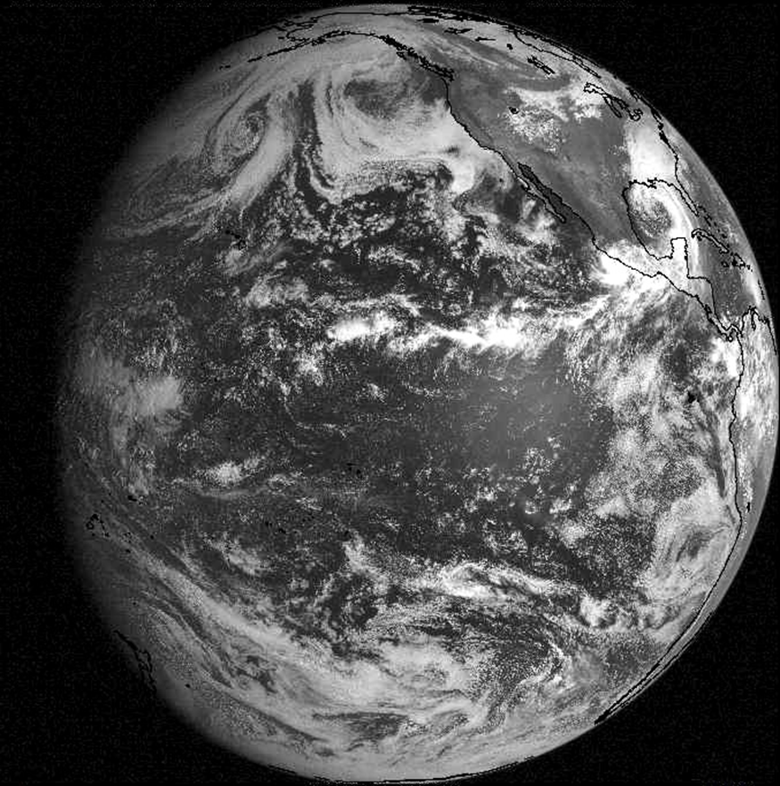
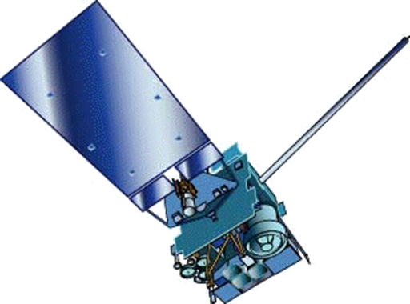
GOES-15 Becomes GOES-West
By Ross Van Til
NWS Training Division
Forecast Decision
Training Branch
Contributions by:
Brian Motta, FDTB
Tim Schmit, NESDIS
Natalia Donoho, NESDIS
Scott Bachmeier, CIMSS
Patrick Dills, COMET
Notes:
On December 6, 2011, the GOES-15 Satellite replaces GOES-11 as the operational GOES-West Satellite covering Western North America and the Eastern Pacific. This short training session will highlight the primary operationally significant changes associated with this transition.

Slide 2
Learning Objectives
Recognize that GOES-West is transitioning from GOES-11 to GOES-15
Distinguish the differences between GOES-11 and GOES-15 water vapor imagery
Recognize that a new 13.3 um IR “CO2” channel is available from GOES-15
Describe additional image frames available from GOES-15
Notes:
Learning objectives for the training are…

Slide 3
Performance Objectives
Utilize higher resolution Water Vapor imagery
Illustrate applications of 13.3 um IR channel
Examine additional frames produced by the GOES-West Routine and Rapid scanning schedules
Apply enhanced imagery from GOES-15 operationally
Notes:
Performance objectives for the training are…

Slide 4
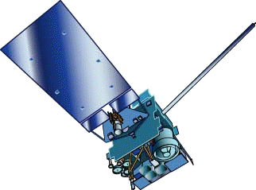
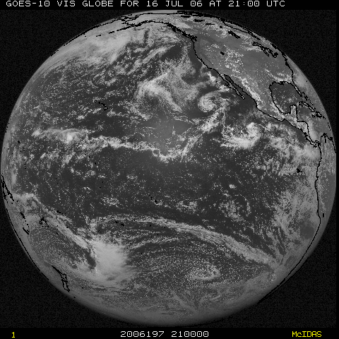
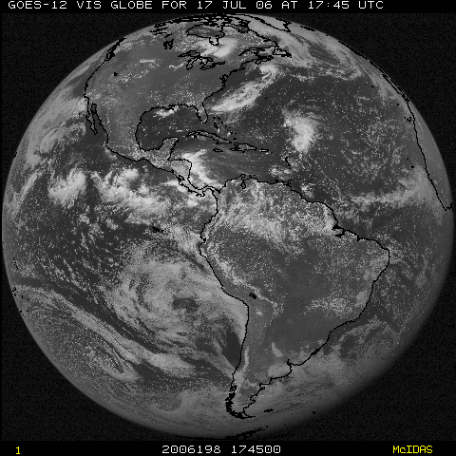
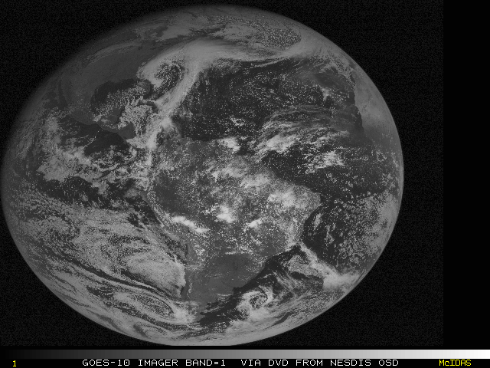
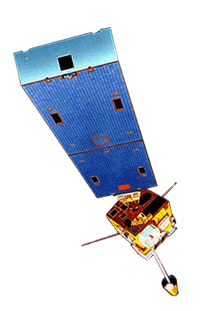
GOES Constellation
GOES-West
GOES-15
(135W)
GOES-East
GOES-13
(75W)
GOES-14
(105W)
Storage
GOES-12
(60W)
South America
Notes:
To quickly review the configuration of the two geostationary satellites utilized in North America, GOES-East, which is currently the GOES-13 satellite, is positioned above the equator at 75 degrees W, while GOES-West is above the equator at 135 degrees W. In addition, GOES-12 provides coverage for South America from 60W, and GOES-14 is currently in storage at 105W. To maintain their geostationary orbits, GOES satellites fly at 22,300 miles above the earth’s surface. GOES-15 was launched in March 2010, and was tested while positioned at 89.5W.

Slide 5
GOES-West Transition Timeline
October 17, 2011 - Start GOES-15 westward drift from 89.5 W to 135 W (0.78 degrees/day)
December 6, 2011 - Near 129 W, GOES-15 becomes GOES-West at 1550Z (data relayed through GOES-11)
December 14, 2011 - Stop GOES-15 drift at 135W (data acquired directly from GOES-15)
December 15-16, 2011 - GOES-11 decommissioned / de-orbit maneuvers
Notes:
Here is the timeline for GOES-West’s transition from GOES-11 to GOES-15…
This approach minimizes impact to users, and was followed successfully for previous GOES transitions, including the GOES-West transition from GOES-10 to 11 in June 2006, and for the GOES-East transition from GOES-12 to 13 in April 2010. In case a critical weather day is declared for December 6, the backup date for GOES-15 to become GOES-West is December 7.

Slide 6
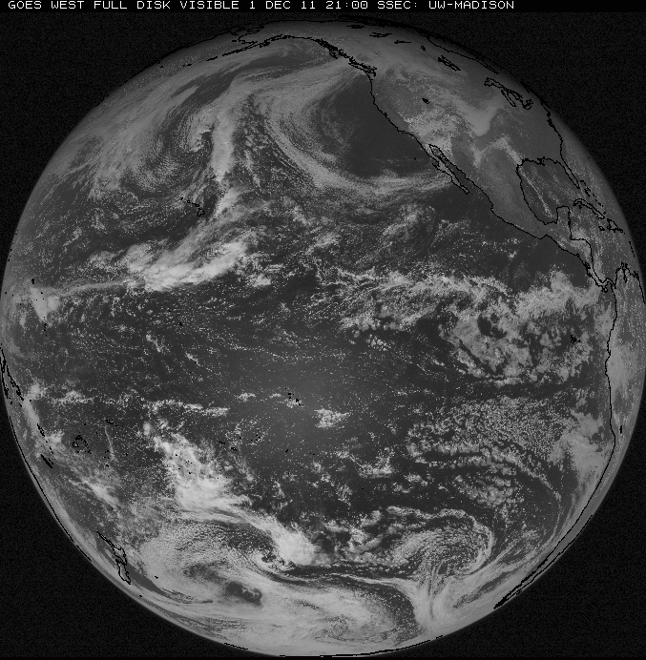
GOES West Field of View
Notes:
In North America, GOES-West is the primary geostationary satellite for areas west of approximately 105 degrees W. GOES-West imagery can be used for areas farther to the E, especially in the event of a GOES-East outage, but the viewing angle becomes increasingly severe as you continue E.

Slide 7
GOES-11/15 – Primary Differences
Higher Resolution Water Vapor Imagery
New 13.3 um IR “CO2” Channel (replaces 12 um channel)
All IR channels with 4km resolution and improved calibration
Improved Visible Imagery
Improved Pixel Geolocation
Minimized Spring/Fall Eclipse Outages
Augmented Scanning Schedule
Notes:
While much with GOES-West will remain virtually unchanged through this transition, there are several differences between the GOES-11 and GOES-15 imaging instruments that operational forecasters should be aware of. In the following slides, we’ll cover…

Slide 8
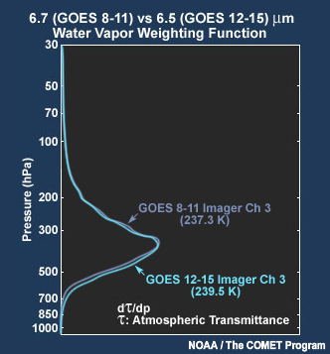
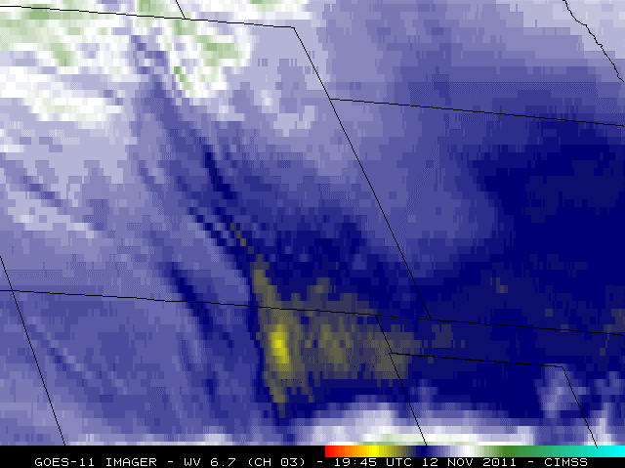
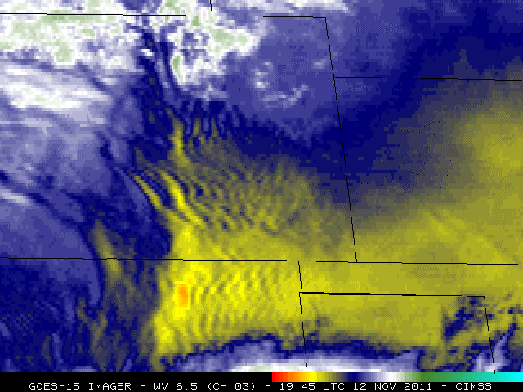
Higher Resolution Water Vapor Imagery
4km resolution instead of 8km with GOES-11
CIMSS Satellite Blog for mountain wave example
GOES-15 “sees” slightly lower in atmosphere where clear
Notes:
Likely the most important enhancement provided by GOES-15 is the enhanced resolution water vapor imagery. As can be seen in this example, the imagery from GOES-15 with 4km spatial resolution is vastly superior to the 8km GOES-11 imagery for revealing mountain waves over Southern Colorado and Northern New Mexico. More information on this example can be found in this CIMSS Satellite Blog entry: http://cimss.ssec.wisc.edu/goes/blog/archives/9158
The Spectral range of the GOES-11 water vapor channel is from 6.47-7.02um, while GOES-15’s spectral range is wider at 5.77-7.33um. This results in GOES-15 “seeing” a slightly lower and deeper layer of the atmosphere. In clear areas, this also results in the GOES-15 imagery appearing approximately 2 degrees C warmer on average than GOES-11.

Slide 9
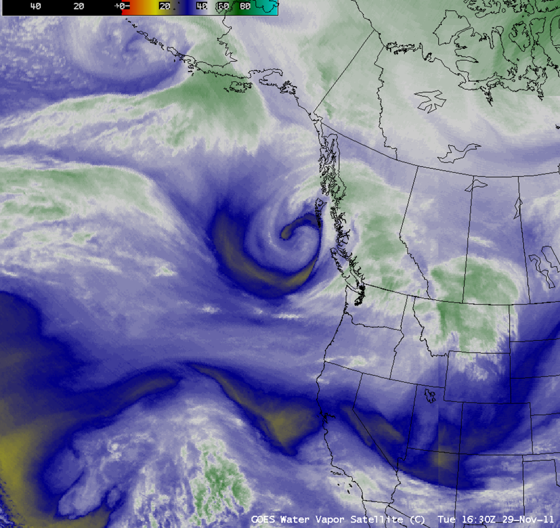
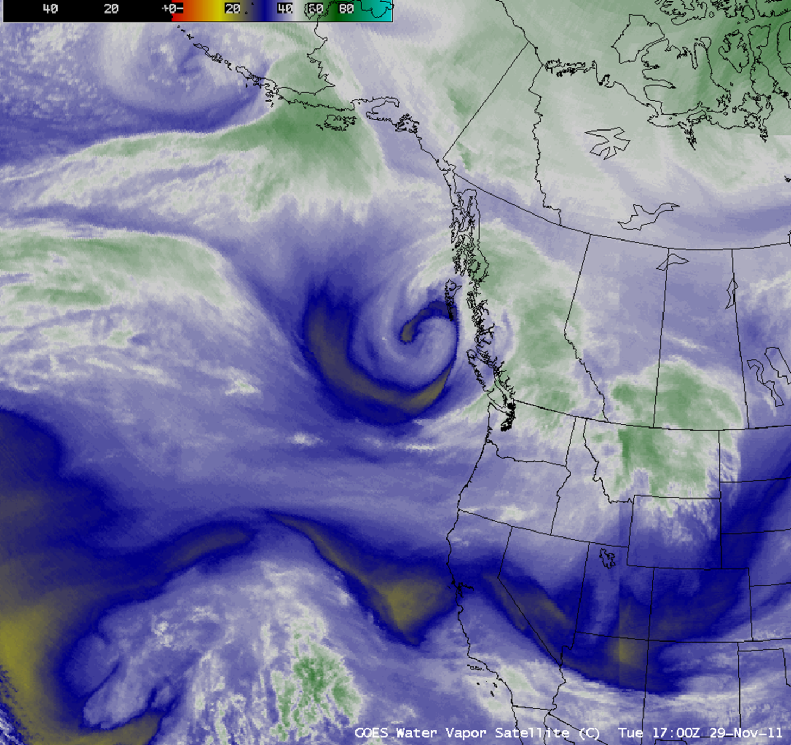
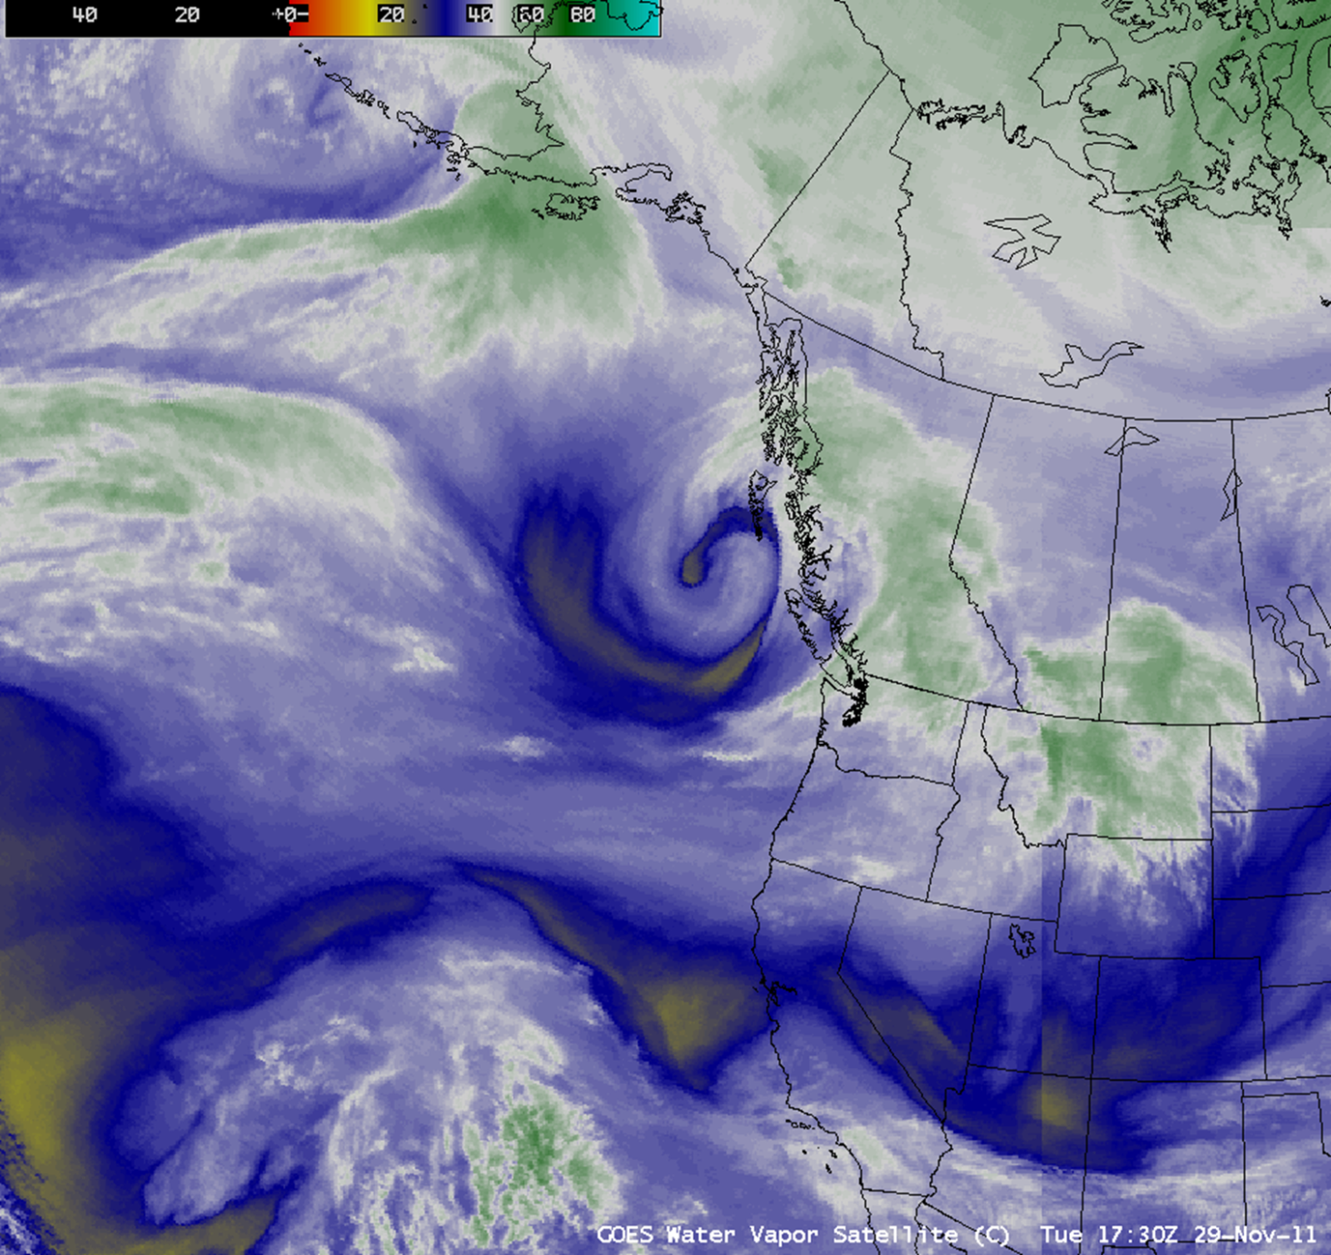
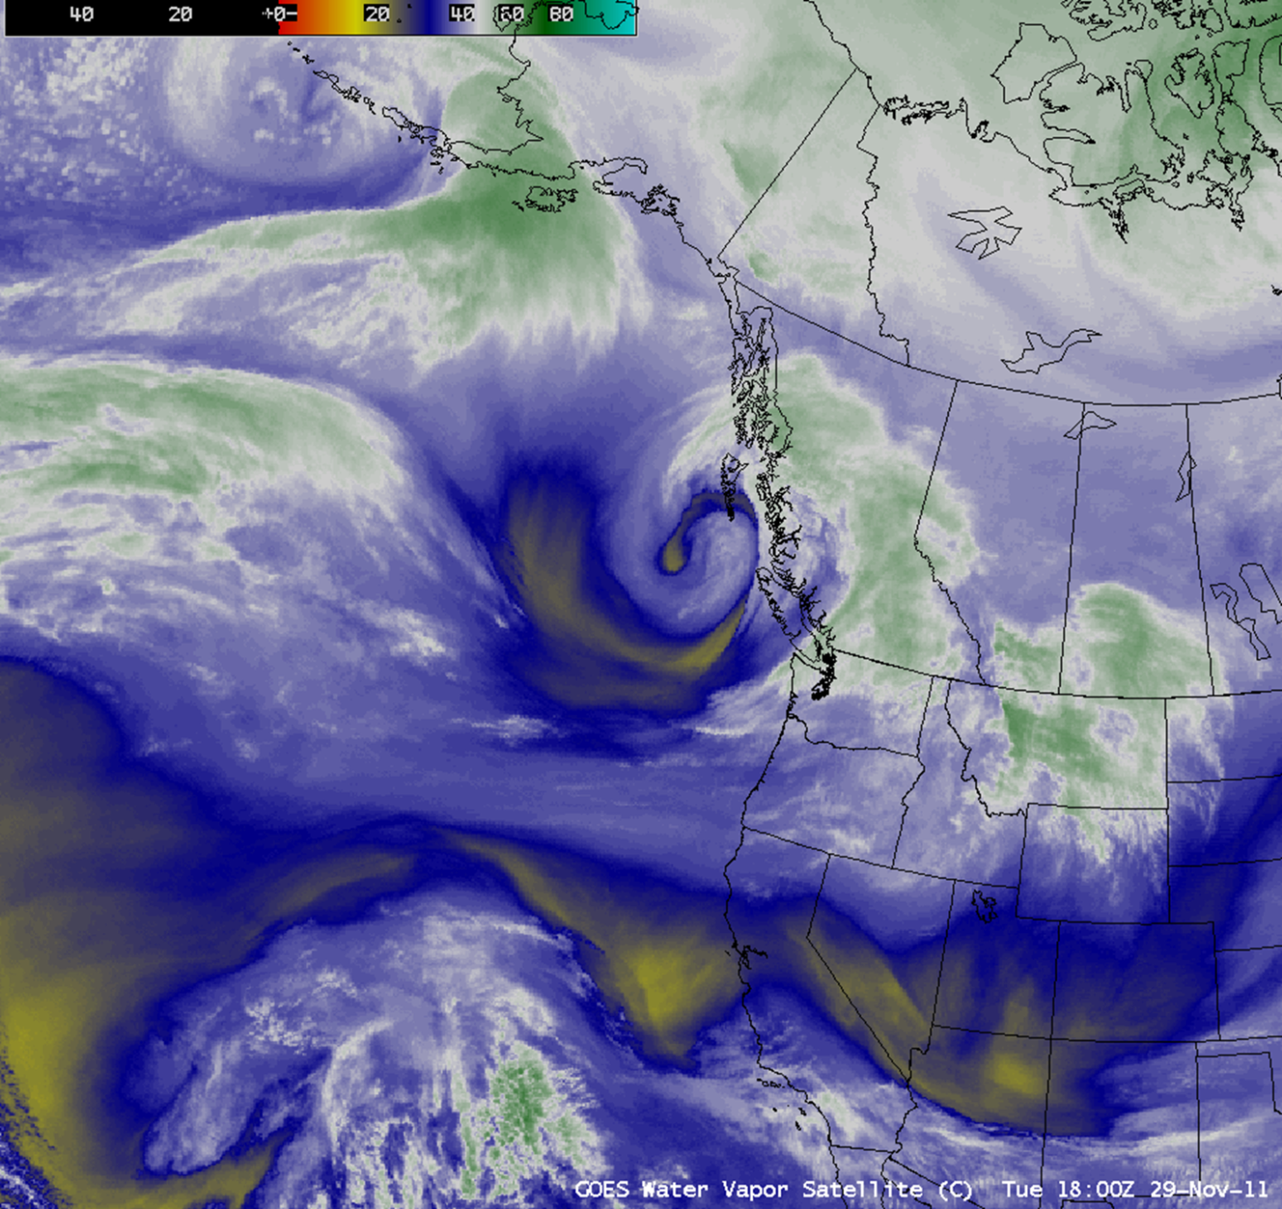
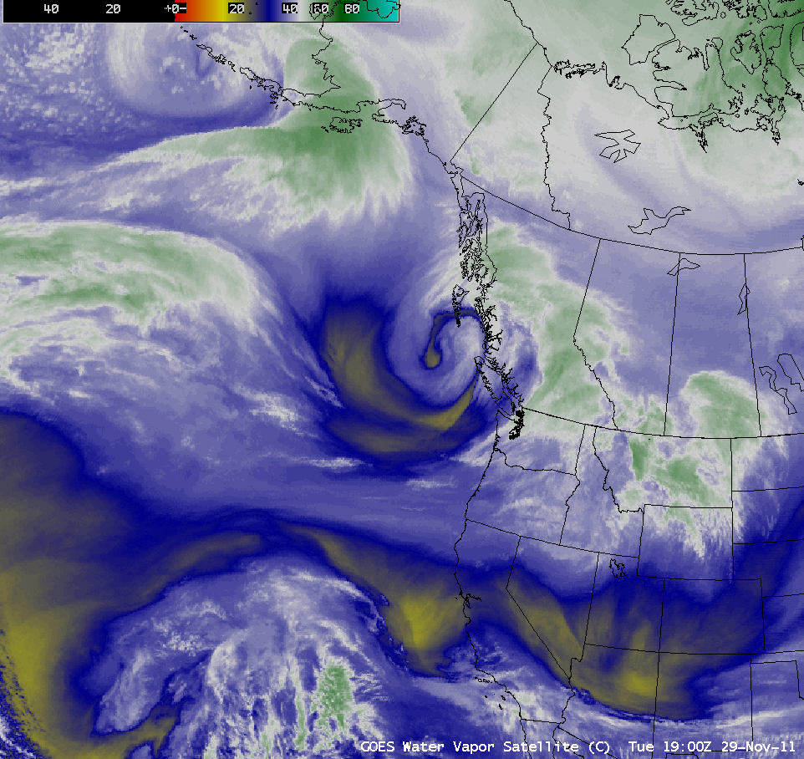
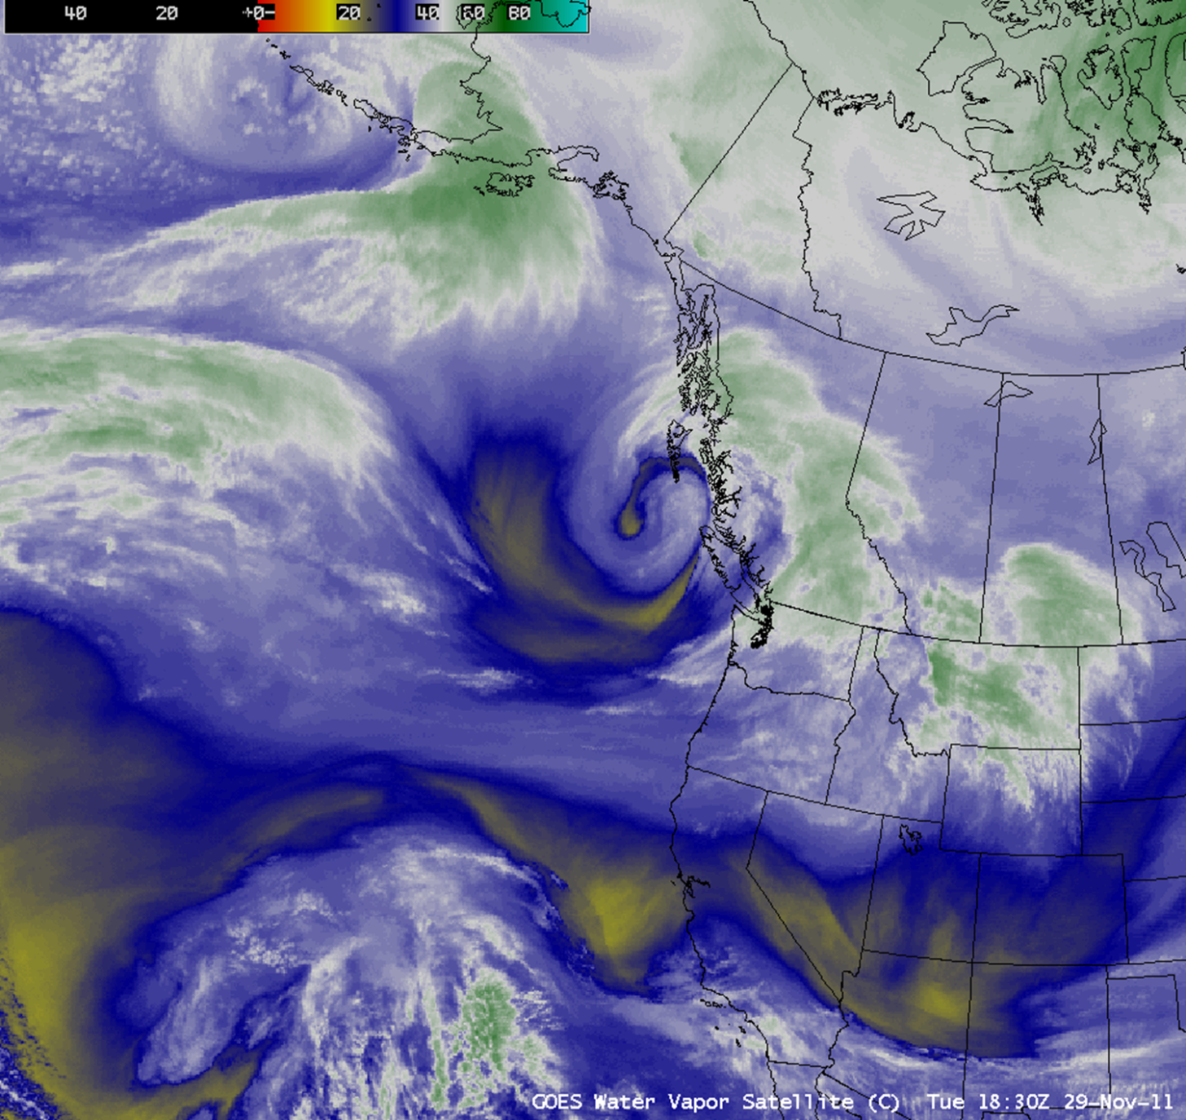
GOES-11/15 Water Vapor Comparison
Notes:
This animation shows three frames from GOES-11 followed by three frames from GOES-15. The warmer signal with the GOES-15 imagery in cloud-free areas can clearly be noted.

Slide 10
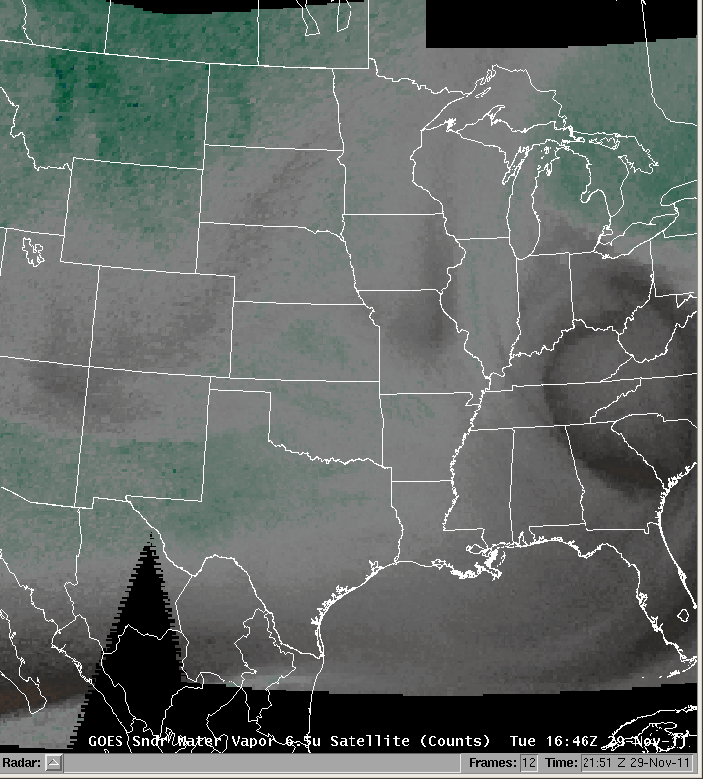
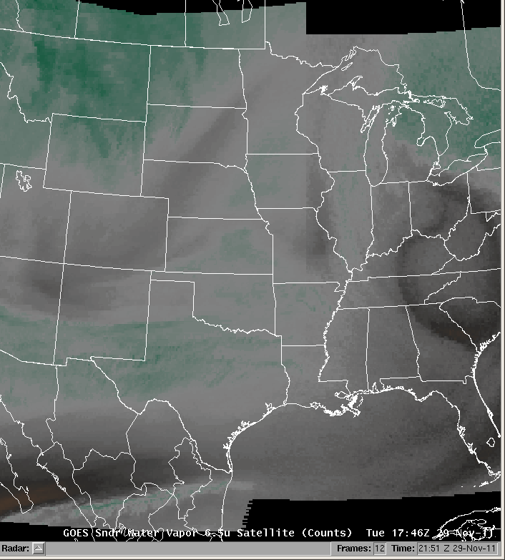
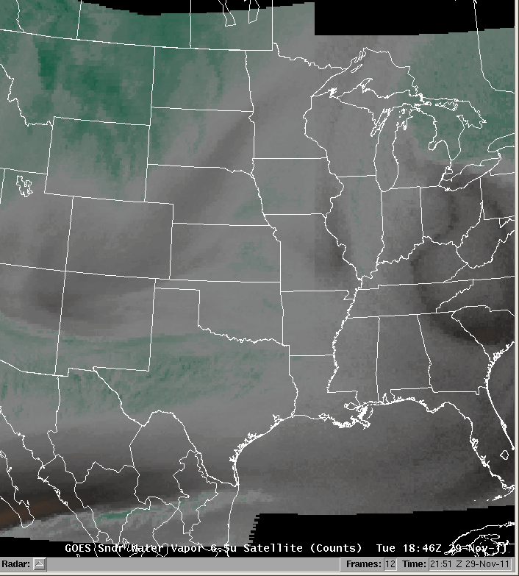
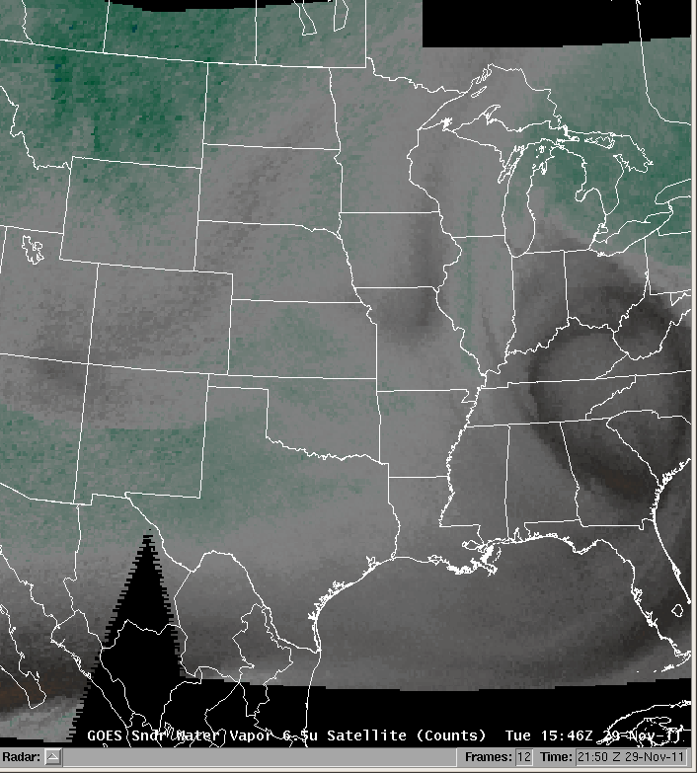
GOES Sounder Water Vapor Imagery
GOES-11
GOES-15
GOES-13
Notes:
In addition, water vapor imagery from the GOES-15 Sounder is significantly less noisy. Keep an eye on the left side of the animation for a significant improvement from GOES-11 to GOES-15.

Slide 11
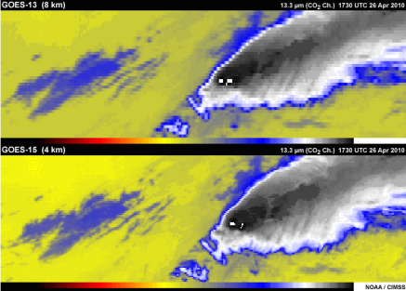
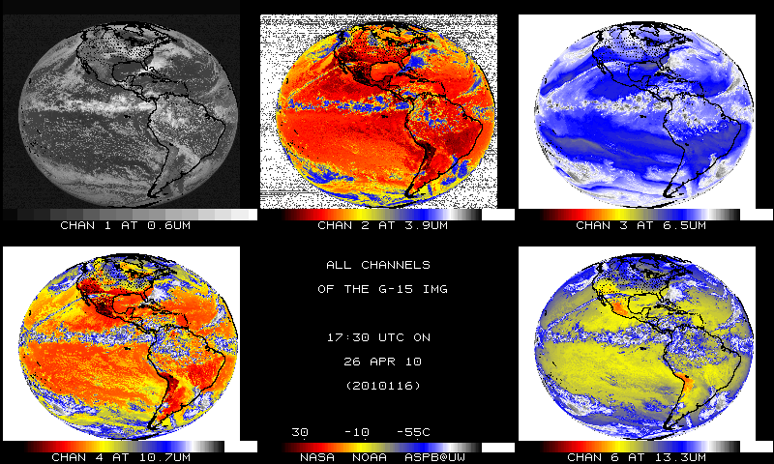
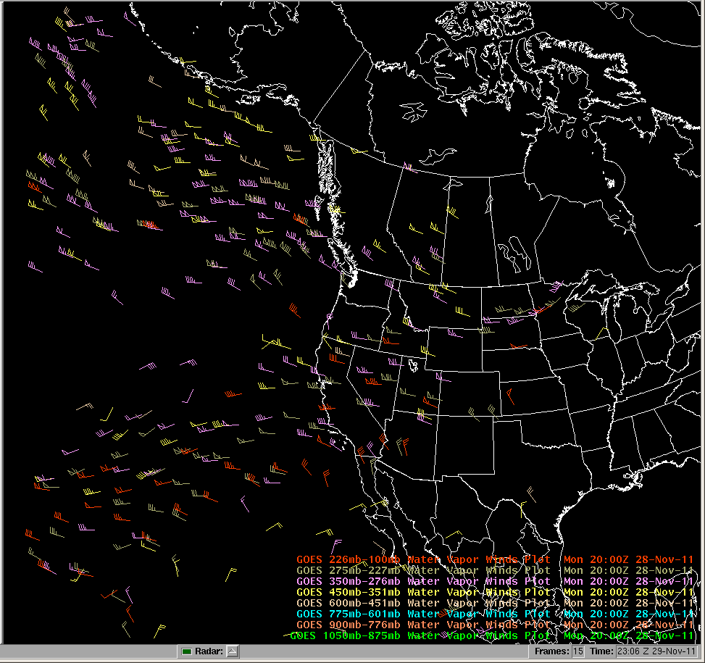
New 13.3 um IR “CO2” Channel
Replaces 12 um channel on GOES 11
Optimal for cloud height assignment technique
Longwave IR difference can show volcanic ash
Accessed from “12u” in AWIPS Satellite Menu
See COMET’s GOES Channel Selection V2 module for more information
All GOES-15 IR Channels
  4km resolution
  Improved calibration (less noise)
Notes:
With GOES-West’s transition to GOES-15, the 12 um IR “dirty window” channel has been replaced by a 13.3 um IR “CO2” channel. CO2 in the atmosphere is a significant attenuator and emitter of IR radiation in this spectral range around 13.3 um.
The current GOES-East satellite, GOES-13, also has this 13.3 um channel, but GOES-15 (and 14) provide 4km spatial resolution as opposed to 8km for GOES-13. Improved cloud top height estimates can be derived using this channel in concert with the 10.7 um longwave IR channel. As a result, height assignment for atmospheric motions vectors will benefit. The 13.3 um channel can also be used for volcanic ash detection.
For now, the 13.3 um imagery will be accessed in the AWIPS satellite menu from the “12u” menu selection. GOES-R will have an expanded suite of 16 imaging channels, including both the 12 um and 13.3 um channels.
In addition, all IR channels on GOES-15 feature improved calibration, which results in less noise within the imagery (due to colder detectors). This improvement is especially noticeable with 3.9 um imagery for cold scenes at night.
For more information on this new 13.3 um channel, please see the “Carbon Dioxide (GOES 12-15)” section of COMET’s “GOES Channel Selection V2” module.

Slide 12
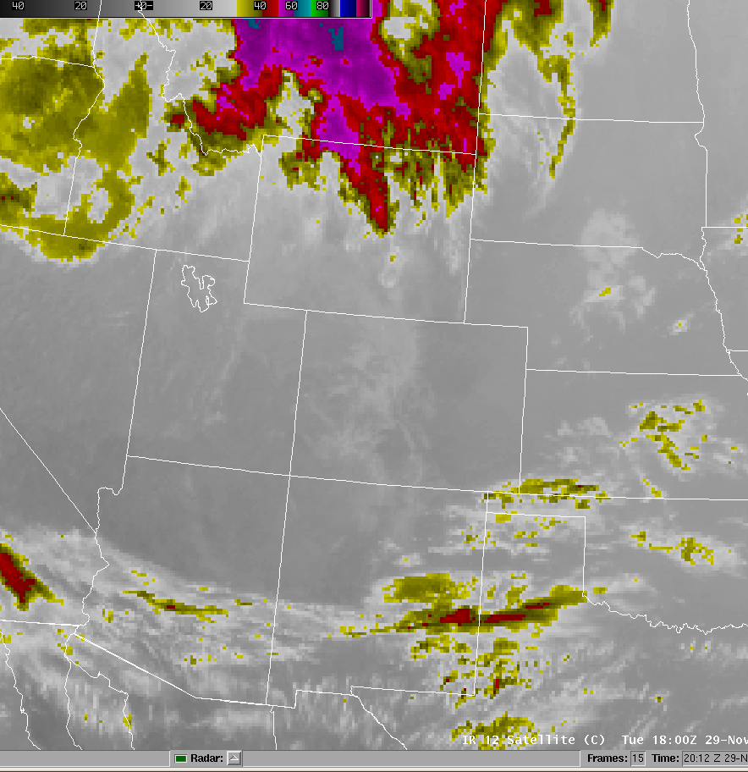
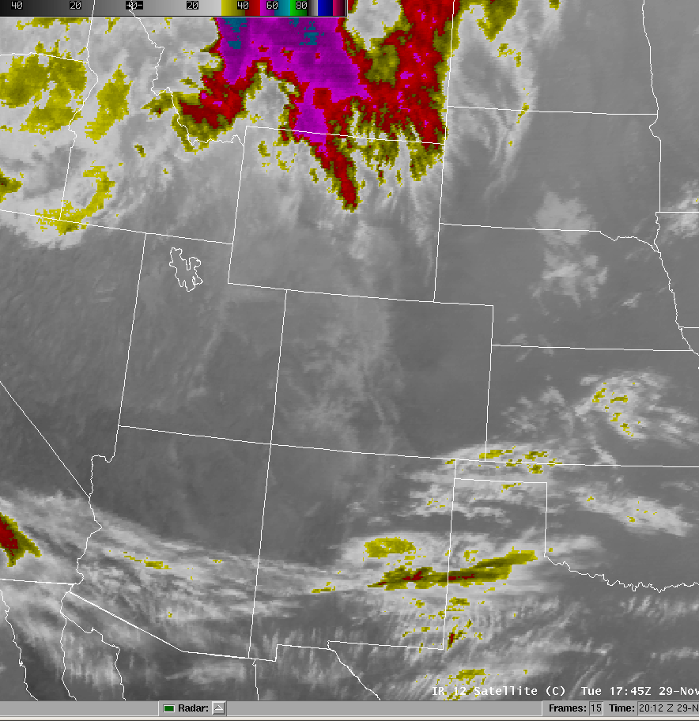
12 um vs. 13.3 um Comparison
Notes:
The 13.3 um channel from GOES-15 is more sensitive to high clouds and less sensitive to low clouds and surface features as compared to the 12 um channel from GOES-11. IR emission from CO2 partially masks the low-level and surface features with the 13.3 um imagery.

Slide 13
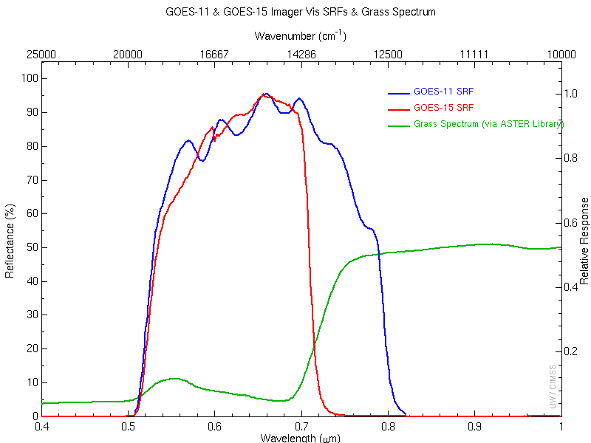
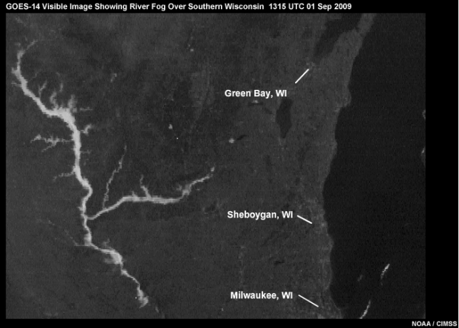
Improved Visible Imagery
Narrower spectral window
  Enhanced surface feature contrast
  Vegetation appears darker
Reduced Noise
Brighter Imagery (signal from GOES-11 has decreased over time)
“Linear” AWIPS/D2D enhancement may be helpful for ID of subtle features especially early/late in day
Notes:
Spectral range of the GOES-11 visible channel is from 0.52-0.8 um, while GOES-15’s spectral range is somewhat narrower at 0.52-0.71 um. Since green vegetation becomes significantly more reflective between 0.71 and 0.8 um, the range covered by GOES-11 but not by GOES-15, it appears darker in the GOES-15 imagery. This results in green vegetation having more contrast with urban and non-vegetated areas (which appear lighter) in the GOES-15 (and GOES-14) imagery. In turn, contrast between vegetation and water’s typically dark surface is reduced. In addition, the visible imagery from GOES-15 has an overall brighter and less noisy appearance. All of this in combination yields better detection of small and fine-scale cloud patterns, such as valley fog.
With GOES-15 visible imagery, the “Linear” AWIPS/D2D enhancement may be helpful for ID of subtle features especially early/late in day. The “CA (low light vis)” enhancement may also be helpful.

Slide 14
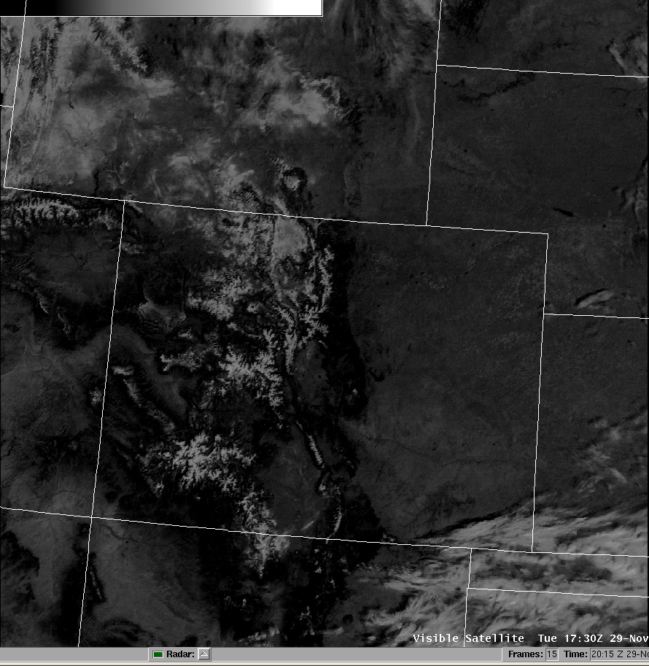
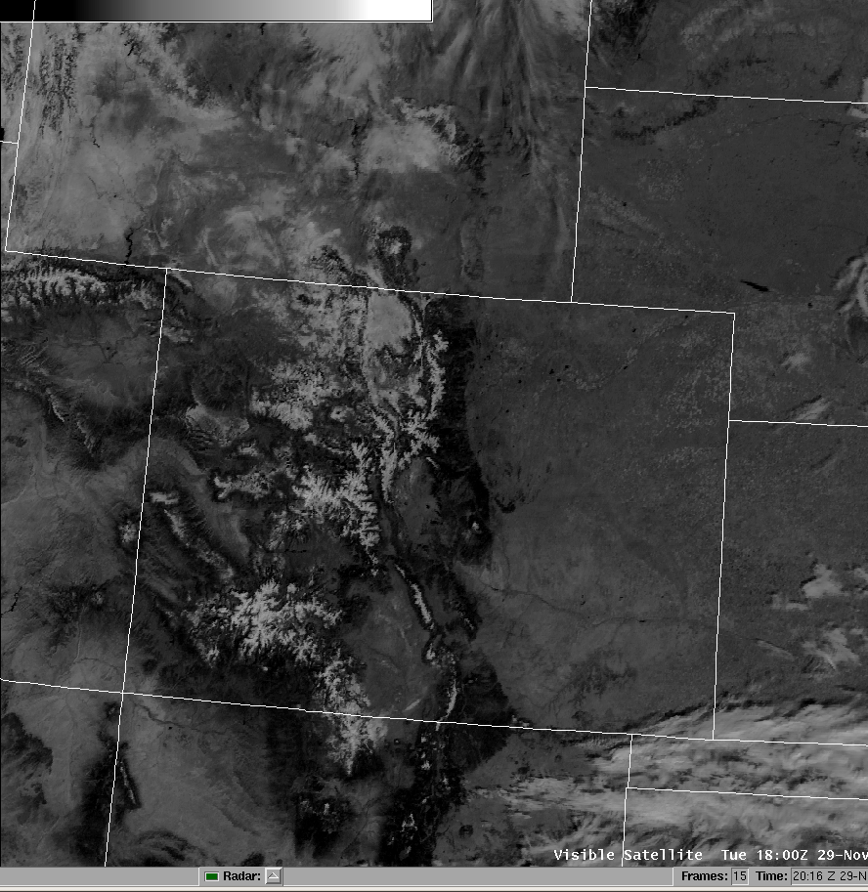
GOES-11/15 Visible Comparison
Notes:
In this comparison, the brighter appearance of the GOES-15 visible imagery is apparent.

Slide 15
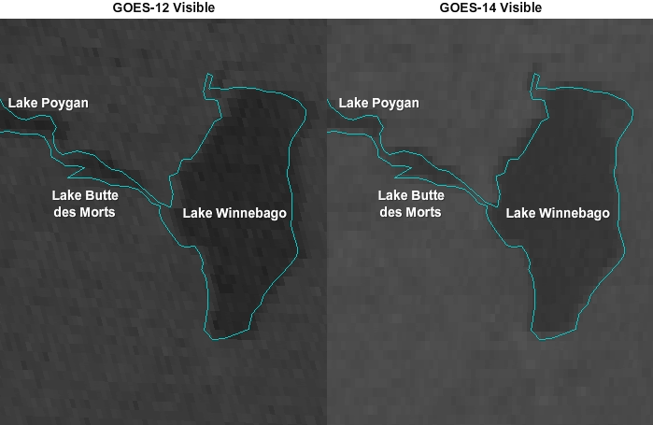
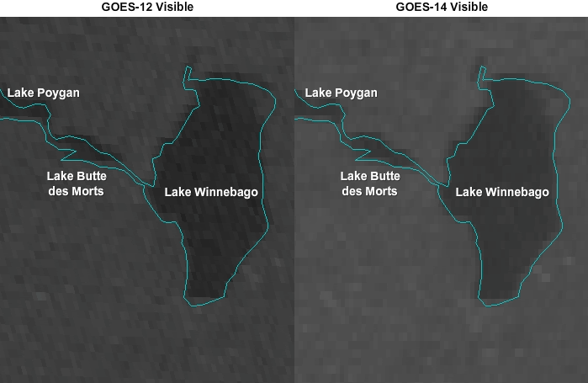
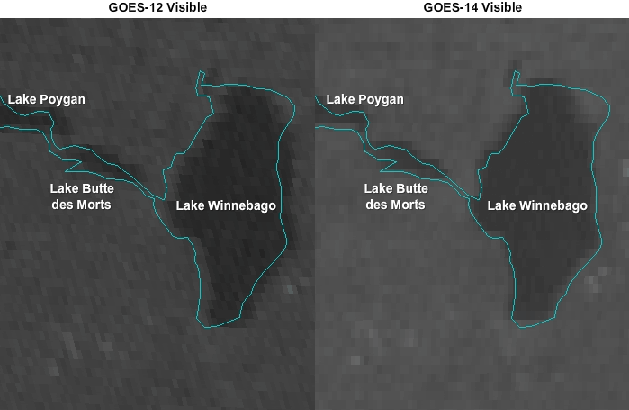
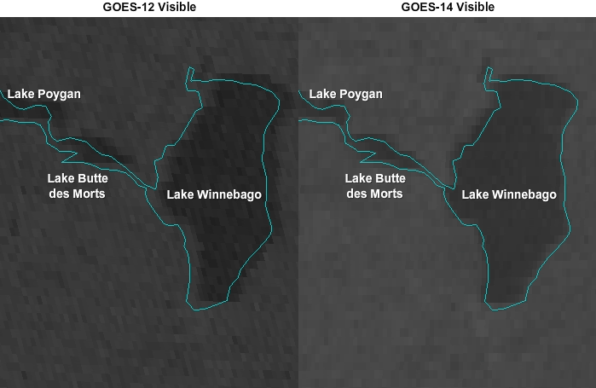
Improved Pixel Geolocation
Notes:
GOES-15 has an enhanced image navigation and registration system. As a result, image to image shifting of fixed surface features is greatly reduced with GOES-15 (and GOES-14) as seen in this loop.

Slide 16
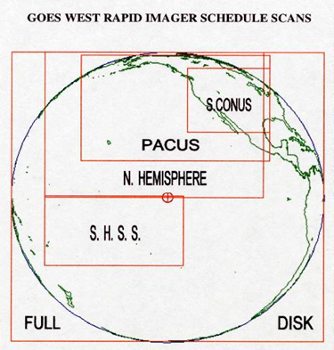
GOES-West Frame Additions
NEW GOES-15 West Routine (WRTN) schedule
New images with ROUTINE SCHEDULE:
UTC TIME SCAN SECTOR
xx:10 (Each non-full disk hour) SUB-CONUS
xx:40 (Each hour) SUB-CONUS
NEW GOES-15 West Rapid (WRAP) schedule
Additional images per hour with RAPID SCHEDULE:
UTC TIME SCAN SECTOR
xx:54 SUB-CONUS xx:57 SUB-CONUS
Notes:
With the new GOES-15 West Routine schedule, additional “sub-CONUS” scale image will be provided at 10 and 40 minutes after each hour, except when full disk images are taken every three hours, in which case only the additional image at 40 minutes after the hour is produced. These additional images cover the same sector as those provided when GOES-11 was in rapid-scan operations.
When GOES-15 goes into rapid-scan, an additional pair of sub-CONUS images will be provided at 54 and 57 minutes after the hour. This means two more images per hour as compared to when GOES-11 was in rapid scan.

Slide 17
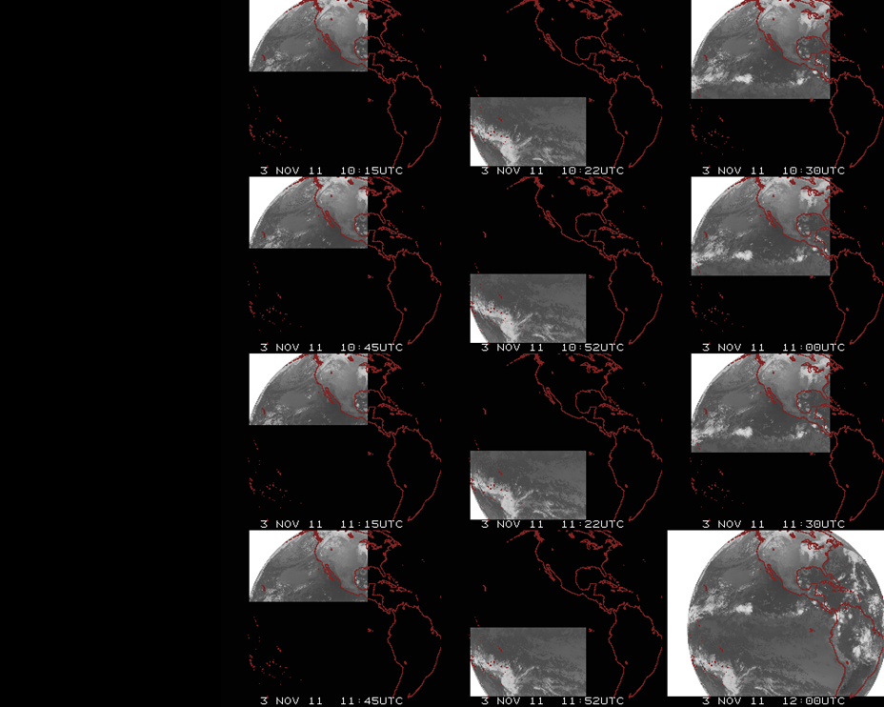
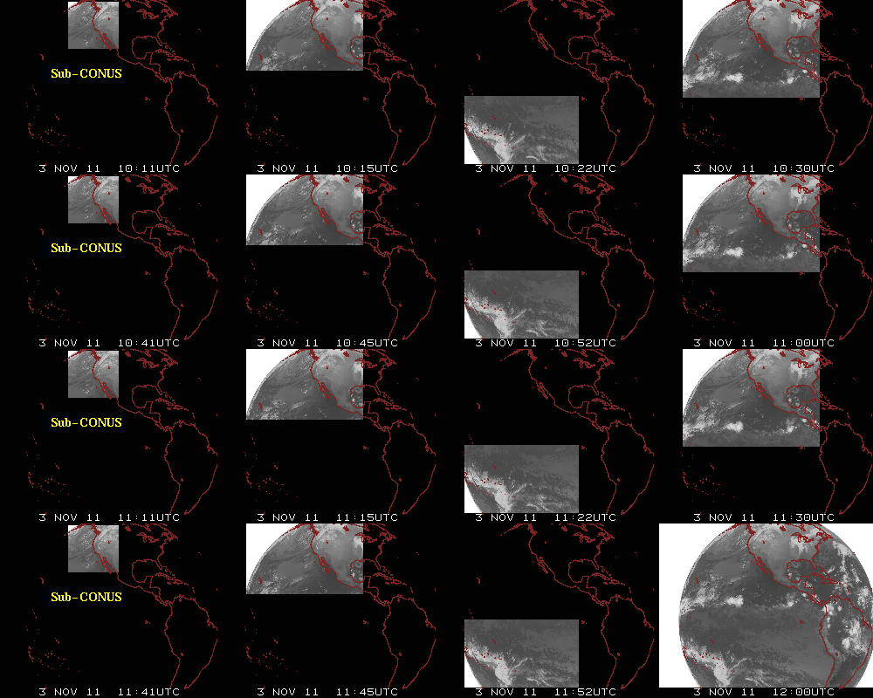
Augmented Routine Scanning Schedule
Notes:
Here’s a visual perspective of the new GOES-15 West Routine scanning schedule.

Slide 18
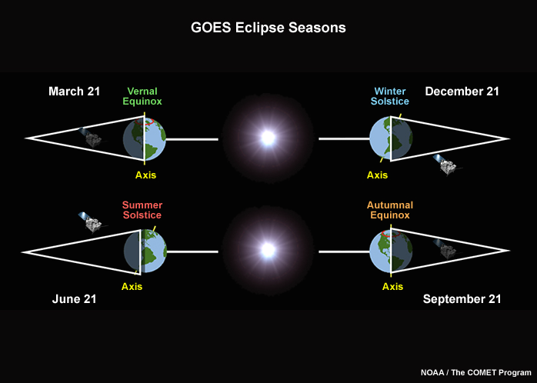
Minimized Spring/Fall Eclipse Outages
Notes:
Increased battery capacity with GOES-15 will enable observations during the fall and spring eclipse periods. Eclipse periods span 46 days centered on the equinoxes. During these periods, geostationary satellites find themselves in the earth’s shadow for up to 72 minutes. GOES-11 outages lasted up to 3 hours during the middle of eclipse season near the equinox. Minimal outages of up to 1 hour per day will still occur with GOES-15 due to the satellite’s passage through “stray light zones”, which occurs just before and after an eclipse.

Slide 19
Resources for more Information
COMET Satellite Meteorology: GOES Channel Selection V2 module – Includes information, examples, and animations regarding improvements for GOES-15
CIMSS Satellite Blog – Informative blog entries with mention of and/or examples from GOES-15
GOES-15 NOAA/Science Post Launch Test
GOES-15 Satellite Status Summary
NESDIS User Services
For AWIPS/GOES image questions contact NCF
Notes:
Please see the following for further details and examples…
The GOES-15 NOAA/Science Post Launch Test page provides access to the to the latest GOES-15 Technical Report draft.

Slide 20
Summary
GOES-15 becomes GOES-West
Higher resolution Water Vapor imagery
New 13.3 um IR “CO2” channel
Improved Visible Imagery
New routine hourly imaging schedule
Minimized Spring/Fall eclipse outages
Notes:
Summary…

