Slide 1
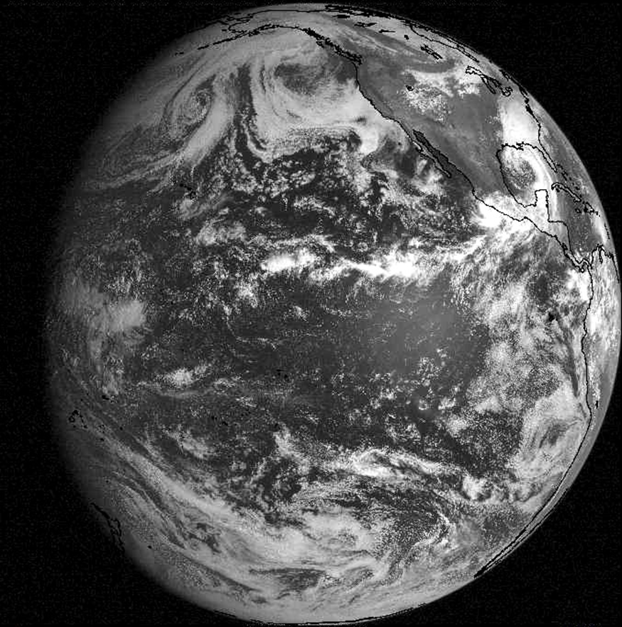
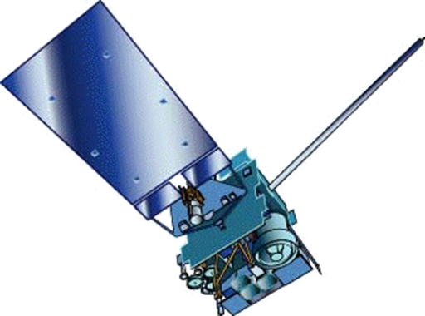
GOES-15 Becomes GOES-West
By Ross Van Til
NWS Training Division
Forecast Decision
Training Branch
Contributions by:
Brian Motta, FDTB
Tim Schmit, NESDIS
Natalia Donoho, NESDIS
Scott Bachmeier, CIMSS
Patrick Dills, COMET
SSEC, UW-Madison
Notes:
Welcome to the GOES-15 Becomes GOES-West training session. My name is Ross Van Til, and I’m with the National Weather Service Training Division’s Forecast Decision Training Branch. On December 6, 2011, the GOES-15 Satellite replaced GOES-11 as the operational GOES-West Satellite covering Western North America and the Eastern Pacific. This short training session will highlight the primary operationally significant changes associated with this transition.

Slide 2
Learning Objectives
Recognize that GOES-West has transitioned from GOES-11 to GOES-15
Distinguish the differences between GOES-11 and GOES-15 water vapor imagery
Recognize that a new 13.3 um IR “CO2” channel is available from GOES-15
Describe additional image frames available from GOES-15
Notes:
Learning objectives for the training are…

Slide 3
Performance Objectives
Utilize higher resolution water vapor imagery
Illustrate applications of 13.3 um IR channel
Examine additional frames produced by the GOES-West Routine and Rapid scanning schedules
Apply enhanced imagery from GOES-15 operationally
Notes:
Performance objectives for the training are…

Slide 4
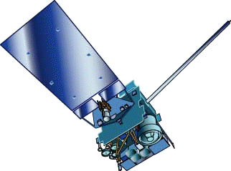

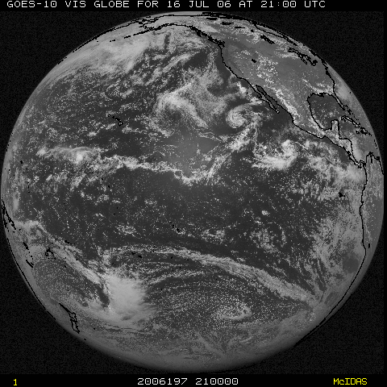
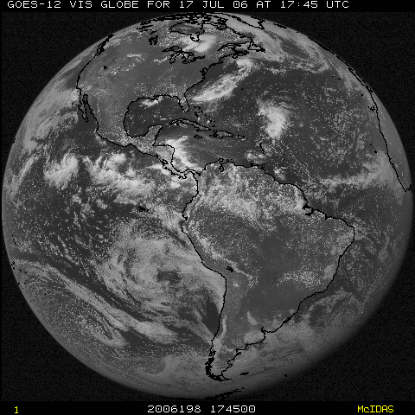
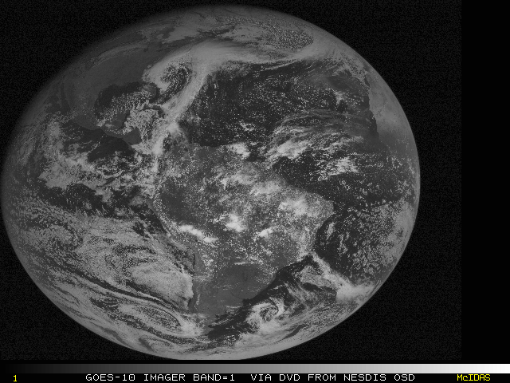

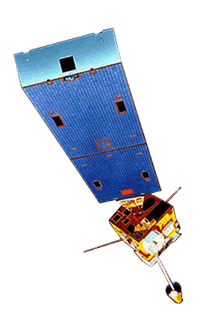
GOES Constellation
GOES-West
GOES-15
(135W)
GOES-East
GOES-13
(75W)
NESDIS
GOES-14
(105W)
Storage
GOES-12
(60W)
South America
Notes:
To quickly review the configuration of the two geostationary satellites utilized in North America, GOES-East, which is currently the GOES-13 satellite, is positioned above the equator at 75 degrees W, while GOES-West is above the equator at 135 degrees W. In addition, GOES-12 provides coverage for South America from 60W, and GOES-14 is currently in storage at 105W. To maintain their geostationary orbits, GOES satellites fly at 22,300 miles above the earth’s surface. GOES-15 was launched in March 2010, and was tested while positioned at 89.5W.

Slide 5
GOES-West Transition Timeline
October 17, 2011 - Start GOES-15 westward drift from 89.5 W to 135 W (0.78 degrees/day)
December 6, 2011 - Near 129 W, GOES-15 becomes GOES-West at 1545Z (data relayed through GOES-11)
December 14, 2011 - Stop GOES-15 drift at 135W (data acquired directly from GOES-15)
December 15-16, 2011 - GOES-11 decommissioned / de-orbit maneuvers
Notes:
Here is the timeline for GOES-West’s transition from GOES-11 to GOES-15…
This approach minimizes impact to users, and was followed successfully for previous GOES transitions, including the GOES-West transition from GOES-10 to 11 in June 2006, and for the GOES-East transition from GOES-12 to 13 in April 2010.

Slide 6
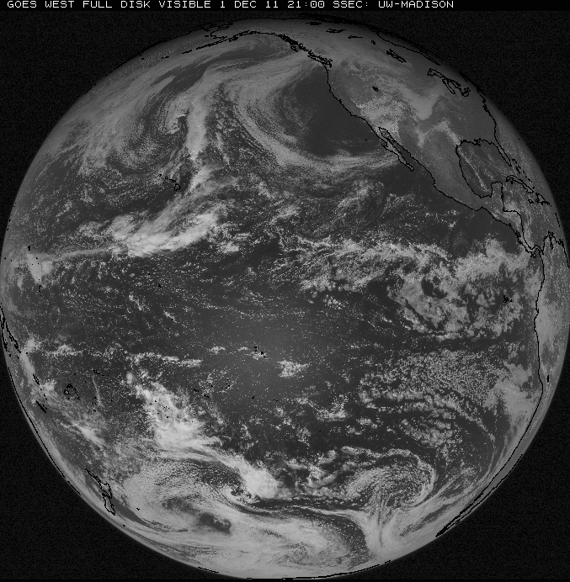
GOES West Field of View
Notes:
Here’s a view of what GOES-West looks down at. In North America, GOES-West is the primary geostationary satellite for areas west of approximately 105 degrees W. GOES-West imagery can be used for areas farther to the E, especially in the event of a GOES-East outage, but the viewing angle becomes increasingly severe as you continue E.

Slide 7
GOES-11/15 – Primary Differences
Higher Resolution Water Vapor Imagery
New 13.3 um IR “CO2” channel (replaces 12 um channel)
All IR channels with 4km resolution and improved calibration
Improved Visible Imagery
Improved Pixel Geolocation
Minimized Spring/Fall Eclipse Outages
Augmented Scanning Schedule
Notes:
While much with GOES-West has remained virtually unchanged through this transition, there are several differences between the GOES-11 and GOES-15 imaging instruments that operational forecasters should be aware of. In the following slides, we’ll cover…

Slide 8
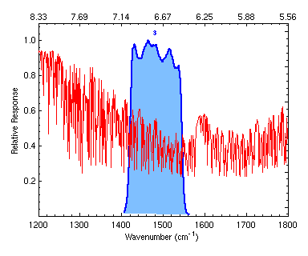
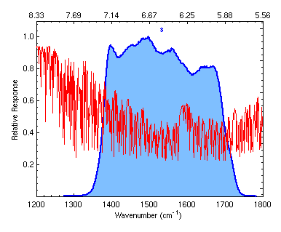
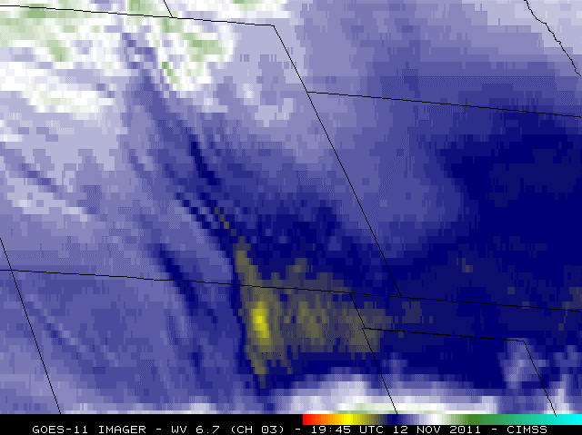
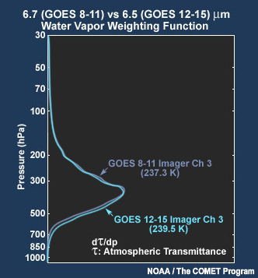
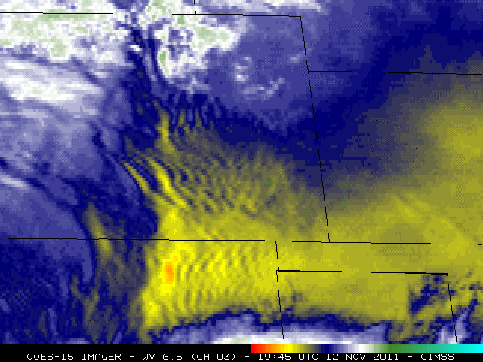

Higher Resolution Water Vapor Imagery
4km resolution instead of 8km with GOES-11
CIMSS Satellite Blog for mountain wave example
GOES-15 “sees” slightly lower in atmosphere in absence of opaque high/mid level clouds
GOES-11
GOES-15
SSEC, UW-Madison
Notes:
Likely the most important enhancement provided by GOES-15 is the enhanced resolution water vapor imagery. As can be seen in this example, the imagery from GOES-15 with 4km spatial resolution is vastly superior to the 8km GOES-11 imagery for revealing mountain waves over Southern Colorado and Northern New Mexico. One caveat with this example is that GOES-15 had only partially completed it’s drift to 135 W at this point, and therefore was much more directly overhead of this area as compared to GOES-11. However, as we’ll see in the next slide, the higher resolution 4km imagery makes a significant difference in cases like this, even when viewing angles are similar. More information on this example can be found in the CIMSS Satellite Blog entry linked from this slide.
As seen in these diagrams, the spectral range of GOES-15’s water vapor channel is significantly wider than that from GOES-11. This results in GOES-15 “seeing” a slightly lower and deeper layer of the atmosphere as indicated by this weighting function diagram. In the absence of opaque high/mid level clouds, this also results in the GOES-15 imagery appearing approximately 2 degrees C warmer on average than GOES-11.

Slide 9
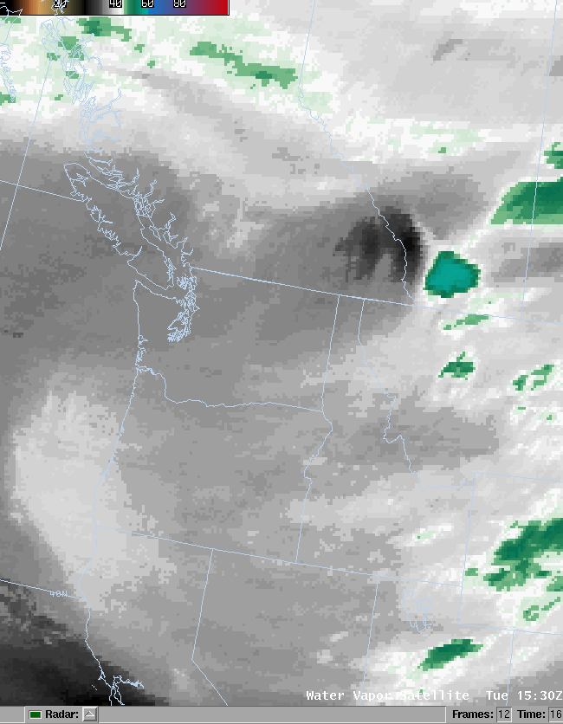
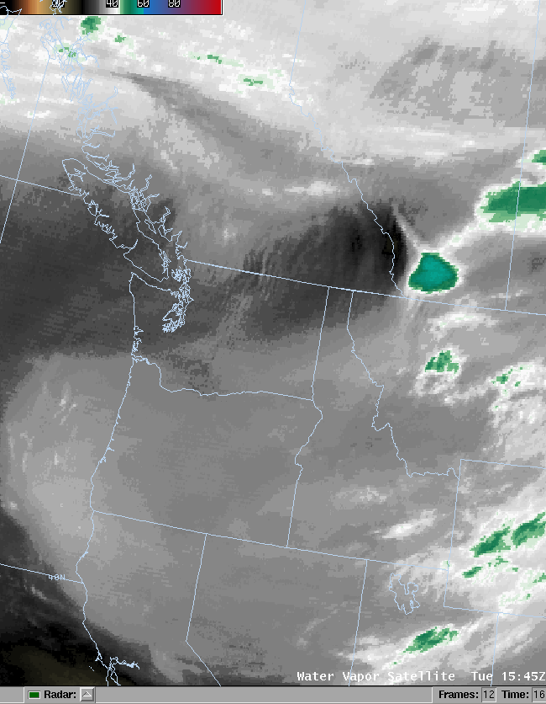



Higher Resolution Water Vapor Imagery
Notes:
This example was provided by WFO Spokane on the day of GOES-West’s transition to GOES-15. Mountain waves over the Cascades of Washington State and British Columbia were not evident in the final GOES-11 water vapor image on the left, but were suddenly revealed with the first higher resolution image from GOES-15. Such features indicate areas of significant turbulence and potential impacts to aviation.

Slide 10
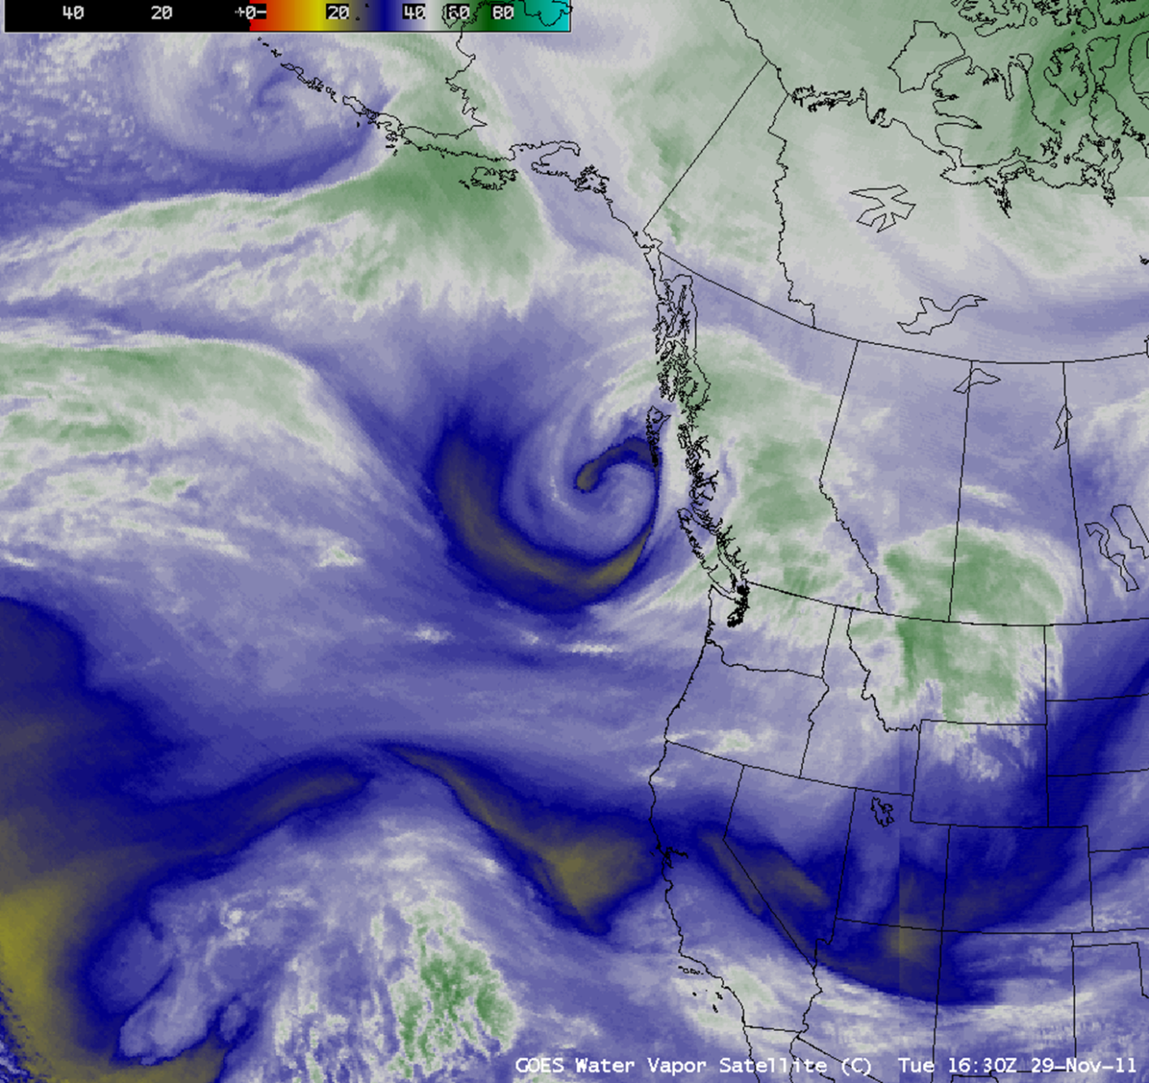
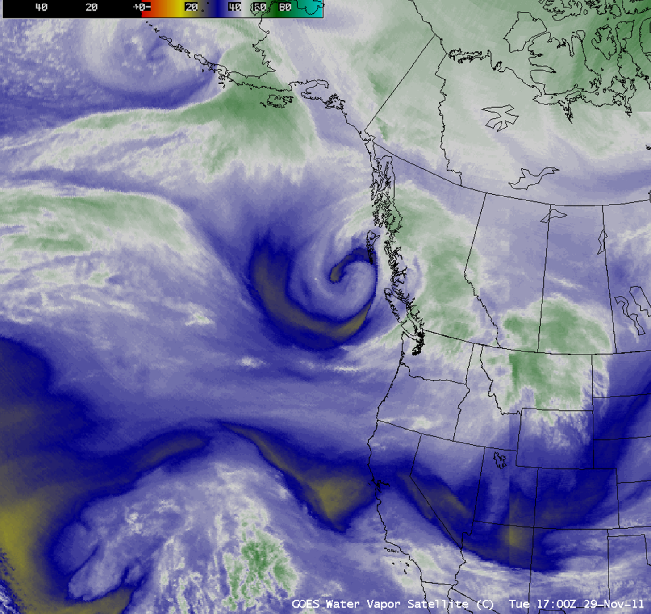
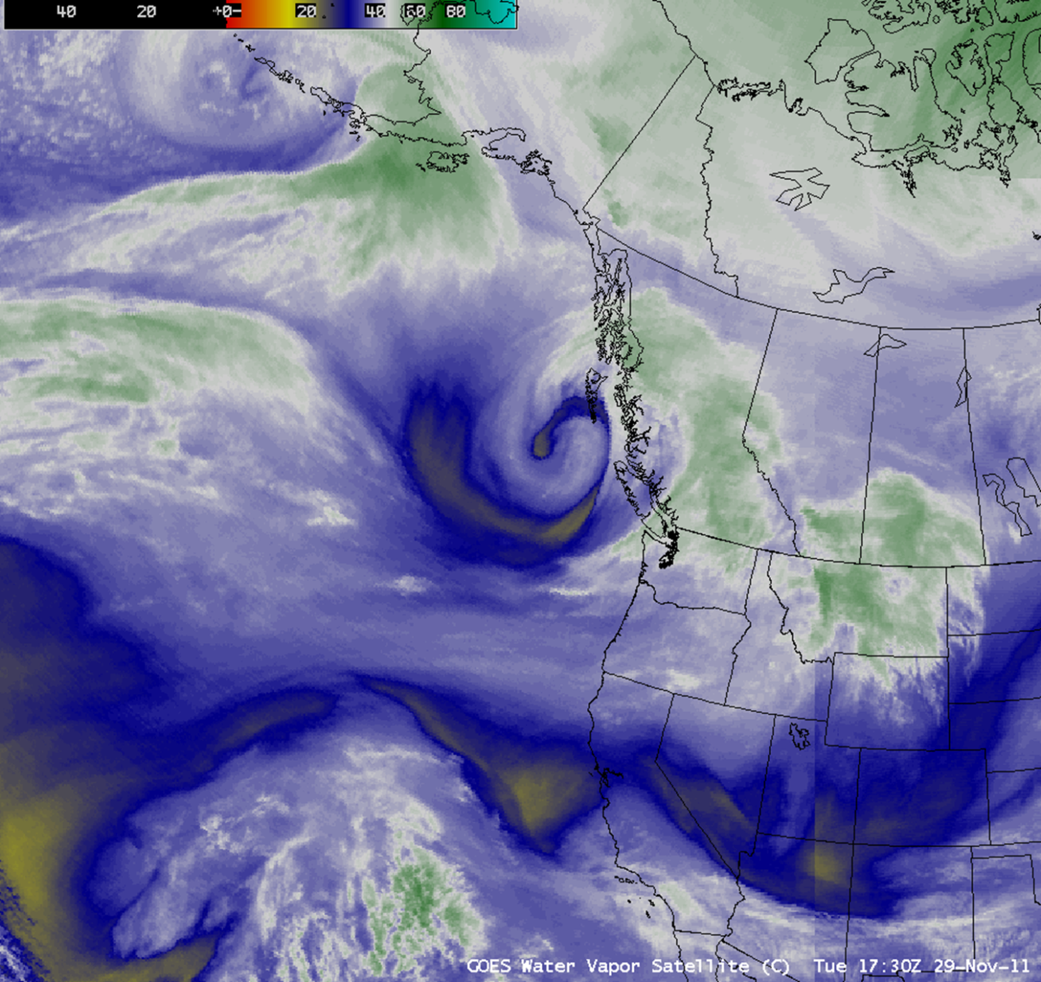
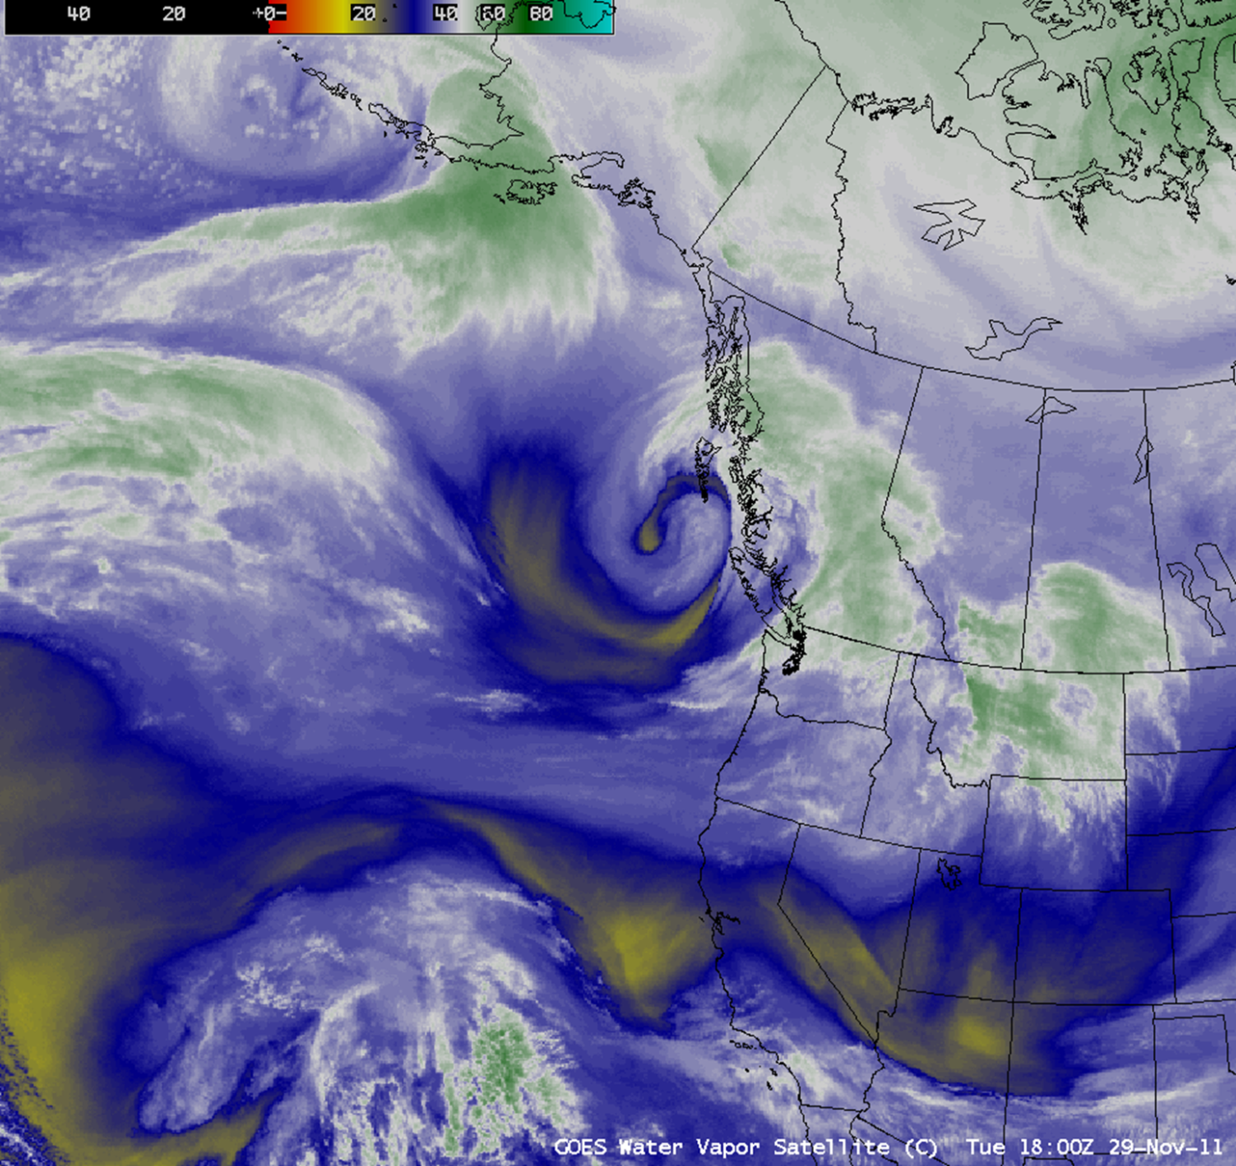
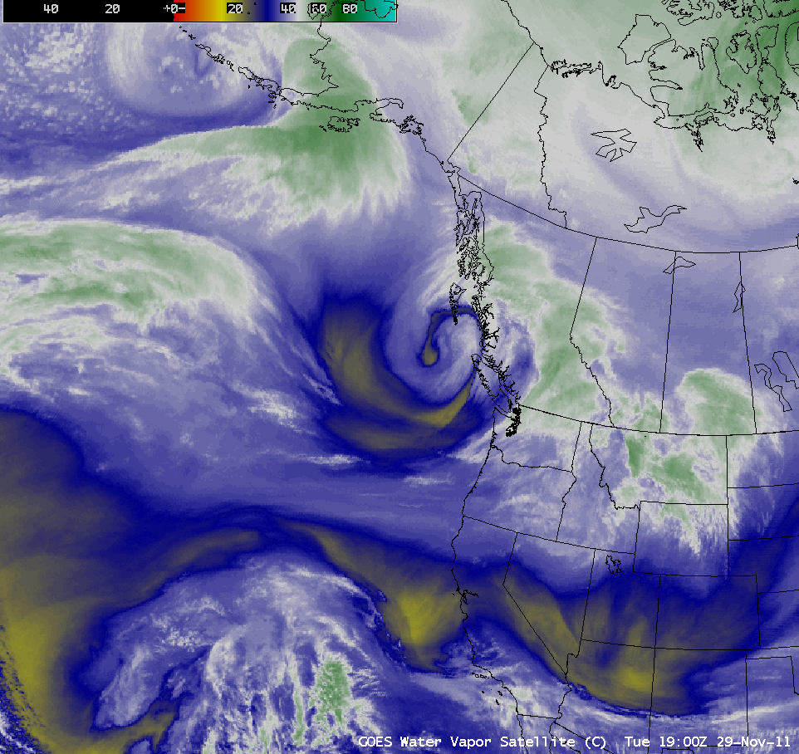
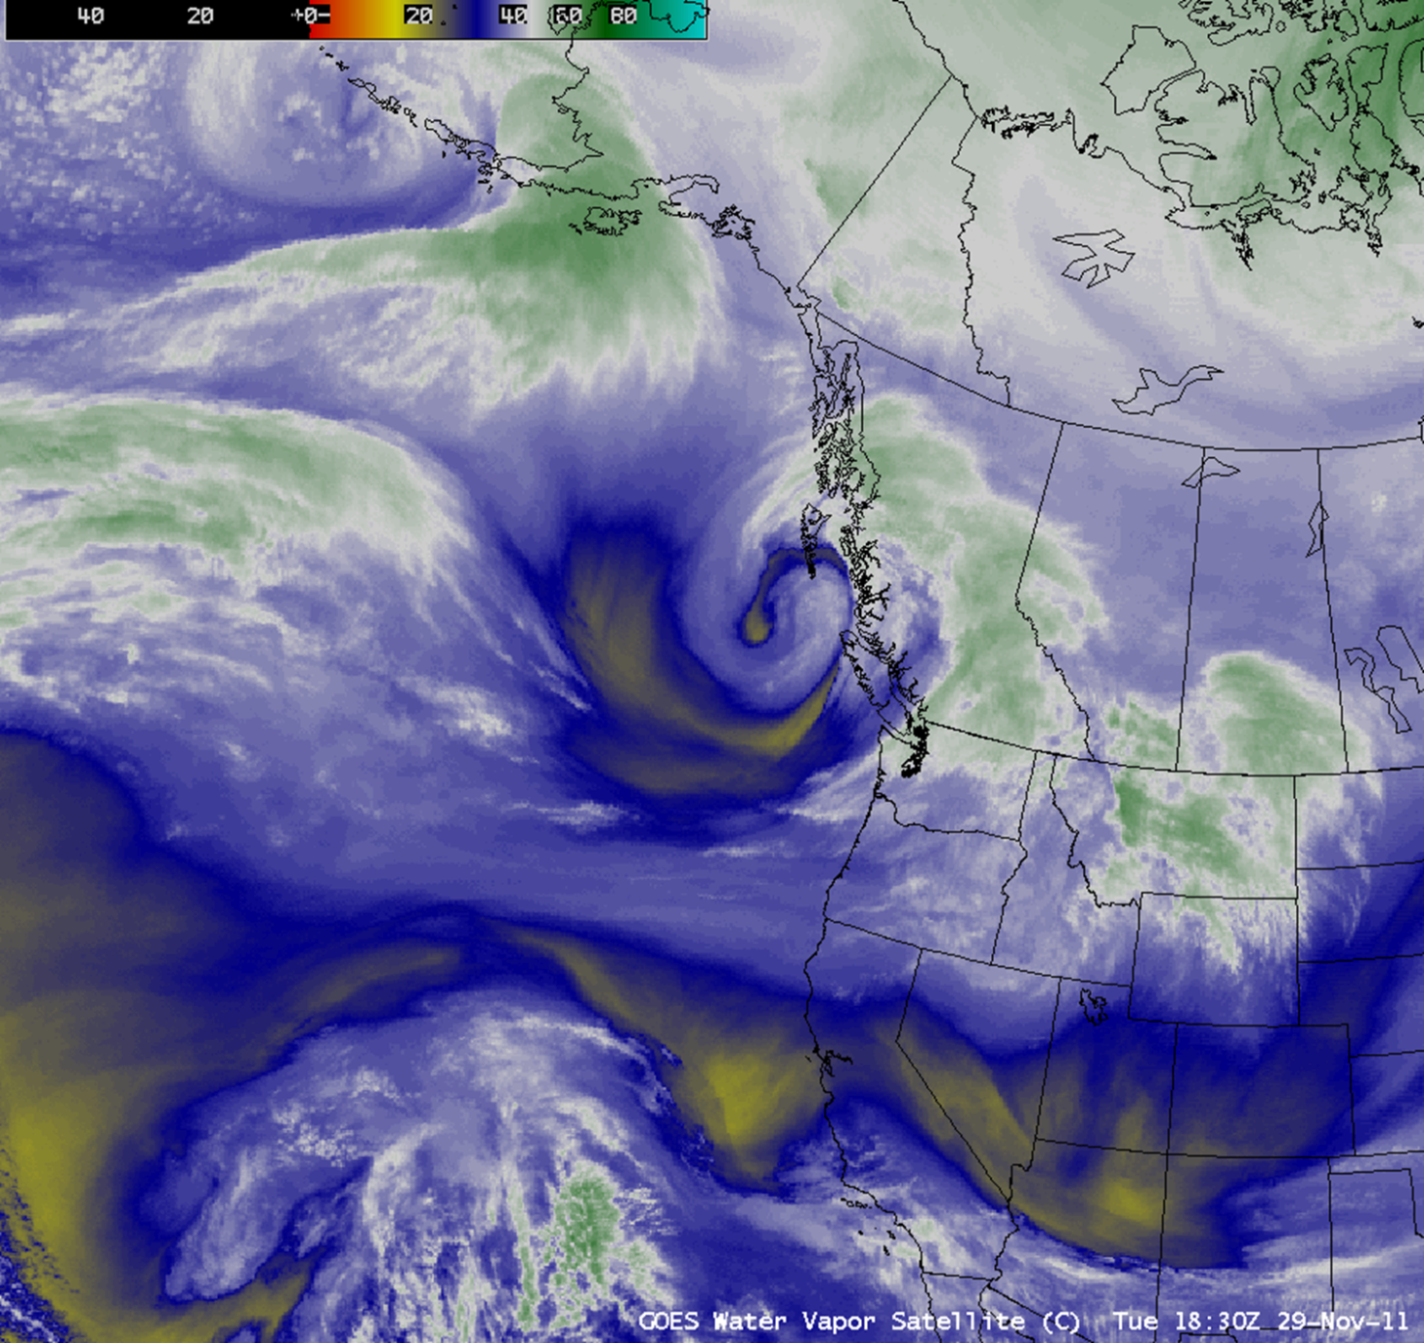
GOES-11/15 Water Vapor Comparison
Notes:
This animation shows three frames from GOES-11 followed by three frames from GOES-15. As I toggle back and forth between the last GOES-11 image and first from GOES-15, the warmer signal with the GOES-15 imagery in areas free of opaque high/mid-level clouds can clearly be noted. Also note that the seam apparent in the GOES-11 imagery from SE Idaho through Utah and Arizona becomes imperceptible with the GOES-15 imagery. This is because the water vapor channel from GOES-13, the current GOES-East satellite, has the same wider spectral range as GOES-15.

Slide 11
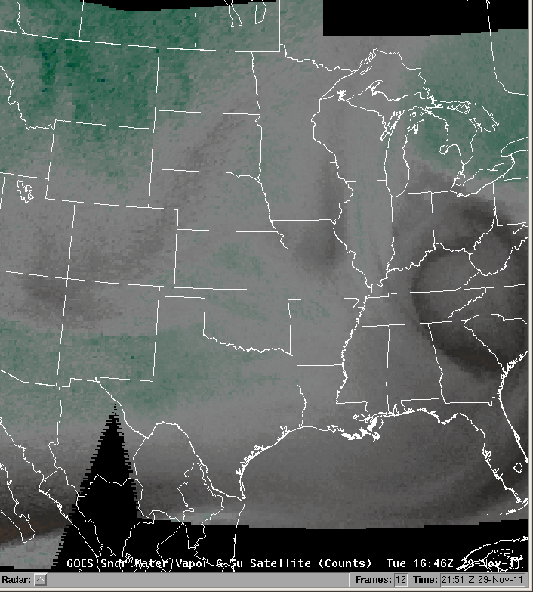
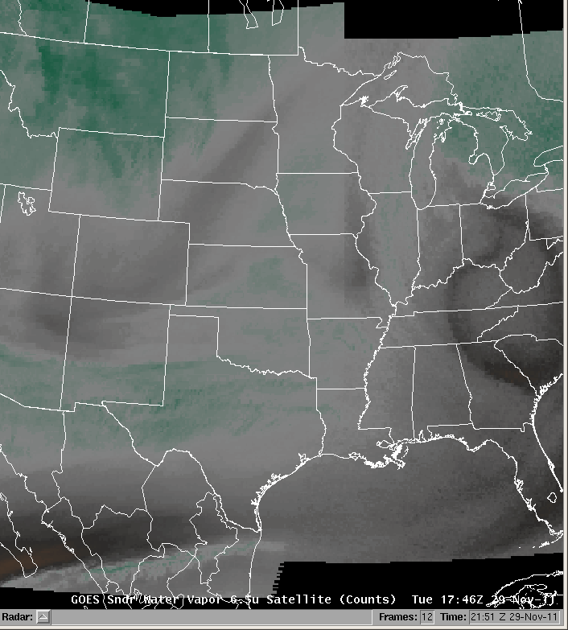
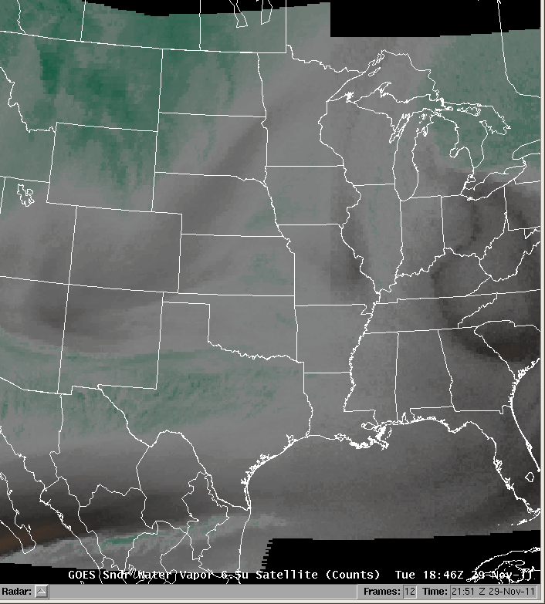
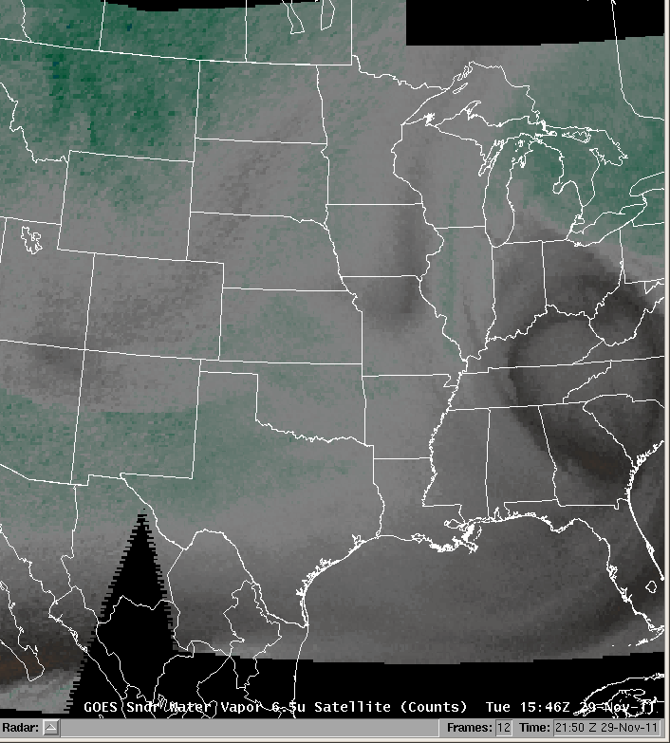
GOES Sounder Water Vapor Imagery
GOES-11
GOES-15
GOES-13
Notes:
In addition, water vapor imagery from the GOES-15 Sounder’s 6.5 um channel is significantly less noisy. Keep an eye on the left side of the animation for a significant improvement from GOES-11 to GOES-15.

Slide 12
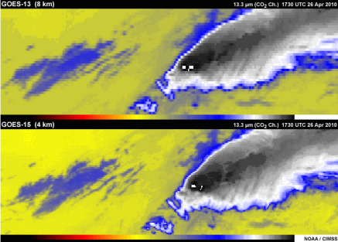


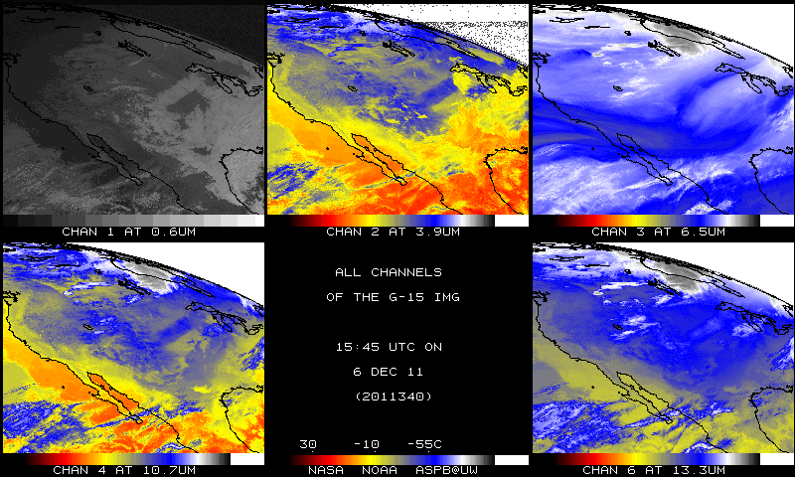
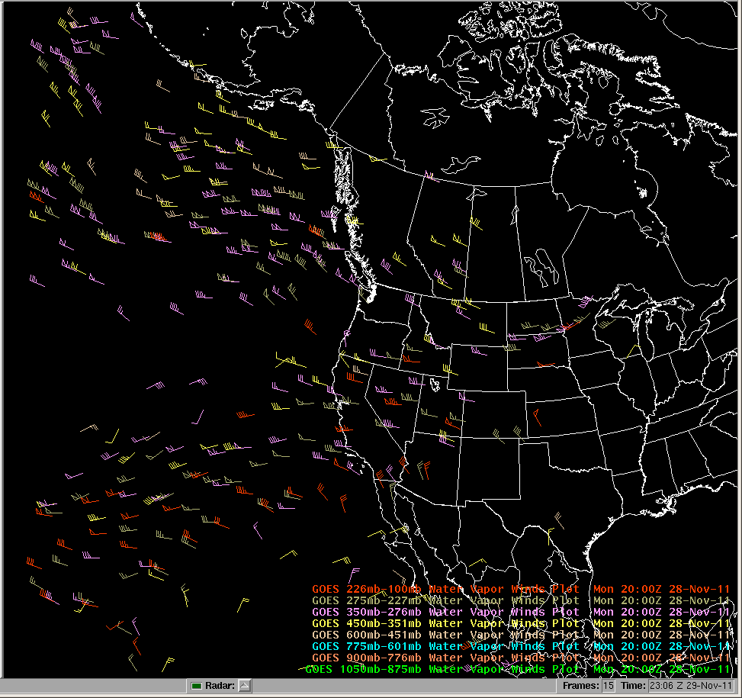

New 13.3 um IR “CO2” Channel
Replaces 12 um channel on GOES-11
Optimal for cloud height assignment technique
Longwave IR difference can show volcanic ash
See COMET’s GOES Channel Selection V2 module for more information
All GOES-15 IR Channels
  4km resolution
  Improved calibration (less noise)
Notes:
With GOES-West’s transition to GOES-15, the 12 um IR channel has been replaced by a 13.3 um IR “CO2” channel. This is known as the CO2 channel because CO2 in the atmosphere is a significant attenuator and emitter of IR radiation in this spectral range around 13.3 um.
The channels provided by GOES-15’s imager include the visible channel, the shortwave IR channel, the water vapor channel, the longwave IR channel at 10.7 um, and instead of the 12 um channel provided by GOES-11, we now have the 13.3 um channel (channel 6) from GOES-15.
Improved cloud top height estimates, especially with thin clouds, can be derived using this channel in tandem with the 10.7 um longwave IR channel. As a result, height assignment for atmospheric motions vectors will benefit. The 13.3 um channel can also be used for volcanic ash detection.
For more information on this new 13.3 um channel, please see the “Carbon Dioxide (GOES 12-15)” section of COMET’s “GOES Channel Selection V2” module.
The current GOES-East satellite, GOES-13, also has this 13.3 um channel, but GOES-15 will provide 4km spatial resolution imagery as opposed to 8km for GOES-13. However, initially, only 8km GOES-15 13.3 um imagery is being generated and disseminated to the SBN/NOAAport. The current plan is to switch to full resolution 4km 13.3 um imagery in AWIPS in mid-January 2012.
In addition, all IR channels on GOES-15 feature improved calibration, which results in less noise within the imagery (due to colder detectors).

Slide 13
Relocalizing AWIPS for “13u”
Menu Option
THE FOLLOWING STEPS SHOULD BE TAKEN BY AWIPS FIELD SITE STAFF
ON TUESDAY DECEMBER 6, ON AWIPS-I MACHINES ONLY:
RELOCALIZE DX3 AND DX4 WITH -TABLES OPTION
WHEN DX LOCALIZATIONS HAVE COMPLETED, RESTART INGEST ON DX3
RELOCALIZE ONE OR TWO LX WORKSTATIONS WITH -TABLES OPTION
WHEN LX LOCALIZATIONS HAVE COMPLETED, RESTART D-2D
CONFIRM THAT D-2D SATELLITE MENU INCLUDES 13UM AND GOES M-Q ENTRIES
For additional info CLICK HERE
Notes:
The 13.3 um imagery is accessed in the AWIPS satellite menu from the “13u” menu selection once your AWIPS system has been properly relocalized. Steps for relocalizing are listed on this slide. The link provided leads to the GOES-15 AWIPS transition bulletin with additional info.

Slide 14
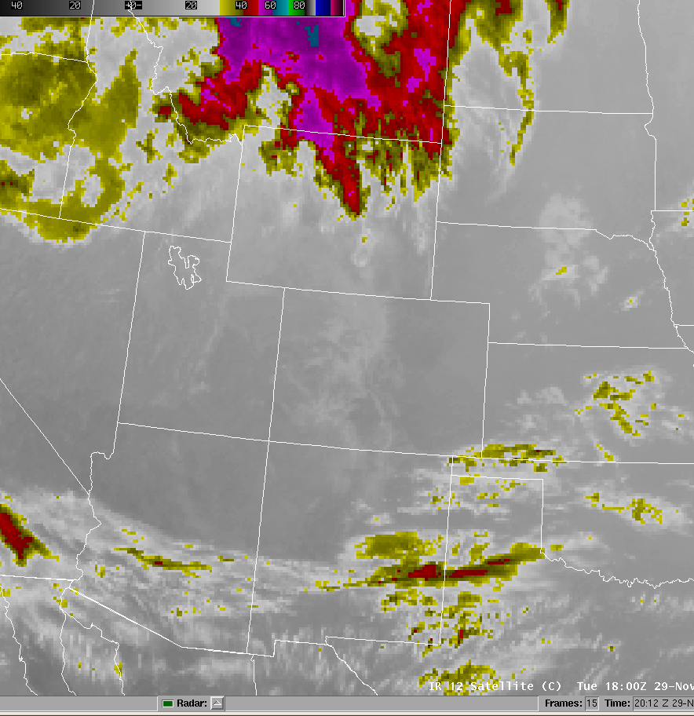
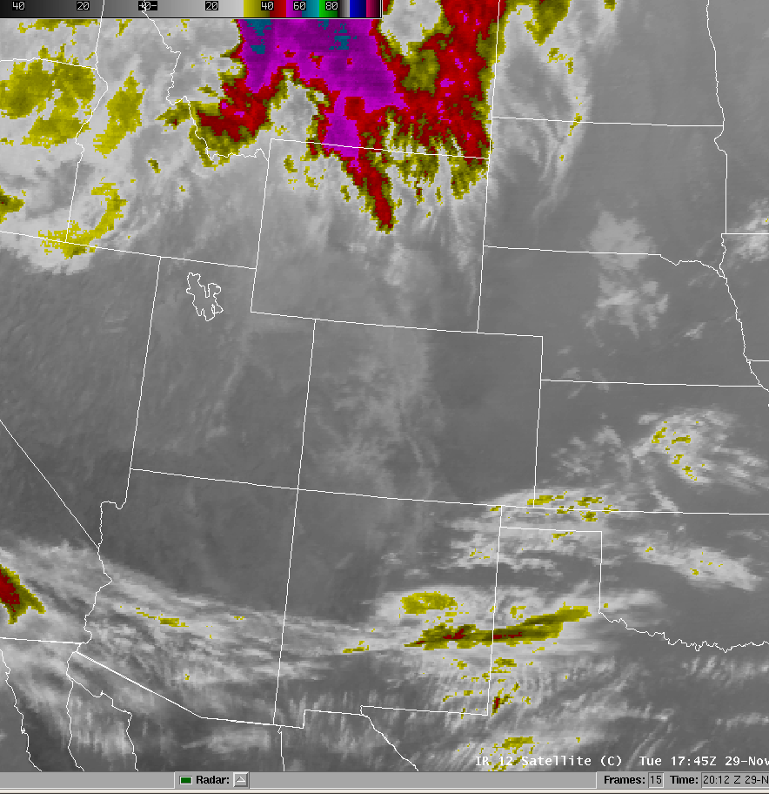
12 um vs. 13.3 um Comparison
Notes:
As we toggle back and forth here, you can see that the 13.3 um channel from GOES-15 is more sensitive to high clouds and less sensitive to low clouds and surface features as compared to the 12 um channel from GOES-11. IR emission from CO2 partially masks the low-level and surface features with the 13.3 um imagery. Looking ahead a few years, GOES-R will have an expanded suite of 16 imaging channels, including both the 12 um and 13.3 um channels.

Slide 15
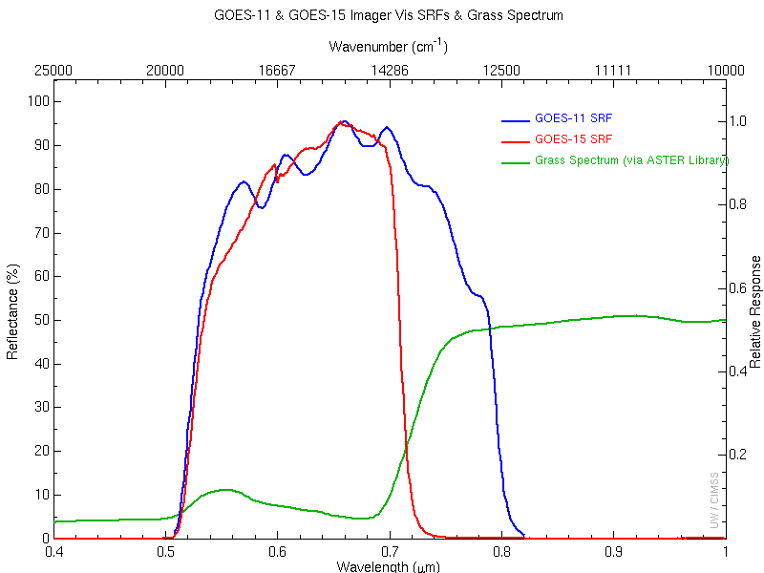
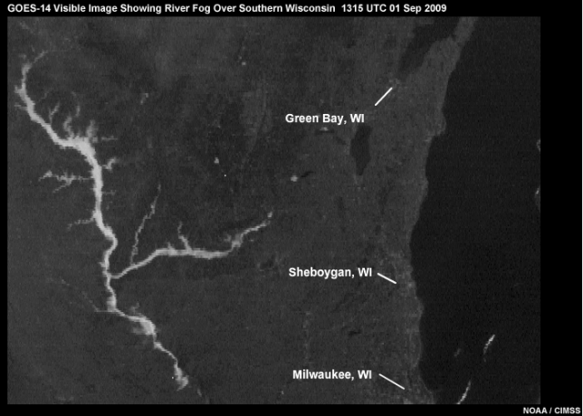
Improved Visible Imagery
Narrower Spectral Window
  Enhanced surface feature contrast
  Vegetation appears darker
Reduced Noise
Brighter Imagery (signal from GOES-11 has decreased over time)
“Linear” AWIPS/D2D enhancement may be helpful for ID of subtle features especially early/late in day
Mat Gunshor, CIMSS
Notes:
As can be seen in the spectral response diagram, the spectral range of the GOES-11 visible channel was from 0.52-0.8 um, while GOES-15’s spectral range is somewhat narrower at 0.52-0.71 um. Since green vegetation becomes significantly more reflective between 0.71 and 0.8 um, the range covered by GOES-11 but not by GOES-15, green vegetation appears darker in the GOES-15 imagery. This results in green vegetation having more contrast in the GOES-15 imagery with urban and non-vegetated areas, which appear lighter. In turn, contrast between vegetation and water’s typically dark surface is reduced. In addition, the visible imagery from GOES-15 has an overall brighter and less noisy appearance. All of this in combination yields better detection of small and fine-scale cloud patterns, such as valley fog.
With GOES-15 visible imagery, the “Linear” AWIPS/D2D enhancement may be helpful for the identification of subtle features especially early/late in day. The “CA (low light vis)” enhancement may also be helpful.

Slide 16
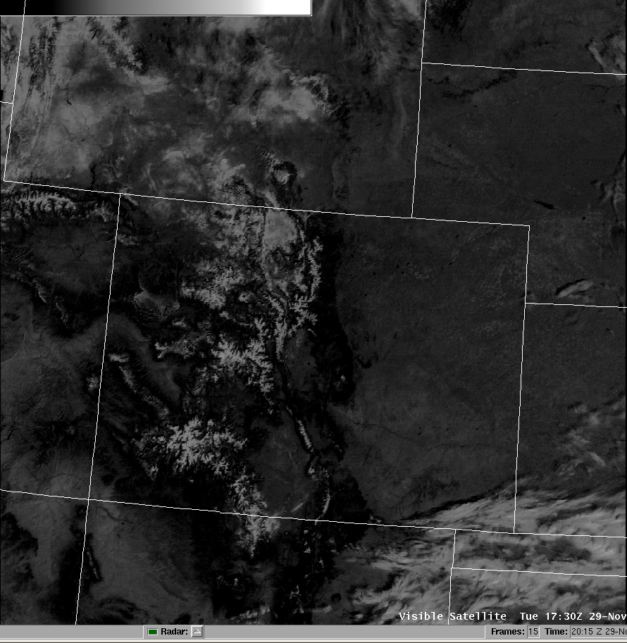
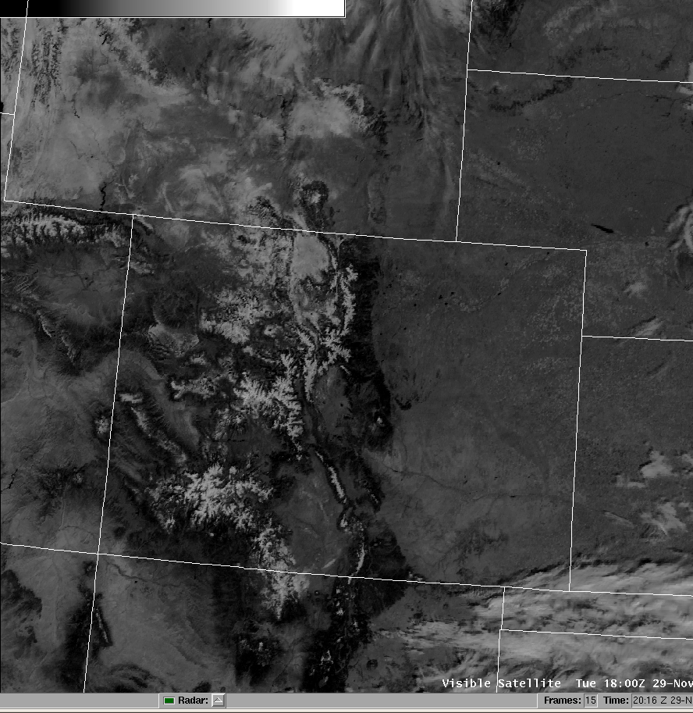
GOES-11/15 Visible Comparison
Notes:
In this comparison from the operational test of GOES-15 done the week before the transition, the brighter appearance of the first GOES-15 visible image is apparent. This example is from late morning, and the overall scene was still brightening up a bit all else being equal, but the bottom line is, though areas of green vegetation may appear somewhat darker, GOES-15 visible imagery has an overall brighter appearance.

Slide 17
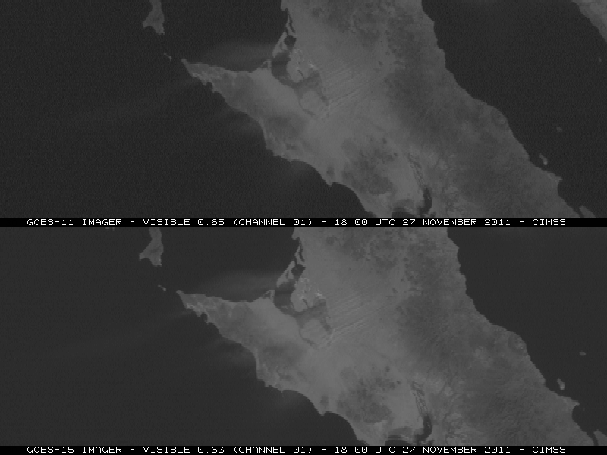
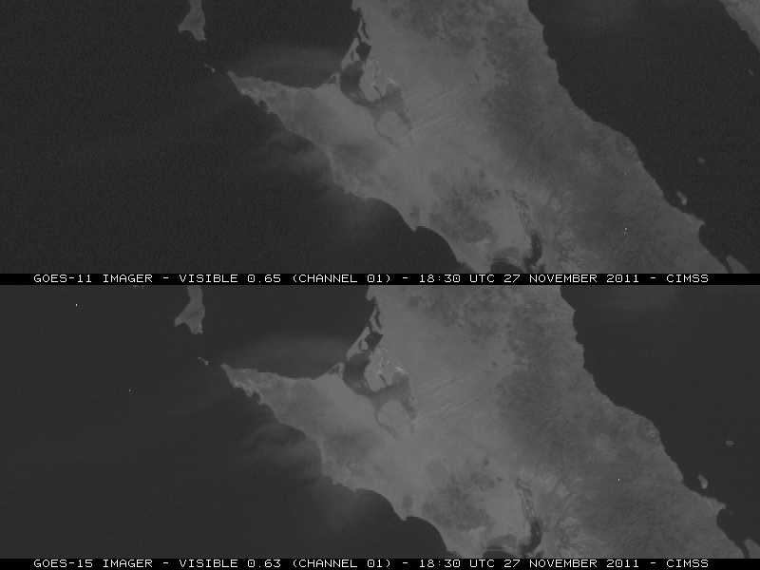
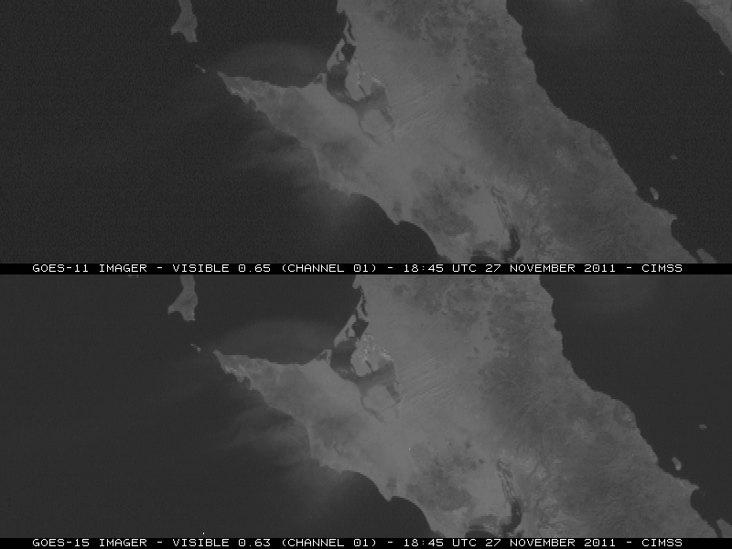
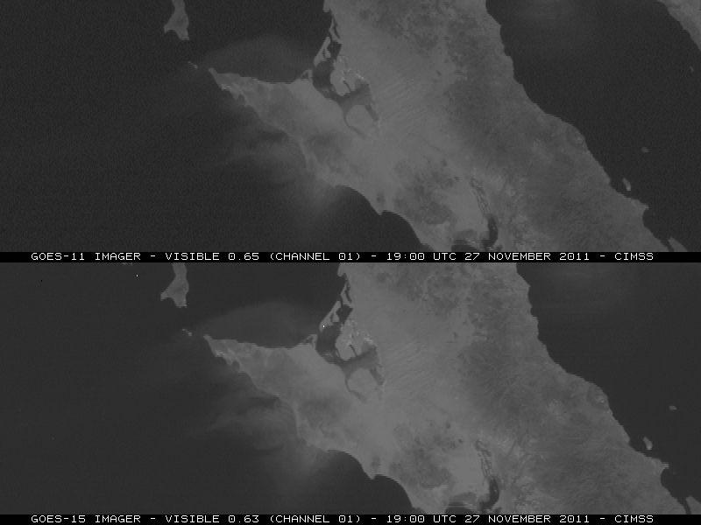
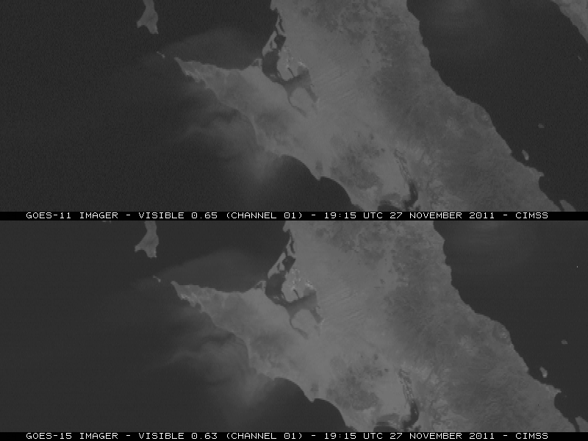
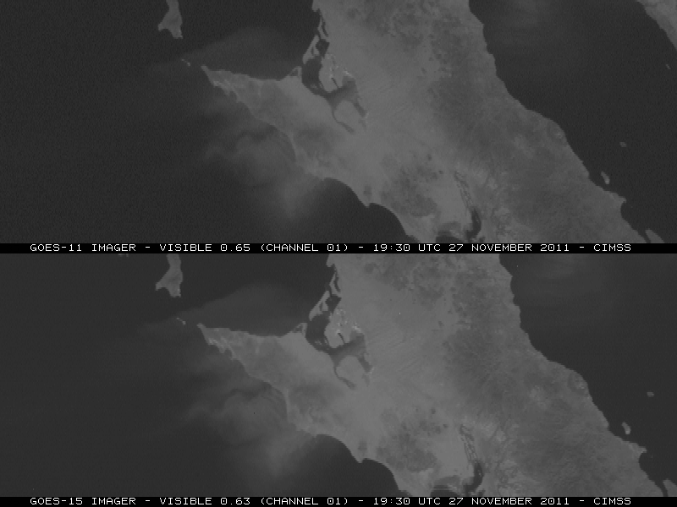
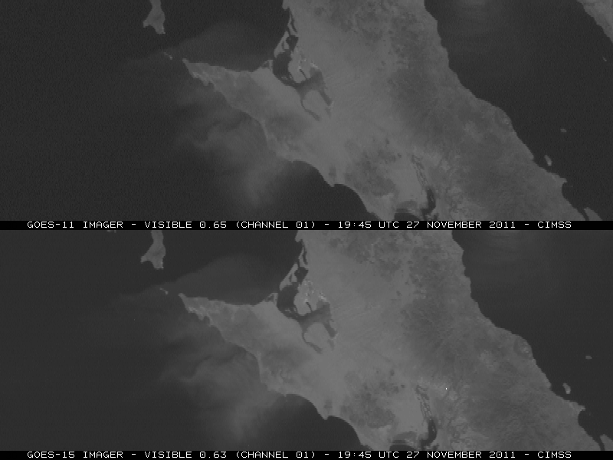
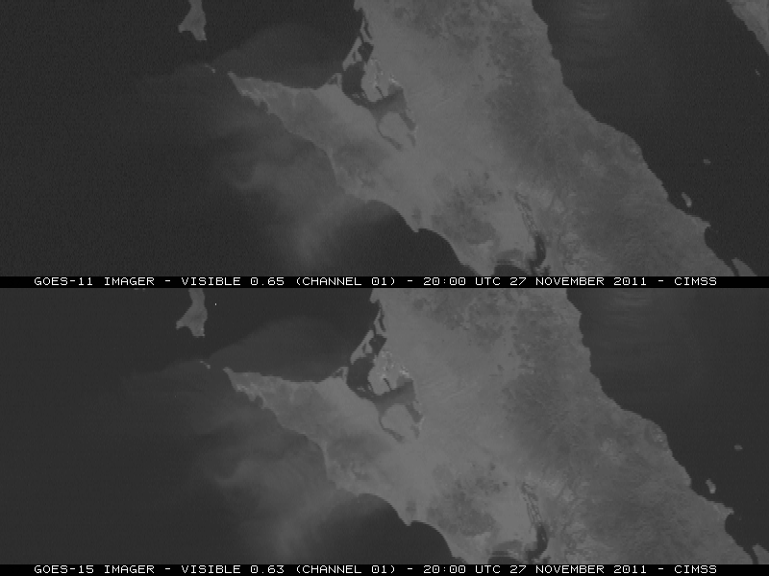
Improved Pixel Geolocation
Notes:
GOES-15 has an enhanced image navigation and registration system. As a result, image to image shifting of fixed surface features is greatly reduced with GOES-15 as seen in this loop of a blowing dust event in Baja California.

Slide 18
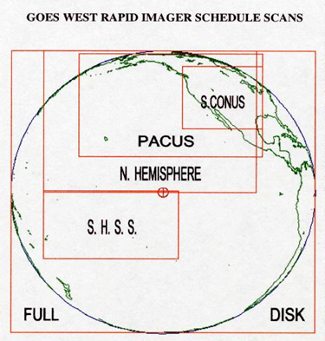
GOES-West Frame Additions
NEW GOES-15 Routine Schedule
6 images per hour for Sub-CONUS area (4 during full-disk hours)
New images with ROUTINE SCHEDULE:
UTC TIME SCAN SECTOR
xx:10 (Each non-full disk hour) SUB-CONUS
xx:40 (Each hour) SUB-CONUS
NEW GOES-15 Rapid Scan Schedule
During RSO for Western CONUS - 10 images per hour (7 during full-disk hours)
New images with RAPID SCAN SCHEDULE (for Western CONUS)
UTC TIME SCAN SECTOR
xx:54 SUB-CONUS xx:57 SUB-CONUS
Tim Schmit, NESDIS
Notes:
With the new GOES-15 routine schedule, additional “sub-CONUS” scale image will be provided at 10 and 40 minutes after each hour, except when full disk images are taken every three hours, in which case only the additional image at 40 minutes after the hour is produced. These additional images cover the Sub-CONUS sector, which is the same sector as was provided when GOES-11 was in rapid-scan operations for a weather event over the CONUS.
When GOES-15 goes into rapid-scan for an event in the Western CONUS, an additional pair of images for the sub-CONUS sector will be provided at 54 and 57 minutes after the hour. This means two more images per hour as compared to when GOES-11 was in rapid scan.

Slide 19
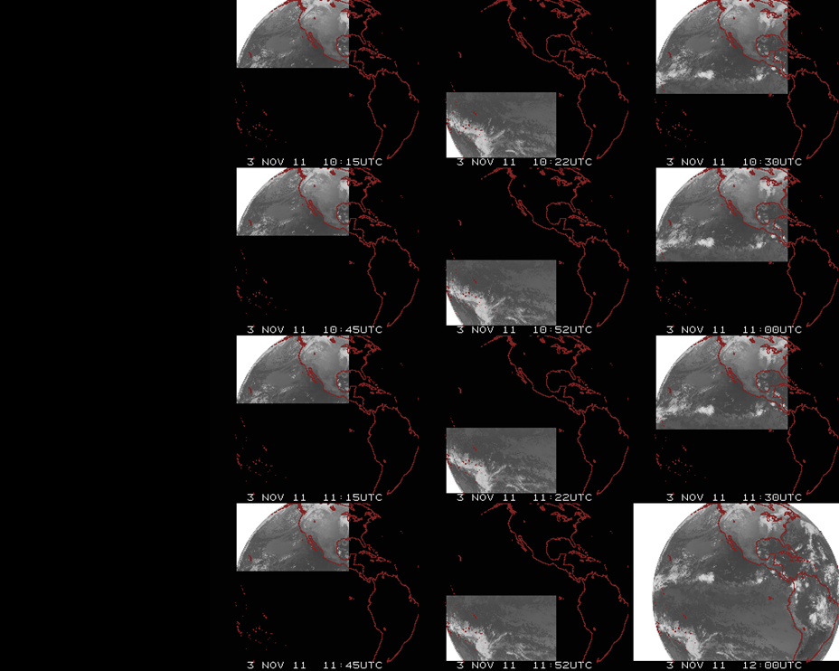
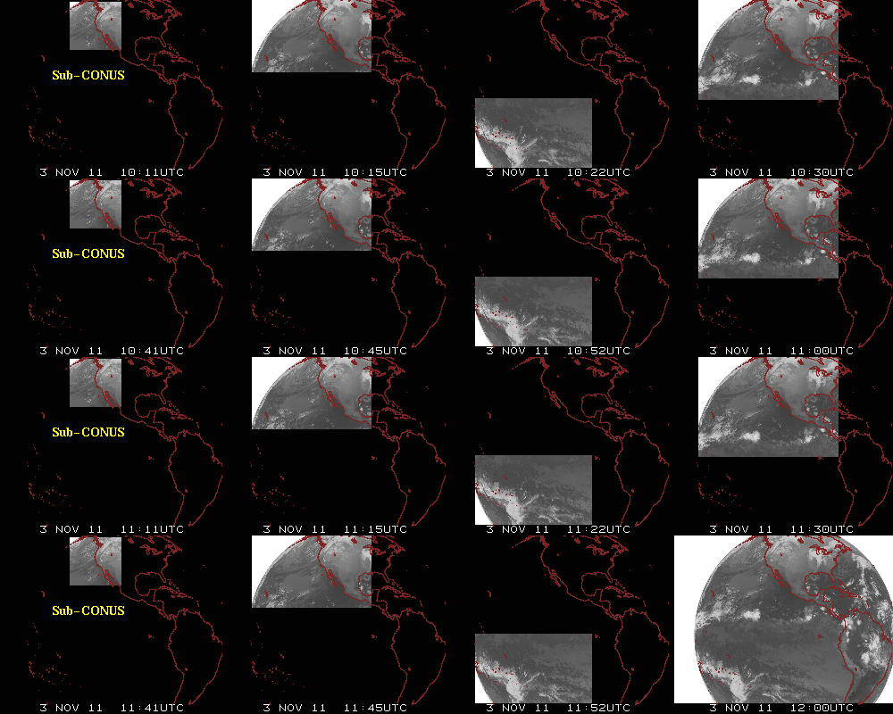
Augmented Routine Scanning Schedule
Notes:
Here’s a visual perspective of the new GOES-15 routine scanning schedule covering a pair of non-full disk hours. As you can see, as compared to GOES-11’s schedule, four additional sub-CONUS scale images are provided during this two hour period.

Slide 20
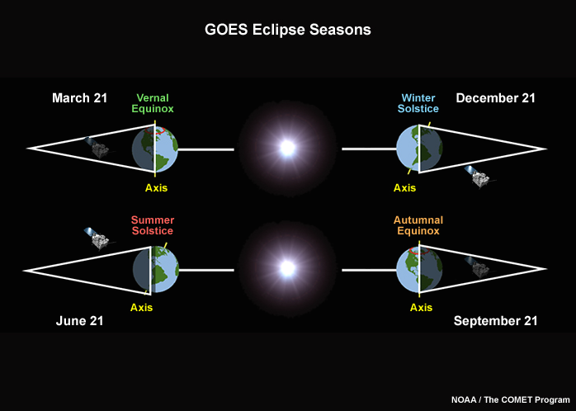
Minimized Spring/Fall Eclipse Outages
Notes:
Increased battery capacity with GOES-15 will enable observations during the fall and spring eclipse periods. Eclipse periods span 46 days centered on the equinoxes. During these periods, geostationary satellites find themselves in the earth’s shadow for up to 72 minutes. GOES-11 outages lasted up to 3 hours during the middle of eclipse season near the equinox. Minimal outages of up to 1 hour per day will still occur with GOES-15 due to the satellite’s passage through “stray light zones”, which occurs just before and after an eclipse.

Slide 21
Resources for more Information
COMET Satellite Meteorology: GOES Channel Selection V2 module – Includes information, examples, and animations regarding improvements for GOES-15
CIMSS Satellite Blog – Informative blog entries with mention of and/or examples from GOES-15
GOES-15 NOAA/Science Post Launch Test
GOES-11 to GOES-15 Transition - FAQ
GOES-15 Satellite Status Summary
NESDIS User Services
For AWIPS/GOES image questions contact NCF
Notes:
Please see the following for further details and examples…
The GOES-15 NOAA/Science Post Launch Test page provides access to the GOES-15 NOAA Technical Report.

Slide 22
Summary
GOES-15 Becomes GOES-West
Higher Resolution Water Vapor Imagery
New 13.3 um IR “CO2” Channel
Improved Visible Imagery
New Routine Hourly Imaging Schedule
Minimized Spring/Fall Eclipse Outages
Future questions? Contact ross.vantil@noaa.gov
Notes:
Summary…

