Slide 1
GOES-R Aerosols in AWIPS
Shobha Kondragunta
NOAA / SMCD
Amy Huff
Pennsylvania State University
Scott Lindstrom
University of Wisconsin-Madison CIMSS
(Cooperative Institute for Meteorological Satellite Studies)
Notes:
This is the Satellite Foundational Course for GOES-R on GOES-R Aerosol products that are available in AWIPS. Drs. Kondragunta, and Huff are major contributors to this task. I'm Scott Lindstrom and I'm navigating your way through this training

Slide 2
Learning Objectives
Which Aerosol Products are available in AWIPS
Aerosol Product Details
  What is the temporal cadence for the Full Disk, CONUS and Meso domains?
  What is the spatial resolution of Aerosol Products?
  Which spectral bands on GOES-R ABI are used to create Aerosol Products
What forecast problems can Aerosol Products help with?
Notes:
What will you take away from this training? Learning Objectives are shown on this page.

Slide 3
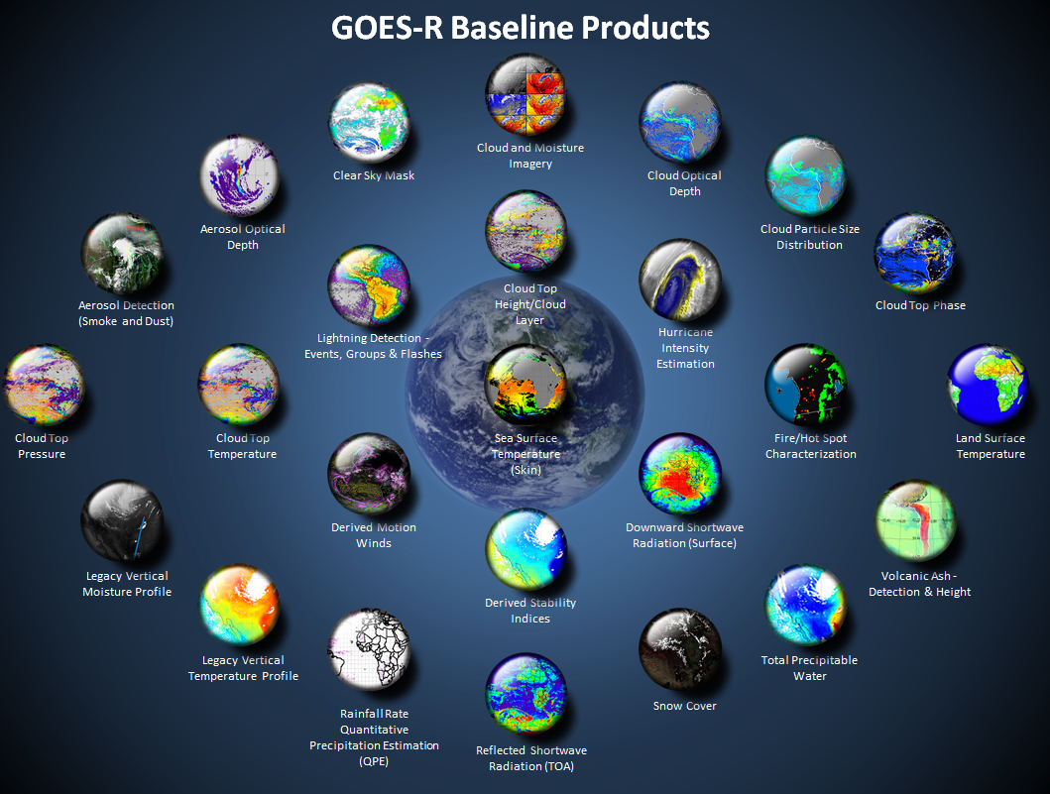
Aerosol Optical Depth
Aerosol Detection
http://www.goes-r.gov
Notes:
Aerosol products -- boxed in yellow - are just part of the constellation of Baseline Products shown on this page. GOES-R Baseline products are flowing into AWIPS.

Slide 4
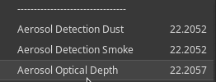
The AWIPS Menu for Derived GOES-R Aerosols
Aerosol Detection (Dust and Smoke) is computed
in all domains: Full Disk, CONUS and Meso
FD, CONUS: Every 15 minutes;
Meso: every 5 minutes
AOD is only computed for
all Full Disk and CONUS domains (no meso)
Notes:
These Baseline GOES-R Aerosol products are available in AWIPS. Menu items are 'Aerosol Detection Dust' 'Aerosol Detection Smoke' and 'Aerosol Optical Depth'
Aerosol Detection is available for all 3 sectors: Full Disk, CONUS and Meso.
Aerosol Optical Depth, AOD, is available for Full Disk and CONUS sectors, but not Mesos.

Slide 5
Aerosol Detection (Dust/Smoke)
and Aerosol Optical Depth
The two products are complementary
  Aerosol Detection
    Indicates the presence of certain aerosol types (dust and smoke) but does not quantify them. (There is no information on the amount of aerosols)
  Aerosol Optical Depth
    Measures the amount of all aerosols, but it doesn’t identify the type.
    Incorrect type identification is allowed as long as AOD meets requirements.
Notes:
The two aerosol products complement each other in some ways. Aerosol Detection doesn't tell you anything about the amount of aerosols, for example - it simply tells you that certain types (dust or smoke) are present; Aerosol optical Depth is a measure of the amount of all aerosols - but it says nothing about the type!

Slide 6
Aerosol Detection Product (ADP)
Why detect aerosols?
  Aerosols change the way the atmosphere absorbs or transmits light
  Aerosol Detection Product (ADP) helps you monitor areas of smoke and dust
    Smoke/Dust can impact high temperature forecasts
    Critical for visibility and air quality forecasts.
    Monitor long-term trends in aerosol quantities and distribution
  GFS/NAM/Rapid Refresh do not include aerosols
    NWS RAQMS and CMAQ models do forecast smoke/dust
For GOES-R algorithm: dust and smoke and haze count as aerosols
  Includes Sulfate/Nitrate aerosols from urban/industrial pollution
Notes:
Why do you need Aerosol Detection, as available in the AWIPS menu? Aerosols affect the amount of radiation that hits the surface, which in turn will affect (for example) high temperature forecasts. Aerosol detection is important for air quality considerations and air quality forecasts.
Many operational Numerical models do not as yet include aerosol loading (although there are non-operational models that will predict aerosol motion, and you can find these online). The aerosol products give you information not routinely available in models available in AWIPS.
For the purposes of this training, Aerosol Detection focuses on dust and smoke and haze.

Slide 7
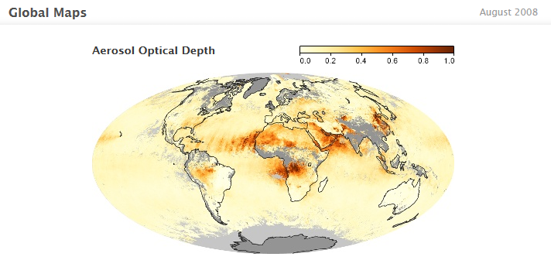
Aerosol Optical Depth (AOD)
AOD measures extinction (by both scattering and absorption).
AOD measures aerosol amount in the vertical atmospheric column
  Typically range: 0-1.
  Optical Depth is very low for pristine, clear skies
  Optical Depth is very high for smoky skies.
  Background AOD over CONUS: ~0.15 ^{(for 550 μm radiation)}
Things that affect AOD:
  Windblown Sand/Dust
  Haze
  Agricultural Burning
(Data from Terra and Aqua)
Notes:
AOD measures the extinction (that is to say, attenuation of light) due to scattering and absorption, so it's related to the number of aerosols in the column. As the scattering or absorption increases (because the number of particles in the air increases), AOD will increase. AOD is very low for pristine air with clear skies, but the value can be large, up to near 5 or 6, for thick smoke events) Visibility is definitely linked to AOD and extinction.
The inset map shows AOD from MODIS on Terra and Aqua. AOD can be affected by a variety of events as noted.

Slide 8
GOES-R ABI Aerosol Detection
Uses reflectance channels on ABI: Daytime only!
2-km resolution. Neither ADP (Aerosol Detection Product) nor AOD (Aerosol Optical Depth) are computed if clouds are present
Aerosol Detection Produced every 15 minutes (Full Disk, CONUS) or every 5 minutes (Meso Domains)
AOD produced every 15 minutes (Full Disk) and every 5 minutes (CONUS)
Smoke plumes are likely to be detected over land and water
Dust is likely to be detected over water; Dust is less likely to be detected over land, thin dust especially
Notes:
Here's a Summary Slide for Aerosol Products.
The Aerosol Products are created using reflectance values, so they are daytime-only product (when solar reflectance is present). They have 2-km resolution - this is the poorest resolution of the reflectance channels and are not computed if clouds are present.
Aerosols Detection occurs every 15 minutes in Full Disk and CONUS domains, and every 5 minutes in Mesoscale domains.
Aerosol Optical Depth is computed every 15 minutes in the Full Disk domain and every 5 minutes in the CONUS domain; - AOD is not computed over Meso domains.
Land is pretty reflective at some wavelengths, and that reflectance makes it a bit harder to detect aerosols over land relative to over water.

Slide 9
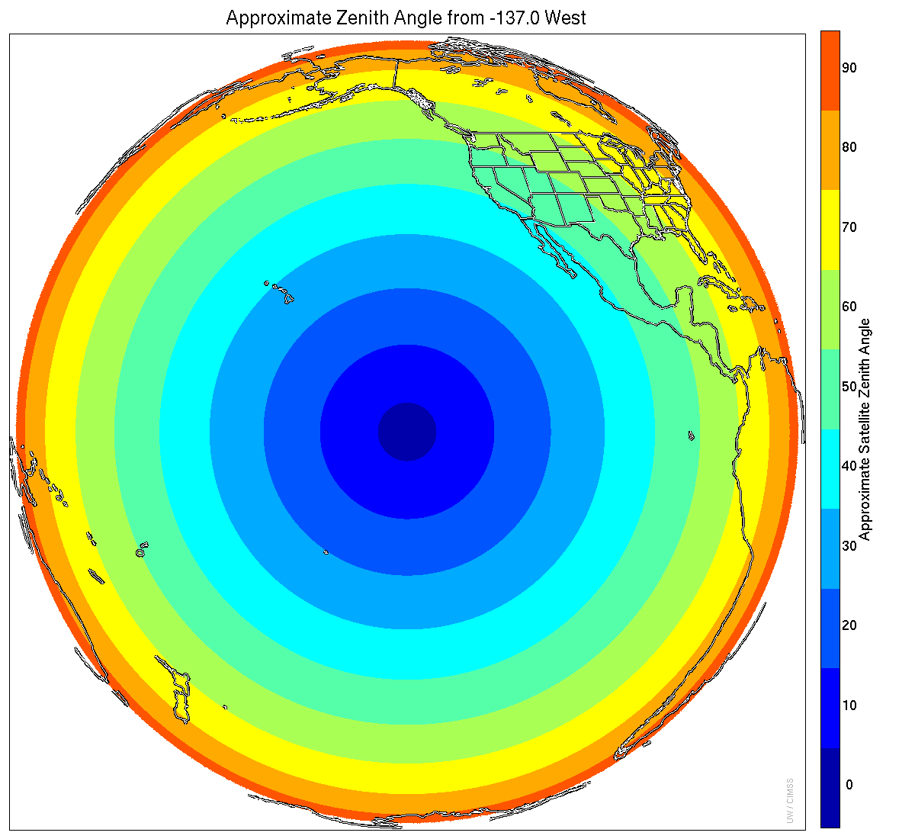
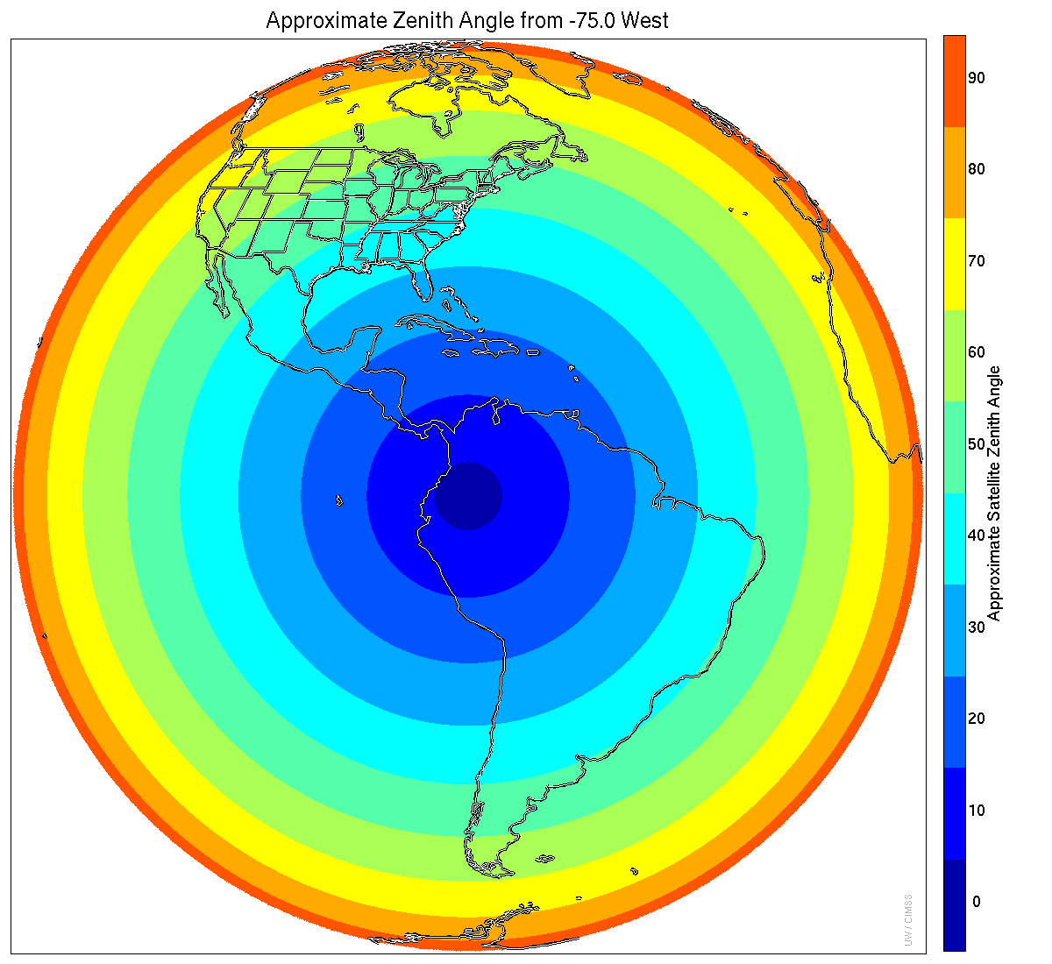
When/Where are ADP products computed?
Full Disk:
  Aerosols and AOD: Every 15 Minutes
CONUS:
  Aerosols: Every 15 Minutes
  AOD: Every 5 minutes
Meso:
  Aerosols: Every 5 Minutes
  AOD: Not Computed
(Quantitative) Up to Solar Zenith Angle of 60
(Qualititative) Beyond Solar Zenith Angle of 60
GOES-R as GOES-West
GOES-R as GOES-East
Notes:
When and where are these products produced? This slide shows that information for the Mode 3 Domains. Quantitative estimates are limited to solar zenith angles less than 60 degrees, the greenish band in the images of the GOES footprints. A forecaster should be more cautious in using products at high zenith angle where the results are only qualitative..

Slide 10
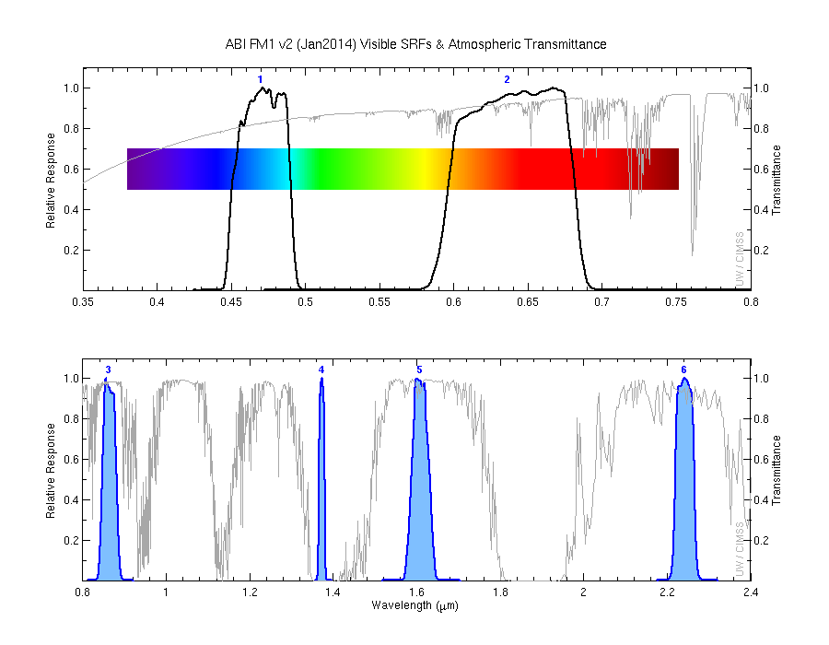
Transmittance for Visible and Near-IR bands on the ABI
Transmittance drops in the blue band as scattering increases
3 of 4 near IR channels are in regions that are transparent to radiation
Notes:
This shows the 2 visible and 4 near-IR channels on ABI that are used to discern reflectance from the surface and from aerosols. The thin line that shows transmittance. Small amounts of scattering/absorption are present in bands 2, 3, 5 and 6 -- that is the red band at 0.64 micrometers, the veggie band at 0.86 micrometers, the ice band at 1.6 micrometers and the cloud phase band at 2.2 micrometers. The cirrus band -- band 4 at 1.38 micrometers -- is a region of strong absorption by water vapor, and the blue band -- 0.47 micrometers, band 1 -- is a region of increased scattering. Differences in absorption and scattering by aerosols between all the bands helps algorithms identify the presence of aerosol.

Slide 11
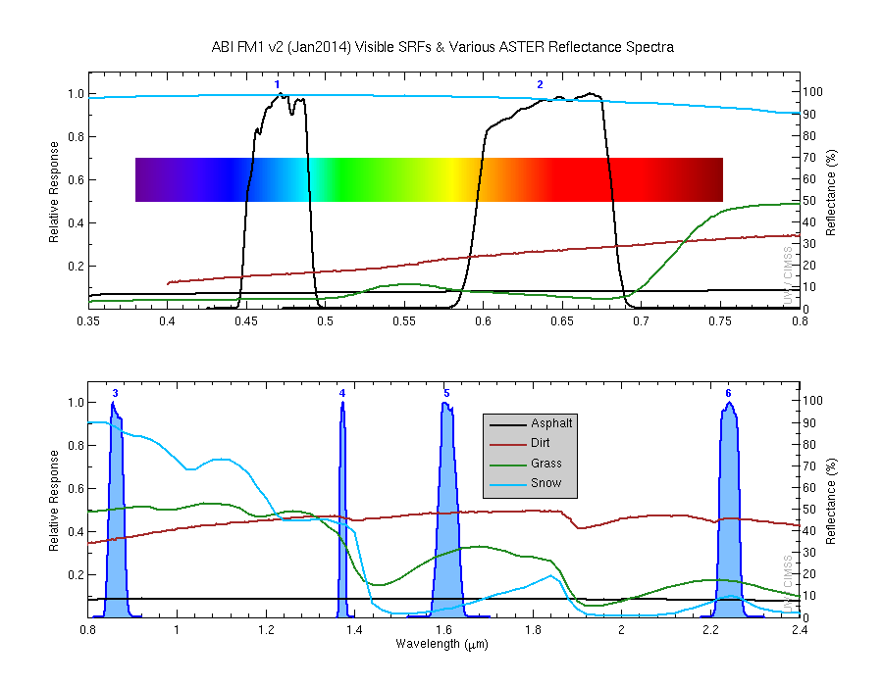
Reflectance for different surface types
Notes:
Reflectance changes as a function of both wavelength and surface type -- and that complicates aerosol detection over land : are reflectance differences being driven by surface type or by aerosols? Aerosol detection over water is more straightforward.

Slide 12
Aerosol Detection and AOD
Reflectance can be from land/ocean surface (unimportant), or from aerosols (important). The trick: Separate the two
Reflectance properties for aerosols and land and water differ for different wavelengths ; multiple channels on ABI allow the ADP to exploit this
All Visible and Near-Infrared ABI Bands are used
  Bands 1-6: 0.47 μm, 0.64 μm, 0.86 μm, 1.4 μm, 1.6 μm, 2.2 μm
The infrared ABI Bands are used
  Bands 7, 14, 15: 3.9 μm, 11.2 μm and 12.1 μm
Notes:
To repeat: The Earth's surface can be highly reflective. Aerosols also affect reflectance in the atmosphere. The trick/challenge is to separate the effect of the surface (not so interesting) from the effect of the atmosphere (much more interesting).
The effect of aerosols on reflected visible light varies with wavelength: the multi-spectral observing abilities of GOES-R (or in polar orbiting satellites) in the visible and near-IR are key. Remember that this is daytime only, as noted already: reflectance is driving the observations of Aerosols/AOD.
All visible/near IR bands are used with this product; Some infrared channels are used as well, especially with regard to the cloud mask.

Slide 13
Imagery is available online as well as in AWIPS
AerosolWatch (Geo and Polar Data)
GeoColor Imagery from CIRA (Geo Data, useful during day)
Natural True Color Imagery from Real Earth (Geo Data, useful during day)
NASA Worldview (Polar Data)
NOAA’s JSTAR Mapper (Polar Data)
Also: HRRR Smoke Modeling!
Notes:
You can find GOES16 Aerosol products - and other products useful for detecting aerosols and smoke - at numerous sites online, such as Aerosol Watch. Some of these show data from polar orbiters that don't have the temporal coverage of GOES, but they have higher spatial resolution, especially near the Poles. There is also as of late 2018 a HRRR Smoke Modeling effort that can help you anticipate where smoke will be.

Slide 14
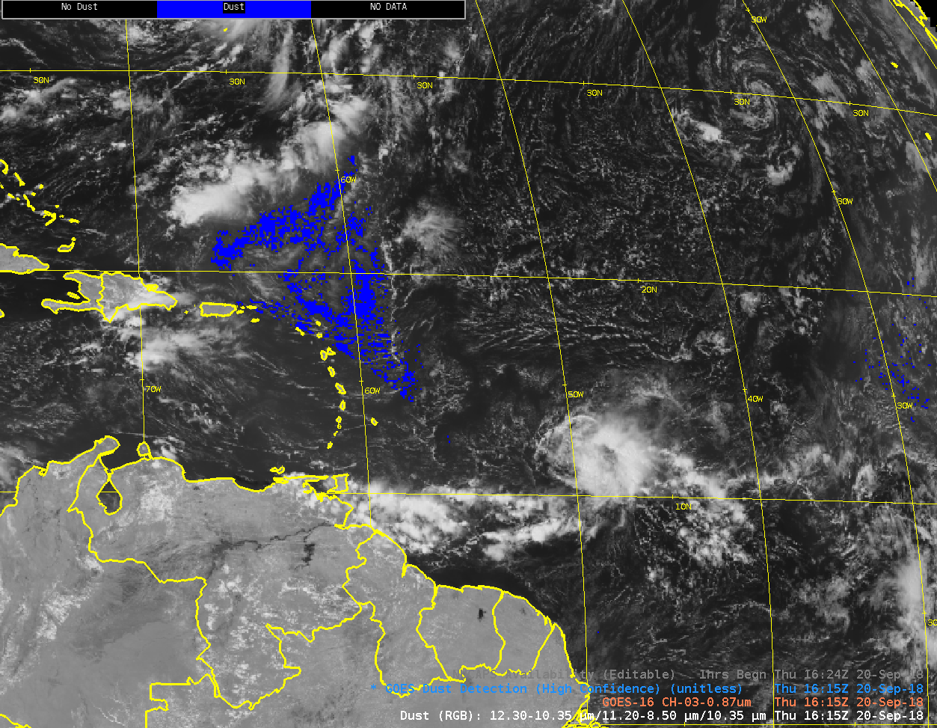
GOES-16 Dust Detection in AWIPS
Notes:
Here's an example of GOES-16 dust detection over the ocean. This is dust associated with a Saharan Air Layer outbreak, GOES-16 Aerosol Detection captured some - but not all of the event. The Split Window Difference product and the Dust RGB, (the RGB is shown next) better captured the large horizontal extent of the dust feature.

Slide 15
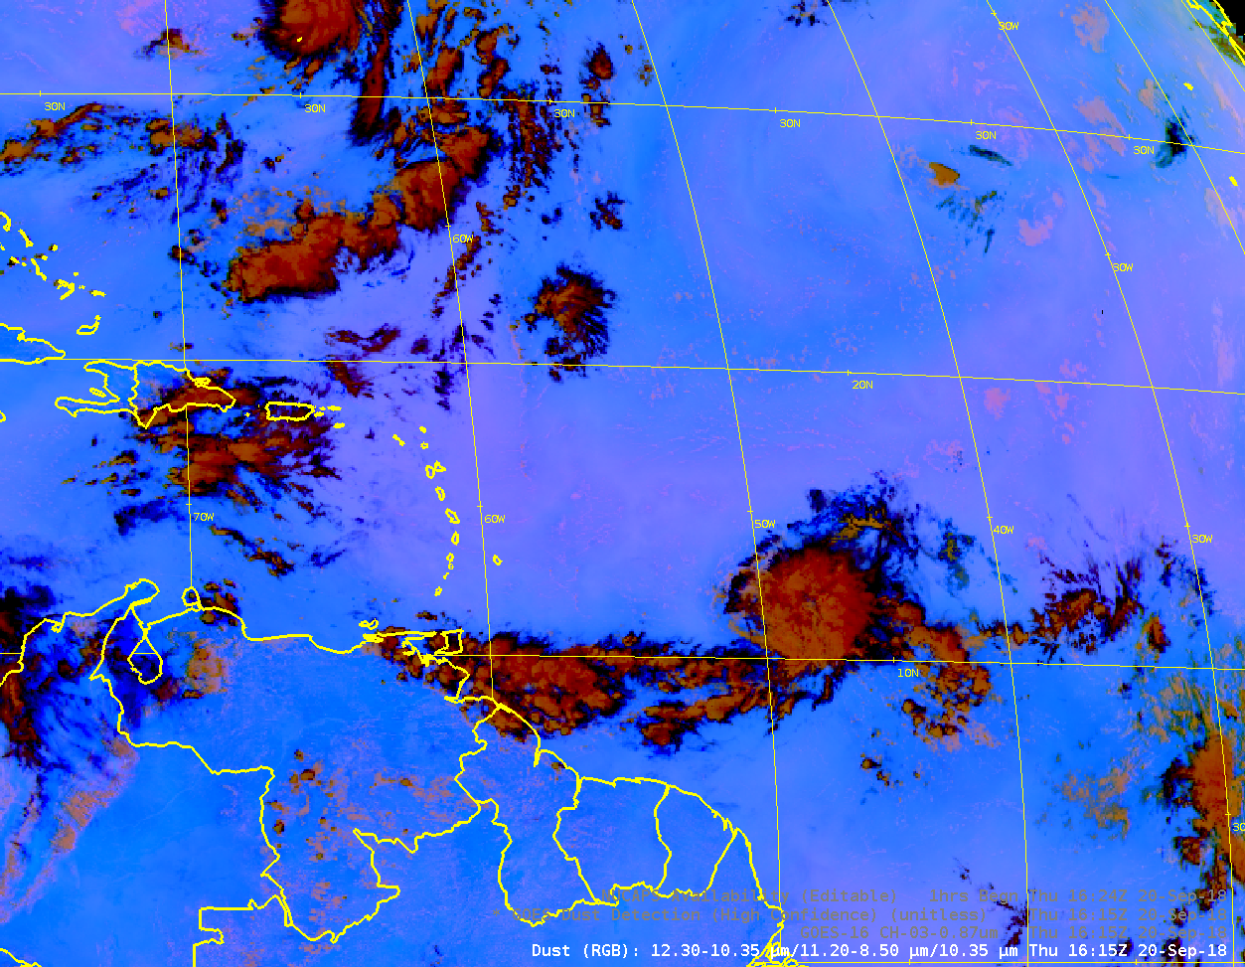
Other ways to detect dust:
Dust RGB (uses IR Imagery)
Pink shading is the region where dust is present
Red Component: 12.3 – 10.3
Green Component: 11.2 – 8.4
Blue Component: 10.3
Notes:
The Dust RGB - components are shown in the lower left - can be used to infer the presence of dust. Dust shows up as shades of pink. In this example, the pink is subtle. Over land, with dust storms, the pink can be vivid.

Slide 16
Recipes for finding smoke
Smoke is separated from cloud using spatial uniformity tests in the 0.64 μm channel. Relative to smoke, clouds show larger variability in this channel.
Cloud reflectance is spectrally independent; smoke reflectance is not. Spectral contrast tests using 0.47 um, 1.61 um, and 2.25 μm separate clouds from thick smoke. This is why multiple spectral bands on ABI are important!
Notes:
GOES-16 daytime Aerosol detection can find smoke. Some of the spectral tests used in the retrievals are shown on this slide. These mostly include looking at a signal in one band and comparing it to a signal in a different band. Aerosol effects differ at different wavelengths. This is the power of multispectral observations.

Slide 17
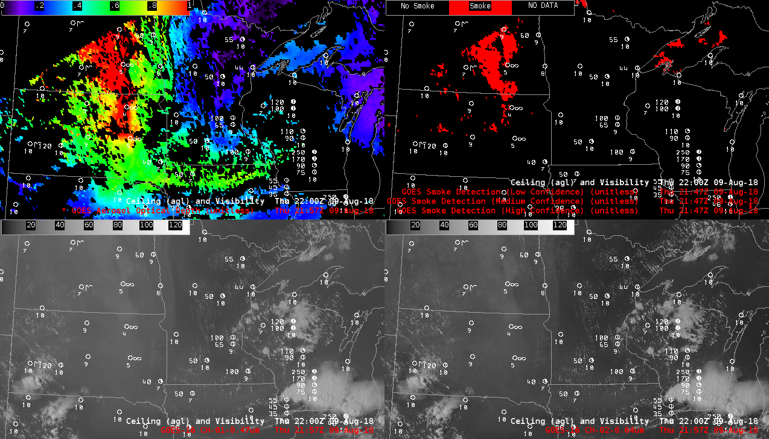
Aerosol Smoke Detection
AOD
ADP (smoke)
0.47 μm
0.64 μm
Notes:
Here's an example that shows Aerosol Detection of smoke in AWIPS (upper right) and Aerosol Optical depth (upper left). The local satellite zenith angle limit is also showing up in these GOES-16 images from 2200 UTC on 9 August 2018. There's a nice correlation -- as you might expect -- between lots of smoke and high values of AOD.

Slide 18
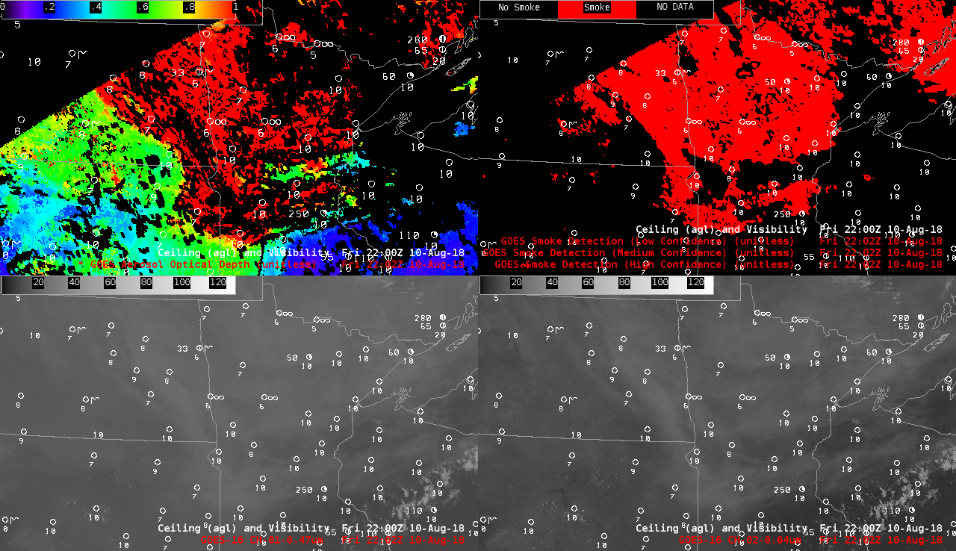
Aerosol Smoke Detection
AOD
ADP (smoke)
0.47 μm
0.64 μm
Notes:
On the following day, Smoke detection and large AOD values were far more widespread. The local satellite zenith angle limit is again showing up in these GOES-16 images from 2200 UTC on 10 August 2018. The very high AOD suggests what a potential health hazard this smoke might be - if it's at the surface. Satellite detection has to be blended with surface detectors and models to ascertain that. But this smoke would certainly affect high temperature forecasts.

Slide 19
Aerosol Optical Depth (AOD) on top of GeoColor imagery
Notes:
Smoke can be very apparent in true-color imagery. Layer the AOD under of true color and you'll see where the air containing the most particulate matter sits. Aerosol Optical Depth is very large near where smoke is apparent in the true color. Is there also smoke there? Yes -- it becomes apparent later in the day when forward scattering allows it to become more obvious.
Along the southern border of this CONUS view you can see the moving region where AOD is not computed because of the potential for Sun Glint.

Slide 20
Challenges to computing AOD over bright surfaces
What is driving the reflectance?
An issue over land especially because radiation reflected by bright surface is much larger than radiation scattered by aerosol towards the sensor (the aerosol signal)
  It’s difficult to quantify the radiation reflected by a bright surface
Sun Glint over water also very bright, but regions of Sun Glint can be predicted
Thus: AOD more likely to be computed for dust over water than over land
Notes:
AOD/Aerosol retrievals are a challenge over very reflective surfaces, especially for dust. So you may see cases where there is obvious dust over land, but little signal in the aerosol products.

Slide 21
Reminders
AOD is not computed
  At Night
  In Cloudy Areas
  Over Bright surfaces (such as deserts or some high mountains)
If smoke or dust is too thick, it can be mistaken for clouds – look at the cloud mask to see if this is happening
Notes:
Reminders as you use the aerosol baseline day-1 products. No useful values where it's cloudy, at night, or over bright surfaces. Very thick smoke and dust can be misidentified as cloud, in which case Aerosol products aren't computed.

Slide 22
Internet Resources
GOES-R Aerosol Advanced Theoretical Basis Document (ATBD)
PowerPoint presentation on aerosols in the atmosphere (from Istvan Laszlo)
Aerosol Watch (with GOES-R Data)
Idea Website (POES-based aerosol observations and links to GOES-based observations of aerosols)
Notes:
Here's where to find more information if you want it. Click on the links. This concludes the GOES-R Baseline Training on Aerosol Products. Thanks for you attention!

