Slide 1
Fog/Low Clouds: Formation and Dissipation
Scott Lindstrom
University of Wisconsin-Madison CIMSS
(Cooperative Institute for Meteorological Satellite Studies)
Notes:
This is the Satellite Foundational Course for GOES-R on Fog Formation and Dissipation, with a focus on how to detect fog. I'm Scott Lindstrom and I will lead you through this training.

Slide 2
Learning Objectives Subject Matter Experts
What bands on ABI can detect fog/low cloud formation and dissipation
What GOES-R Products can detect fog/low cloud formation and dissipation
Michael Pavolonis
Corey Calvert
In this training, the acronym FLS means Fog/Low Stratus
BTD means Brightness Temperature Difference
Notes:
Learning objectives are on the left. You'll learn which GOES-R ABI channels and products can be used to detect fog's presence and to monitor its evolution.
Note the acronyms you'll see in this training, boxed in yellow at the bottom.
Subject Matter Experts for this training are listed on the right. Mike Pavolonis from NOAA, Corey Calvert from the Cooperative Institute for Meteorological Satellite Studies.

Slide 3
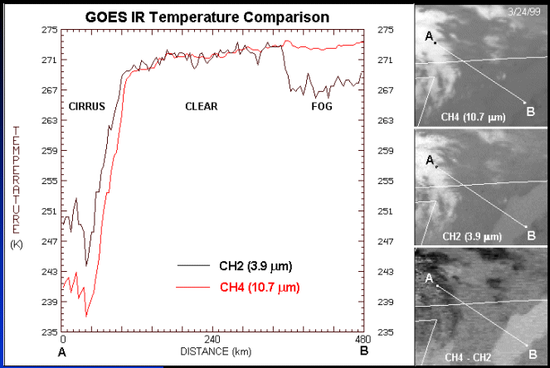
Legacy
Band differences can be related to surface- (or cloud-) based
emissivity differences or to sub-pixel effects
Regardless of cause, the differences can be exploited
Notes:
BTD detection of clouds made up of water droplets works because water droplets in clouds are not blackbody emitters of 3.9 micrometer radiation. The conversion of satellite-detected radiance to temperature assumes that an emitter is a blackbody; for the case of 3.9 micrometer radiation above cloud droplets, then, where the amount of radiation detected will be less than that emitted by a blackbody, the inferred temperature is cold. clouds do emit 11 micrometer radiation more as blackbodies, so the inferred brightness temperature won't be so cold. In this cross-section from a fog bank to a cirrus deck, you see brightness temperature differences over the fog that are related to emissivity differences in the cloud (so that the 3.9 micrometer brightness temperature is cooler than that a 10.7 micrometer). Over the cirrus, sub-pixel effects cause a difference so that 3.9 micrometer brightness temperatures are warmer than 10.7 micrometer brightness temperatures. In clear regions, at night, the 10.7 and 3.9 brightness temperatures are similar.

Slide 4
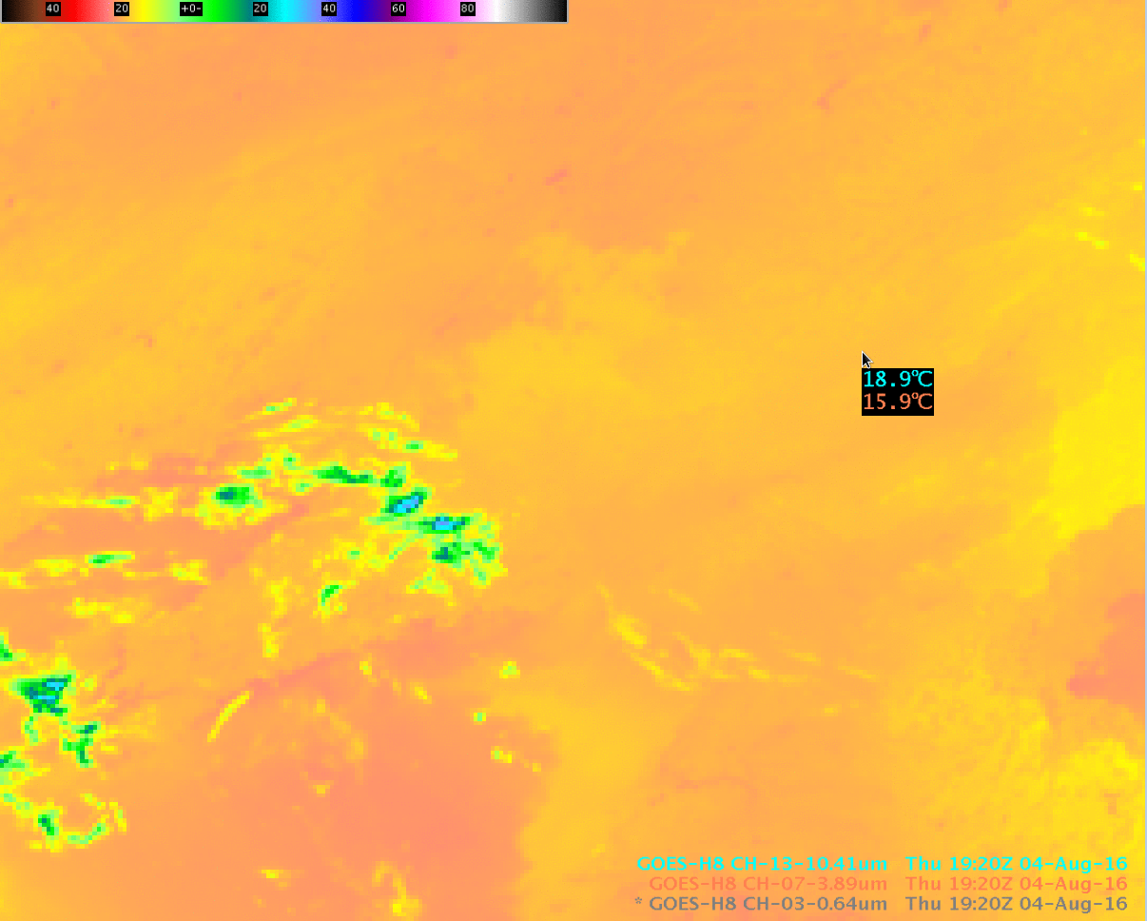
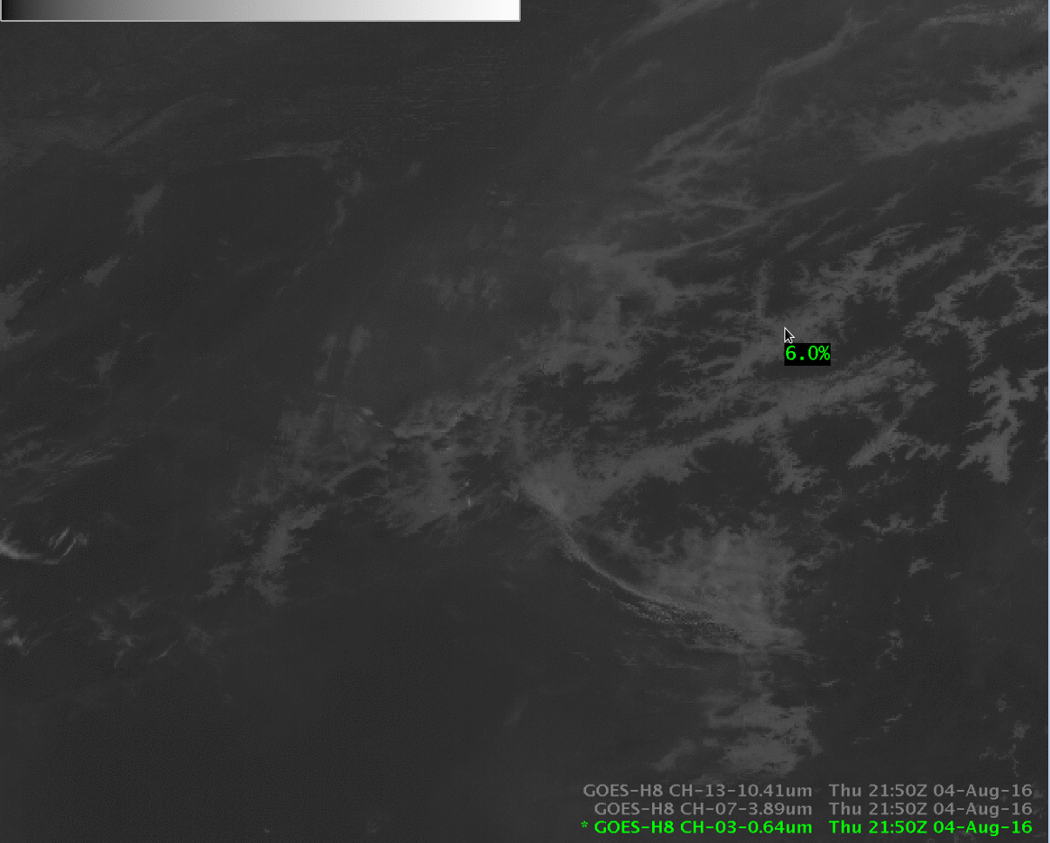
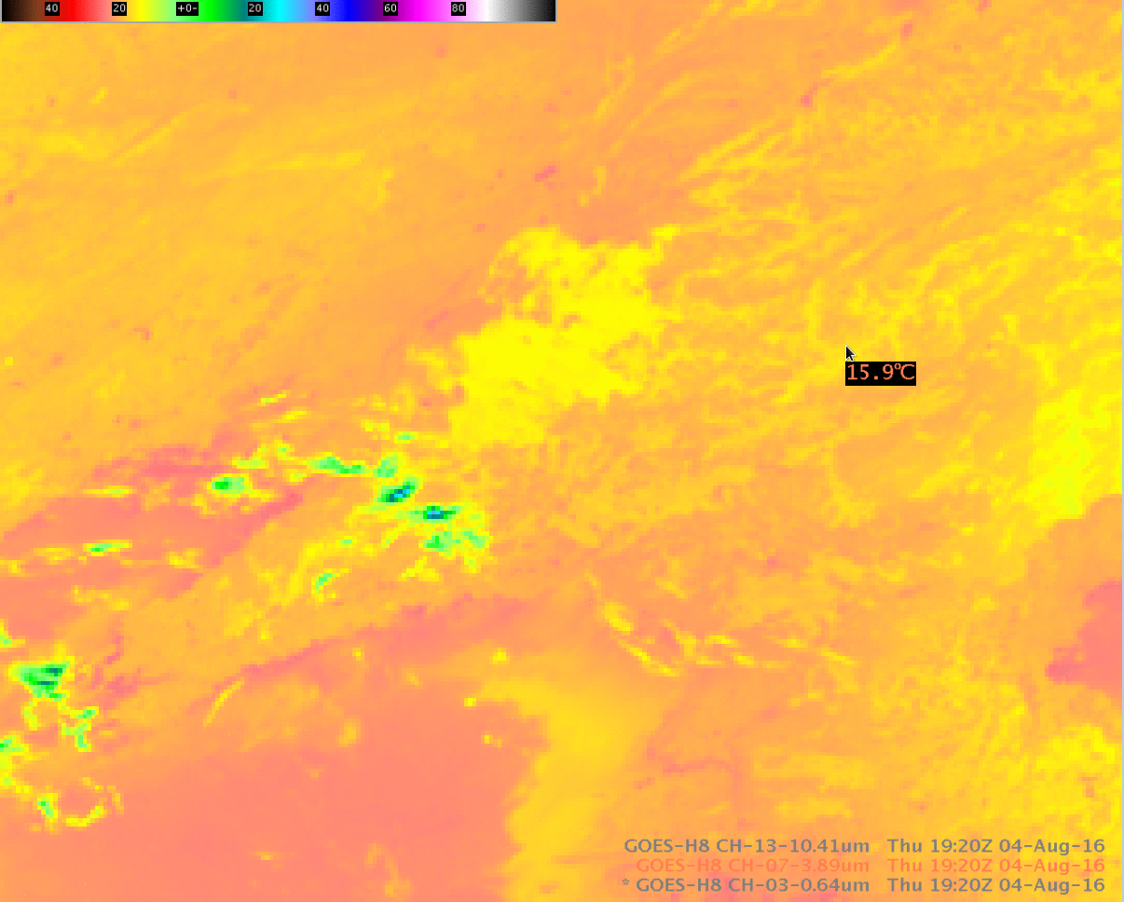
Himawari has similar bands as GOES-R
Longwave Infrared (10.4 μm)
Shortwave Infrared (3.9 μm)
Notes:
This slide shows Himawari data over northeast China near the Korean Peninsula --(Himawari and GOES-R have similar bands). The Band 13 (10.4) micrometer imagery shows a fairly flat field. The AWIPS probe shows temperatures from 10.4 and from 3.9 micrometers at a point. *click* Note that the 3.9 micrometer brightness temperature is much cooler in many places, not just at the probe, as is obvious based on the 3.9 micrometer imagery. Stratus clouds are filling the valleys in this region of Asia, and emissivity differences from the water droplets in the cloud drive temperature difference between this channel and the 10.4 micrometer channel; those differences highlight low clouds/fog/stratus. The difference field between those two infrared channels show signatures similar to*click* this visible image from shortly after sunrise that confirms the presence of clouds in the valleys. But do those clouds extend to the ground? That's a hard thing to determine from satellite data. *click*b

Slide 5
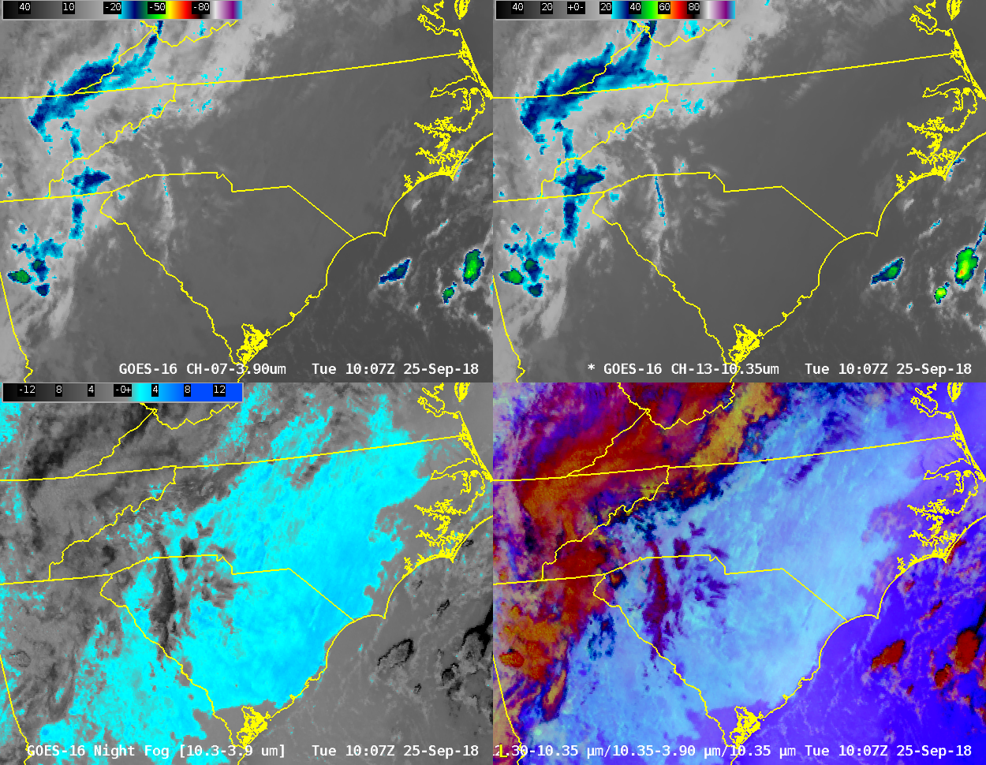
Fog over the Carolinas
3.9 μm
10.3 μm
10.3 – 3.9
Notes:
Low stratus is indicated in these images by the Brightness Temperature Difference field (regions enhanced in blue, meaning positive values at night) in the lower left. You can also infer the presence of clouds because you can't see surface features like rivers in the single band imagery. The Advanced Night time Microphysics imagery also indicates stratus (with a blue/cyanish hue in the same region as the brightness temperature difference field) Here's the question: Is this stratus, or fog? Is there stratus under the high clouds over Georgia and Tennessee? How can you tell?

Slide 6
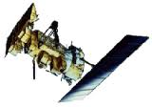
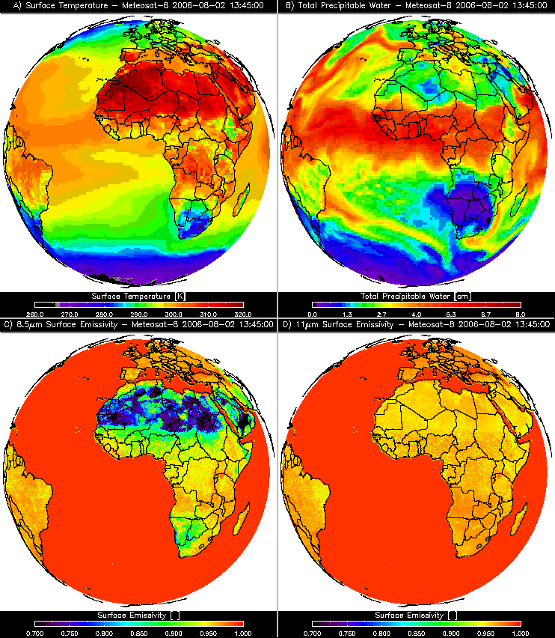
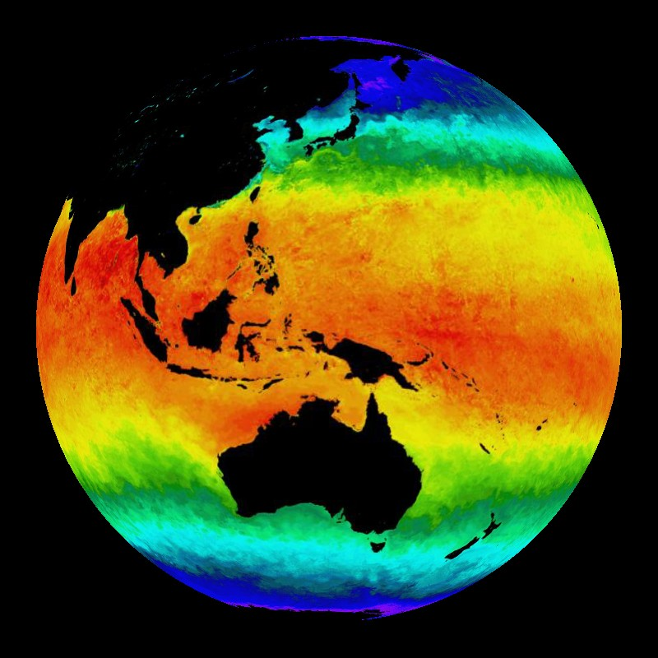
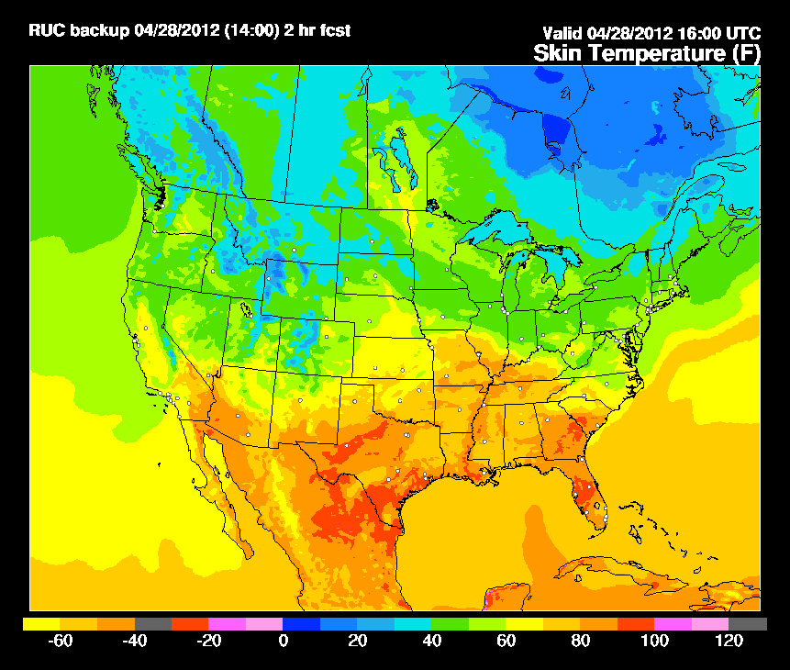
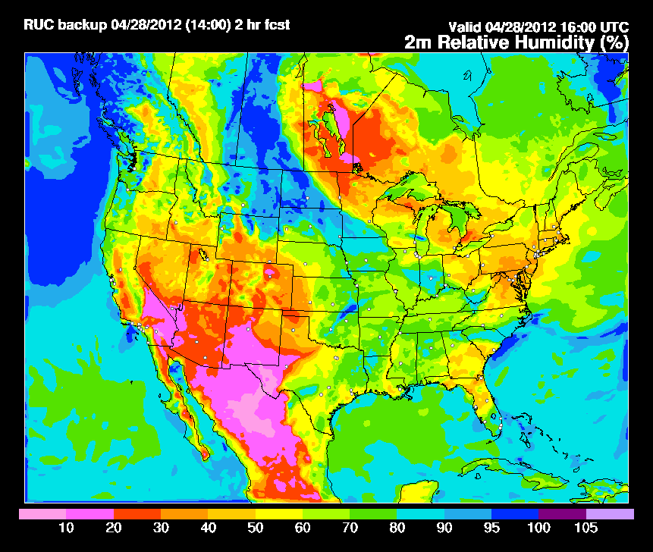
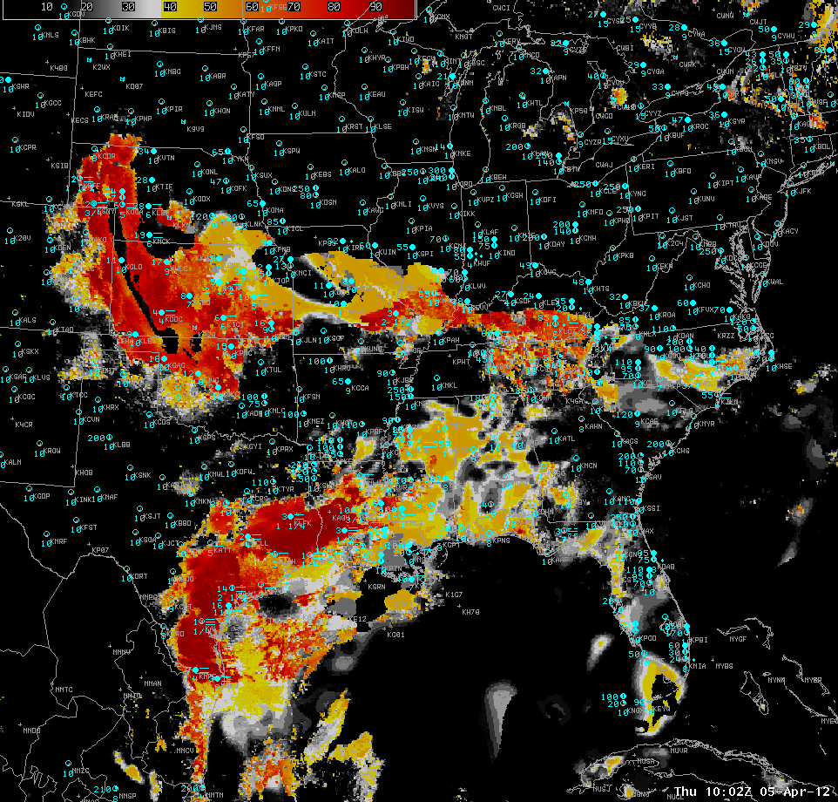
Fused Fog/Low Cloud Detection Approach
Satellite Data
Static Ancillary Data
Daily SST Data
NWP
+
+
+
-Minimum channels needed: 0.65, 3.9, 6.7/7.3, 11, and 12/13.3 μm
-Previous image for temporal continuity (GEO only)
-Cloud Phase
-Surface Temperature
-Profiles of T and q
-RUC/RAP (2-3 hr forecast) or GFS (12 hr forecast)
-DEM
-Surface Type
-Surface Emissivity
0.25 degree OISST
Clear Sky RTM
NWP RH Profiles
IFR and LIFR Probability
Statistical Model
Total run time: 2 - 3 minutes
-RUC/RAP (2-3 hr forecast) or GFS (12 hr forecast)
Other sources of relevant data (e.g. sfc obs) influence results through the model fields
Notes:
6
GOES-R IFR Probability fuses cloud information from satellites with model information (the Rapid Refresh is used over CONUS) about low-level saturation. Other Static information is used as well to create a statistically-generated prediction about the probability of IFR conditions.
Saturation information from the model screens out regions of mid-level stratus that are usually unimportant as a transportation hazard. Saturation information from the model also reveals important information about low clouds under cirrus. Model fields can struggle to depict small-scale fog events like valley fogs that occur at sub-grid scale resolutions.
The fusion process takes the strengths of both systems -- satellite and model --- and allows for confident identification of MVFR, IFR or Low IFR conditions even when one of the individual predictors fails at highlighting their potential.

Slide 7
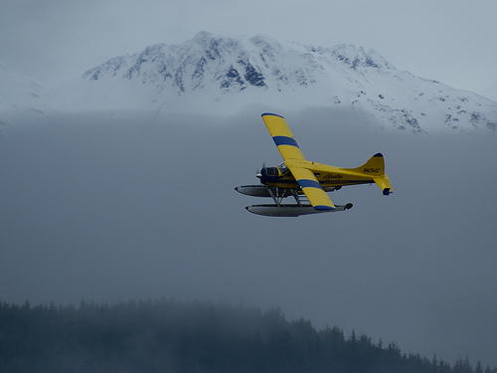
Why create Probabilities of Flight Rules?
VFR - Visual flight rules
ceiling > 3000 ft and vis > 5 mi
MVFR - Marginal visual flight rules
1000 ft ≤ ceiling ≤ 3000 ft or 3 mi ≤ vis ≤ 5 mi
IFR - Instrument flight rules
500 ft ≤ ceiling ≤ 1000 ft or 1 mi ≤ vis ≤ 3 mi
LIFR - Low instrument flight rules
ceiling ≤ 500 ft or vis ≤ 1 mi
There is no widely accepted definition of Fog/Low Stratus (FLS) so the GOES-R definition of FLS relies on aviation flight rules
The primary goal of the GOES-R fog/low cloud detection algorithm is to identify IFR, or lower, conditions.
Notes:
IFR conditions was selected for this product because it has well-defined limits, unlike the more nebulous word 'fog'.

Slide 8
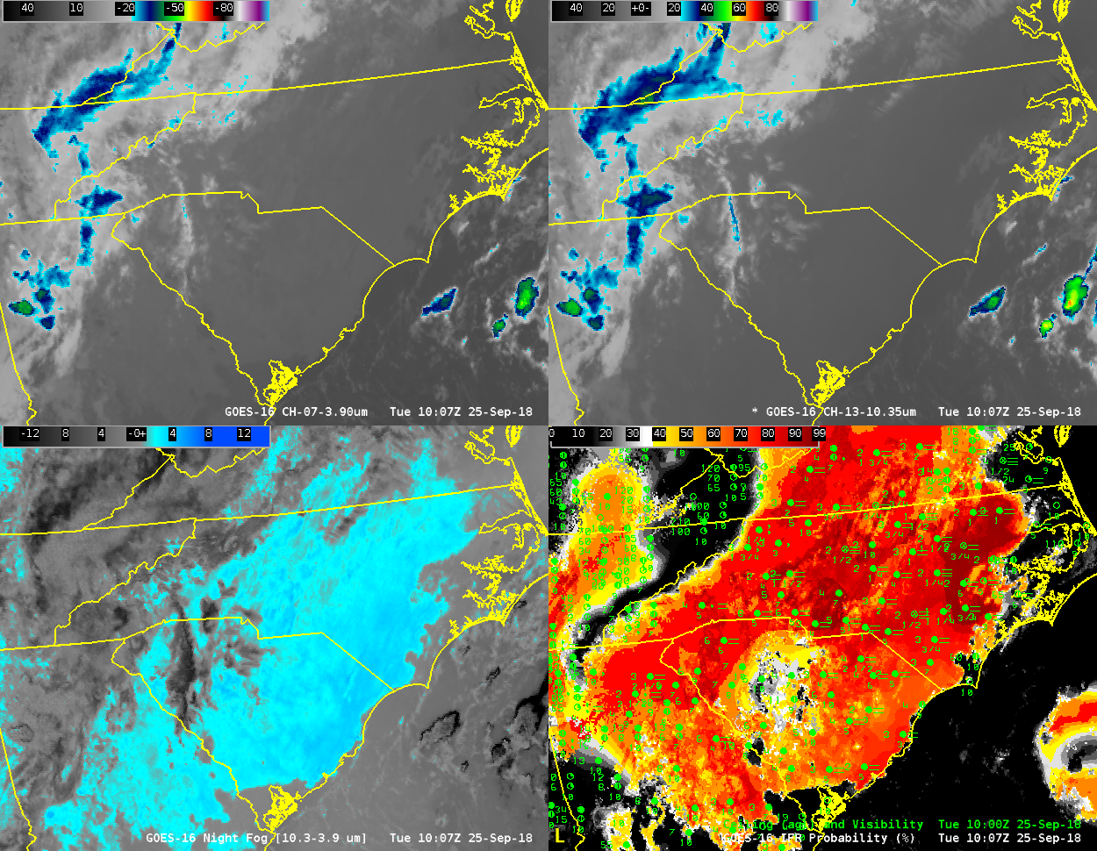
Fog over the Carolinas
3.9 μm
10.3 μm
10.3 – 3.9
Notes:
So here's the view over the Carolinas again, but IFR Probability has replaced the RGB.
Because information from both satellite and model are considered, IFR Probability can give a consistent signal in regions where cirrus clouds block the satellite view of low clouds, such as over northeast Georgia. Model fields suggest low-level saturation there. Stratus and Fog can look very similar from the satellite, but saturation information from the Rapid Refresh allows IFR Probability to screen out regions of mid-level stratus, such as over central South Carolina (where the Rapid Refresh is not suggesting that low-level saturation is occuring).

Slide 9
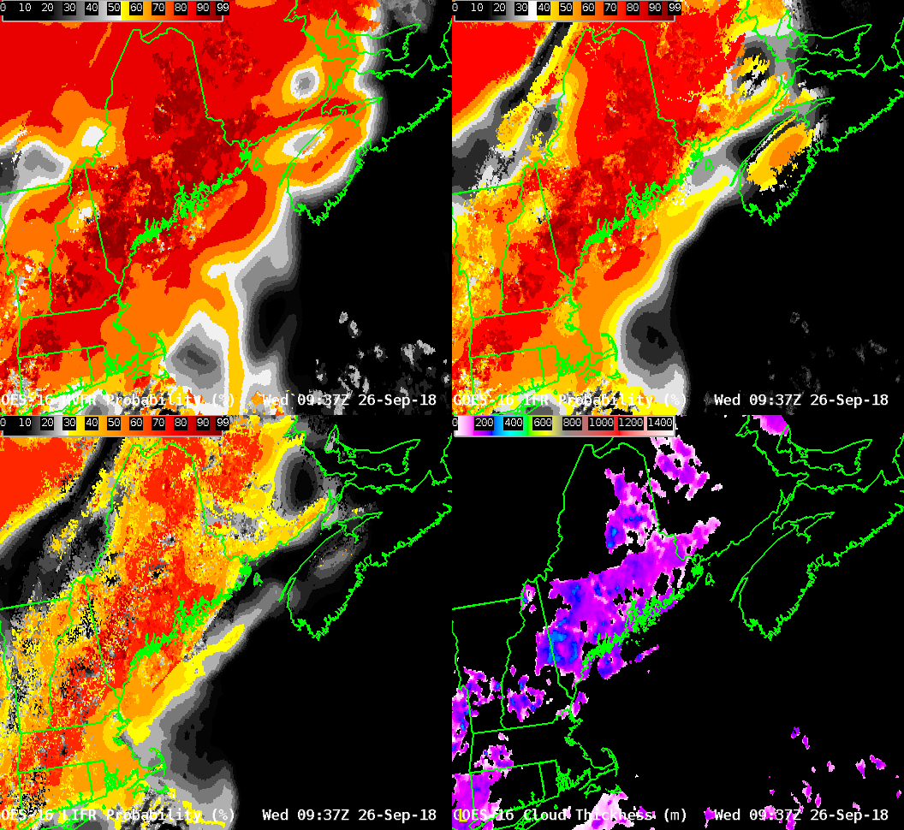
GOES-R Fields
MVFR Probability
IFR Probability
LIFR Probability
Cloud Thickness
Notes:
The previous slide showed IFR probability, but there are actually three probability fields, for MVFR, IFR, and Low IFR conditions, as shown here over New England. As you might expect, MVFR Probabilities are always greater than IFR Probabilities which are always greater than Low IFR Probabilities.
Cloud Thickness is a GOES-R Product that estimates the vertical thickness (cloud base to cloud top) of the lowest water-based cloud layer. This product is essentially a look-up table that compares 3.9 micron emissivity to SODAR observations of cloud thickness off the west coast of the USA. GOES-R Cloud Thickenss is not created in regions of multiple cloud layers because satellite information on the lowest layer is missing in such cases. GOES-R Cloud Thickness is also not computed during twilight conditions because of rapid changes in the reflected component of 3.9 micron radiation.
The fields shown here have two distinct regions. Over coastal Maine, the satellite has an unobstructed view of low clouds. Probability fields are pixelated, reflecting the variability inherent in satellite data. GOES-R Cloud Thickness can be computed. High clouds are present over eastern massachusetts, and Probability fields there rely on model data, and they consequently look much smoother because of smoothing that occurs in the model and because of relatively coarse model resolution.

Slide 10
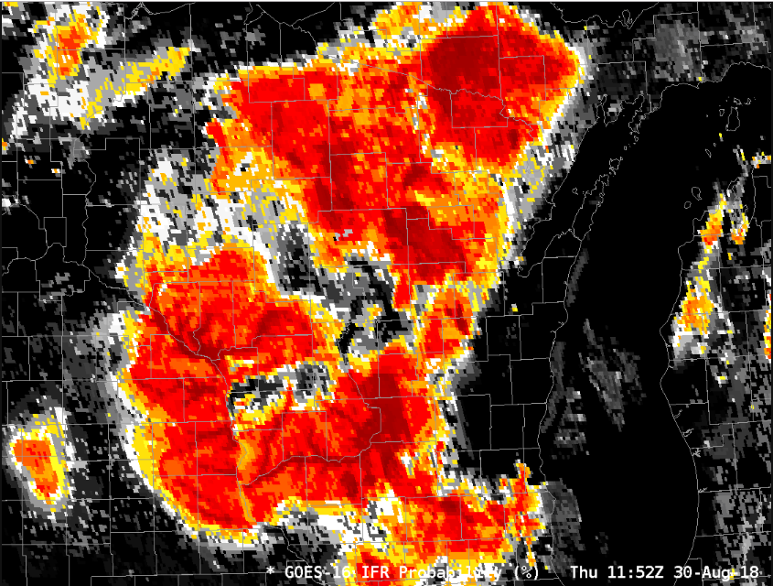
Satellite Data can see River Valleys – Rapid Refresh data may not resolve them
Higher Probabilities where Satellite detects clouds in River Valleys, or is it because Rapid Refresh doesn’t have a big signal here?
Horizontal Resolution for GOES-R: 2km at sub-satellite point
Notes:
When river valley dimensions are smaller than the model resolution - as is often the case with small rivers in, for example, Appalachia, or the ozarks, or in this case over Wisconsin and Iowa, satellite information will accentuate river valleys in IFR Probability fields. In fact you'll often see an IFR Probability signal there first. GOES-16 and GOES-17 has 2-km horizontal resolution at the sub-satellite point. Rapid Refresh horizontal resolution is 13 km.

Slide 11
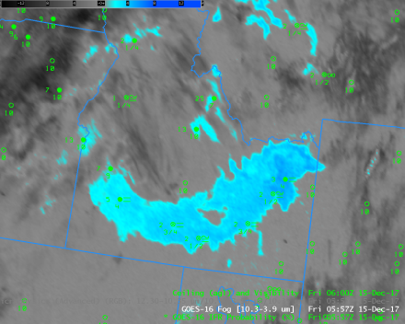
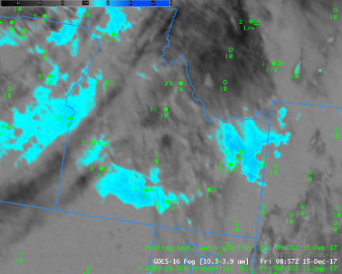
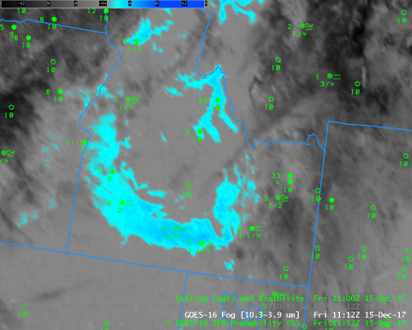
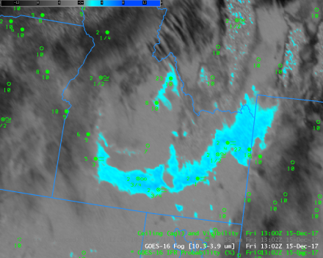
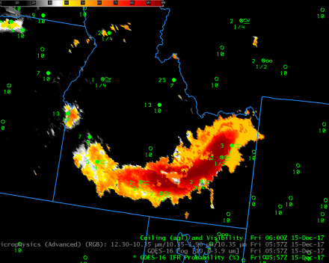
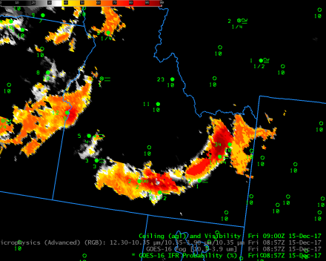
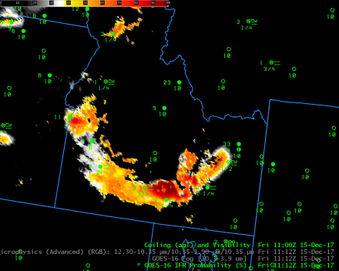
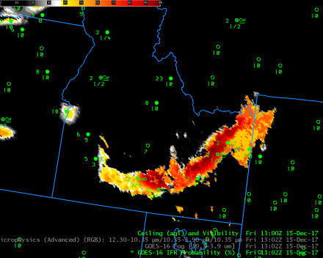
Fog over Idaho under cirrus
0557
0857
1112
1302
10.3 μm – 3.9 μm
0557
0857
1112
1302
IFR Probability
(Source)
Notes:
These images show topography constraining low clouds (around the Snake River in Idaho). Occasional cirrus here makes the brightness temperature difference field sub-optimal for fog detection. But IFR probability fields maintain a consistent signal.

Slide 12
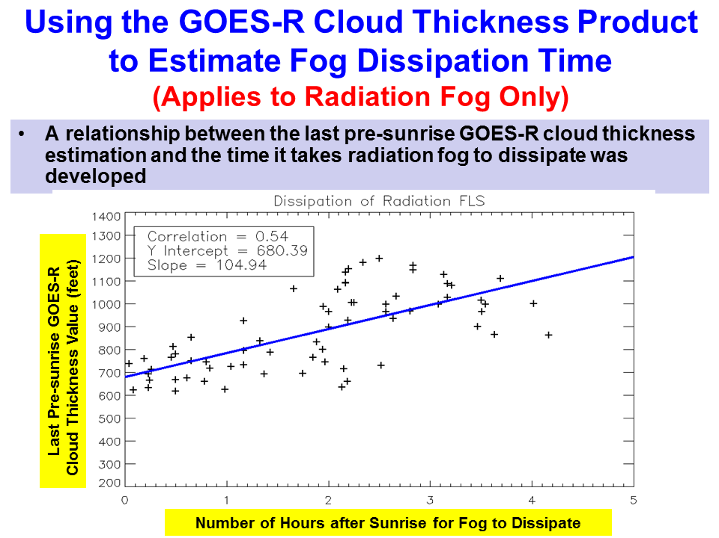
Fog Dissipation as a function of Cloud Thickness
Notes:
GOES R Cloud Thickness -- the last one before sunrise (the y axis values) -- and fog dissipation time (x-axis values) are related. The points on this graph were determined by hand for radiation fog only, mostly for cases over the southeast US.
If the last Cloud Thickness value before sunrise was at 1145 UTC, and it showed a cloud thickness of 900 feet, the best-fit blue line suggests a dissipation time of about 2 hours later: 1345 UTC.

Slide 13
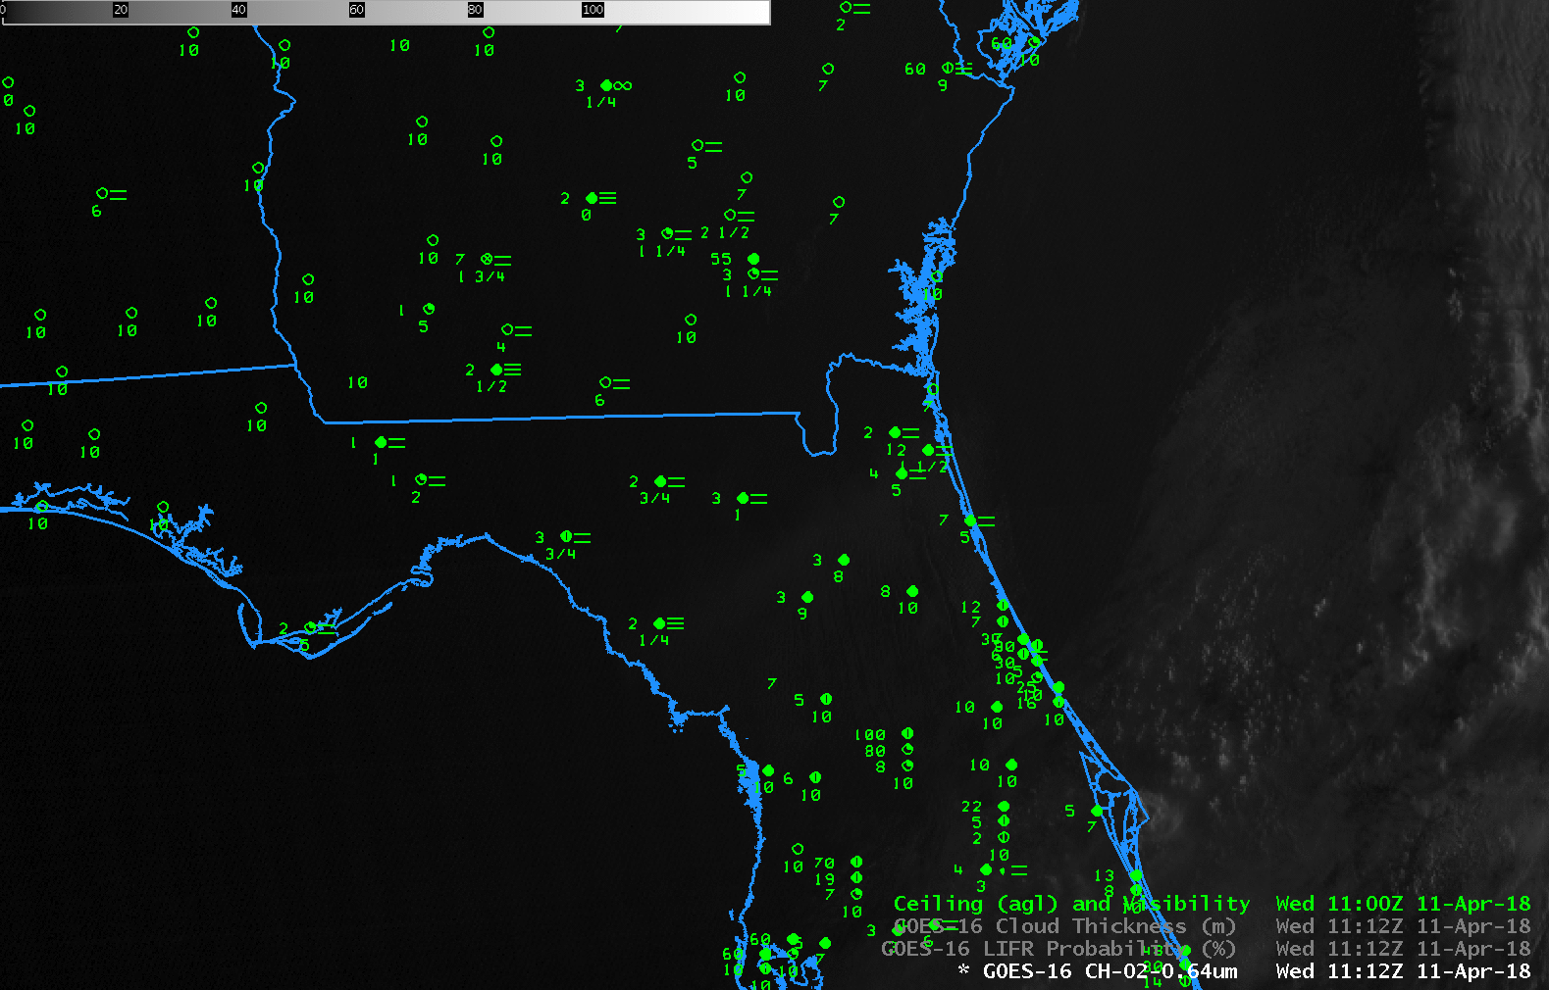
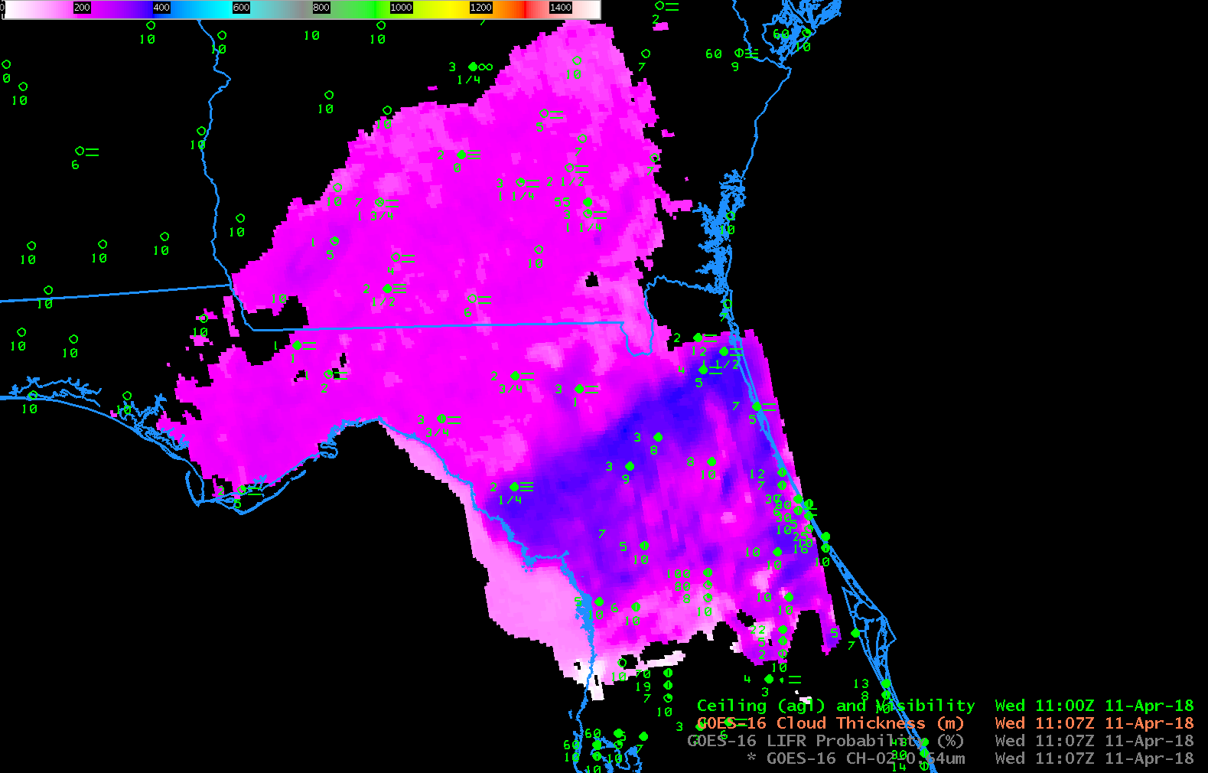
Cloud Thickness and Dissipation
1107 UTC GOES-R Cloud Thickness
Source
Notes:
This example demonstrates the utility of Cloud Thickness in predicting dissipation time. The still figure is Cloud Thickness - the last one before morning twilight conditions (and in fact you can see the data cutoff right off of Florida’s east coast). Values are very small – magenta is around 300 feet, blue is closer to 400 feet. Those small values suggest rapid burnoff, and that’s what happened, as shown in the inset animation. Note that the region with thickest fog had fog for the longest time, but that almost all is gone by 1307 UTC, 2 hours after the Cloud Thickness image.

Slide 14
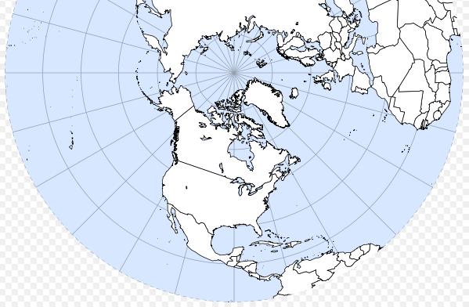
Keep in mind…. (Model Domains)
Model used to predict location of FLS varies and there are inter-model seams
GFS
AK
Grid
(~11 km)
Regional Grid
(~32 km)
CONUS Grid
(~13 km)
GOES-R FLS products can significantly change between neighboring pixels at model seams.
Notes:
The Model data used in IFR Probability varies by region; domains and resolutions noted on this slide. If you are forecasting outside of North America, You might see probability differences at the model boundaries because GFS and Rapid Refresh solutions will vary.

Slide 15
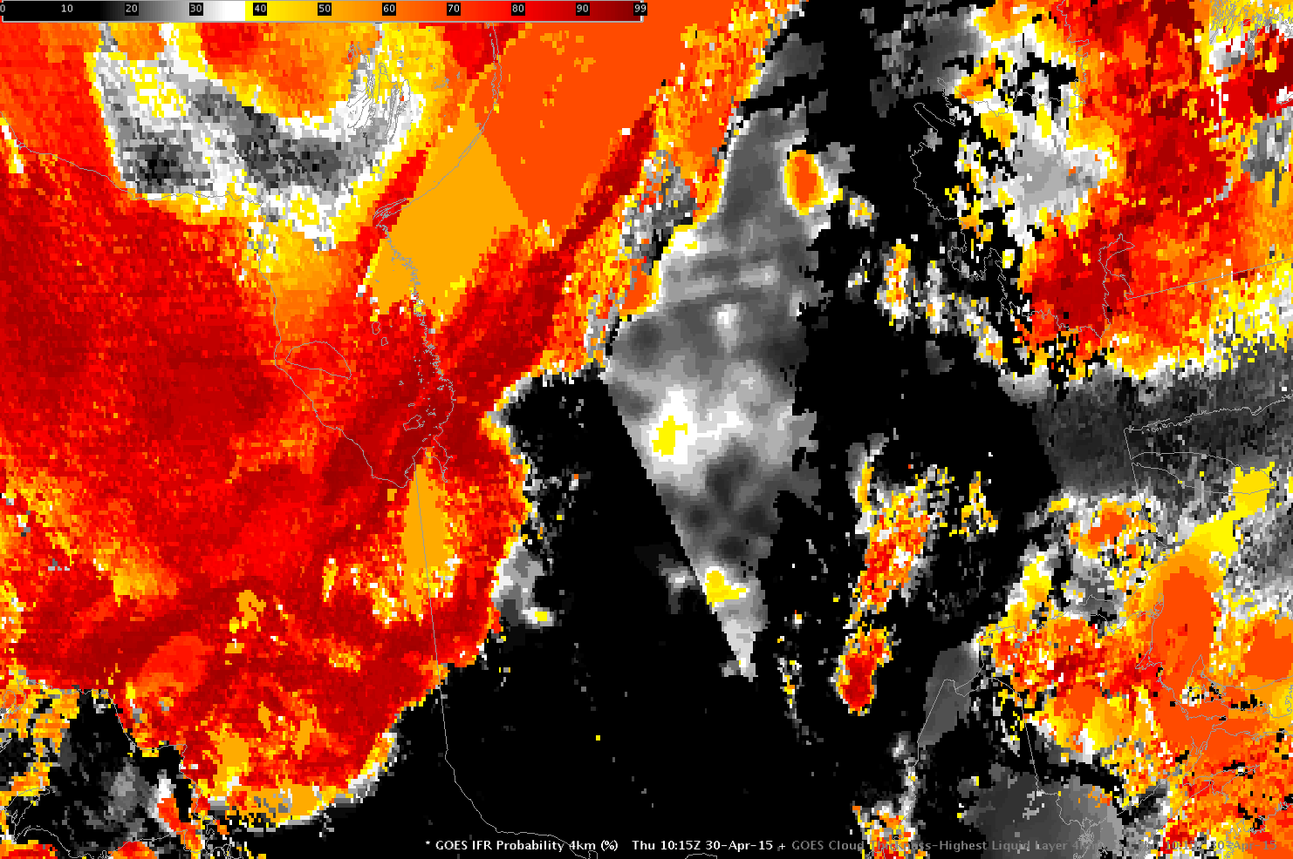
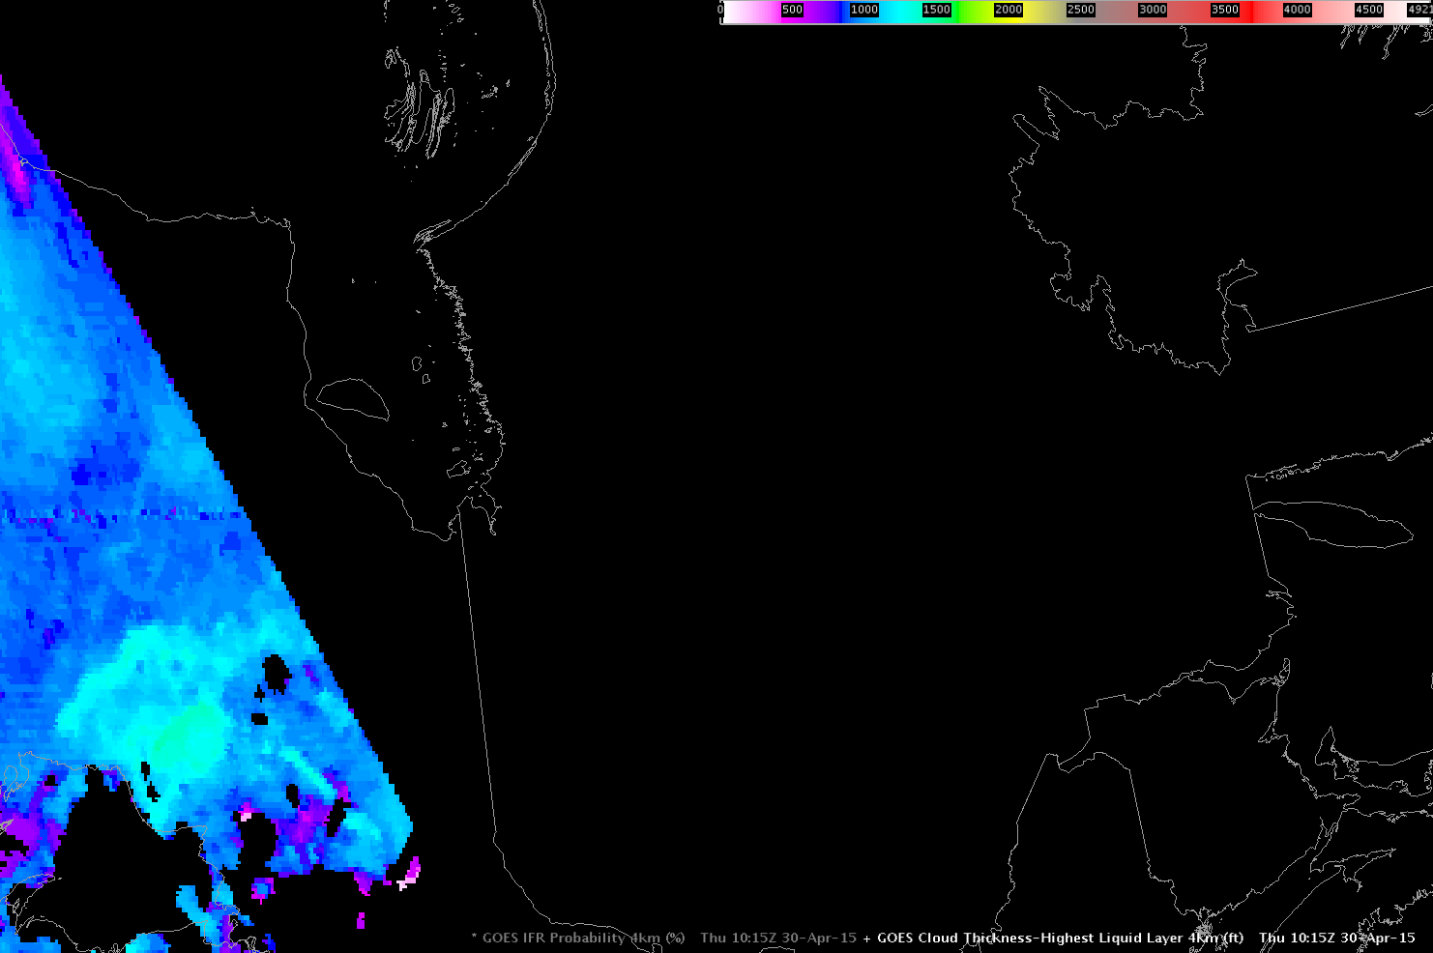
Keep in mind…. (Day/Night)
Twilight Conditions:
Cloud Thickness not
computed
Daytime Predictors
used
Nighttime Predictors
used
GOES-R IFR Probabilities
GOES-R Cloud Thickness
Still nighttime over here
Not shown on this slide: the Brightness Temperature Difference changes sign at sunrise as 3.9 μm radiation reflects/scatters off clouds. Changes in IFR Probability are more subtle than Brightness Temperature Difference changes
Notes:
There are occasionaly stray light issues around the Equinoxes in Brightness Temperature Difference fields -- and that affect IFR Probability fields. Be aware of that. This slide shows the discontinuity in IFR probabilities during the transition from day to night or vice versa. Satellite predictors used during the day differ from those used at night. In general, IFR Probability increases during the day because of changes in the statistical predictors used.
The GOES-R cloud thickness product is not computed during twilight conditions, but is available all night and during most of the day for single layer water clouds.

Slide 16
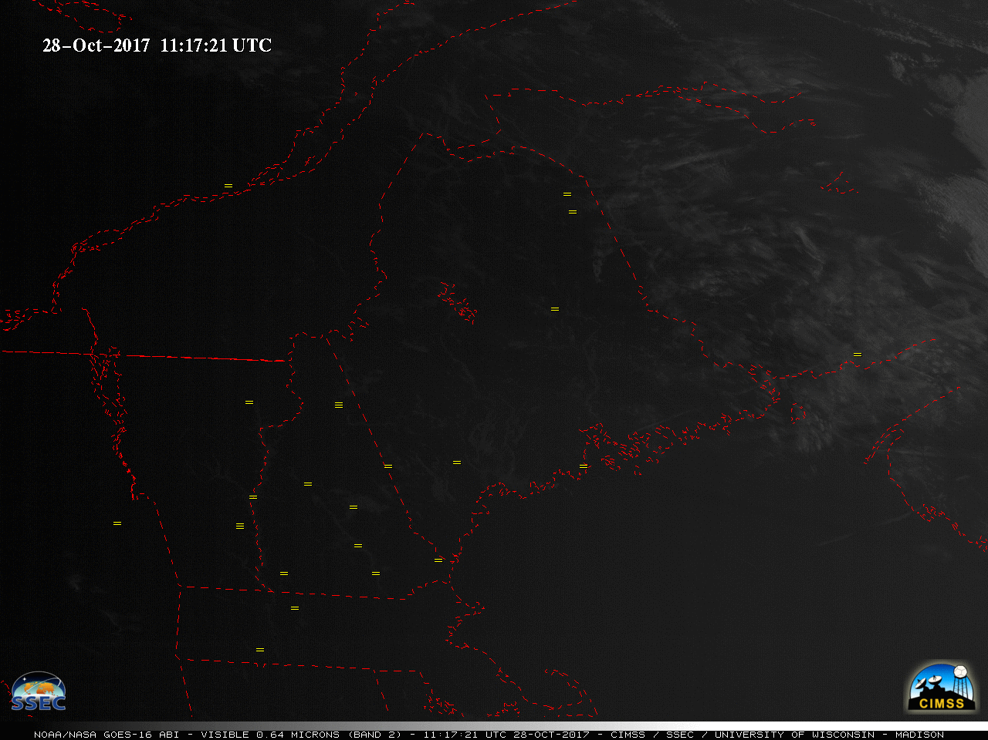
Precise temporal information on dissipation: routine 5-minute data
Notes:
GOES-R has routine 5-minute data. This is a handy when precise information on dissipation time is required. If you need even more precision, request a meso and get 1-minute data!

Slide 17
GOES-R FLS Validation Over CONUS
The FLS products were validated using surface observations of ceiling and visibility
The plot below shows the Critical Success Index (CSI) of the daytime/nighttime GOES-R IFR probabilities along with the nighttime BTD product as a function of the threshold used to differentiate between FLS and non-FLS clouds
The maximum CSI for the nighttime BTD product was calculated at 0.254
The maximum CSI for the daytime/nighttime IFR probabilities were calculated at 0.453/0.438 respectively, nearly double that of the traditional BTD product
The maximum CSI occurs when the IFR probability is ~25% (physical basis for our colorbar)
Notes:
GOES-R IFR Probability is statistically superior to Brightness Temperature Difference fields in predicting IFR conditions. You've already seen cases that should convince you of this. If high clouds block the view, IFR Probability can give a good signal based on model data. If stratus is elevated, IFR Probability will screen out the region based on model data. Both of these examples will lead to better statistics for GOES-R IFR Probabilities.
Validation here was performed using 1 day from each month. There were roughly 1100 GOES-E scenes. CSI for IFR PRobability is roughly twice that of Brightness Temperature Difference fields for lower IFR Probability values.

Slide 18
Summary
BTD provides little information about
cloud ceilings
low clouds in regions of multiple cloud layers
The GOES-R IFR Probability fuses satellite data with model information about low-level saturation
Supplies information about cloud ceilings
Fills in information in regions where multiple clouds layers exist
IFR Probability is a statistically superior product for fog detection.
It screens out mid-level stratus
It adds information in regions where cirrus clouds block satellite view of low clouds
Notes:
Brightness Temperature Difference fields are challenged to provide information about cloud ceilings, as the satellite sees only the top of the cloud. Brightness Temperature Difference fields cannot give information when high cirrus obstructs the view of low clouds. IFR Probability fields in these cases can augment the satellite to give a more complete description of the near-surface saturation.
GOES R cloud thickness fields can be used to predict fog dissipation time.

Slide 19
Internet Resources
Blog on IFR Probability fields
GOES-based fields available online
1-page Quick Guide on IFR Probability
Training Module on GOES-R IFR Probability
Notes:
You can click on these links to find more information on the product. This concludes the Satellite Foundation Course for GOES-R on Fog Detection. Thank you for your attention.

