Slide 1
The Baseline
GOES-R Volcanic Ash Product
Michael Pavolonis
NOAA / STAR
Justin Sieglaff and Scott Lindstrom
University of Wisconsin-Madison CIMSS
(Cooperative Institute for Meteorological Satellite Studies)
Notes:
This is the Satellite Foundational Course for GOES-R training on the Baseline GOES-R Volcanic Ash Product. The Subject Matter Expert on this is Mike Pavolonis, from NOAA STAR, assisted by Justin Sieglaff at CIMSS. My name is Scott Lindstrom and I’ll be navigating you through this training.

Slide 2
Module Goals
Introduce the baseline volcanic ash products that will be available to users from the operational GOES-R Ground System (known as the baseline products).
Outline the best practices for using the baseline GOES-R volcanic ash products.
Highlight differences between the baseline GOES-R volcanic ash products and the products generated by the VOLcanic Cloud Analysis Toolkit (VOLCAT). Users are currently receiving the VOLCAT products.
Notes:
This training will describe the baseline Volcanic Ash products that are available to users from the GOES-R Ground System. These products are available in AWIPS. This module will also outline best practices for using the baseline GOES-R Volcanic ash products, and highlight differences between the Baseline Product and VOLCAT (VOLcanic Cloud Analysis Toolkit) products that some users currently access.

Slide 3
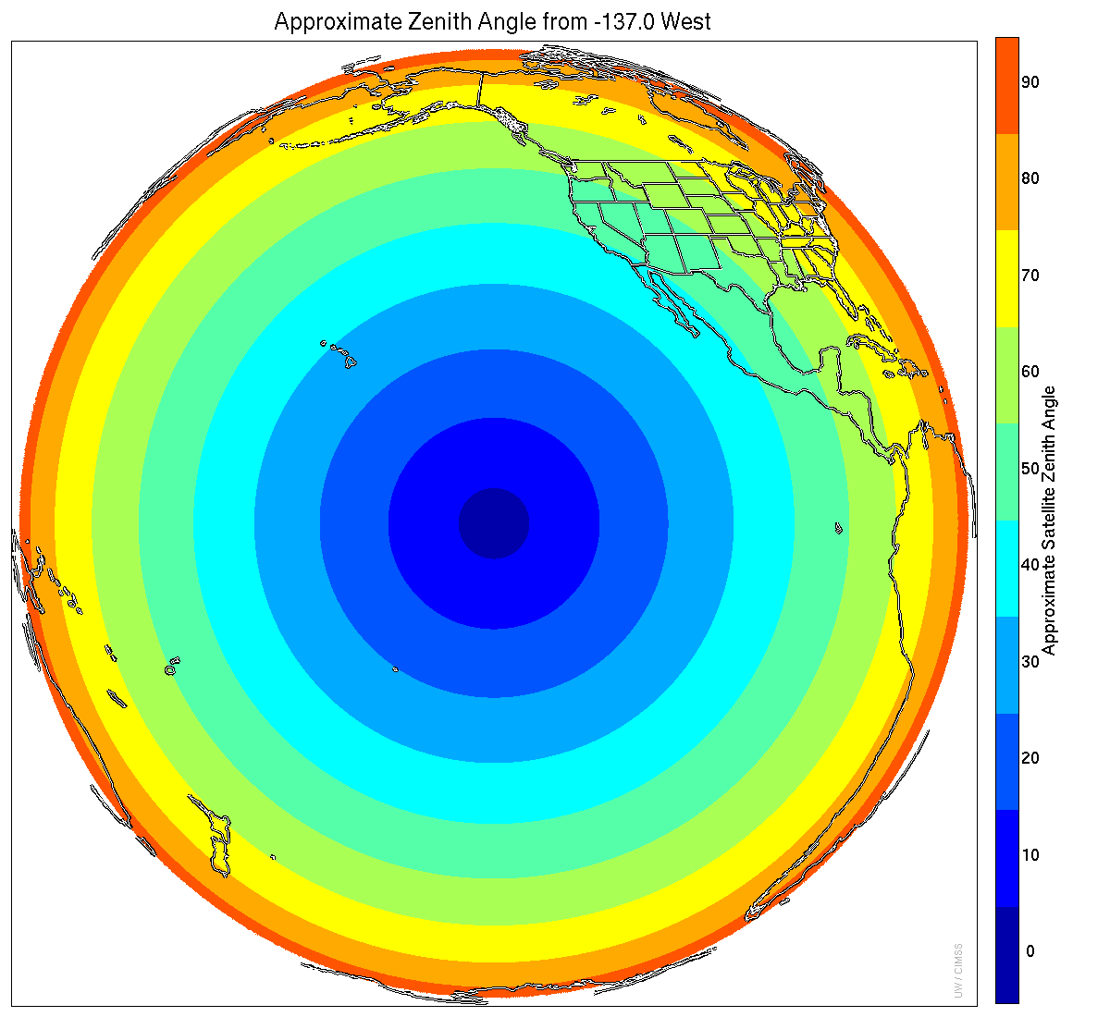
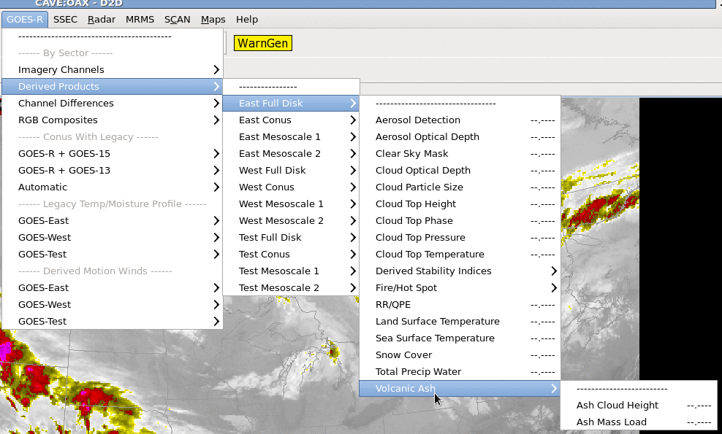
Where are they in AWIPS ;
How Often are they produced?
The products are produced for every Full Disk image
Quantitative out to 60 degrees LZA, Qualitative beyond that. Aleutians have LZA > 60
Uses 7.3, 8.4, 10.3, 12.3, 13.3 μm infrared channels
Only shows up in Full Disk Menus: East, West, or Test
Notes:
Baseline Volcanic Ash Cloud Height and Ash Mass Load products are computed for every Full Disk image - they're not produced for CONUS or MESO domains. These products are quantitative (that is, the values computed have been validated and shown to be accurate) out to a solar zenith angle of 60 degrees (near the boundary between yellow and green on the globe). The products are qualitative for solar zenith angles beyond 60 degrees, meaning the values shown may not be accurate, but the general distributions are good. Product computation requires ABI bands 10, 11, 13, 15, and 16 on ABI (which bands have the wavelengths noted on the slide: 7.3, 8.4, 10.3, 12.3 and 13.3 micrometers)

Slide 4
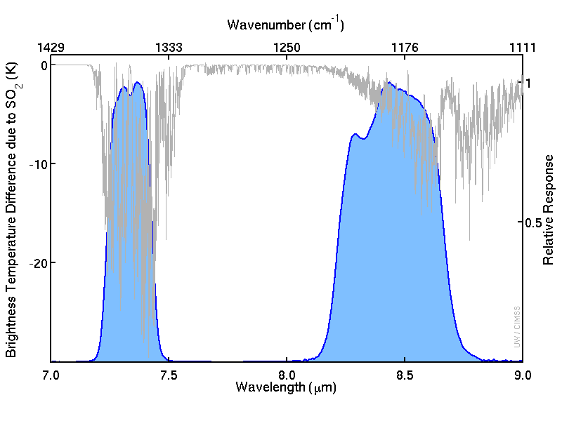
Why use Bands 10 and 11?
SO₂ absorption is strong at 7.3 μm and at 8.5-8.8 μm
Notes:
Bands 10 and 11, the low-level water vapor band and the infrared cloud phase band, are used because they sense radiation that is absorbed by sulfur dioxide, a common discharge from Volcanoes.

Slide 5
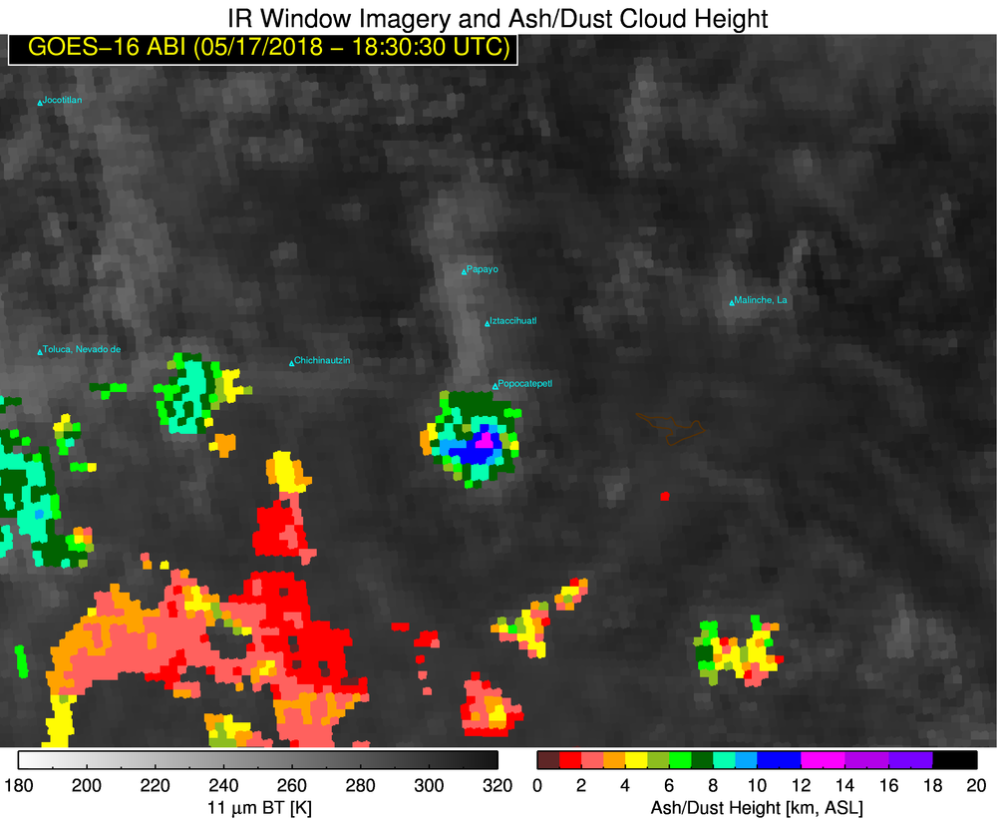
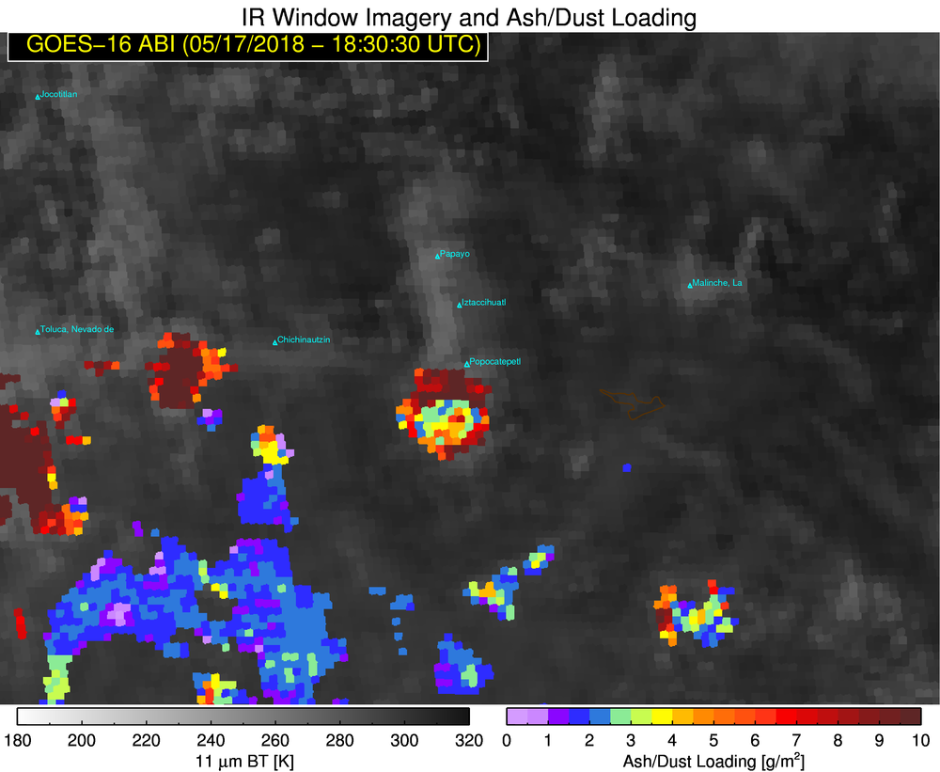
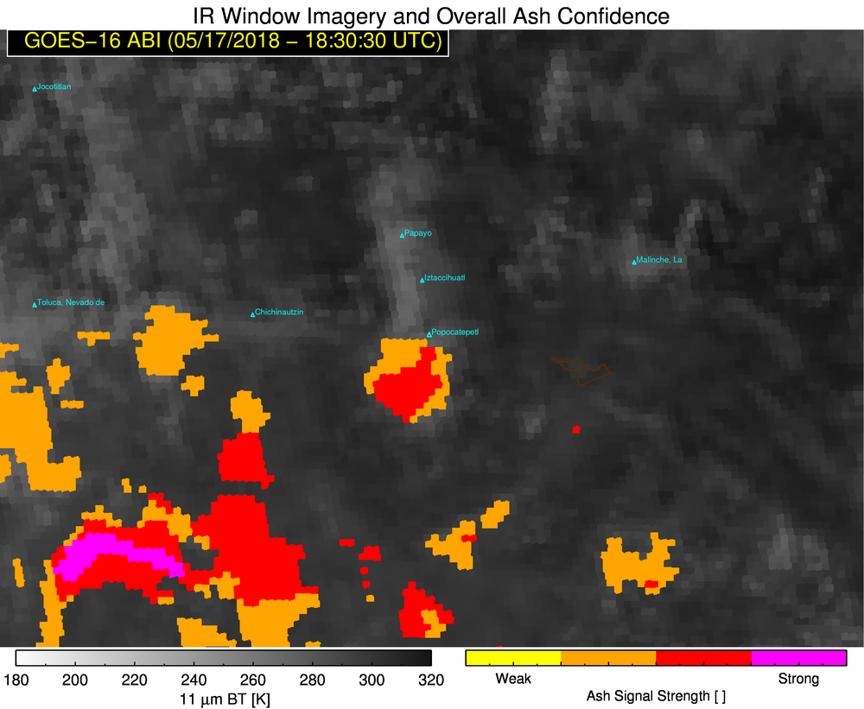
Baseline GOES-R Products
Product: Ash Cloud Height
Units: km AMSL
Required Accuracy: 3 km
IMPORTANT: Baseline requirements do not penalize for false alarms; ash cloud height and mass loading will have valid values for all pixels that MIGHT be volcanic ash.
Product: Ash Mass Loading
Units: tons/km² & g/m²
Required Accuracy: 2 tons/km²
Product: Quality Flags
Primary Utility: ash detection confidence
Users must couple baseline GOES-R products with multi-spectral imagery to manually extract regions of volcanic ash (to filter out the false alarms)
Notes:
Baseline Products (Ash Cloud Height and Ash mass Loading) were designed to identify Volcanic Events if at all possible - so there is a degree of overforecast in the fields. (From a Statistical point of view, there is no penalty for False Alarms so long as the Probability of Detection is high). The Best Practice is to use the information from the Baseline Products. If these products suggest an eruption may be occurring, then verify the eruption's occurrence by looking at GOES-R's multispectral imagery (visible, near-IR, IR) to determine exactly where the ash might be. In this way you can filter out any false alarms.

Slide 6
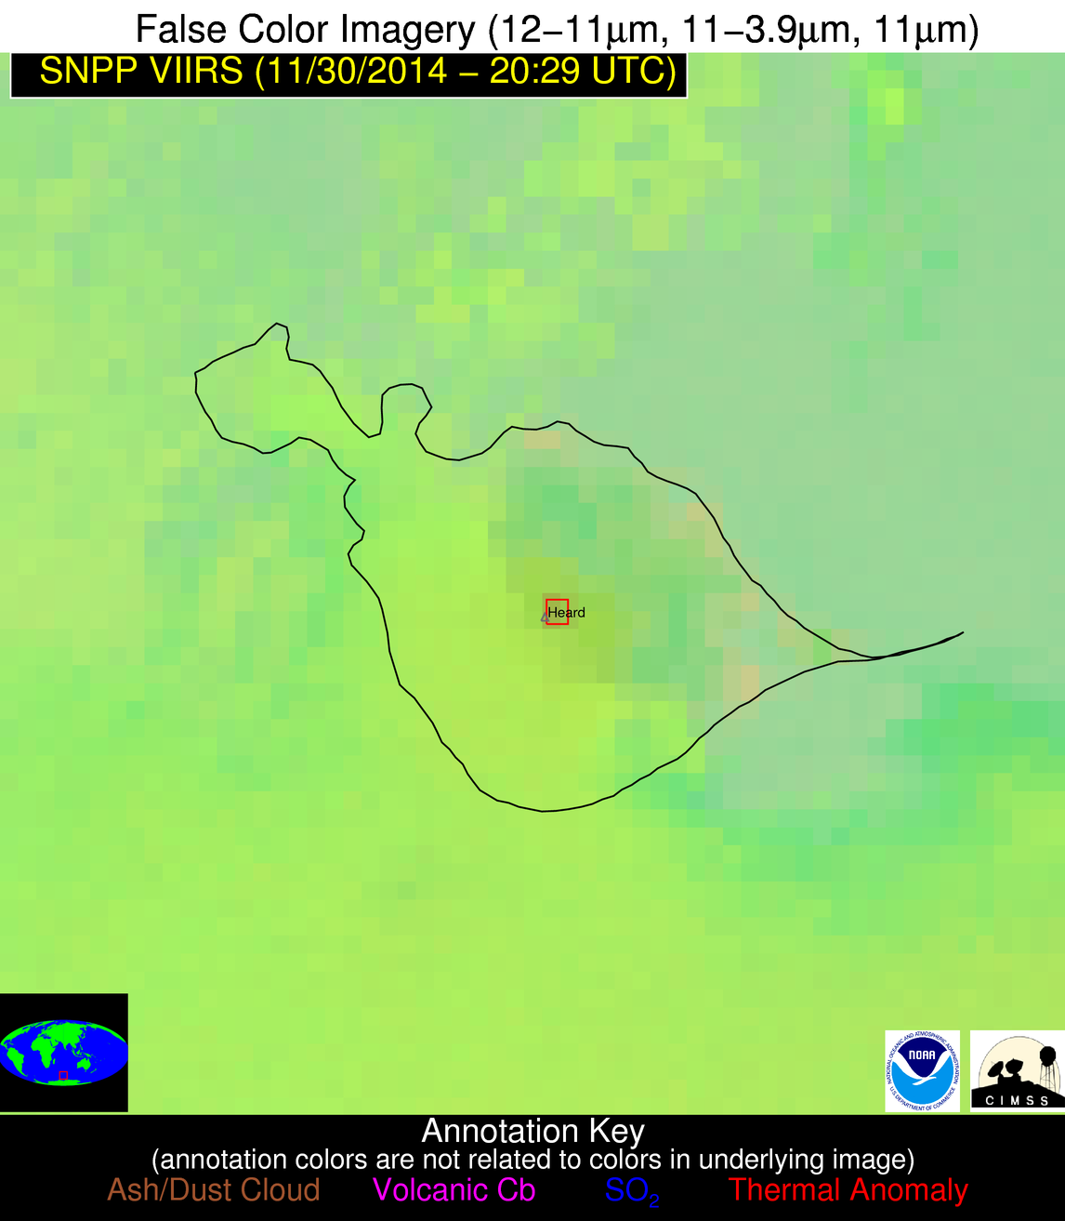
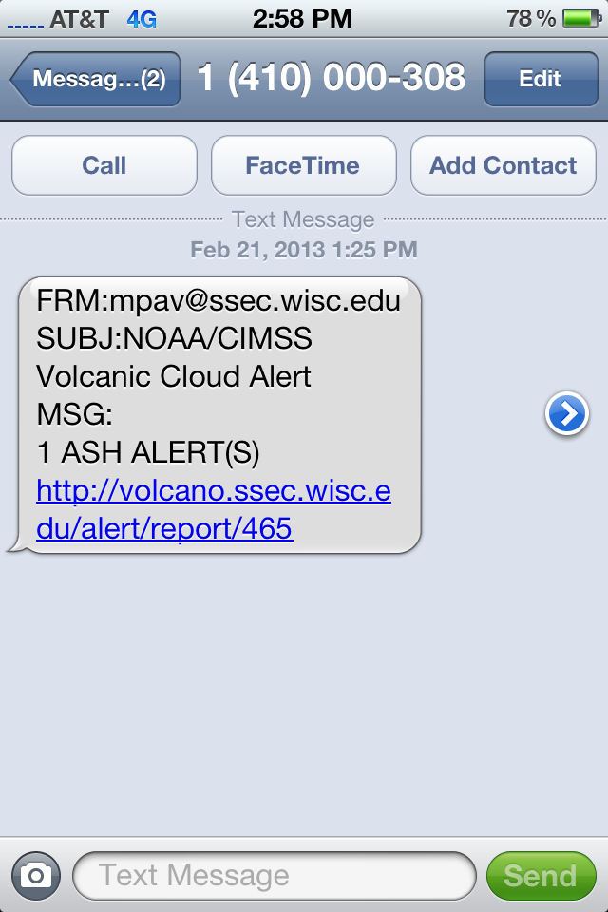
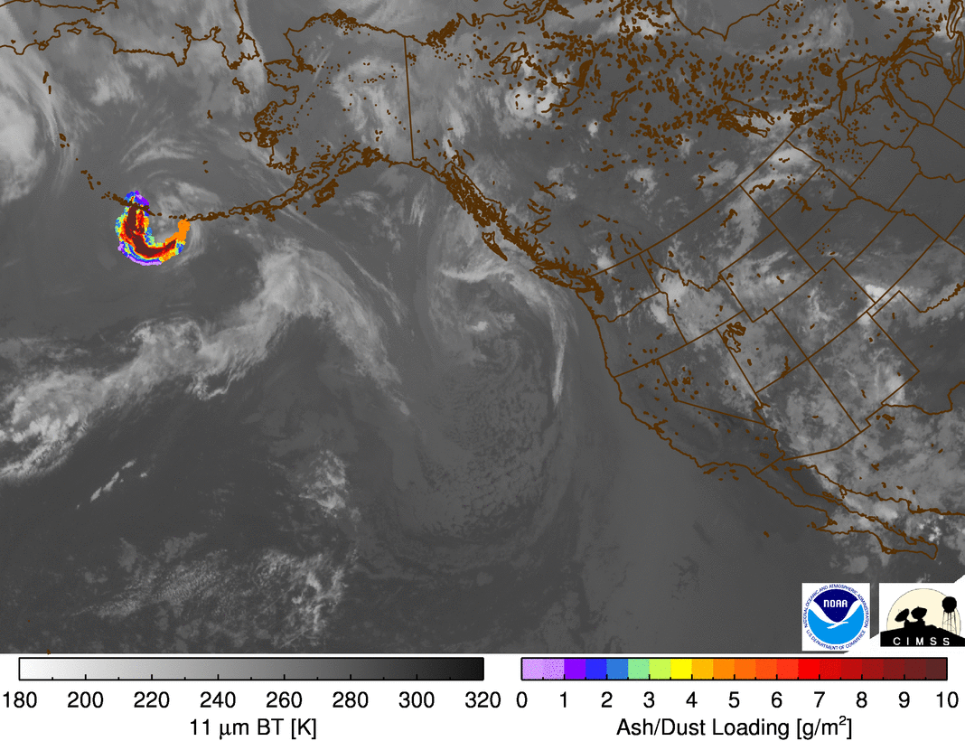
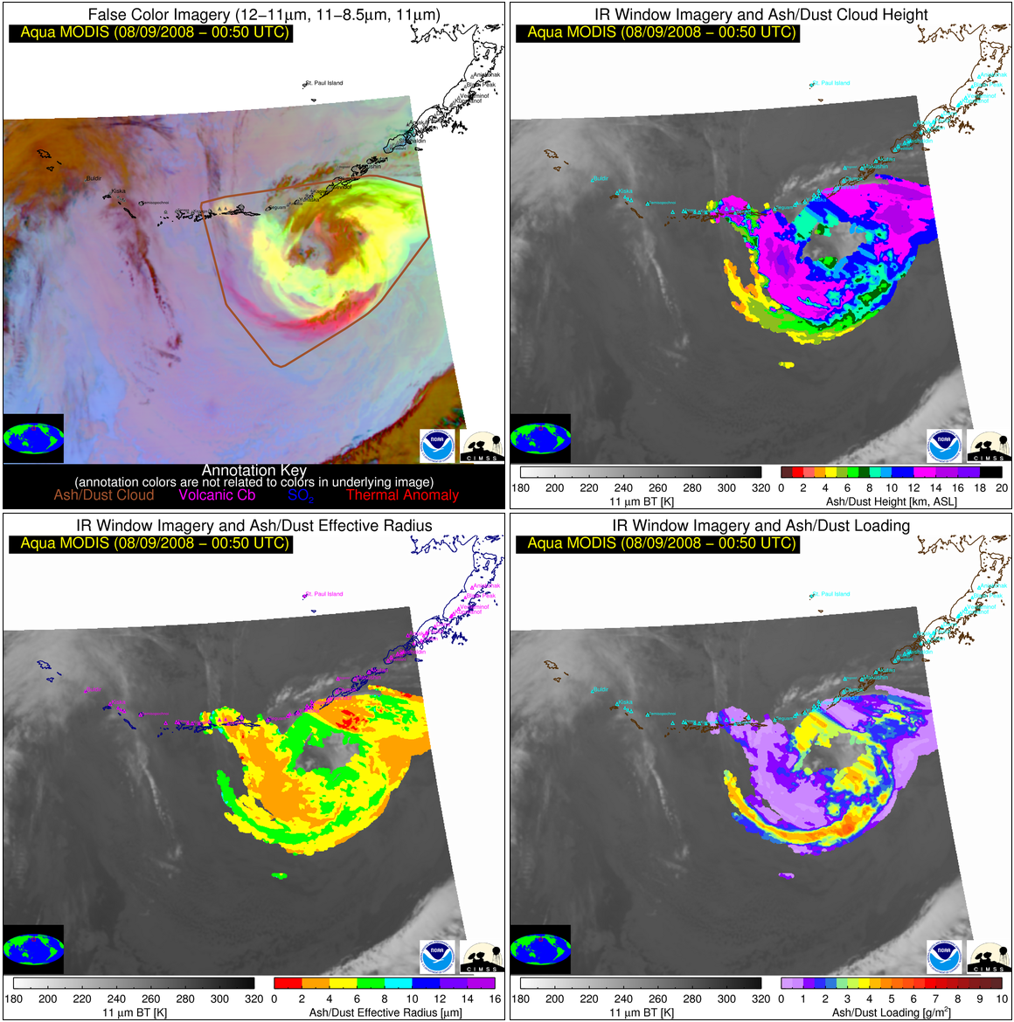
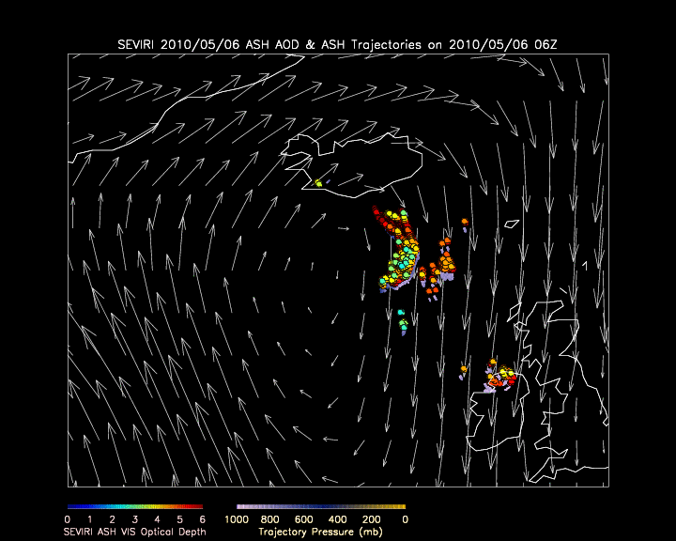
The VOLcanic Cloud Analysis Toolkit (VOLCAT)
1). Unrest Alerts
2). Eruption Alerts
3). Volcanic Cloud Tracking
4). Volcanic Cloud Characterization
5). Eruption Source Parameters
Notes:
-Users have been using VOLCAT - the Volcanic Cloud Analysis Toolkit -- products and services from a variety of GEO and LEO sensors for several years now.
-The algorithm that produces the baseline GOES-R volcanic ash algorithm was finalized in 2010. VOLCAT is the result of many new innovations that have been developed since after the baseline algorithm was finalized and includes more advanced applications including volcanic thermal anomaly alerts, volcanic eruption alerts, volcanic cloud tracking, volcanic cloud characterization (ash cloud height and mass loading), and the generation of key parameters needed to run and validate dispersion models. (The Baseline algorithm was finalized to allow development of the GOES-R Ground System)
-As such, VOLCAT more directly addresses operational needs.

Slide 7
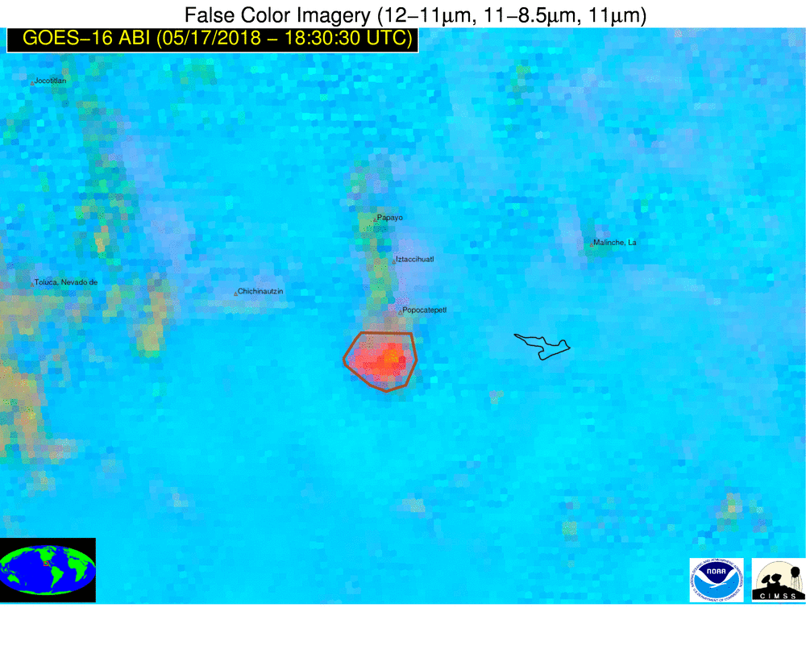
Example Case – False Color Image (aka RGB)
Eruption is visible at 18:30 UTC
Mexico
Popocatepetl
Notes:
-The next few slides were developed using imagery from GOES-16 ABI Imager. This example is a volcanic cloud that originated over Popocatepetl in Mexico on May 17, 2018..
-The Eruptive cloud is enclosed by a brown contour in the animation. It shows up well in the RGB image. The RGB image is not baseline but is used here to define the ash cloud; we’ll use that areal definition later in the depiction of the eruption by baseline and Volcat products. The RGB components are noted: The split window difference is the red component of the image, the brightness temperature difference between 11.2 and 8.5 microns is the green component, and the 11.2 micron brightness tempreature is the blue component.

Slide 8
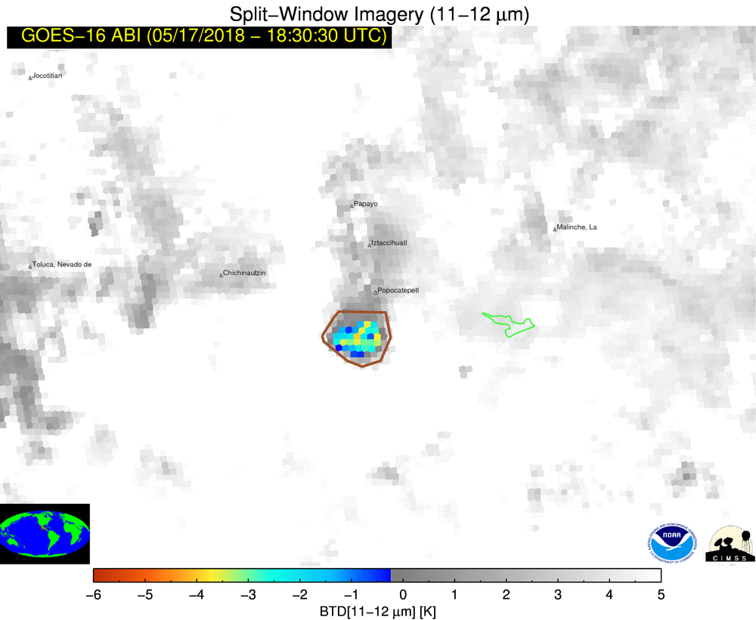
Example Case – Split-window BTD Image
Eruption is visible at 18:30 UTC
Mexico
Popocatepetl
Notes:
This shows the Split Window Difference (11-12 microns) from GOES-16 ABI for the same example of a volcanic cloud that originated over Popocatepetl in Mexico on May 17, 2018.
The Eruptive cloud is enclose by brown contour, and this product neatly defines the region that will be considered next. The cloud shows up pretty well in this non-baseline product.

Slide 9

Example Case – Baseline Ash Cloud Height
Eruption is visible at 18:30 UTC
Notes:
The GOES-R Baseline ash cloud top height algorithm provides pixel height estimates for all pixels that MIGHT contain volcanic ash; only those pixels that are confidently non-ash do not have height estimates. The Ash cloud from Popocatepetl shows up nicely, but there are plenty of pixels identified as having ash cloud height that don't. This is why you must verify the GOES-R Baseline Algorithms with other information from individual bands on ABI or on AHI.

Slide 10

Example Case – Baseline Ash Mass Loading
Eruption is visible at 18:30 UTC
Notes:
-Similarly, Baseline ash mass loading provides pixel mass loading estimates for all pixels that MIGHT contain volcanic ash-only those pixels that are confidently non-ash do not have mass loading estimates. Again, the ash cloud from Popocatepetl shows up nicely, but there are plenty of pixels identified as having ash mass loading that don't contain volcanic ash. You would need to be looking at other ABI single channels (or channel differences) to zero in on it.

Slide 11
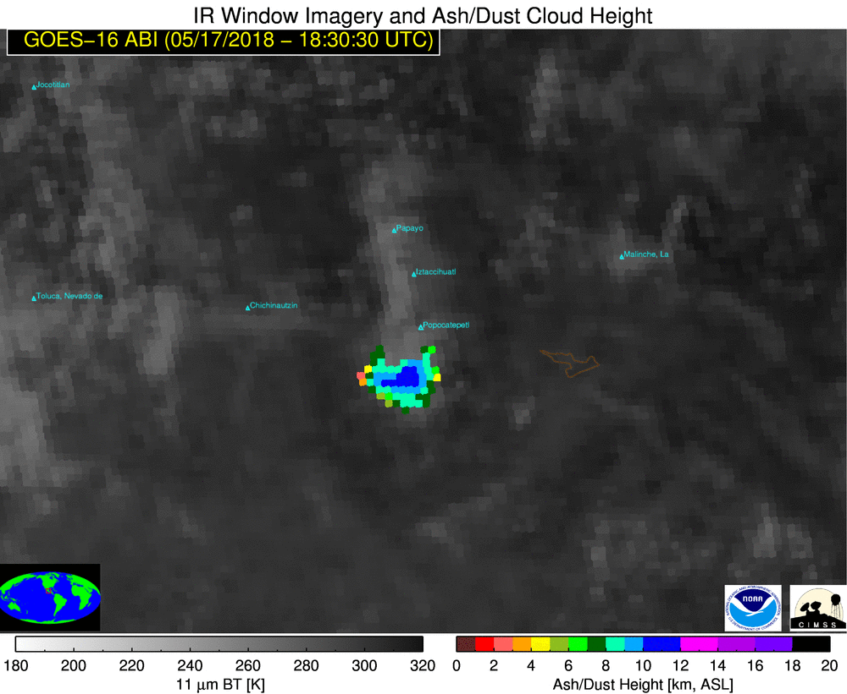
Example Case – Baseline vs VOLCAT Ash Height
Baseline
VOLCAT
VOLCAT generates alert upon first detection of eruption
- Valid VOLCAT ash cloud heights align well with actual volcanic ash locations.
- Baseline ash cloud height product includes numerous false alarms (including directly north of the actual ash cloud)
- Baseline and VOLCAT ash cloud heights are generally similar within the actual ash cloud
- The accuracy of both the baseline and VOLCAT ash cloud heights is a function of the cloud thickness and location. Both heights exhibit a low bias of 0.5-3 km.
Notes:
This slide shows the baseline Ash Height product on the left, and the VOLCAT product on the right. There are similar values within the ash cloud itself, but the baseline products have many false alarm pixels that a human interpreter must screen out. Note that VOLCAT will issue an alert as soon as an eruption is detected; Baseline products do not include an alerting capability.

Slide 12
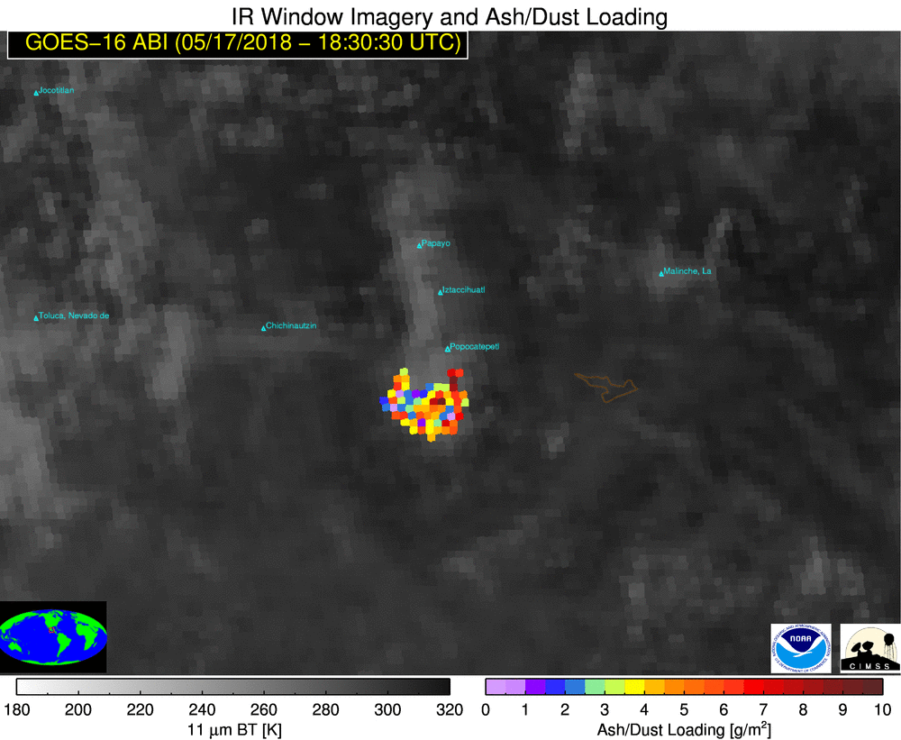
Example Case – Baseline vs VOLCAT Ash Mass Loading
Baseline
VOLCAT
VOLCAT generates alert upon first detection of eruption
-Valid VOLCAT ash mass loadings align very well with the actual volcanic ash locations.
-The baseline ash mass loading product includes numerous false alarms (including directly north of the actual ash cloud)
-In an actual ash cloud, baseline and VOLCAT ash mass loadings are generally similar
-The accuracy of both the baseline and VOLCAT ash mass loading is a function of the cloud thickness and location. In general, both are within a factor of 6 of aircraft based estimates.
Notes:
This shows baseline GOES-R Ash Mass Loading product is on the left, and the VOLCAT Ash Mass Loading product is on the right. Within the ash cloud, Ash Mass Loading Products show similar results - but GOES-R Baseline Products have a lot of extraneous return outside the ash cloud . Baseline and VOLCAT products do have similar accuracy within the ash cloud.

Slide 13
Internet Resources
ATBD on Volcanic Ash Products
Two-Page Fact Sheet on Volcanic Ash
Volcanic Ash at the GOES-R Website
Quick Guide on Volcanic Ash
GOES-R website
NOAA/CIMSS Volcanic Ash Monitoring Site
Notes:
You can find more information about the Baseline Product, and other products used to detect Volcanic Ash, at these websites.

Slide 14
Summary
The Baseline GOES-R Volcanic Products that are Available to Users in AWIPS on Day 1: ash cloud top height, ash mass loading, and quality flags (includes ash detection confidence)
Primary Limitation: The users must couple the baseline GOES-R products with multi-spectral imagery to manually extract regions of volcanic ash (and to filter out the false alarms)
Ash Cloud Height Accuracy: The accuracy is a function of the cloud thickness and location. Heights generally have a low bias of 0.5-3 km.
Ash Mass Loading Accuracy: The accuracy is a function of the cloud thickness and location. In general, the mass loading is within a factor of 6 of aircraft based estimates.
The VOLCAT products, that users have become accustomed to, are more accurate and capable than the baseline products
We anticipate that the VOLCAT products and services (alerts) will continue to be available: https://volcano.ssec.wisc.edu/
Volcanic Ash Subject Matter Expert: Mike.Pavolonis@noaa.gov
Notes:
Baseline Products give information that must be used in tandem with multispectral imagery to isolate the true areal extent of the ash cloud. This is in part because the Baseline product does not penalize for false positives. Volcat products that have been developed since the baseline products were inserted into the GOES-R Ground System are more familiar to users who need volcanic alerts. Mike pavolonis is the subject matter expert on this product and his email address is listed. This concludes the Satellite Foundational Course on GOES-R for baseline Volcanic Ash products. Thanks for listening!

