Slide 1
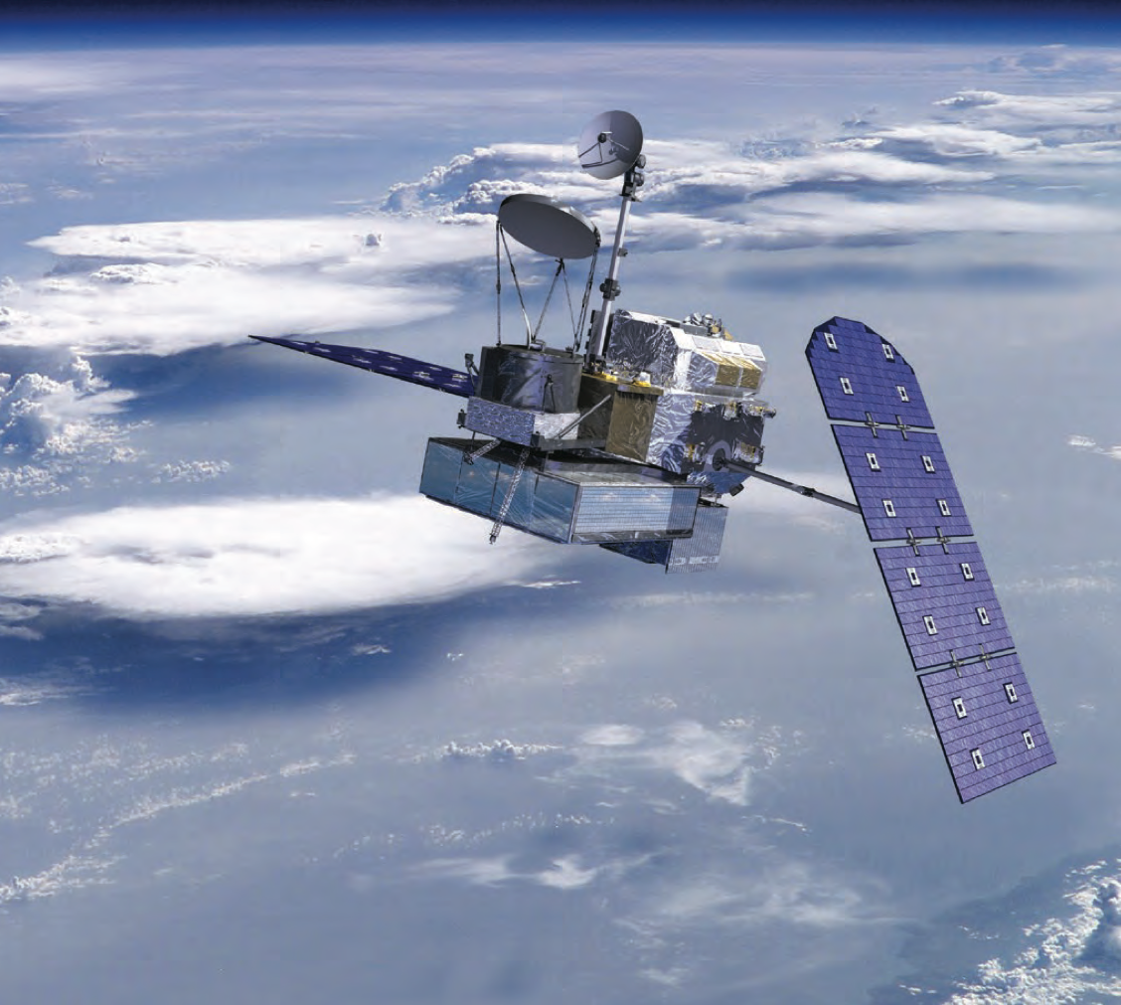
Global Precipitation Measurement (GPM) mission overview
Credit: NASA
Josh King
Cooperative Institute for Research in the Atmosphere
September 2014
Notes:
-This presentation was developed to provide a brief overview of the Global Precipitation Measurement – or, GPM – satellite mission and its associated precipitation products.

Slide 2

Mission objectives
An international satellite mission to:
  Advance understanding of Earth’s water and energy cycle
  Extend and improve upon the legacy of the Tropical Rainfall Measuring Mission (TRMM)
    Expanding coverage to higher latitudes (snowfall, light rain)
  Provide global observations of precipitation every ≤ 3 hours (with additional “constellation” sensors)
  Data available in near-real time (within 3 hours of observation)
    Storm, flood, and freshwater monitoring; etc.
    Assimilation into weather forecasting systems
Notes:
-In short, GPM is an international satellite mission that was developed to provide next-generation spaceborne observations of precipitation. GPM’s primary mission objective is to advance the understanding of the Earth’s water and energy cycles. To this end, GPM will extend and improve upon the legacy of its predecessor, the Tropical Rainfall Measuring Mission – or, TRMM – a satellite mission which focused on moderate to intense tropical rainfall. GPM will expand TRMM-like coverage to higher latitudes, where its unique suite of sensors will quantify snowfall and light rain – precipitation modes that contribute significantly to the total precipitation falling at these latitudes. GPM is a mission designed to meet both science and operational objectives. With frequent global observations available in near-real time, GPM data can be used to, for instance, monitor floods and storms. It can also be assimilated into weather forecasting systems for improved meteorological prediction.

Slide 3
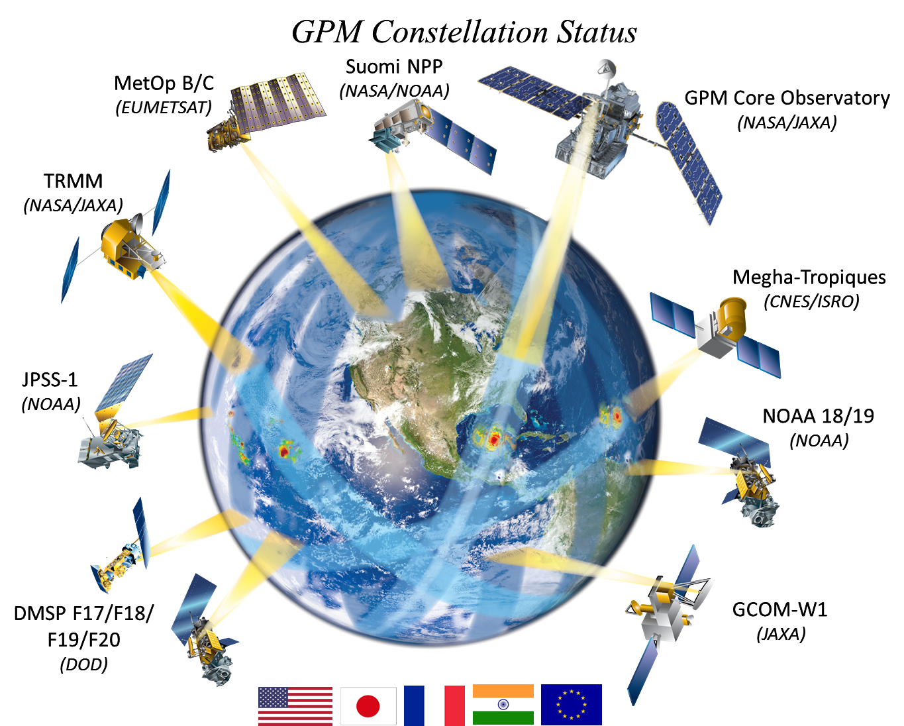
GPM constellation sensors
Credit: NASA Precipitation Measurement Missions
Notes:
-Through a series of international partnerships, the GPM mission is made up of a constellation of sensors consisting primarily of microwave radiometers. While a number of techniques are used to estimate global precipitation, the radiative signatures observed by microwave sensors are directly linked to precipitation hydrometeors – making them an indispensible tool in global precipitation measurement. By intercalibrating observed brightness temperatures between GPM constellation radiometers and utilizing common precipitation retrieval algorithm elements, the GPM mission will unify precipitation retrievals from this set of sensors.

Slide 4
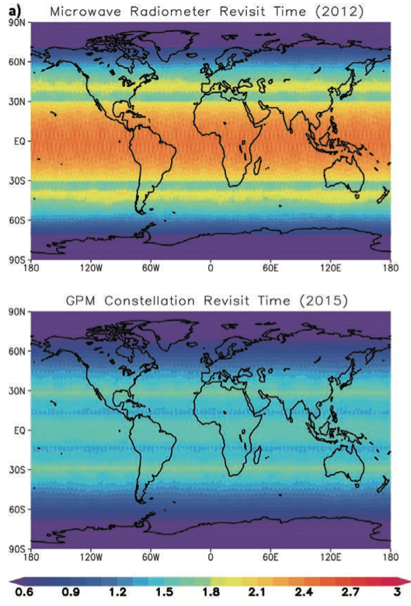
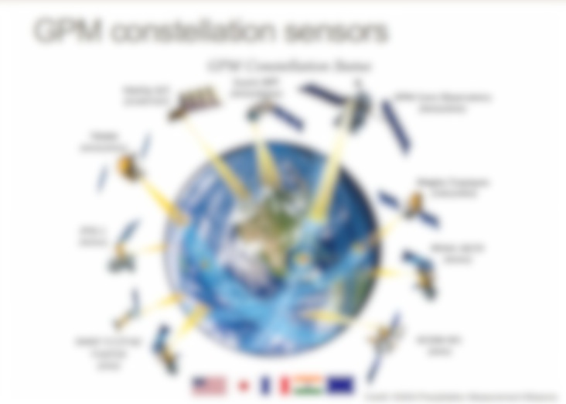
Before GPM
GPM era
Hours
Hou et al., 2014
Notes:
-This map from Hou et al., 2014 shows the mean microwave radiometer observation revisit times before and within the GPM era. The reduced revisit times within the GPM era highlight the improved global precipitation observation capabilities ushered in through the mission.

Slide 5
GPM constellation sensors
Credit: NASA Precipitation Measurement Missions
Notes:
-The central platform for the mission is the GPM Core Observatory – a joint venture between NASA and the Japanese Aerospace Exploration Agency – or, JAXA. The focus of the remainder of this session will be upon this core observatory’s instrumentation and associated precipitation products.

Slide 6
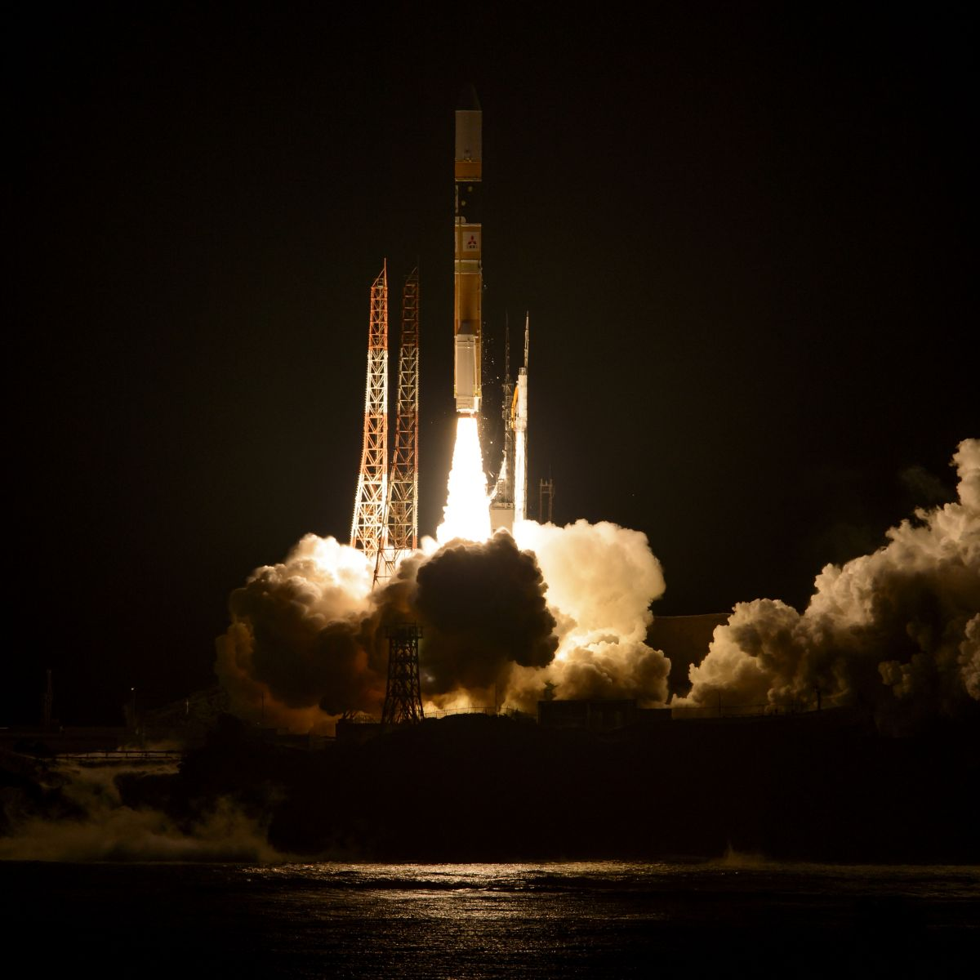
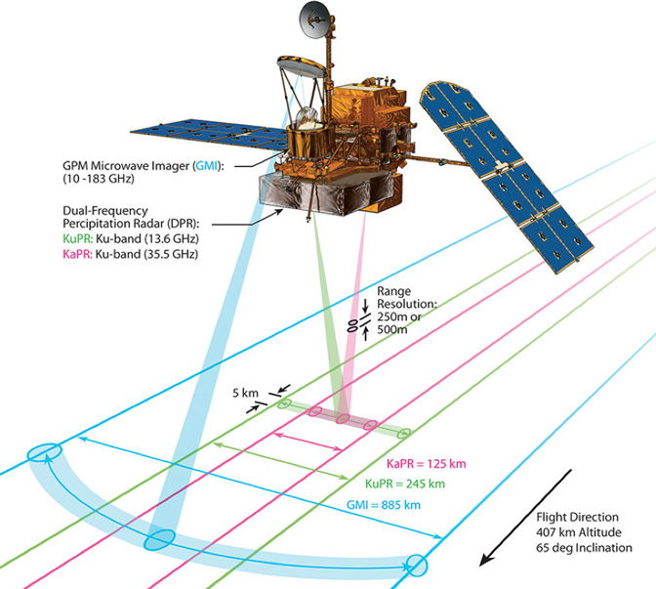
GPM Core Observatory
Launched:
February 27, 2014
Credits: NASA
Notes:
-Launched on February 27, 2014, the GPM Core Observatory now observes precipitation systems from an altitude of ~400 km above Earth’s surface. The observatory’s GPM Microwave Imager – or, GMI – and the Dual-Frequency Precipitation Radar – or, DPR – will provide unprecedented information on the distribution and three-dimensional structure of precipitating systems. We will now take a closer look at each of these sensors.

Slide 7
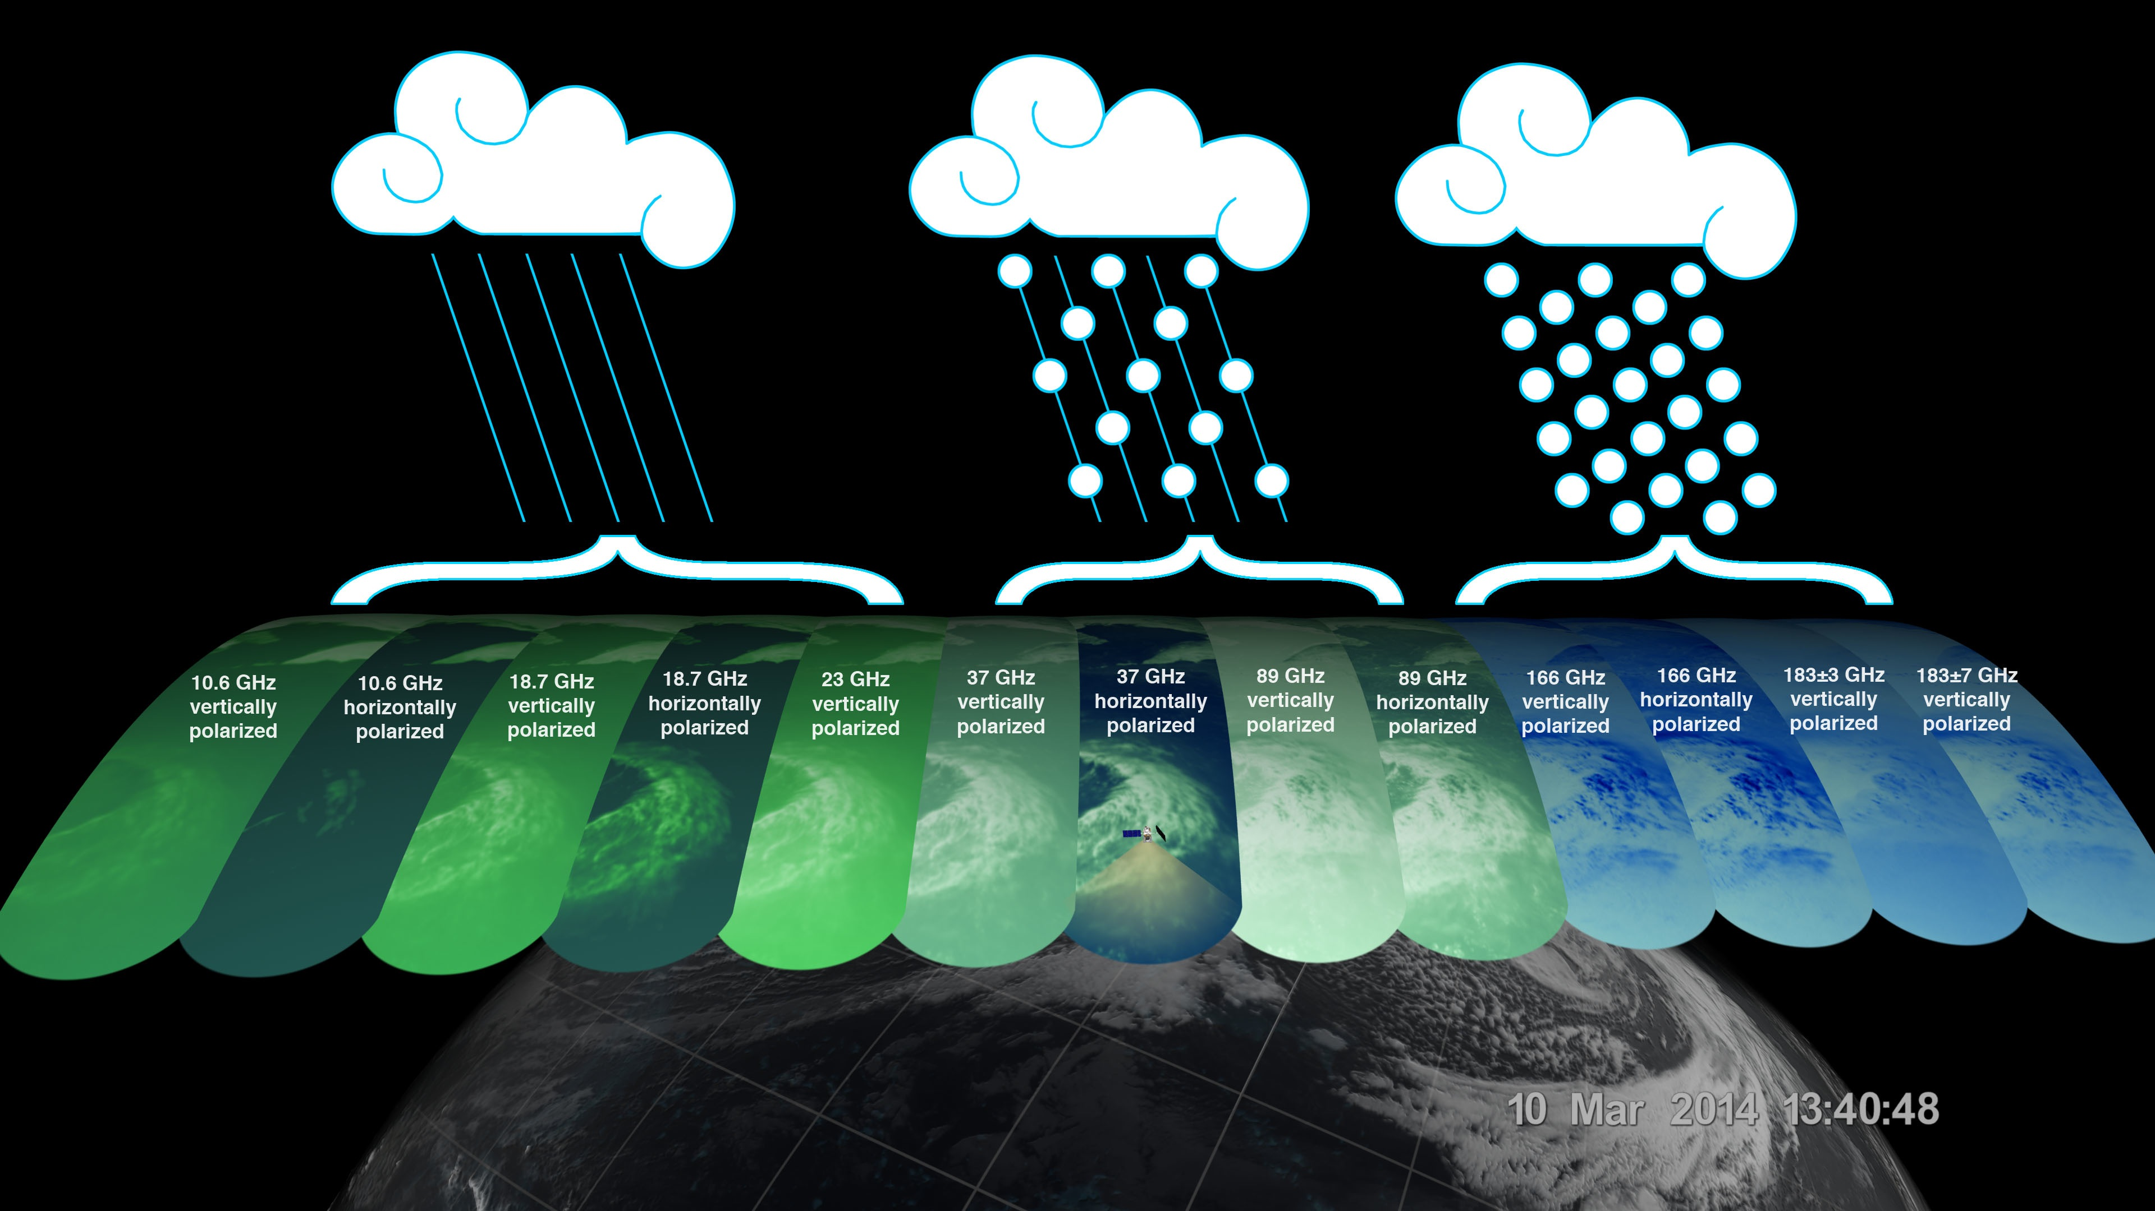
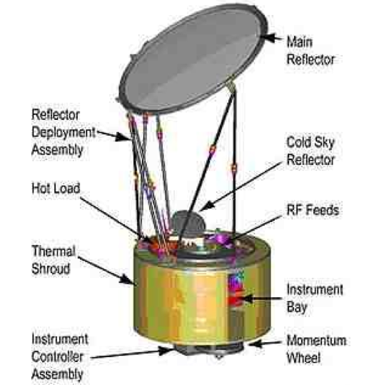
GPM Microwave Imager (GMI)
10.6 GHz
10.6 GHz
18.7 GHz
18.7 GHz
23 GHz
37 GHz
37 GHz
89 GHz
89 GHz
166 GHz
166 GHz
183±3 GHz
183±7 GHz
vertical pol.
horizontal pol.
vertical pol.
horizontal pol.
vertical pol.
vertical pol.
horizontal pol.
vertical pol.
horizontal pol.
vertical pol.
horizontal pol.
vertical pol.
vertical pol.
13 channels
Credits: NASA
Improvements over TMI
  Coverage to higher latitudes (~68° N/S)
    TRMM latitudinal coverage: ~37° N/S
  Four highest frequency channels (ice, light rain)
  Higher spatial resolution
  Wider swath (by ~125 km)
Notes:
-GMI is a 13-channel, conically-scanning microwave radiometer. With a spectral range of 10 to 183 GHz, GMI observes radiative features from liquid and frozen precipitation hydrometeors across a broad spectrum of precipitation intensities. With coverage to higher latitudes – up to 68deg N and S, the addition of four high frequency channels for improved detection of snow and light rain, higher spatial resolution, and a wider ground swath width, GMI not only extends the legacy of the TRMM Microwave Imager – TMI – it also improves upon it.

Slide 8
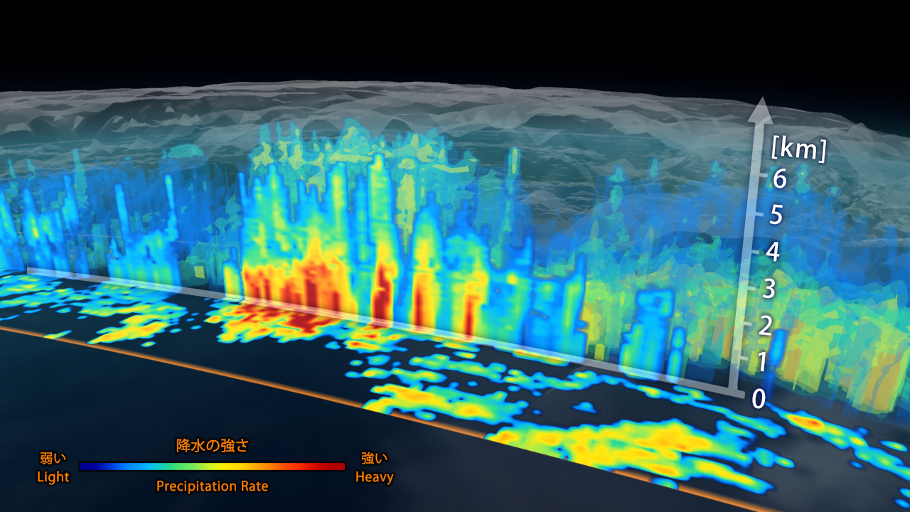
Dual-frequency Precipitation Radar (DPR)
Ku-band (13.6 GHz)
  Similar to TRMM Precipitation Radar (PR)
    Precipitation rates ≥ 0.5 mm/hr
  250-km wide swath, 250-m vertical res.
Ka-band (35.5 GHz)
  Improved detection of light precipitation
    Precipitation rates ≥ 0.2 mm/hr (high sensitivity mode)
  125-km wide swath, 250-/500-m vertical res.
5-km horizontal res.
Credit: NASA/JAXA
Notes:
-DPR represents the first spaceborne dual-frequency precipitation radar, providing unprecedented information on the 3D structure of precipitating systems. Similar to the TRMM Precipitation Radar, it features a Ku-band radar able to detect precipitation rates down to 0.5 mm/hr. For the improved detection of light precipitation, the DPR also features a higher frequency Ka-band radar – able to detect precipitation rates down to 0.2 mm/hr. These radars provide precipitation profile information within the innermost portions of the wider GMI swath. The overlapping dual-frequency radar observations can also be used to quantitatively estimate parameters of the precipitation particle size distribution – thereby decreasing uncertainties in precipitation retrieval algorithms and providing new insight into microphysical processes.

Slide 9
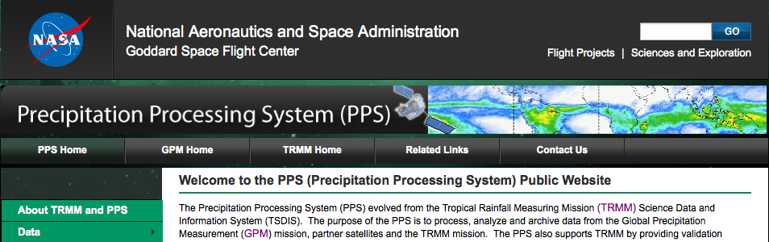
Precipitation products from GPM
Three different algorithms for precipitation estimates:
  Radar-enhanced microwave radiometer (e.g., GMI) retrievals
  DPR-only retrievals
  Combined DPR and GMI retrievals
Data available in either:
  Pixel-scale instantaneous precipitation rate estimates (level 2)
  Gridded time-space accumulations (level 3)
  http://pps.gsfc.nasa.gov/
Notes:
-Three distinct algorithms will be used to derived precipitation estimates from GPM data. Radar-enhanced microwave radiometer retrievals utilize databases of coincident DPR-radiometer observations to constrain retrievals from all microwave sensors within the GPM constellation. A second, DPR-only algorithm exclusively utilizes DPR observations to estimate surface precipitation and hydrometeor profiles. Lastly, combined DPR-GMI retrievals use multi-spectral observations from GMI to further constrain uncertainties in the DPR-only algorithm. All of these data are available in either instantaneous pixel-scale precipitation rate or gridded time-space accumulation formats.

Slide 10
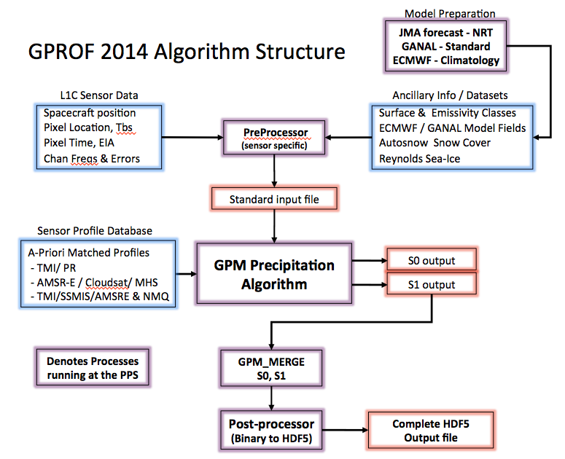
Goddard Profiling Algorithm (GPROF)
GPROF uses multi-frequency observations from passive microwave radiometers (e.g., GMI) to estimate instantaneous surface precipitation rates
  Precipitation estimates are derived using an a-priori database of coincident active (radar) – passive (radiometer) observations and Bayesian statistics
Credit: NASA Scientific Visualization Studio
Credit: GPM ATBD
Notes:
-The Goddard Profiling algorithm – or, GPROF – is the GPM mission’s unified radar-enhanced microwave radiometer retrieval algorithm. Within GPROF, instantaneous surface precipitation rates are derived from multi-spectral observations made by microwave radiometers through the use of a previously constructed DPR-radiometer observational database and Bayesian statistical techniques.

Slide 11
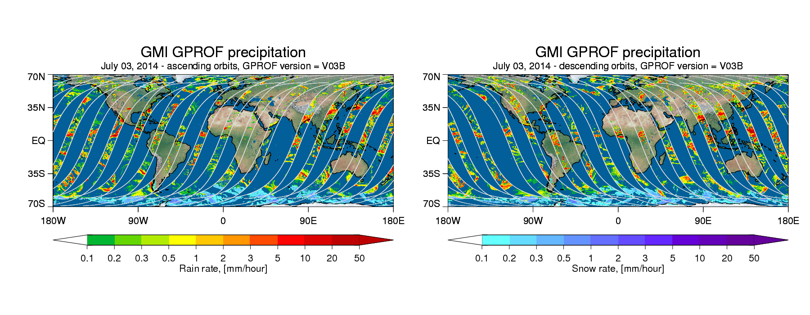
Notes:
-These maps show GPROF-estimated instantaneous surface precipitation rates for ascending and descending GMI orbit portions for a single day in July 2014. Note the identification of precipitation structures in various stages of organization and the delineation of identified rain and snow. The data gaps in this pixel-level precipitation field are are related to the finite swath width of the GMI sensor. A zoomed in view reveals the fine-scale precipitation structure captured by GMI.

Slide 12
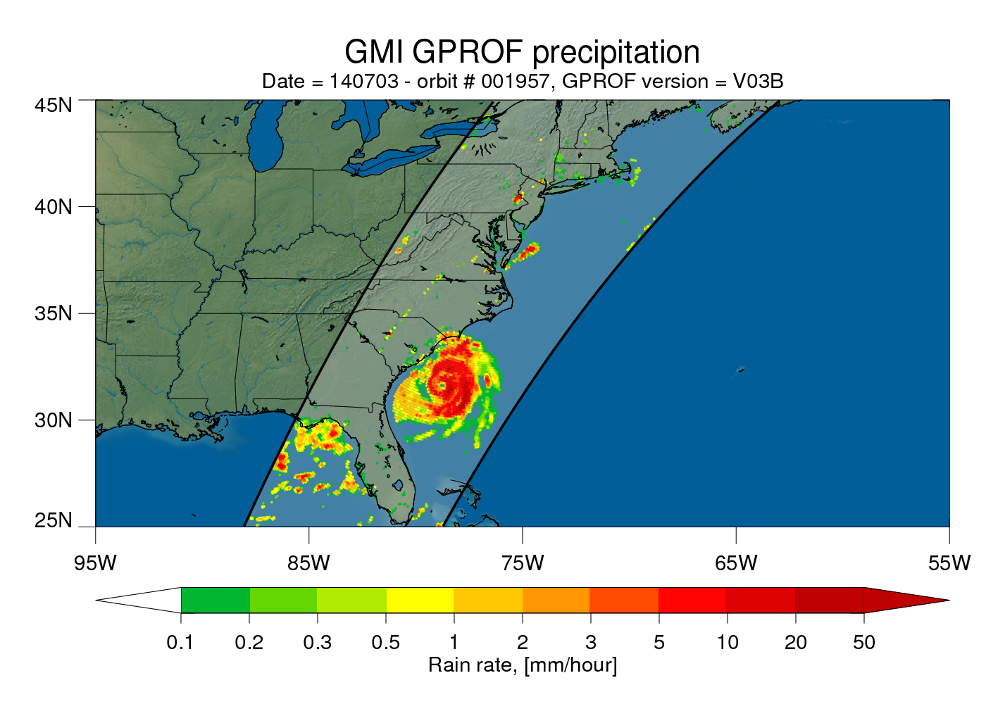
Hurricane Arthur
Notes:
-In this single orbit from the same day in July 2014, Hurricane Arthur was captured before making landfall in North Carolina. Note the fine-scale rain band and eye wall features captured in this surface precipitation rate field.

Slide 13
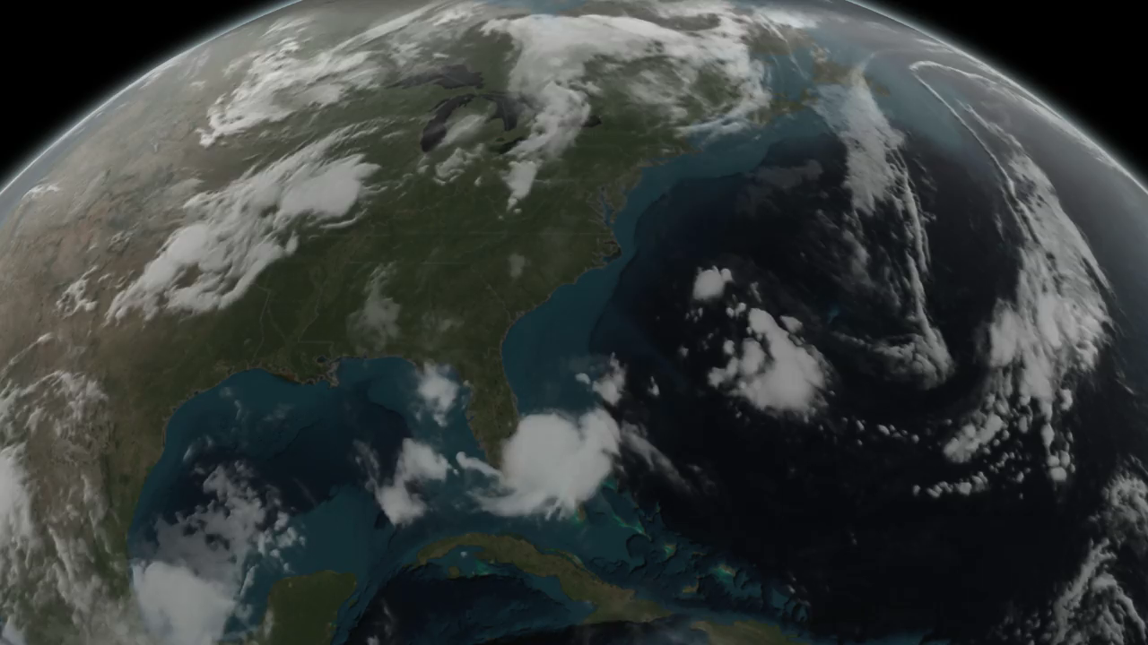
Hurricane Arthur’s internal structure - DPR
Credit: NASA's Scientific Visualization Studio. Data provided by the joint NASA/JAXA GPM mission.
Notes:
-DPR provided additional insight into the vertical structure of precipitation within Hurricane Arthur. In this animation, the wider, colored swath data represent GPROF-estimated GMI surface precipitation rate estimates. The inner, three-dimensional swath data are derived from DPR.

Slide 14
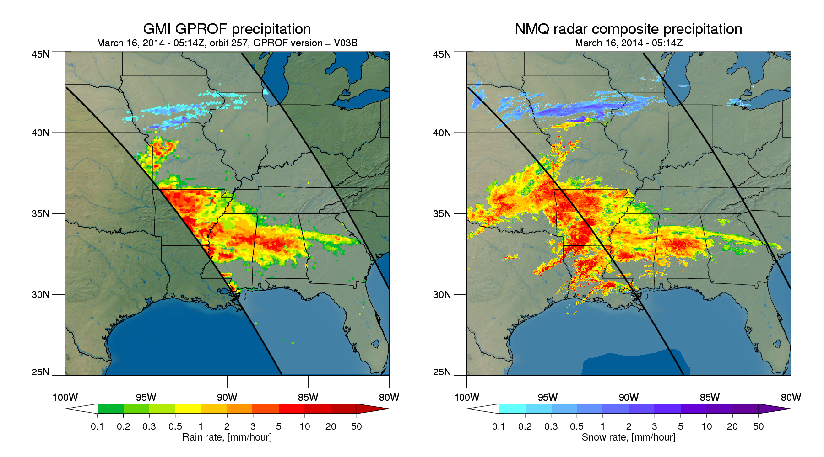
Ground validation with surface radar composite QPE
Notes:
-In an effort to validate GPM precipitation estimates using surface-based sensors, the GPM mission has partnered with other organizations and projects. One way to ground-validate GPM retrievals is to directly and statistically compare them to those from other independent national networks. In this case from March 2014, GMI GPROF surface precipitation rate estimates over the south-central United States are shown alongside corresponding time-matched precipitation rate estimates derived from U.S. surface radar composite data.

Slide 15
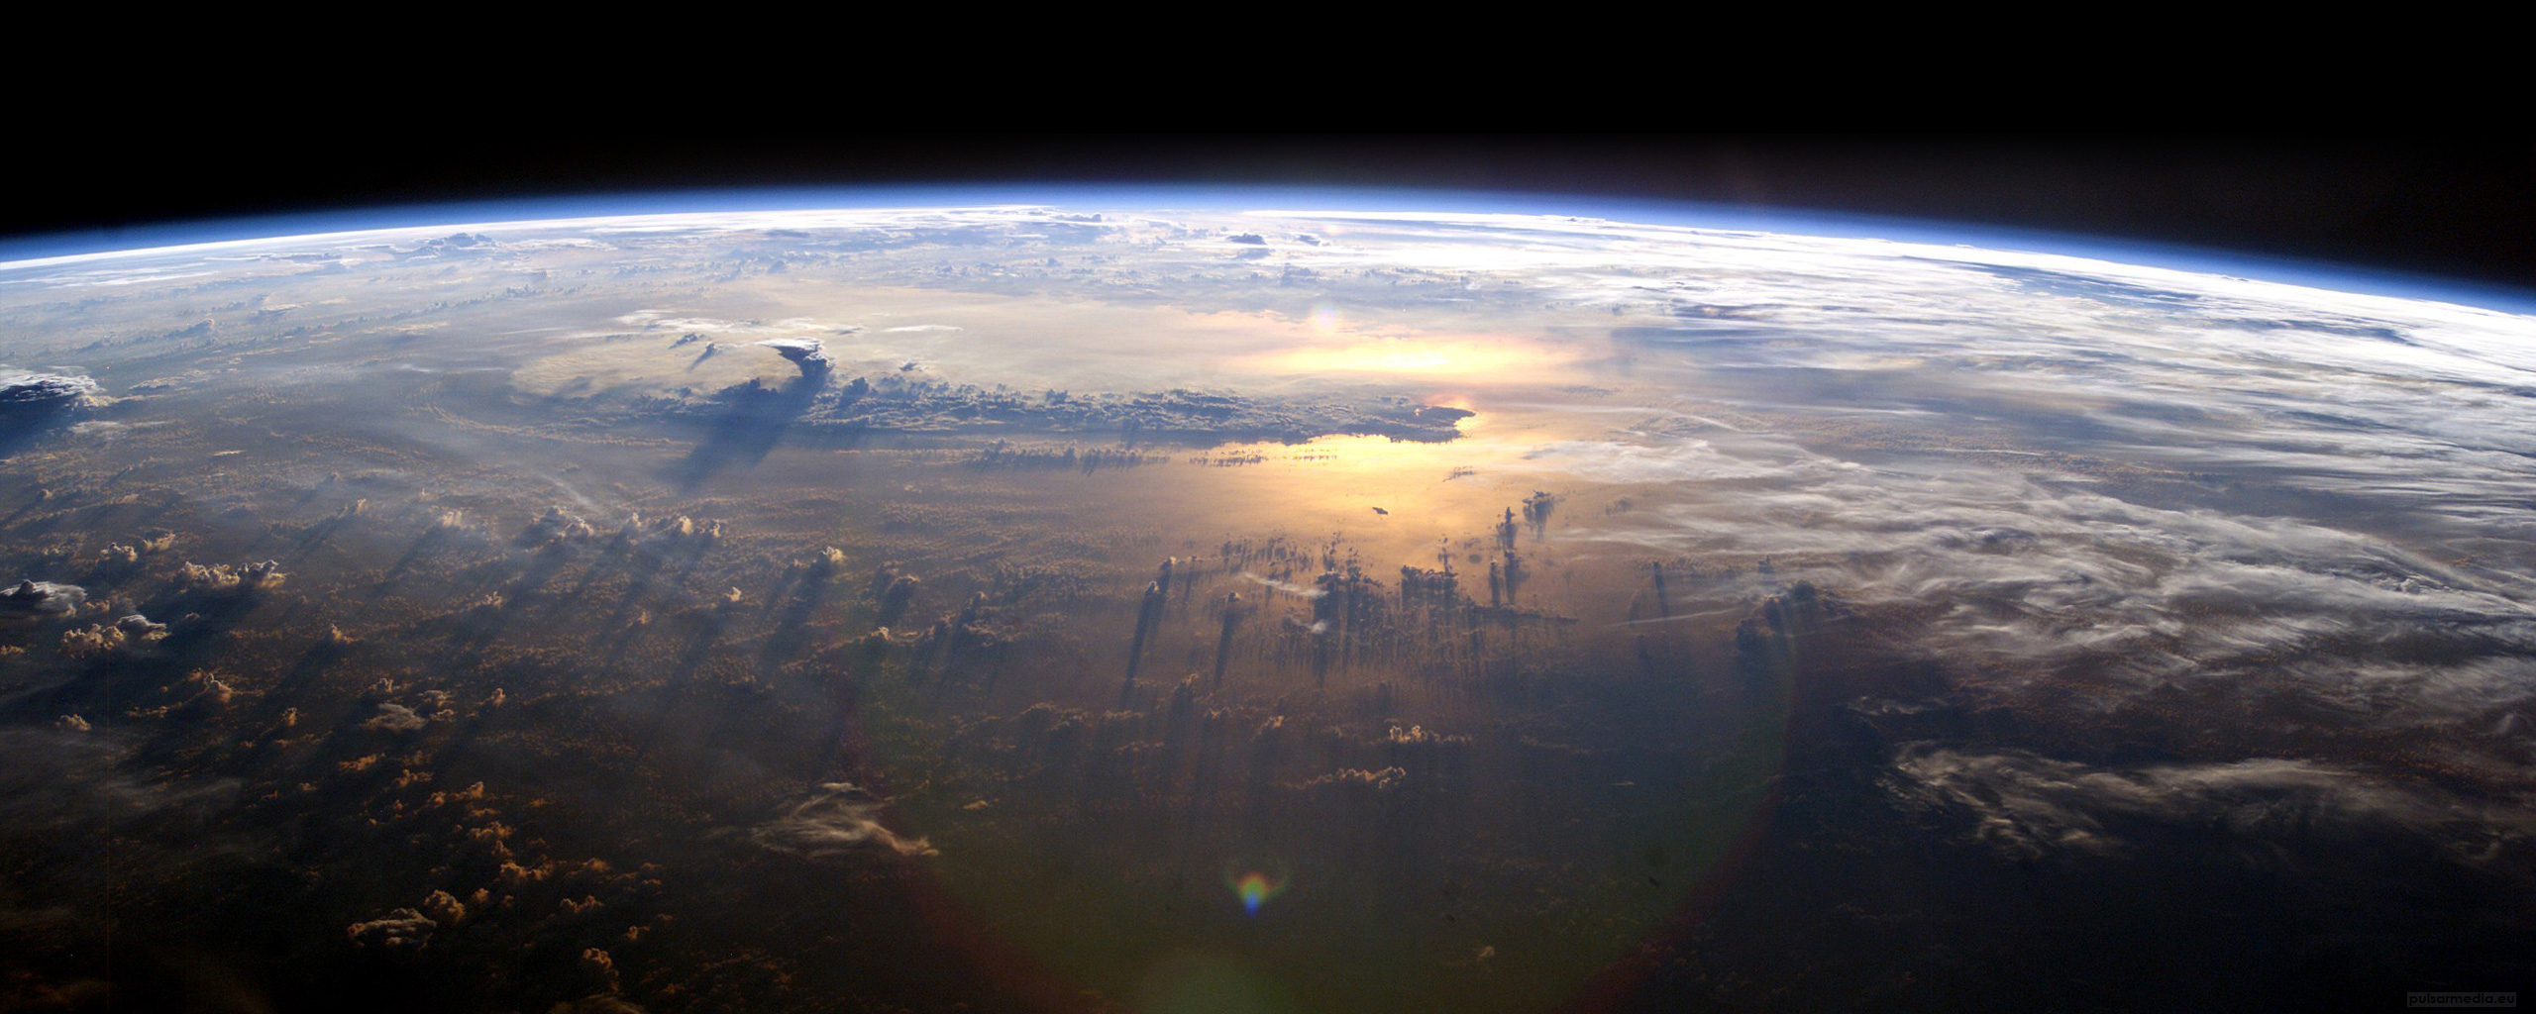
For more information
Data
  NASA’s Precipitation Processing System: http://pps.gsfc.nasa.gov/
Additional GPM information
  NASA’s GPM webpage: www.nasa.gov/mission_pages/GPM/main/
  NASA’s Precipitation Measurement Missions webpage:
  http://pmm.nasa.gov/
  Arthur Y. Hou, Ramesh K. Kakar, Steven Neeck, Ardeshir A. Azarbarzin, Christian D. Kummerow, Masahiro Kojima, Riko Oki, Kenji Nakamura, and Toshio Iguchi, 2014: The Global Precipitation Measurement Mission. Bull. Amer. Meteor. Soc., 95, 701–722.
Additional GPROF information
  GPM Algorithm Theoretical Basis Document (ATBD):
  http://rain.atmos.colostate.edu/ATBD/ATBD_GPM_Aug1_2014.pdf
Notes:
-Thank you for listening to this session. Additional GPM-related information may be obtained from the following sources.

