Slide 1
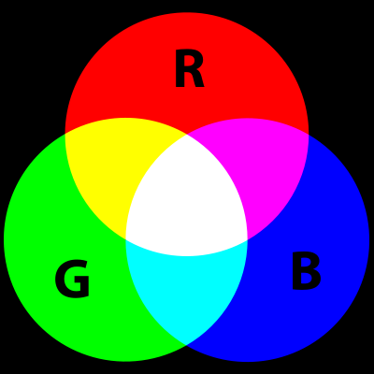
SO₂ RGB Recipe
Color | Band or Band Diff. (µm) | Min to Max ; Gamma
Red | 6.9 (Ch9) – 7.3 (Ch10) | -4.0 to 2.0 °C; 1
Green | 10.3 (Ch13) – 8.4 (Ch11) | -4.0 to 5.0 °C; 1
Blue | 10.3 (Ch13) | -30.1 to 29.8 °C ; 1
R
G
B
Notes:
Need to save image as same size as the other images in the hanis html5 loop to get the overlay to work. Best to save as png then use irfanview to convert to gif with transparency for 0

Slide 2
Air Mass RGB Recipe
Color | Band or Band Diff. (µm) | Min to Max ; Gamma
Red | 6.2 (Ch8) – 7.3 (Ch10) | -26.2 to 0.6 °C; 1
Green | 9.6 (Ch12) – 10.3 (Ch13) | -43.2 to 6.7 °C; 1
Blue | 6.2 (Ch8) | -29.2 to -64.6 °C ; 1
R
G
B
Notes:
Best to save as png then use irfanview to convert to gif with transparency for 0

